Slide 1
Manual J8ae -2011 SPEEDSHEET Long House Block Load

Slide 5
MJae SPEEDSHEET

Slide 6
MJae SPEEDSHEET
Free download available at:
WWW.ACCA.ORG/SPEEDSHEET

Slide 7
MJae SPEEDSHEET
A sample load calculations using the SPEEDSHEET:

Slide 8
SPEEDSHEET Location

Slide 9
SPEEDSHEET Location
Blue and Yellow Colored Boxes on the Speedsheet are either
a scroll down choice, or fill in automatically:
Can Not Be Changed!

Slide 10
SPEEDSHEET Location T
White Boxes with red lettering may be changed if required by local code exceptions.

Slide 11
SPEEDSHEET Location

Slide 12
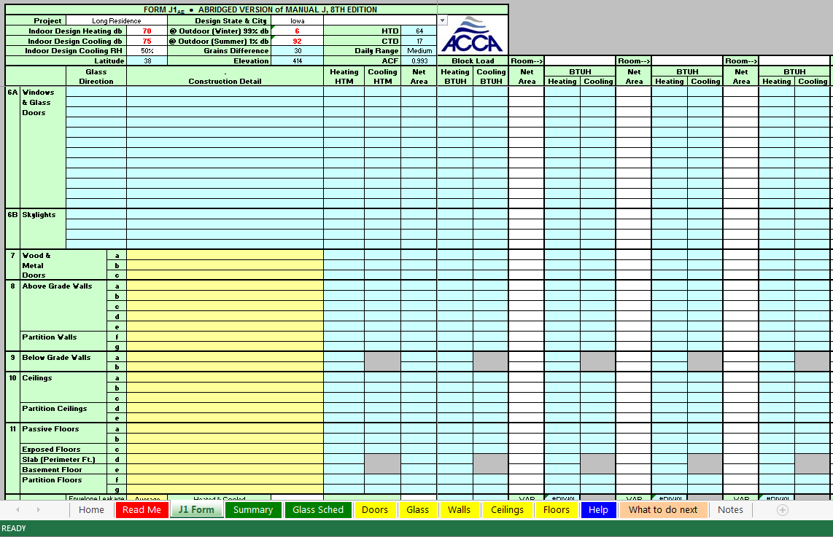
SPEEDSHEET Glass

Slide 13
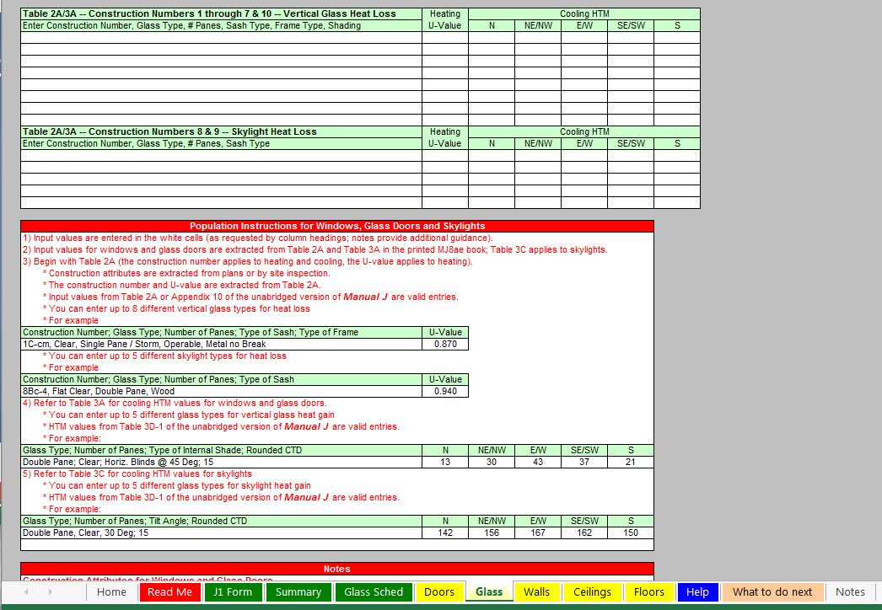
SPEEDSHEET Glass

Slide 14
SPEEDSHEET Glass
Type in values from Table 2A/3A in the Manual J8

Slide 15
SPEEDSHEET Glass

Slide 16
SPEEDSHEET Glass

Slide 17
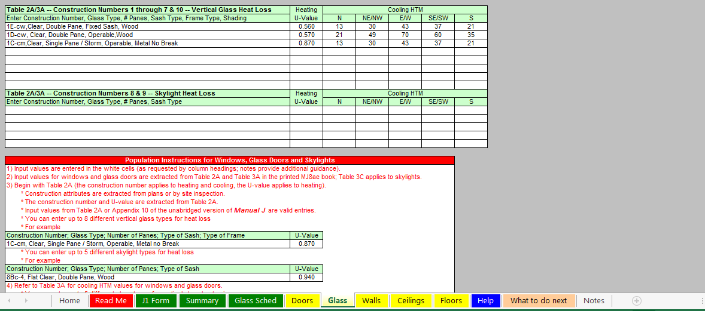
SPEEDSHEET Glass

Slide 18
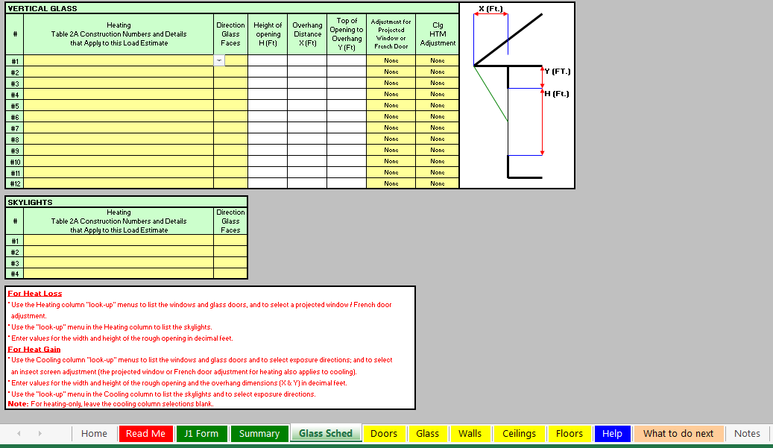
SPEEDSHEET Glass

Slide 19
SPEEDSHEET Glass

Slide 20
SPEEDSHEET Glass

Slide 21
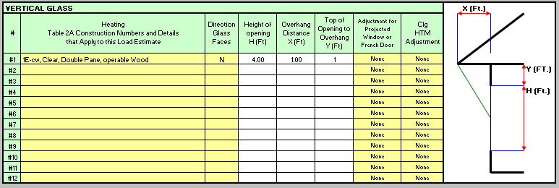
SPEEDSHEET Glass

Slide 22
SPEEDSHEET Glass

Slide 23
SPEEDSHEET Glass

Slide 24
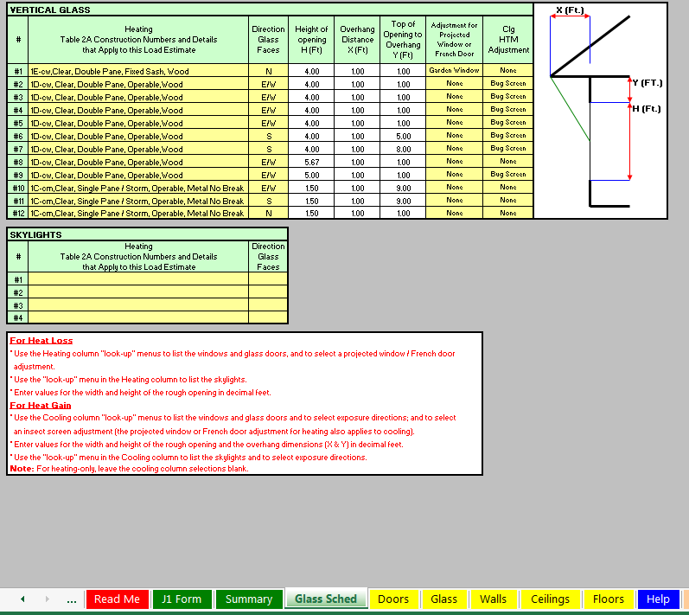
SPEEDSHEET Glass
No sky lights so, proceed to doors.

Slide 25
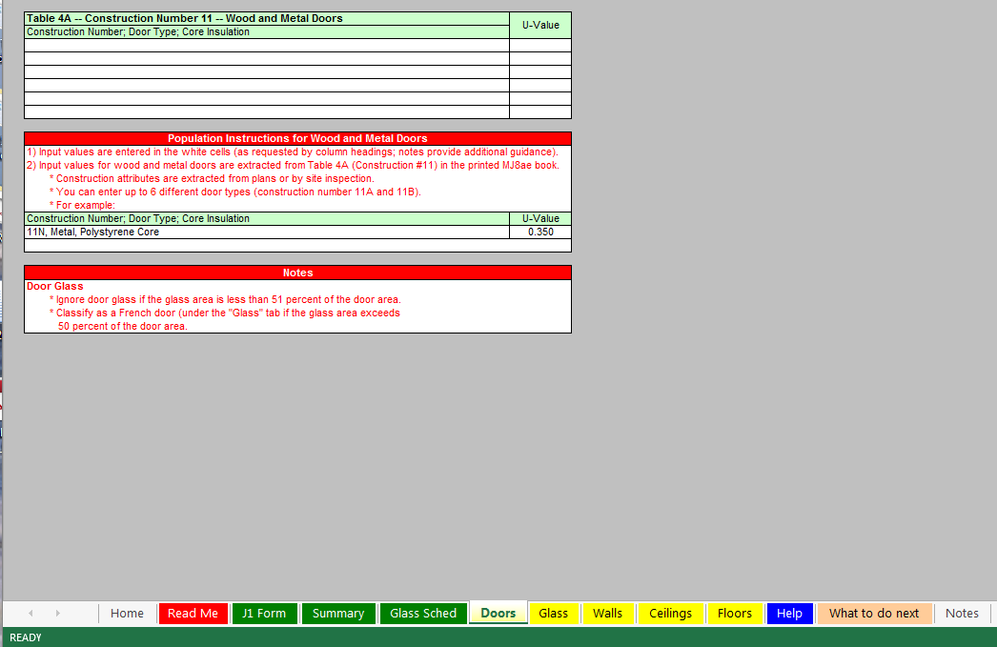
SPEEDSHEET Doors

Slide 26
SPEEDSHEET Doors

Slide 27
SPEEDSHEET Doors

Slide 28
SPEEDSHEET Doors

Slide 29
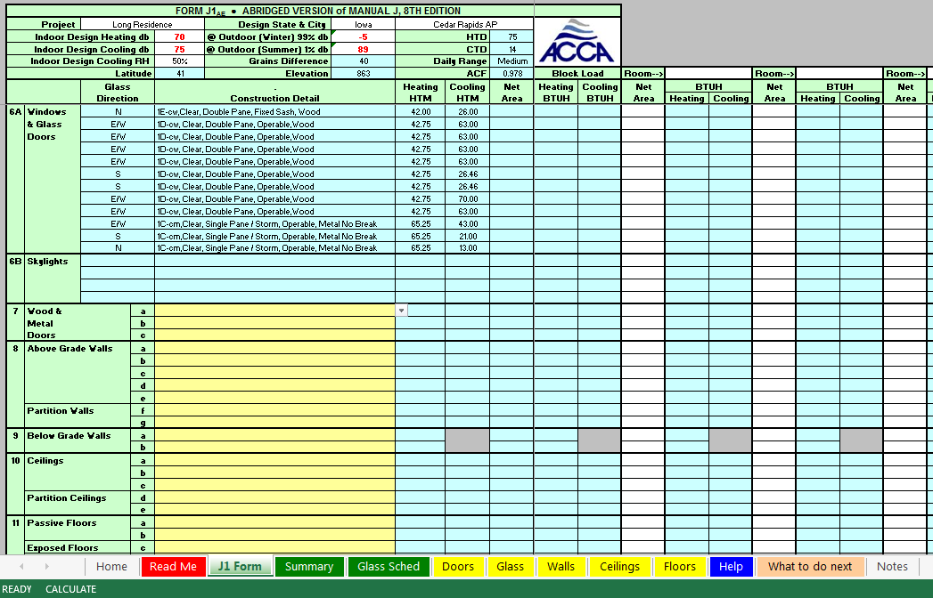
SPEEDSHEET Doors

Slide 30
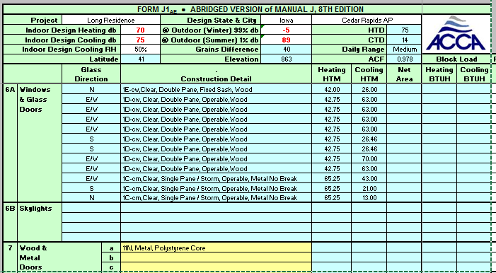
SPEEDSHEET Doors

Slide 31
SPEEDSHEET Doors

Slide 32
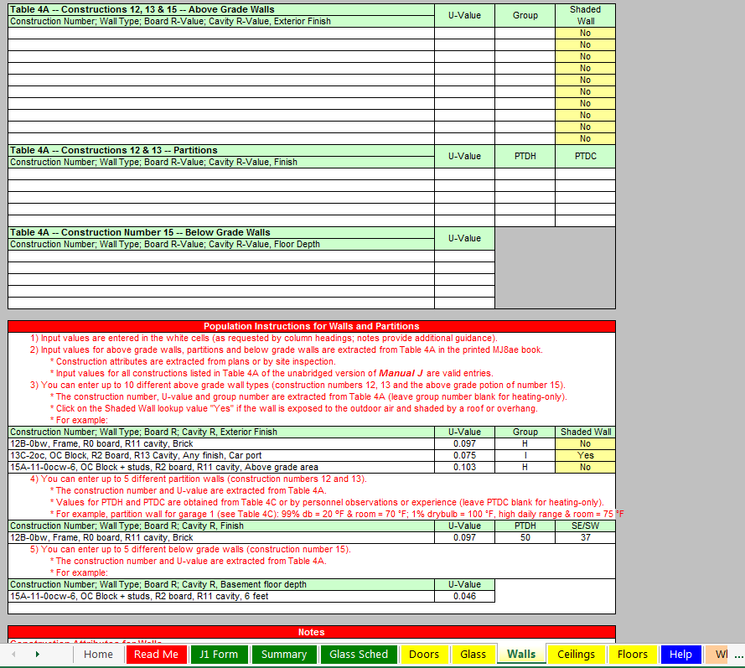
SPEEDSHEET Walls

Slide 33
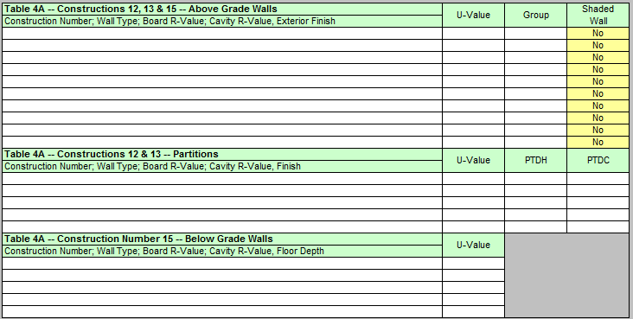
SPEEDSHEET Walls

Slide 34
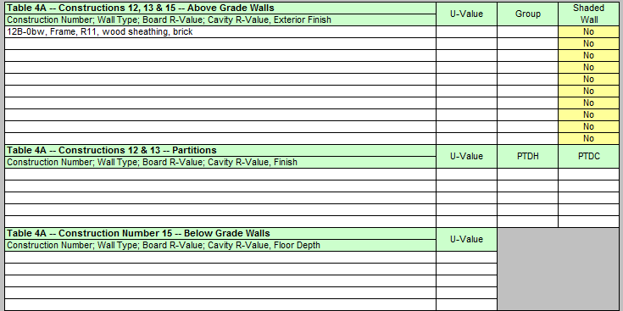
SPEEDSHEET Walls

Slide 35
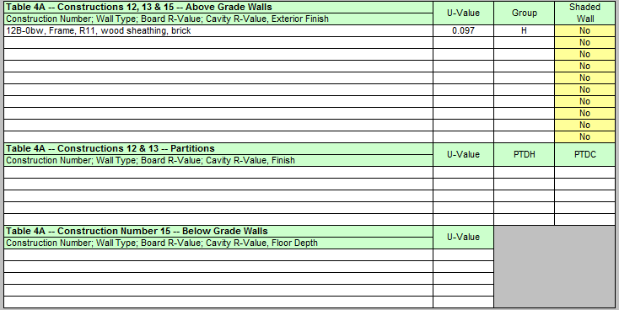
SPEEDSHEET Walls

Slide 36
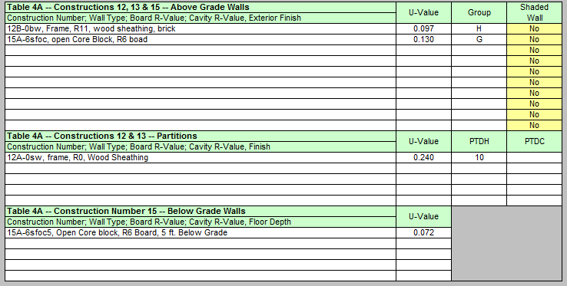
SPEEDSHEET Walls

Slide 37
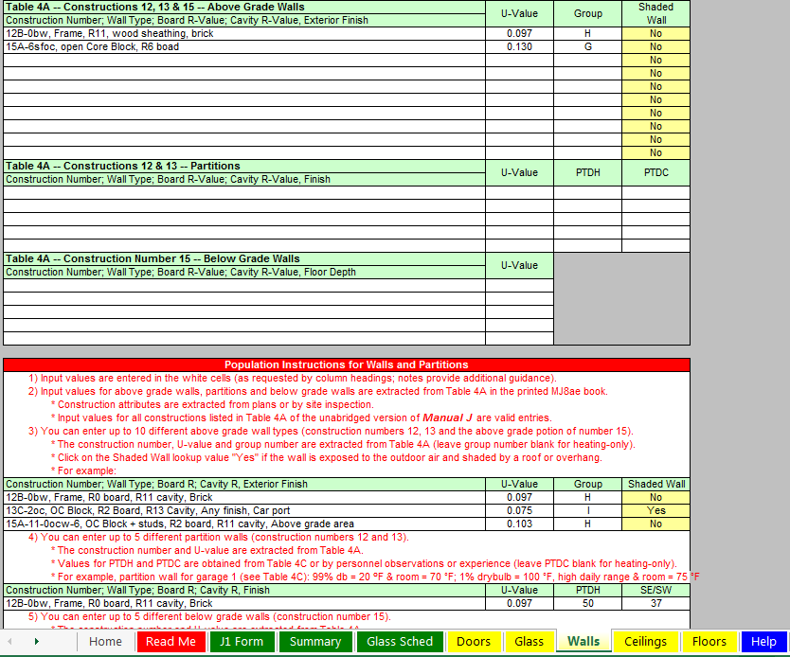
SPEEDSHEET Walls

Slide 38
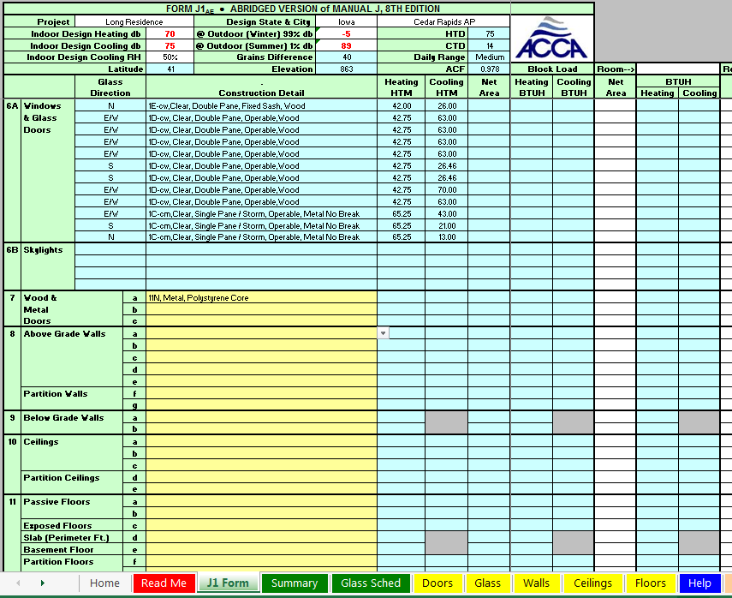
SPEEDSHEET Walls

Slide 39
SPEEDSHEET Walls

Slide 40
SPEEDSHEET Walls

Slide 41
SPEEDSHEET Walls

Slide 42
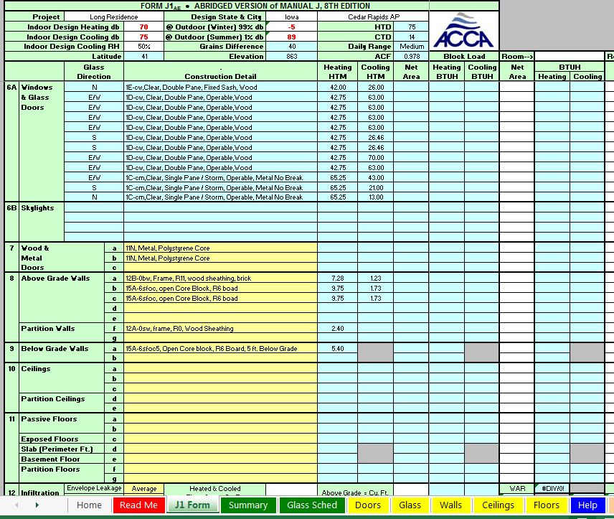
SPEEDSHEET Walls

Slide 43
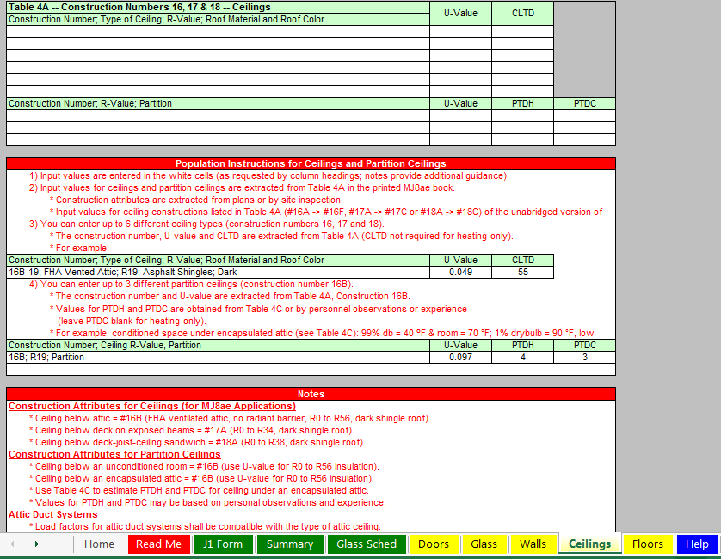
SPEEDSHEET Ceilings

Slide 44
SPEEDSHEET Ceilings

Slide 45
SPEEDSHEET Ceilings

Slide 46
SPEEDSHEET Ceilings

Slide 47
SPEEDSHEET Ceilings

Slide 48
SPEEDSHEET Ceilings

Slide 49
SPEEDSHEET Ceilings

Slide 50
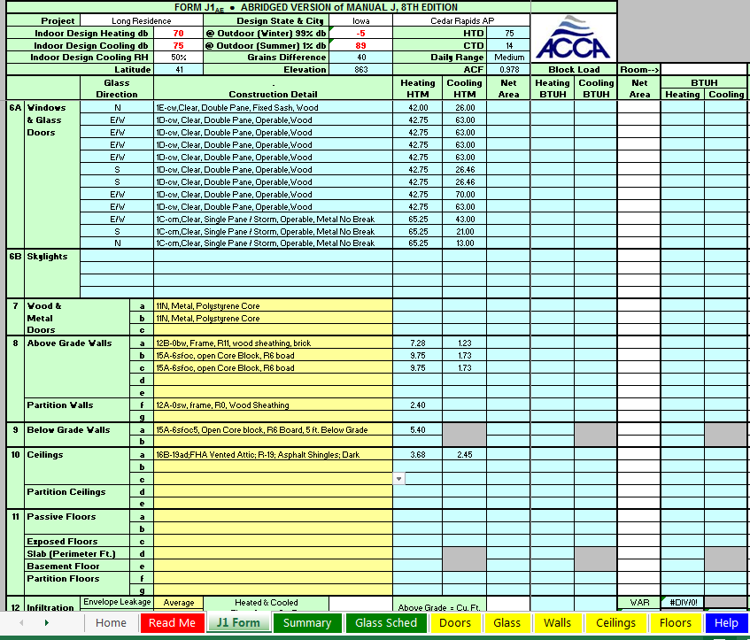
SPEEDSHEET Floors

Slide 51
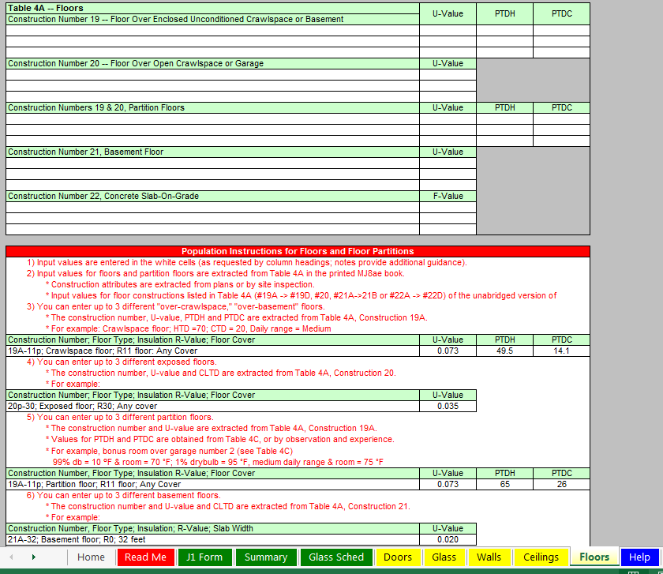
SPEEDSHEET Floors

Slide 52
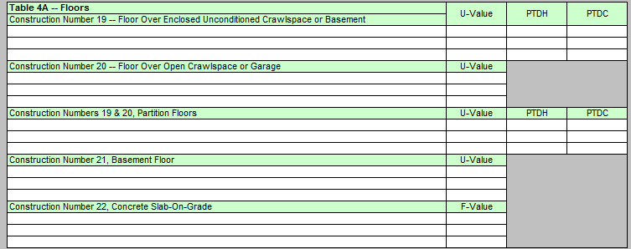
SPEEDSHEET Floors

Slide 53
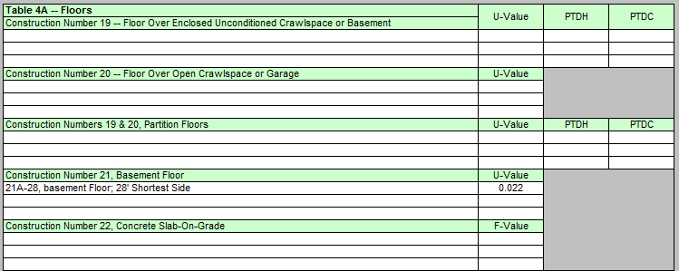
SPEEDSHEET Floors

Slide 54
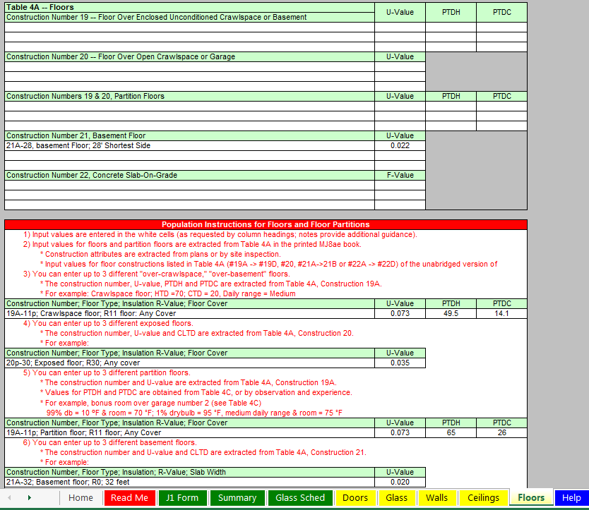
SPEEDSHEET Floors

Slide 55
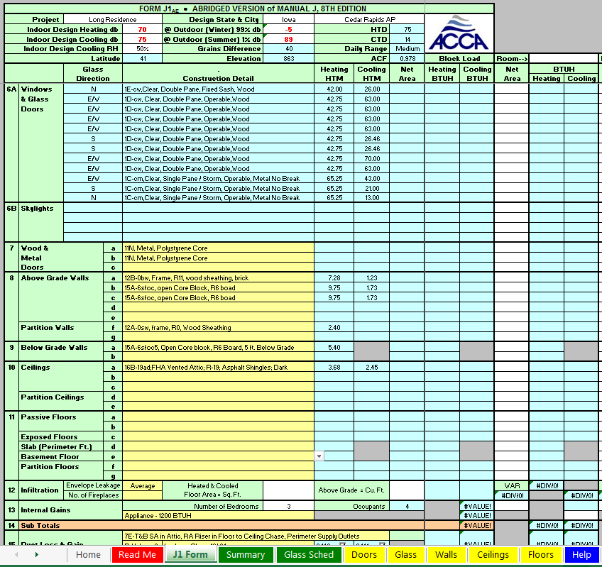
SPEEDSHEET Floors

Slide 56
SPEEDSHEET Floors

Slide 57
SPEEDSHEET Floors

Slide 58
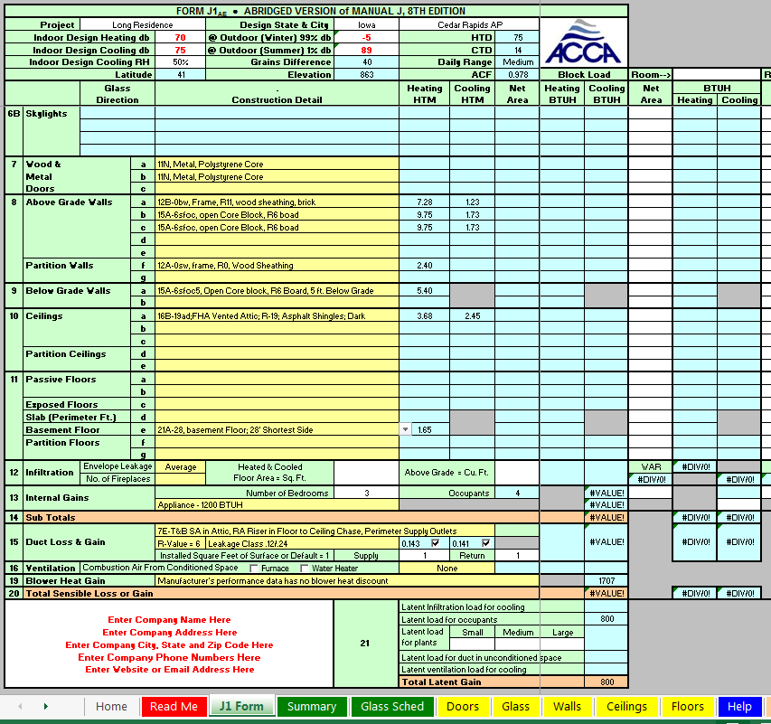
SPEEDSHEET Infiltration

Slide 59
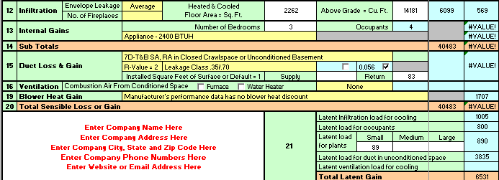
SPEEDSHEET Infiltration
From the drawings, total heated and cooled area in sq. ft:
(29 x 27) + ( 1,479) = 2,262
Note: Shop area not included has it’s own heat and no cooling.

Slide 60
SPEEDSHEET Infiltration
From the drawings above grade heated and cooled
volume in cu. ft:
(3 x 29 x 27) + ( 1479 x 8) = 14,181

Slide 61
SPEEDSHEET Room Load
Line 12: Infiltration
Note: Manual J8 eyeball interpolations resulted in values of 6,944 and 565 respectively.

Slide 62
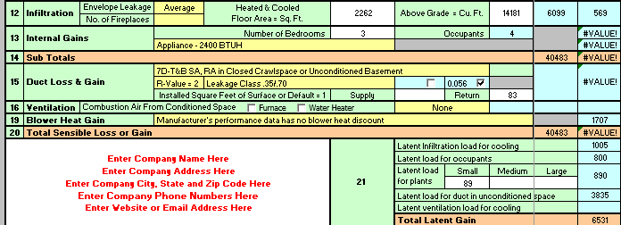
SPEEDSHEET Internal Gains

Slide 63
SPEEDSHEET Internal Gains
Occupants = number of bedrooms + 1
Occupants = number of bedrooms + 1

Slide 64
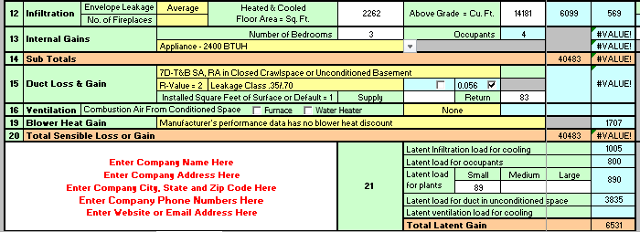
SPEEDSHEET Internal Gains
Appliance BTUH selected 2,400

Slide 65
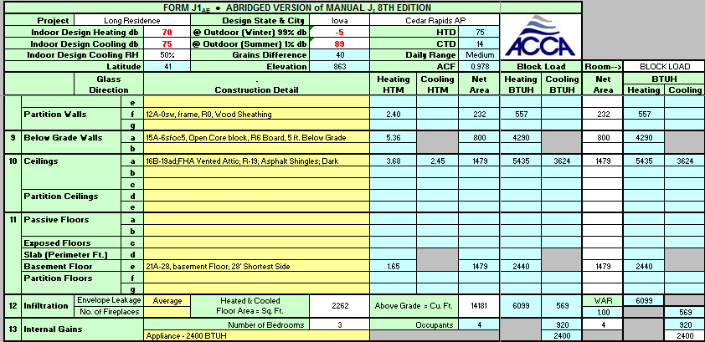
SPEEDSHEET Block Load
Line 13: Internal Gains

Slide 66
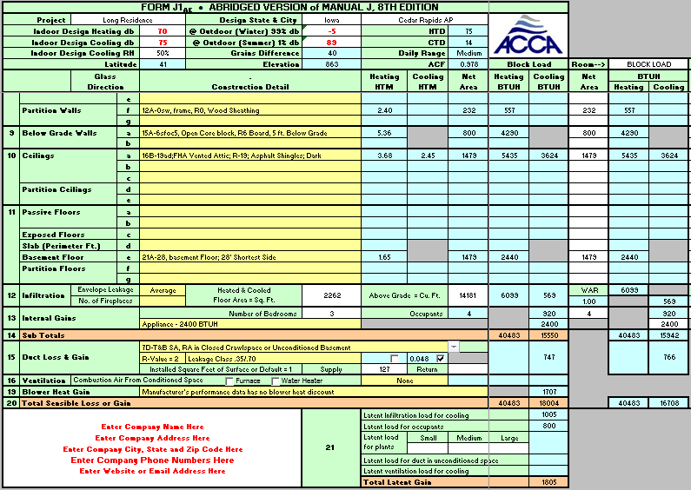
SPEEDSHEET Block Load
Line 14: Total Sensible Loss or Gain Sub Totals (nothing to fill in)

Slide 67
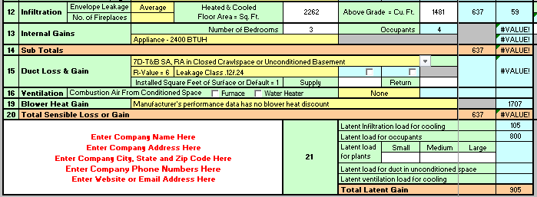
SPEEDSHEET Duct Loss & Gain
Note: ½ of the duct is in the uncooled basement. Thus, it is all exposed to a latent heat gain when the cooling system shuts down. No heat loss will be calculated for heating since the areas have auxiliary heating.

Slide 68
SPEEDSHEET Duct Loss & Gain

Slide 69
SPEEDSHEET Duct Loss & Gain

Slide 70
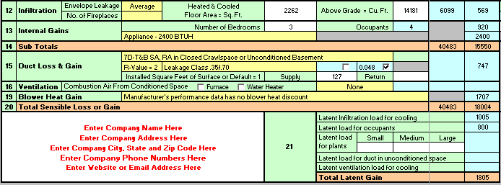
SPEEDSHEET Duct Loss & Gain
127= Supply duct installed sq. ft. surface area.
Note: 0.048 is exact interpolation value. Thus, latent load is less than in text which uses
an “eyeball interpolation”.

Slide 71
SPEEDSHEET Duct Loss & Gains
Line 15: Duct Loss & Gains
Note: In J8 different value of 0.56 (eyeball)

Slide 72
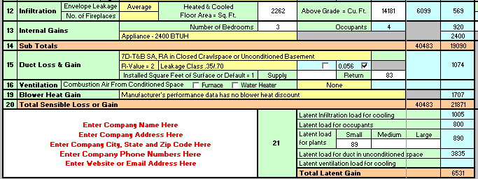
SPEEDSHEET Ventilation
No ventilation air added.

Slide 73
SPEEDSHEET Ventilation
Line 16: No ventilation & no combustion air.

Slide 74
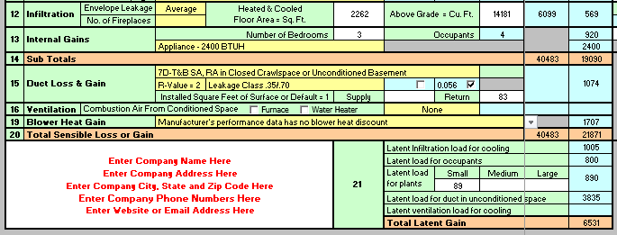
SPEEDSHEET Blower Heat Gain

Slide 75
SPEEDSHEET Blower Heat Gains
No lines 17 & 18 on Speedsheet* Line 19: Blower Heat Gains
*Not supported in the Jae: Line 17 is for winter humidification loads, and Line 18 is for piping loads.

Slide 76
SPEEDSHEET Block Load
Line 20: Total Sensible Loss or Gain…..Nothing to enter.

Slide 77
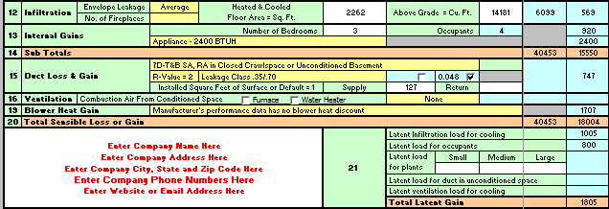
SPEEDSHEET Plants Latent Load
No plants.

Slide 78
SPEEDSHEET Block Load
Line 21: Latent Load Occupants
Note: In J8 wrong value of 1,200 printed

Slide 79
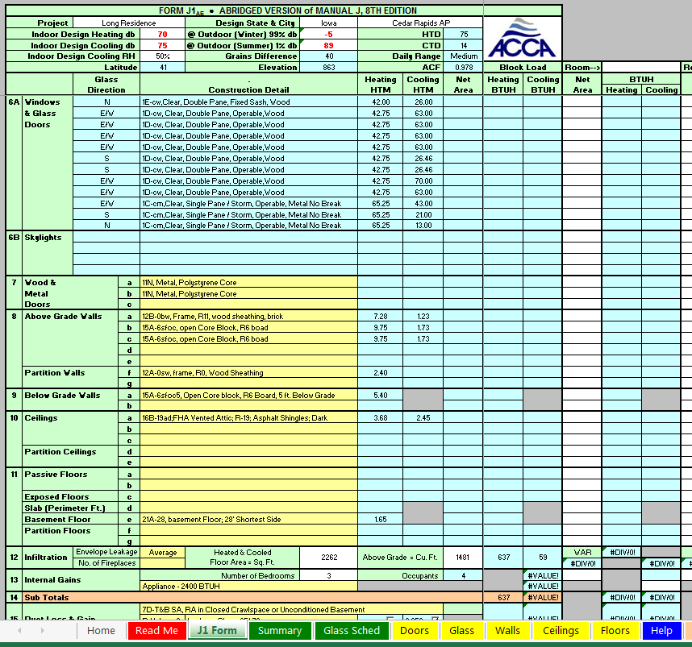
SPEEDSHEET Block Load

Slide 80
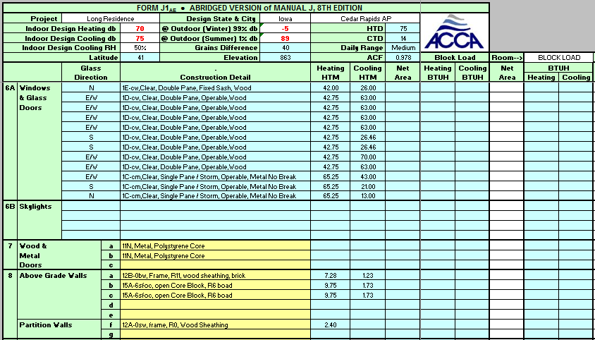
SPEEDSHEET Block Load

Slide 81
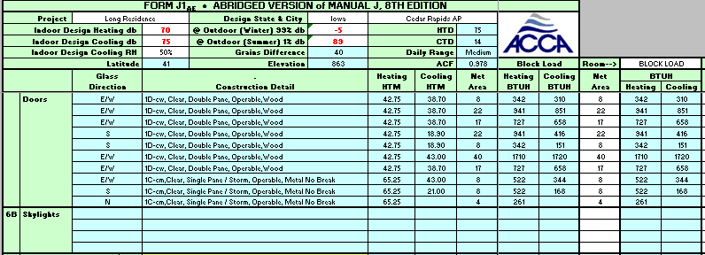
SPEEDSHEET Block Load
Fill In Window Net Areas
Note: HTM x Net Area = BTUH

Slide 82
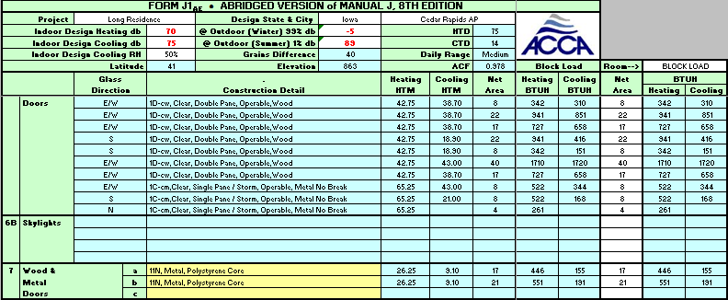
SPEEDSHEET Block Load
Fill In Door Net Areas

Slide 83
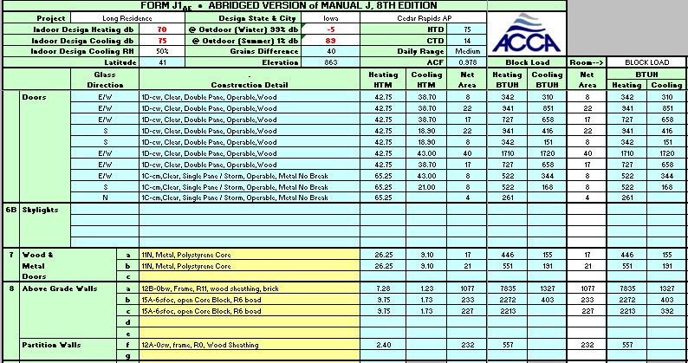
SPEEDSHEET Block Load
Fill In Wall Net Areas

Slide 84
SPEEDSHEET Block Load
Fill In Ceiling Net Areas

Slide 85
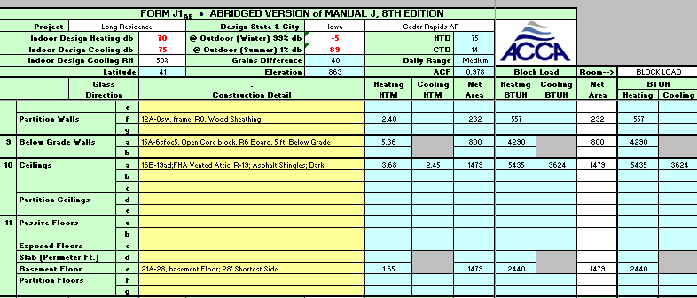
SPEEDSHEET Block Load
Fill In Basement Floor Net Area

Slide 86
SPEEDSHEET Block Load
Infiltration Automatically Populated
Note: Manual J8 eyeball interpolations resulted in values of 6,944 and 565 respectively.

Slide 87
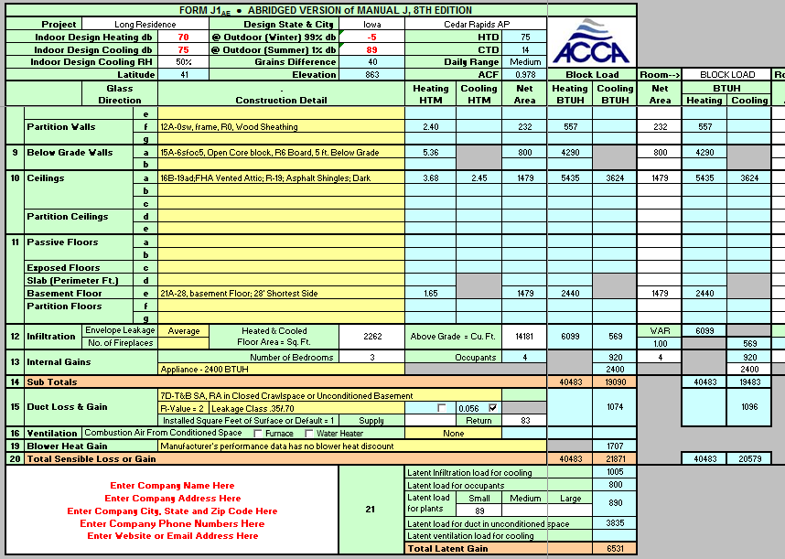
SPEEDSHEET Block Load
Sensible Gain + Latent Gain = Cooling Load 18,004 + 1,805 = 19,809
Heating Load Sensible Only = 40,453

Slide 88
SPEEDSHEET Block Load
Sensible Gain + Latent Gain = Cooling Load 18,004 + 1,805 = 19,809
In J8: 18,130 + 1,798* = 19,928 or 0.59% more
Heating Load Sensible Only = 40,453
In J8: 41,304 or 2.01%
*Corrected for typo of 1,200 instead of 800 on line 21B in Manual J8

Slide 89
SPEEDSHEET Block Load
Thus; “eyeball interpolations by author” within 2%

Slide 90
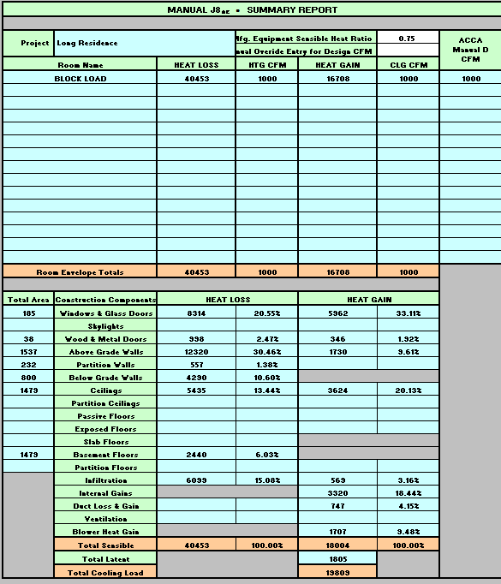
SPEEDSHEET Block Load Summary Report

Slide 91
SPEEDSHEET Block Load Summary Report
You should now be able to do a block load.
Using the speedsheet calculate how much the loads change when the windows are single pane and have no shading?
Hint: Use different values from Table 2A

Slide 92
Instructor Notes
Manual J8 used a different heated square footage for the shop with a space heater. To do this with the Speedsheet you would need to do two separate sheets. Thus, the Speedsheet uses the heated and cooled volume (not including the shop area).
The J8 form line 21 B has a typo or error for occupant latent heat. Should be 4 occupants at 200 = 800 (not 1,200).
The eyeball interpolation and rounding differences found in the Speedsheet totals makes a small difference in the total values.
WAR is the wall area ratio. For a Block load it is 1, and for Room X Room loads the individual room percentages add up to 1.

