Slide 1
Lesson 2 Duct Slide Rule

Slide 2
Velocities, Pressures & Temperatures 2.3

Slide 3
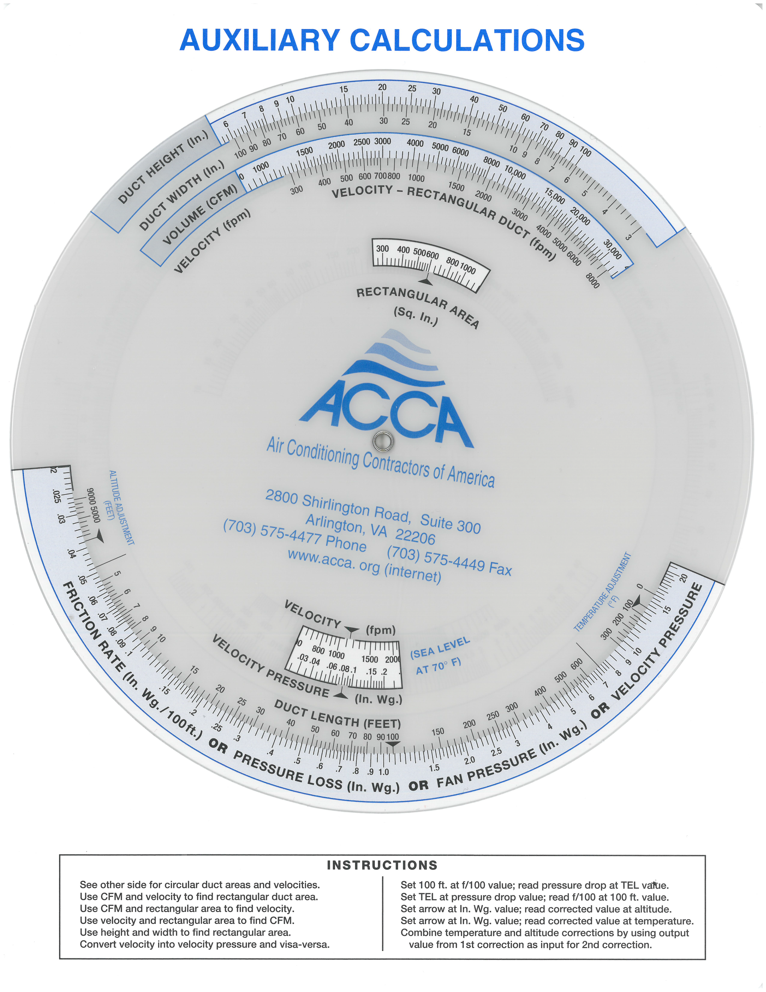
Velocity Pressure Calculations
Velocity Pressure information is required when a designer is using commercial fitting loss tables.

Slide 4
Refresher: Velocity Pressure Measurements for CFM Calculations
Points on a plane
Airflow
VP using a Pitot
tube and a pressure differential gauge

Slide 5
Refresher: Velocity Pressure Measurements for CFM Calculations
FPM = $\sqrt{VP(average) }x 4005$
Points on a plane
Airflow
VP using a Pitot
tube and a pressure differential gauge

Slide 6
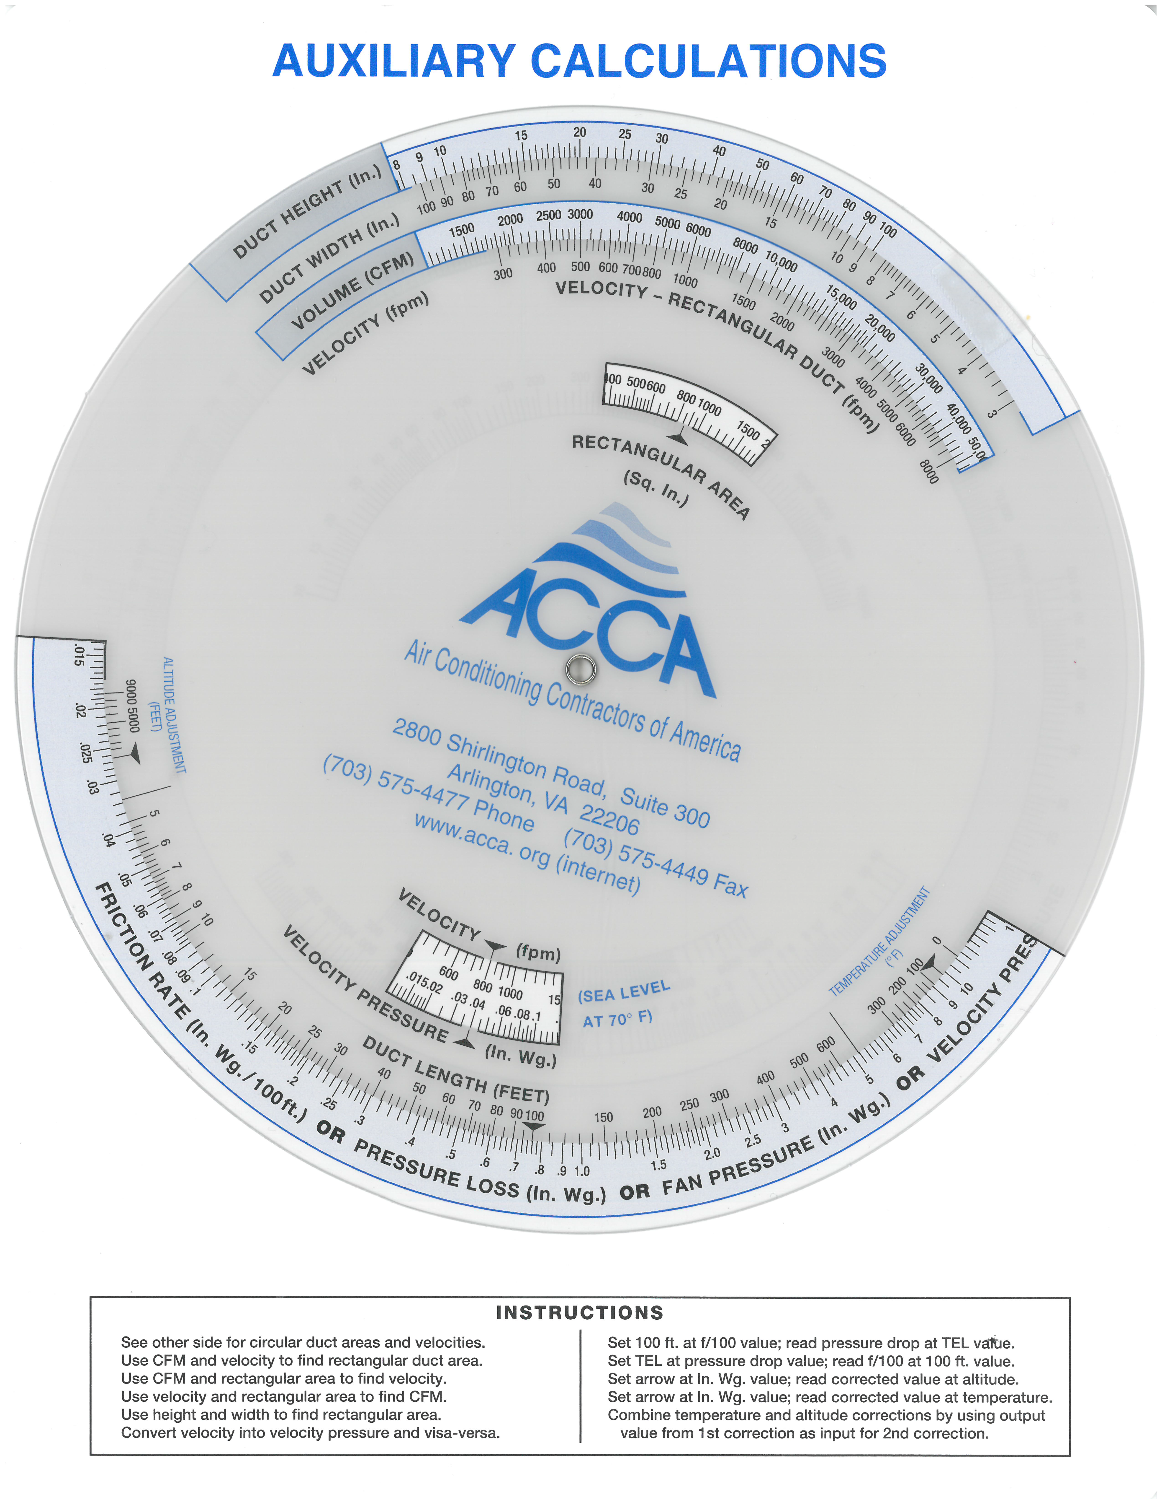
Velocity Pressure Calculations

Slide 7
Velocity Pressure Calculations

Slide 8
Velocity Pressure Calculations

Slide 9
Altitude Adjustments
0.0265
Friction Rate
or
Pressure Loss
or
Fan Pressure
or
Velocity Pressure

Slide 10
Altitude Adjustments
0.0265 for Standard air = .02 at a 7,000 ft. elevation
0.0265
Friction Rate
or
Pressure Loss
or
Fan Pressure
or
Velocity Pressure

Slide 11
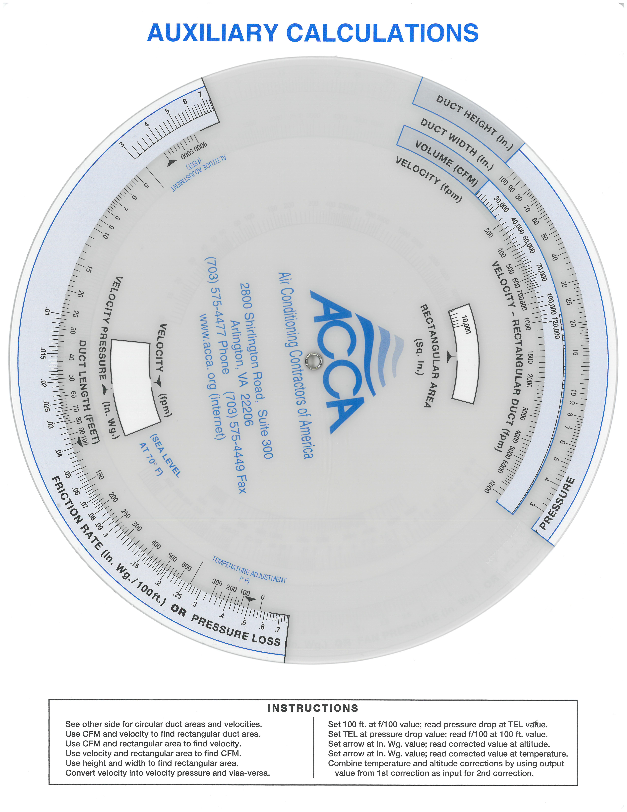
Temperature Adjustments
0.5 at 200^{O}F = ?
0.5 at 0^{O}F = ?

Slide 12
Temperature Adjustments
0.5 at 200^{O}F = 0.4
0.5 at 0^{O}F = ?

Slide 13
Temperature Adjustments
0.5 at 200^{O}F = 0.4
0.5 at 0^{O}F = 0.565

Slide 14
Temperature Adjustments
0.5 at 200^{O}F = 0.4
0.5 at 0^{O}F = 0.565

Slide 15
Reading the Chart’s Values
Between 200 and 300
each line represents 25^{O}F
Between the Friction Rate Pressure Loss etc.
0.3 and 0.4 each line represents 0.02

Slide 16
Combining Altitude & Temperature Adjustments
This is done by simply taking one value on the
slide rule and using it as the second value for the
Other (order does not matter):
For example finding the equivalent value for 0.5 at
200^{O}F and 5,000 ft. elevation:
0.5 at 200^{O}F = .4

Slide 17
Combining Altitude & Temperature Adjustments
This is done by simply taking one value on the
slide rule and using it as the second value for the
Other (order this is done does not matter):
For example finding the equivalent value for 0.5 at
200^{O}F and 5,000 ft. elevation:
0.5 at 200^{O}F = .4
0.4 at 5,000 ft. elevation = 0.325

Slide 18
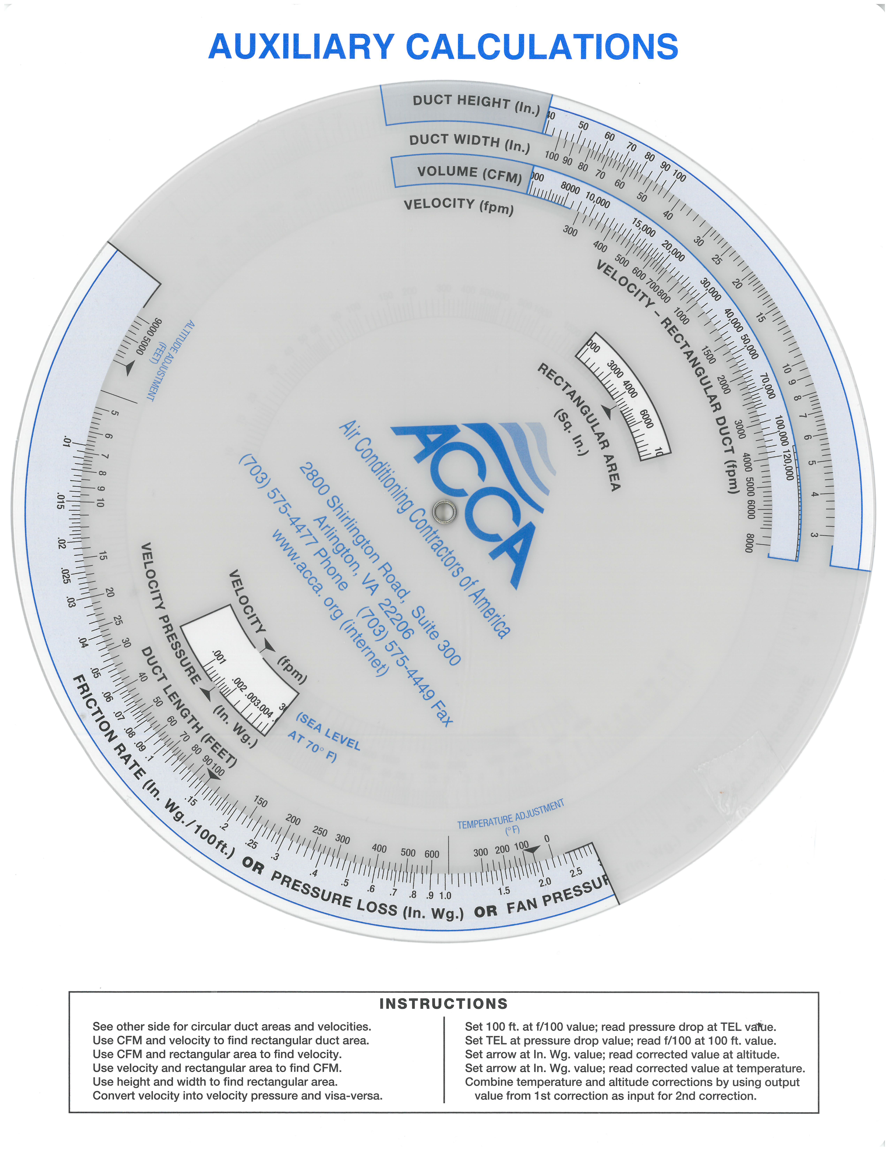
Friction Rate – Pressure Drop Relationships
Friction Rate 0.15 at 100 ft. = 0.6 at 400 ft.

Slide 19
Friction Rate – Pressure Drop Relationships
Friction Rate 0.15 at 100 ft. = 0.3 at 200 ft.

