Slide 1
Duct Design Basics

Slide 2
Duct Design Basics Introduction Friction Chart; Duct Slide Rule; Manual D Speedsheet Basics

Slide 3
Typical AC Air Handler Unit
A Coil
Return Air
Supply Air
Filter
Blower

Slide 4
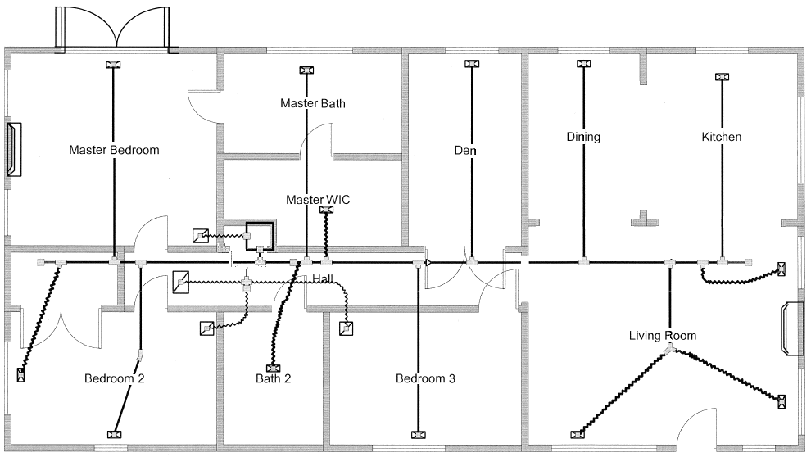
Typical Duct System

Slide 5
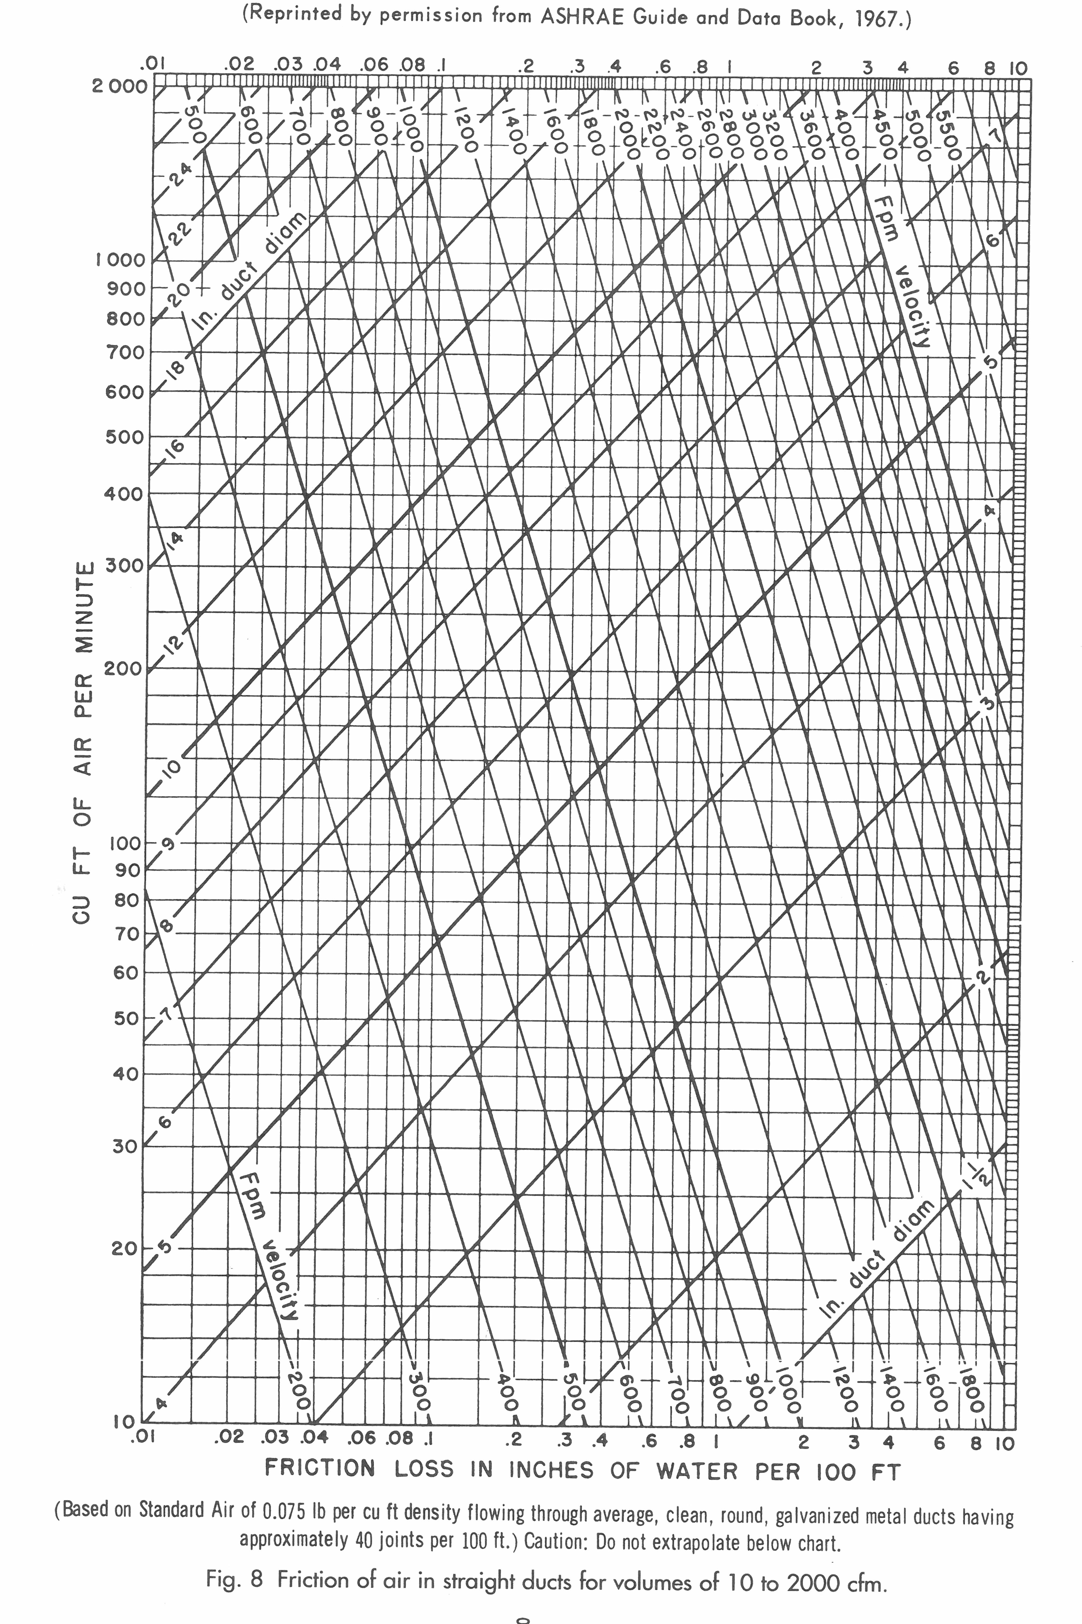
Typical Friction Chart

Slide 6
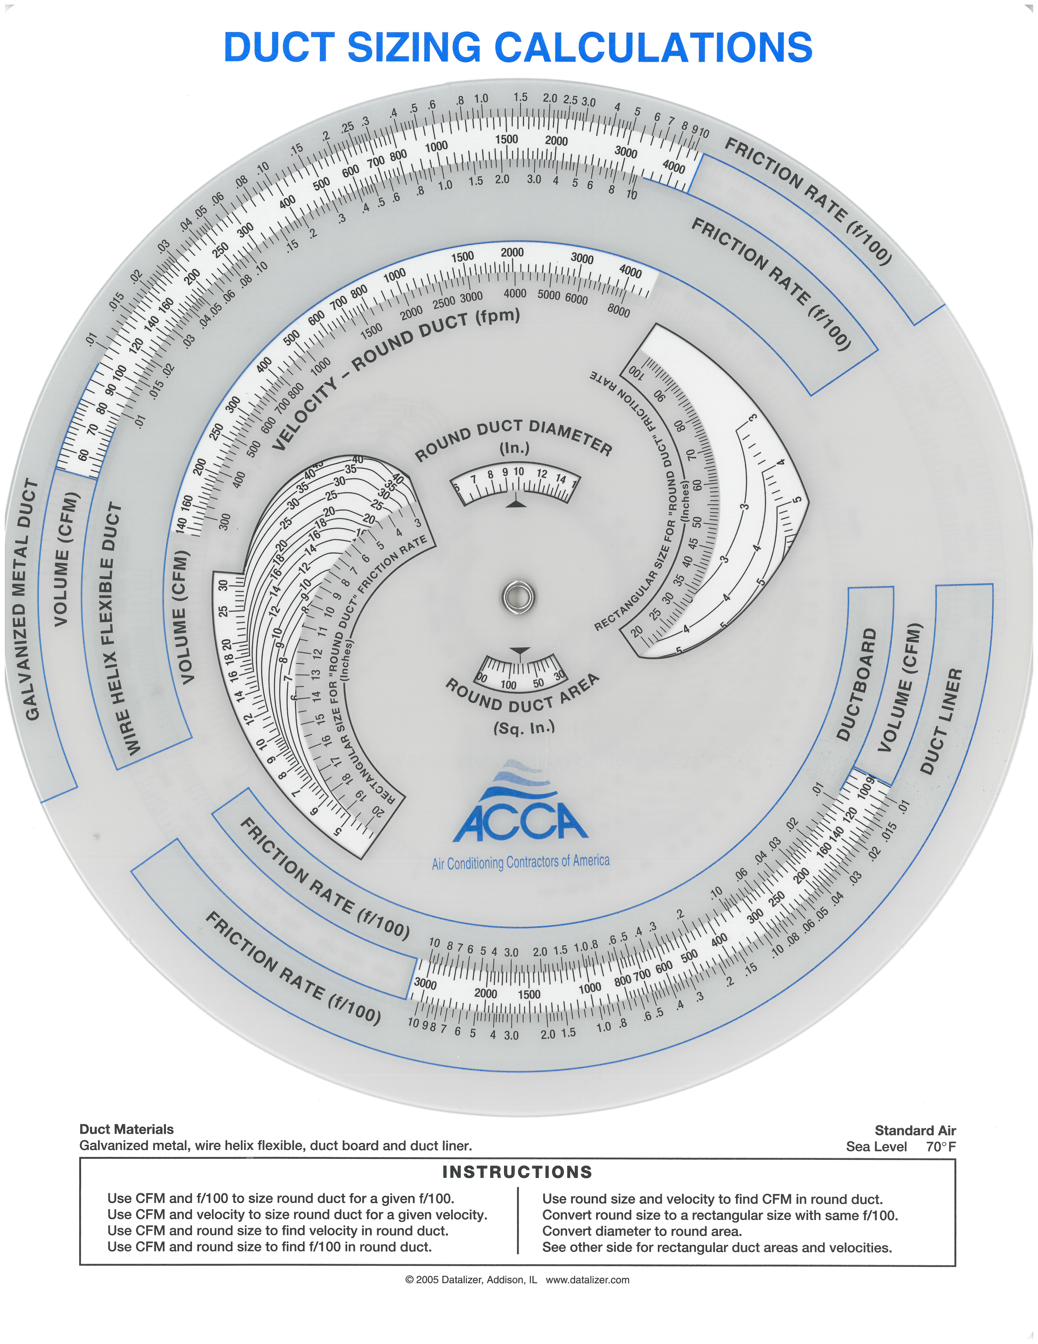
Duct Slide Rule

Slide 7
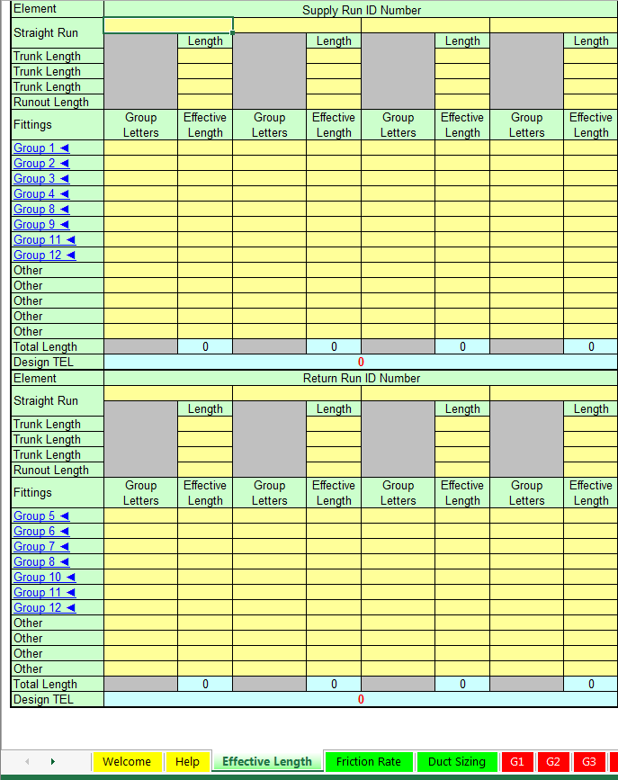
Manual D Speedsheet

Slide 8
Manual D Speedsheet

Slide 9
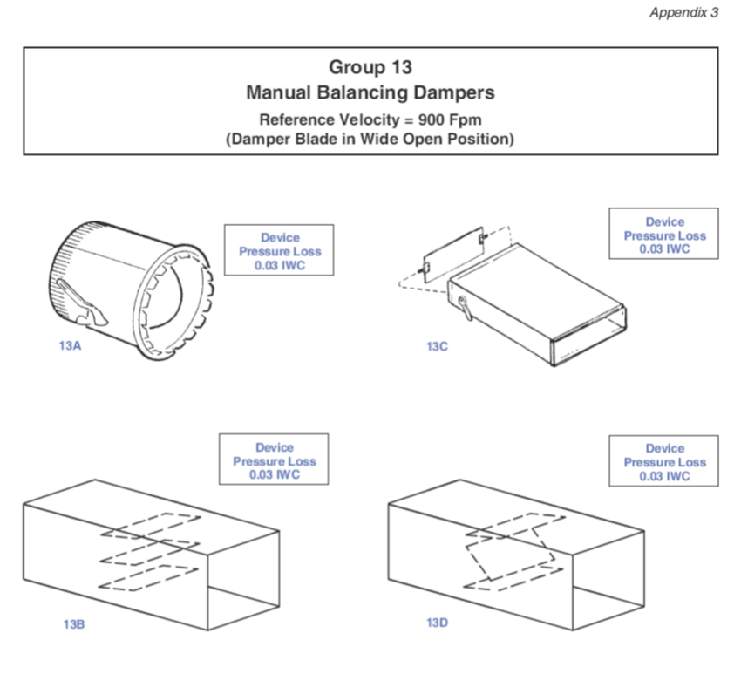
Manual D Speedsheet

Slide 10
Manual D Terms
Air Velocity
Available Static Pressure
Component Pressure Loss
Cubic Feet Per Minute
Equivalent Length
External Static Pressure
Friction Rate
Feet Per Minute
Static Pressure Drop
Velocity Pressure

Slide 11
Typical Duct System

Slide 12
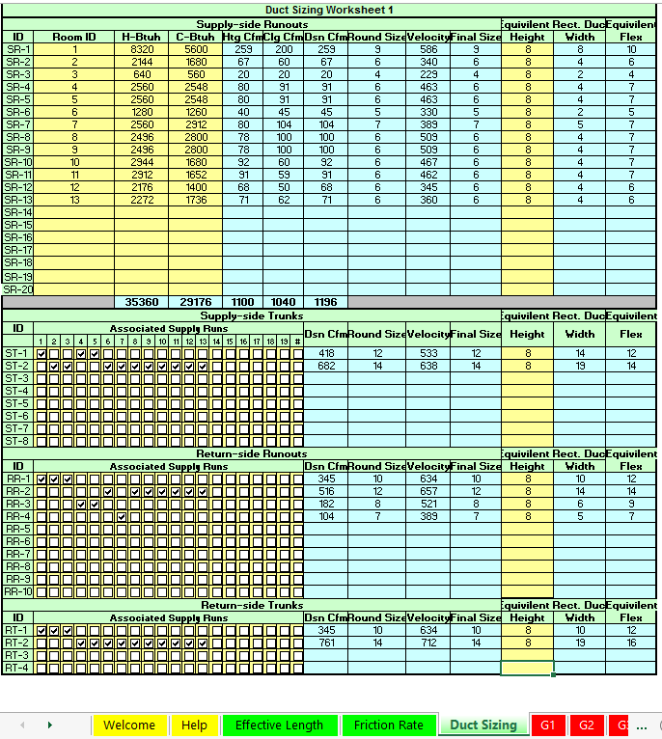
Manual D Speedsheet

Slide 13
Manual D Speedsheet

Slide 14
Manual D Speedsheet

Slide 15
Manual D Speedsheet

Slide 16
Manual D Speedsheet

Slide 17
Manual D Speedsheet

Slide 18
Manual D Speedsheet

Slide 19
Manual D Speedsheet

Slide 20
Manual D Speedsheet

Slide 21
Manual D Speedsheet

Slide 22
Manual D Speedsheet

Slide 23
Manual D Speedsheet

