Slide 1
Duct Design Basics Lesson 4 Manual D Primer

Slide 2
Duct Sizing 4.3

Slide 3
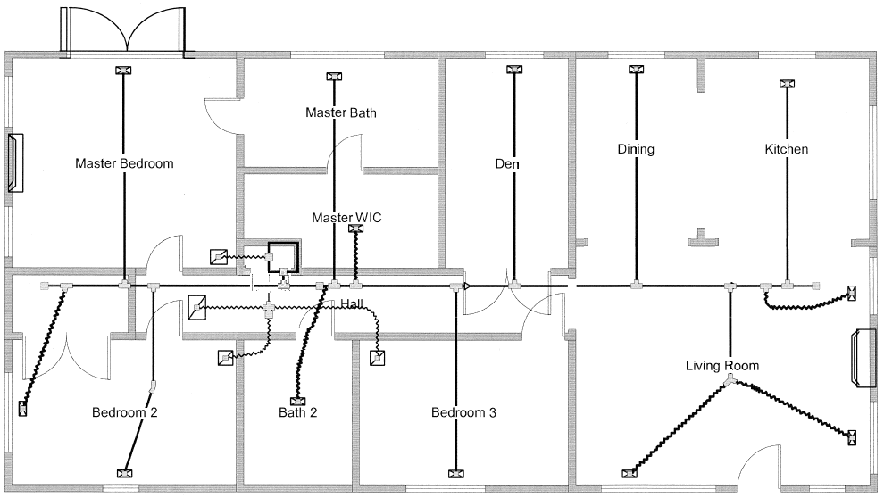
Duct Sketch/Drawing
1
2
13
12
11
3
1
2
10
3
4
6
4
9
5
7
8

Slide 4
Duct Sketch/Drawing
1
2
13
12
11
1N EL 15
9P EL 70
2P EL 35
Galvanized Round Duct
1
3
1
2
2
10
9O EL 15
3
3
4
6
Flex Round Duct
4
2P 5 or more EL 75
9
5
7
8
4K EL 30

Slide 5
Duct Sketch/Drawing
1
2
13
12
11
1N EL 15
9P EL 70
2P EL 35
Galvanized Round Duct
1
3
1
2
2
10
9O EL 15
3
3
4
6
Flex Round Duct
4
2P 5 or more EL 75
9
5
7
8
4K EL 30

Slide 6
Supply Duct Size Calculation
Fittings: Galvanized Duct in ft:
1N EL 15 1 3 ft.
9P EL 70 2 40 ft.
2P EL 75 3 7 ft.
9O EL 15 Total 50 ft.
4K EL 30 Flex Duct in ft.
Total 205 Ft. 1 10 ft.
Total 50 + 10 + 205 = 265 ft.

Slide 7
Duct Sketch/Drawing
1
2
13
12
11
1N EL 15
9P EL 70
3
2P EL 35
Galvanized Round Duct
1
3
1
2
2
10
9O EL 15
3
4
6
4
2P 5 or more EL 75
9
5
7
8
4K EL 30

Slide 8
Supply Duct Size Calculation
Fittings: Galvanized Duct in ft:
1N EL 15 1 3 ft.
9P EL 70 2 50 ft.
2P EL 75 3 16 ft.
9O EL 15 Total 69 ft.
4K EL 30
Total 205 Ft.
Total 69 + 205 = 274 ft.

Slide 9
Return Duct Size Calculation
1
2
13
12
11
Flex Round Duct Return
3
1
1
2
10
2
3
4
Junction Box
6
10 G EL 75
4
4Y EL 30
9
5
7
8

Slide 10
Return Duct Size Calculation
Fittings: Flex Duct in ft.
4Y EL 30 1 4 ft.
10 G EL 75 2 6 ft.
Total 105 ft Total 10 ft.
Total 105 + 10 = 115 ft.

Slide 11
Return Duct Size Calculation
1
2
13
12
11
Flex Round Duct Return
3
10 G EL 75
1
1
2
10
2
3
4
Junction Box
6
4
4Y EL 30
9
5
7
8

Slide 12
Return Duct Size Calculation
Fittings: Flex Duct in ft.
4Y EL 30 1 4 ft.
10 G EL 75 2 12 ft.
Total 105 ft. Total 16 ft.
Total 105 + 16 = 121 ft.

Slide 13
Return Plus Supply Duct Size Calculation
Return plus Supply = 121 + 274 = 395 ft
Return plus Supply = 115 + 265 = 380 ft

Slide 14
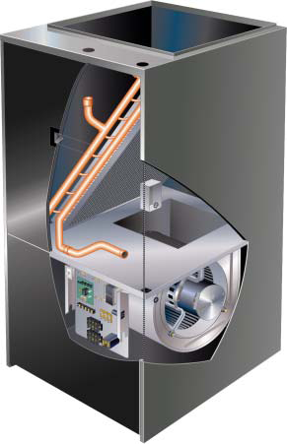
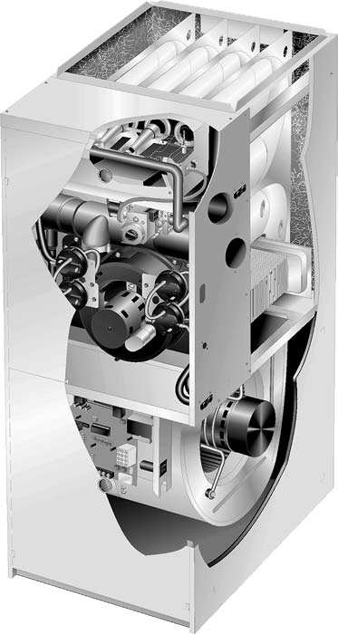
Pressure Drop for Airside Components
Only duct has been shown thus far!
Anything placed in the duct that is not included in
The equipment manufacturer’s external static pressure (ESP)
rating needs to be included in the System friction loss total.
ESP

Slide 15
Pressure Drop for Airside Components
Only duct has been shown thus far!
Anything placed in the duct that is not included in
The equipment manufacturer’s external static pressure (ESP)
rating needs to be included in the System friction loss total.
Filters
Coils
Diffusers & Grilles
Heating Elements
Humidifier
Balancing damper

Slide 16
Pressure Drop for Airside Components
Only duct has been shown thus far!
Anything placed in the duct that is not included in
The equipment manufacturer’s external static pressure (ESP)
rating needs to be included in the System friction loss total.
Filters
Coils
Diffusers & Grilles
Heating Elements
Humidifier
Balancing damper
ESP = 0.50

Slide 17
Pressure Drop for Airside Components
SP = 0.055

Slide 18
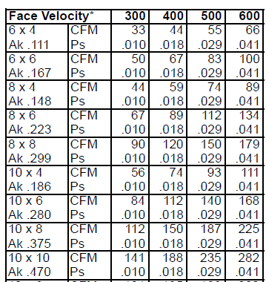
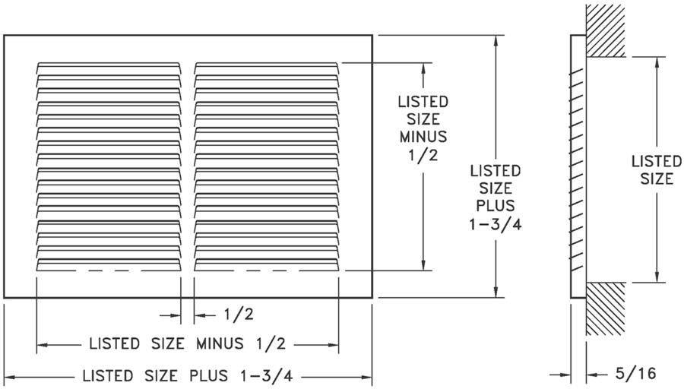
Pressure Drop for Airside Components
SP = 0.010
0.010 + 0.055 = .065

Slide 19
Available Static Pressure (ASP)
Step 1: Manufacturer’s blower data
XYZ Brand ESP 0.50 @ 1,200 CFM (wet coil, filter included)
Step 2: Calculate Component Losses
Filters--------------------------- N/A
Coils----------------------------- N/A
Diffusers & Grilles----------- 0.065
Heating Elements------------ 0.02
Humidifier--------------------- 0.03
Balancing damper----------- N/A (Bad Idea)
Total--------------------------------- 0.115 IWC

Slide 20
Available Static Pressure (ASP)
Step 3: Available Static Pressure (ASP)
ASP = ESP – CPL = 0.50 – 0.115 = 0.385 IWC
Step 4: Total Effective Length (TEL)
Supply Duct TEL + Return TEL = 121 + 274 = 395 Feet
Step 5: Friction Rate Design Value
FR = ASP x 100 ÷ TEL = 0.385 x 100 ÷ 395 = 0.098 IWC/100

Slide 21
Available Static Pressure (ASP)
Step 3: Available Static Pressure (ASP)
ASP = ESP – CPL = 0.50 – 0.115 = 0.385 IWC
Step 4: Total Effective Length (TEL)
Supply Duct TEL + Return TEL = 121 + 274 = 395 Feet
Step 5: Friction Rate Design Value
FR = ASP x 100 ÷ TEL = 0.385 x 100 ÷ 395 = 0.098 IWC/100
0.101 – 0.098 = 0.003 Difference
FR = ASP x 100 ÷ TEL = 0.385 x 100 ÷ 380 = 0.101 IWC/100

Slide 22
Duct Size Calculation BTU & CFM

Slide 23
Duct Size Calculation BTU & CFM
Bedroom 1
43.75
1,629
485

Slide 24
Duct Size Calculation BTU & CFM
Bedroom 1
230
400
2,253
1,630
400

Slide 25
Run-Trunk | Heat BTUH | Cool BTUH | Heat CFM | Cool CFM | DSN CFM | Round Dia. | VEL FPM | Final Dia.
1 | 8,320 | 5,600 | 260 | 200 | 260 | 9 | 600 | 9
2 | 2,144 | 1,680 | 67 | 60 | 67 | 6 | 411 | 6
3 | 640 | 560 | 20 | 20 | 20 | 3 | N/A | 3
4 | 2,560 | 2,548 | 80 | 91 | 91 | 6 | 462 | 6
5 | 2,560 | 2,548 | 80 | 91 | 91 | 6 | 462 | 6
6 | 1,280 | 1,260 | 40 | 45 | 45 | 5 | 340 | 5
7 | 2,560 | 2,912 | 80 | 104 | 104 | 6 | 540 | 6
8 | 2,496 | 2,800 | 78 | 100 | 100 | 6 | 522 | 6
9 | 2,496 | 2,800 | 78 | 100 | 100 | 6 | 522 | 6
10 | 2,944 | 1,680 | 92 | 60 | 92 | 6 | 465 | 6
11 | 2,912 | 1,652 | 91 | 59 | 91 | 6 | 463 | 6
12 | 2,176 | 1,400 | 68 | 50 | 68 | 6 | 410 | 6
13 | 2,272 | 1,736 | 71 | 62 | 71 | 5 | 513 | 5
 |  | Trunk 1 | 420 | 382 | 442 | 12 | 560 | 12
 |  | Trunk 2 | 685 | 660 | 758 | 14 | 720 | 14
Supply Trunk Considerations for Noise
Conservative = 700 FPM
Maximum = 900 FPM

Slide 26
Run-Trunk | Heat BTUH | Cool BTUH | Heat CFM | Cool CFM | DSN CFM | Round Dia. | VEL FPM | Final Dia.
1 | 8,320 | 5,600 | 260 | 200 | 260 | 9 | 600 | 9
2 | 2,144 | 1,680 | 67 | 60 | 67 | 6 | 411 | 6
3 | 640 | 560 | 20 | 20 | 20 | 3 | N/A | 3
4 | 2,560 | 2,548 | 80 | 91 | 91 | 6 | 462 | 6
5 | 2,560 | 2,548 | 80 | 91 | 91 | 6 | 462 | 6
6 | 1,280 | 1,260 | 40 | 45 | 45 | 5 | 340 | 5
7 | 2,560 | 2,912 | 80 | 104 | 104 | 6 | 540 | 6
8 | 2,496 | 2,800 | 78 | 100 | 100 | 6 | 522 | 6
9 | 2,496 | 2,800 | 78 | 100 | 100 | 6 | 522 | 6
10 | 2,944 | 1,680 | 92 | 60 | 92 | 6 | 465 | 6
11 | 2,912 | 1,652 | 91 | 59 | 91 | 6 | 463 | 6
12 | 2,176 | 1,400 | 68 | 50 | 68 | 6 | 410 | 6
13 | 2,272 | 1,736 | 71 | 62 | 71 | 5 | 513 | 5
 |  | Trunk 1 | 420 | 382 | 442 | 12 | 560 | 12
 |  | Trunk 2 | 685 | 660 | 758 | 14 | 720 | 14

Slide 27
Run-Trunk | Heat BTUH | Cool BTUH | Heat CFM | Cool CFM | DSN CFM | Round Dia. | VEL FPM | Final Dia.
1 | 8,320 | 5,600 | 260 | 200 | 260 | 9 | 600 | 9
2 | 2,144 | 1,680 | 67 | 60 | 67 | 6 | 411 | 6
3 | 640 | 560 | 20 | 20 | 20 | 3 | N/A | 3
4 | 2,560 | 2,548 | 80 | 91 | 91 | 6 | 462 | 6
5 | 2,560 | 2,548 | 80 | 91 | 91 | 6 | 462 | 6
6 | 1,280 | 1,260 | 40 | 45 | 45 | 5 | 340 | 5
7 | 2,560 | 2,912 | 80 | 104 | 104 | 6 | 540 | 6
8 | 2,496 | 2,800 | 78 | 100 | 100 | 6 | 522 | 6
9 | 2,496 | 2,800 | 78 | 100 | 100 | 6 | 522 | 6
10 | 2,944 | 1,680 | 92 | 60 | 92 | 6 | 465 | 6
11 | 2,912 | 1,652 | 91 | 59 | 91 | 6 | 463 | 6
12 | 2,176 | 1,400 | 68 | 50 | 68 | 6 | 410 | 6
13 | 2,272 | 1,736 | 71 | 62 | 71 | 5 | 513 | 5
 |  | Trunk 1 | 420 | 382 | 442 | 12 | 560 | 12
 |  | Trunk 2 | 685 | 660 | 758 | 12 | 720 | 14

Slide 28
Duct Sketch/Drawing
71 CFM
68 CFM
91 CFM
1
2
13
12
11
260 CFM
67 CFM
9
20 CFM
284 CFM
Trunk 1
3
1
92 CFM
2
12
6
612 CFM
10
6
3
4
182 CFM
104 CFM
4
6
91 CFM each
9
45 CFM
100 CFM each
5
7
104 CFM
8

Slide 29
Do the same for the other supply trunk and the 4
returns!
71 CFM
68 CFM
91 CFM
1
2
13
12
11
260 CFM
67 CFM
9
20 CFM
284 CFM
Trunk 1
3
1
92 CFM
2
12
6
612 CFM
10
6
3
4
182 CFM
104 CFM
4
6
91 CFM each
9
45 CFM
100 CFM each
5
7
104 CFM
8

Slide 30
Do the same for the other supply trunk and the 4
returns!
71 CFM
68 CFM
91 CFM
1
2
13
12
11
260 CFM
67 CFM
9
6
5
6
6
20 CFM
284 CFM
Trunk 1
3
3
1
92 CFM
2
12
14
Trunk 2
6
612 CFM
10
8
6
6
3
5
4
182 CFM
104 CFM
6
7
4
6
7
91 CFM each
9
45 CFM
100 CFM each
5
7
104 CFM
8

Slide 31
This will never be a QI Job until Balancing dampers
are added so it can be balanced.
71 CFM
68 CFM
91 CFM
1
2
13
12
11
260 CFM
67 CFM
10
20 CFM
284 CFM
3
1
92 CFM
19
13
2
10
612 CFM
7
3
9
4
182 CFM
104 CFM
4
6
91 CFM each
9
45 CFM
100 CFM each
5
7
104 CFM
8

Slide 32
This will never be a QI Job until Balancing dampers
are added so it can be balanced.
71 CFM
68 CFM
91 CFM
1
2
13
12
11
260 CFM
67 CFM
10
20 CFM
284 CFM
3
1
92 CFM
19
13
2
10
612 CFM
7
3
9
4
182 CFM
104 CFM
4
6
91 CFM each
9
45 CFM
100 CFM each
5
7
104 CFM
8

