Slide 1
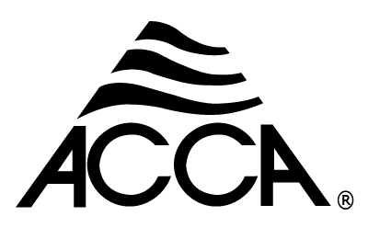
Technician’s First Guide and Workbook Section 19: Maintenance Inspection Basics (3)

Slide 2
Electric Furnaces (1)
Items found should be documented and items needing additional service should be highlighted. Additional electrical power related tasks for electrical furnaces:
Inspect heater contact relays. Measure and record line voltage to heater.
Test Electric heater sequence of operation.
Measure and record amperage of heater element.

Slide 3
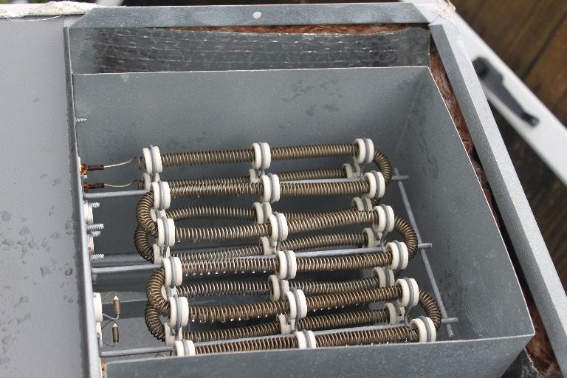
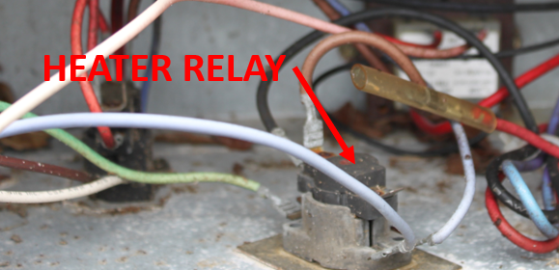
Heater Relay & Resistance Heat Strip

Slide 4
Electric Furnaces (2)
Compare Measured values to equipment name plate values. If not within 5% include findings in the equipment report.

Slide 5
Evaporator Coil Inspection Background
Once again, having the external static pressure (ESP) from when the equipment was first started can make proving the evaporator coil is operating like new simple! However, if there is a variable speed motor one must be careful to set it at the exact speed it is running when the initial ESP was measured. Many technicians also take the static pressure (SP) pressure drop across the coil at start up. This is done by measuring the SP on both sides of the coil and subtracting the SP out from the SP in. Coil manufacturers have tables that can convert the SP drop across a coil to CFM. There are generally two tables, one for a dry coil, and one for a wet coil. The coil is wet when the system is in the cooling mode. Evaporator coil maintenance as noted may include cleaning. It is important to note that the cleaner for an inside evaporator coil needs to be rated for use inside of the home. Warning: make sure the coil cleaner used is rated for indoor use. Your company will probably provide the coil cleaners, as with everything else, read the directions for use. If it calls for adding 6 oz of cleaner to a gallon of water, you do not want to use it straight out of the bottle!

Slide 6
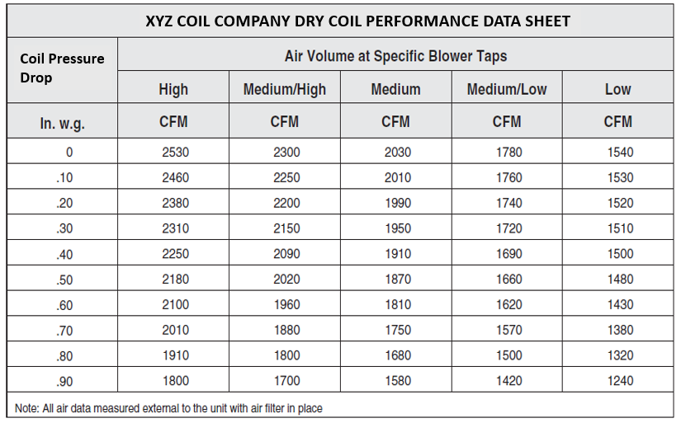
Evaporator Coil Performance Table

Slide 7
Evaporator Coil Inspection Tasks (1)
The following maintenance/inspection tasks apply to evaporator coils:
Inspect the cabinet the evaporator is in to make sure it is tight, no air can bypass the coil, and the insulation is good.
Make sure the cabinet air pathways are clear of obstructions (junk in the way).
Make sure condensate piping is installed correctly and is clear and operating properly.
Look on the discharge side of the coil for signs water is being carried over beyond the condensate pan (a sign that the velocity across the coil is too high, or the coil is dirty).
Inspect for biological growth and include it in the report if found.

Slide 8
Evaporator Coil Inspection Tasks (2)
Verify that over flow protection is operating properly. If there is evidence of water in the overflow pan include it in the report.
Verify correct airflow.
Check fins for damage. Repair if damage is not major, report if the damage is not easily reparable (see Figure 109 for fin repair comb/tool).
Measure and record Temperature and humidity on both sides of the coil. Verify that they are within OEM’s designated range.
Inspect refrigerant line insulation.
Measure the pressure drop across the coil.

Slide 9
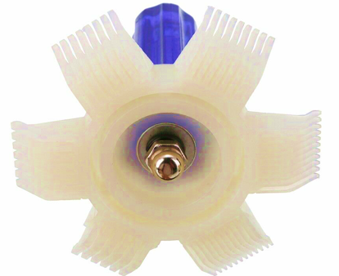
Fin Comb

Slide 10
Condensing Unit (1)
Inspect the condenser for damage and make sure they are correctly assembled:
Inspect electrical disconnect box to make sure fuse/breaker size are correct(if applicable) and connections are tight.
Ensure proper equipment grounding.
Measure and record line voltage compare to listed values on equipment name plate.

Slide 11
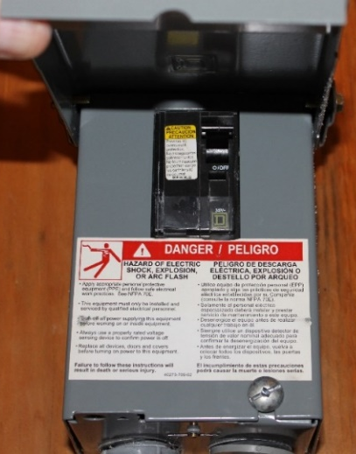
Disconnect Box

Slide 12
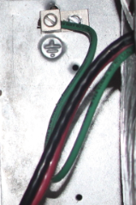
Grounding

Slide 13
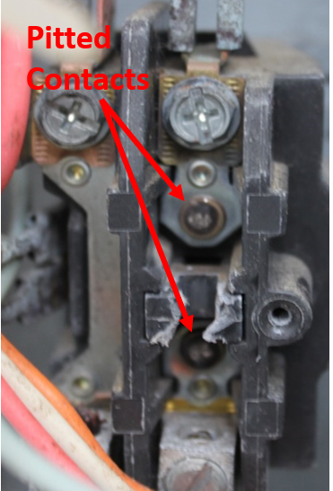
Contactor Points
Inspect the condenser for damage and make sure they are correctly assembled:
Inspect contactors and relay, look for bad connections or signs of wear.

Slide 14
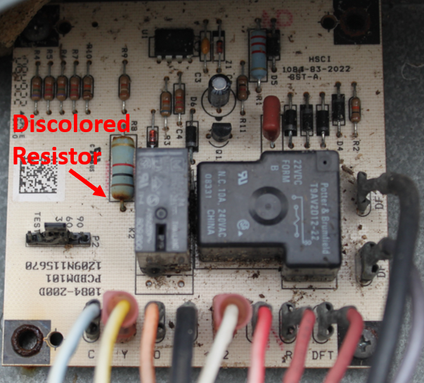
Circuit Boards
Check circuit board and circuit board connections for damage (see Figure 111).
Inspect Electrical connection (tighten if loose.)

Slide 15
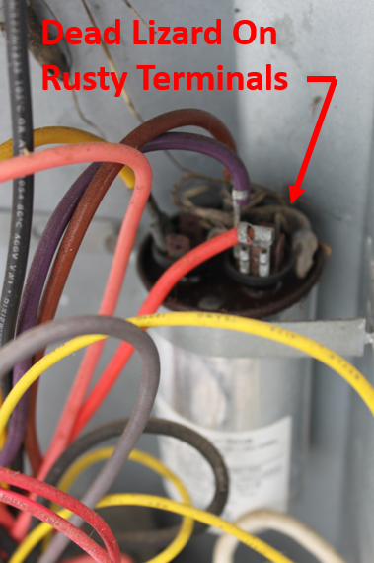
Capacitors
Inspect motor capacitors, look for swelling or damage.
Measure and record nameplate voltage and amperage.

Slide 16
Refrigerant Lines
Inspect accessible refrigerant lines, coils and pipe insulation note signs of oil/leaks or damage.

Slide 17
Condenser Coils
Inspect coil fins repair minor damage and clean as needed using approved coil cleaner and water to rinse off
Verify Fan blade is tightly secured to the motor. Inspect for free motion and signs of damage.
If indoor airflow is not within acceptable temperature differences (inlet to outlet) and airflow has been verified as correct the system charge should be checked using the Superheat or subcooling method.

Slide 18
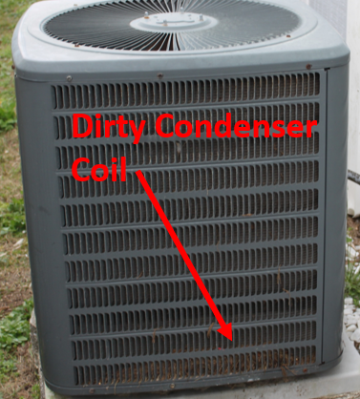
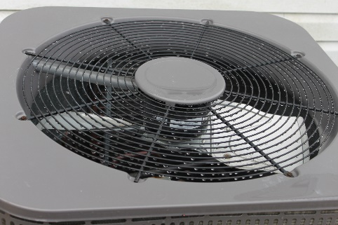
Condenser Coils
Inspect coil fins repair minor damage and clean as needed using approved coil cleaner and water to rinse off
Verify Fan blade is tightly secured to the motor. Inspect for free motion and signs of damage.
If indoor airflow is not within acceptable temperature differences (inlet to outlet) and airflow has been verified as correct the system charge should be checked using the Superheat or subcooling method.

Slide 19
Condenser Coils
Inspect coil fins repair minor damage and clean as needed using approved coil cleaner and water to rinse off
Verify Fan blade is tightly secured to the motor. Inspect for free motion and signs of damage.
If indoor airflow is not within acceptable temperature differences (inlet to outlet) and airflow has been verified as correct the system charge should be checked using the Superheat or subcooling method.

Slide 20
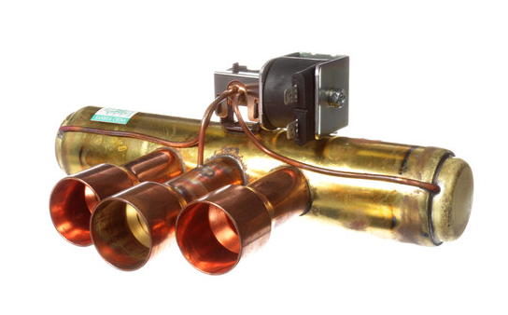
Heat Pump Condensers
Additional items to be inspected on a heat pump condenser:
Test defrost cycle.
Test Reversing Valve.
If indoor airflow is not within acceptable temperature differences (inlet to outlet) and airflow has been verified as correct the system charge should be checked using the Superheat or subcooling method.

Slide 21
Lessons Learned
You should now be able to explain why an electric furnace needs annual maintenance.
You should now be able to identify wiring problems on a circuit board.
You should now be able to identify bad contact points on a relay or motor starter.
You should now be able to explain why there is no reason to hook up refrigerant gauges if the airflow is not know.
You should now be able to identify a reversing valve in a heat pump condenser.

