Slide 1
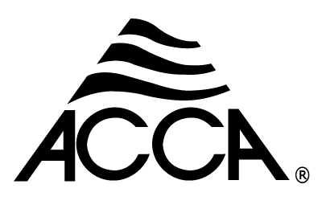
Technician’s Guide and Workbook for the EPA Section 608 Test Section 7: Type 1 Test

Slide 2
Small Appliance Recovery Requirements
Topics in this section are:
Definition of "small appliance"
Evacuation requirements for small appliances with and without working compressors using recovery equipment

Slide 3
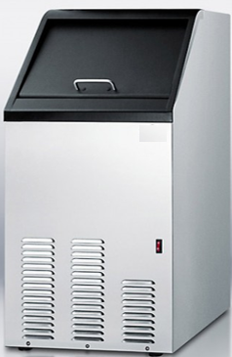
Definition of “Small Appliance”
Small appliance: Any appliance that is fully manufactured, charged, and hermetically sealed in a factory with five (5) pounds or less of refrigerant, including, but not limited to, refrigerators and freezers (designed for home, commercial, or consumer use), medical or industrial research refrigeration equipment, room air conditioners (including window air conditioners, portable air conditioners, and packaged terminal air heat pumps), dehumidifiers, under-the-counter ice makers, vending machines, and drinking water coolers.
Small appliance leak repair is recommended but not required.

Slide 4
Evacuation Requirements for Small Appliances (1)
Starting January 1, 2018, the following requirements apply to the disposal of appliances containing any Class I or Class II refrigerant, or any non-exempt substitute refrigerant.
Before opening a small appliance, or when disposing of a small appliance, the refrigerant must be recovered and/or recycled with equipment certified pursuant to EPA requirements, according to the following conditions:
Recovery equipment manufactured on or after November 15, 1993 must recover 90 percent of the refrigerant in the appliance when the compressor in the appliance is functioning or 80 percent of the refrigerant in the appliance when the compressor in the appliance is not functioning; or it must be able to evacuate the appliance to four inches of mercury vacuum.

Slide 5
Evacuation Requirements for Small Appliances (2)
Recovery equipment manufactured or imported on or after November 15, 1993 may be certified if it is capable of achieving a four-inch vacuum under the conditions of Appendix B1 of ARI Standard 740-1993. Note: ARI is now AHRI, an equipment manufacturer’s association.
Recovery equipment manufactured or imported on or after September 22, 2003 and before January 1, 2017 may also be certified if it is capable of achieving a four-inch vacuum under the conditions of Appendix B2 of this subpart, based upon ARI Standard 740-1995.

Slide 6
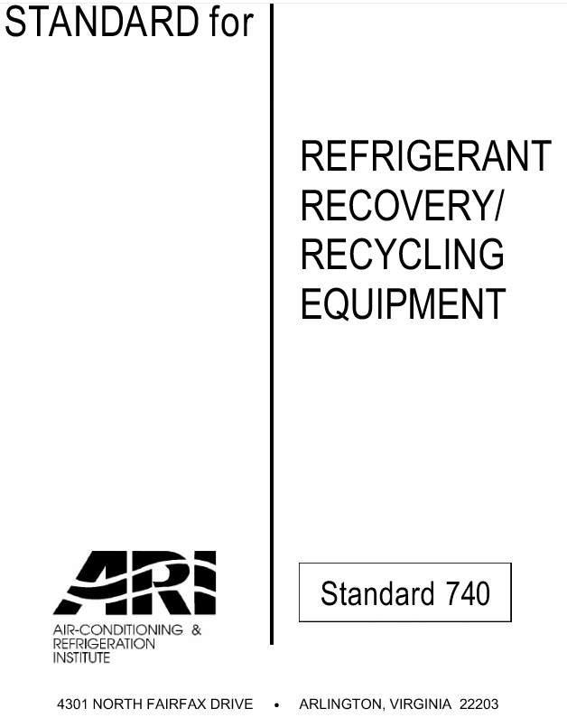
Evacuation Requirements for Small Appliances (3)
Recovery equipment manufactured or imported on or after January 1, 2017 may be certified if it is capable of achieving a four-inch vacuum under the conditions of Appendix B3 of this subpart (for non-flammable refrigerants), based upon AHRI Standard 740-2016 or Appendix B4 of this subpart (for flammable refrigerants), based upon both AHRI Standard 740-2016 and UL 1963, Supplement SB, Requirements for Refrigerant Recovery/Recycling Equipment Intended for Use with a Flammable Refrigerant, Fourth Edition.
Recovery equipment used to evacuate any Class I or Class II refrigerant or any non-exempt substitute refrigerant from small appliances before they are disposed of may be certified if it is capable of achieving a four-inch vacuum when tested using a properly calibrated pressure gauge.

Slide 7
Recovery Techniques
Topics in this section:
Use of pressure and temperature to identify refrigerants and detect non-condensables
Methods to recover refrigerant from small appliances with inoperative compressors using a system-dependent or "passive" recovery device (e.g., heating and sharply striking the compressor or using a vacuum pump with a non-pressurized recovery container)

Slide 8
Use of Pressure and Temperature to Identify Refrigerants and Detect Non-Condensables (1)
For an HVAC system, a non-condensable gas is one that will not condense into a liquid within the system’s operating temperatures. Looking at any refrigerant pressure temperature chart (PT), it is apparent that temperature and pressure are linked for “virgin refrigerants.” The PT charts are based on the refrigerant in a container having both liquid and vapor present. If a recovery cylinder contains an unknown refrigerant, the type of refrigerant can be determined by measuring the pressure and temperature as long as the cylinder does not have a mix of refrigerants or non-condensables in it.

Slide 9
Use of Pressure and Temperature to Identify Refrigerants and Detect Non-Condensables (2)
The same holds true for diagnosing a refrigeration system. In a refrigeration system, the refrigerant is present as a gas and a liquid in three places: the condenser, evaporator, and receiver. If the pressure can be measured in one of these locations, the temperature can be determined using the PT chart; vice versa, if the temperature is found, the pressure can be determined from the PT chart.
In locations where there is only vapor/gas in the system the temperature should be higher than the saturation temperature shown on the PT chart—the difference between the two is called superheat. If there is no difference in the temperature then liquid refrigerant is present (saturated) and the superheat difference is zero.

Slide 10
Use of Pressure and Temperature to Identify Refrigerants and Detect Non-Condensables (3)
In locations where the refrigerant only exists as a liquid, the temperature is at, or lower, than the saturation (PT chart) temperature. When lower, the difference is called sub-cooling. If there is no difference in the temperature, then gaseous refrigerant is present (saturated) and the sub-cooling difference is zero.
When non-condensables are present within an HVACR system they will accumulate in the condenser and make the condenser refrigerant pressure higher than it would be if there were only pure refrigerant in the system. By isolating the condenser and measuring the ambient temperature and the pressure, non-condensables in the system can be established if the measured pressure is higher than the one predicted on the PT chart for the specific refrigerant.

Slide 11
Use of Pressure and Temperature to Identify Refrigerants and Detect Non-Condensables (2)
In locations where the refrigerant only exists as a liquid, the temperature is at, or lower, than the saturation (PT chart) temperature. When lower, the difference is called sub-cooling. If there is no difference in the temperature, then gaseous refrigerant is present (saturated) and the sub-cooling difference is zero.
Note: 5 OZ = Current Maximum Charge for Flammable refrigerants

Slide 12
Refrigerants Found in Small Appliances
CFC refrigerants (like R-12) were replaced by HCFCs (like R-22) and HFCs (like R-134a) due to their high ODP. In turn, HCFC and HFC refrigerants are now being replaced refrigerants with both low ODPs and low GWPs.

Slide 13
Methods To Recover Refrigerant (1) (From Small Appliances)
The EPA allows the use of older recovery equipment because it was designed to handle the CFC refrigerants that are still out there that need to be recovered. It is important to know what types of refrigerant the recovery equipment is designed to remove and to make sure the recovery equipment is purged before refrigerant is recovered. The equipment manufacturer’s operating instructions must be followed. For small appliances, passive and active recovery devices may be used. If the appliance has a flammable refrigerant, EPA charging and recovery devices approved for flammable refrigerants must be used.

Slide 14
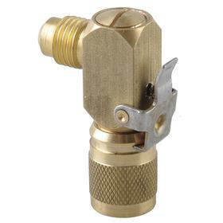
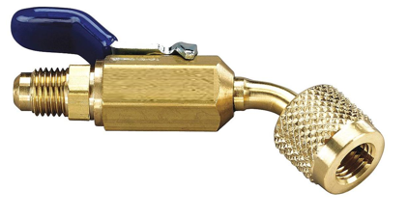
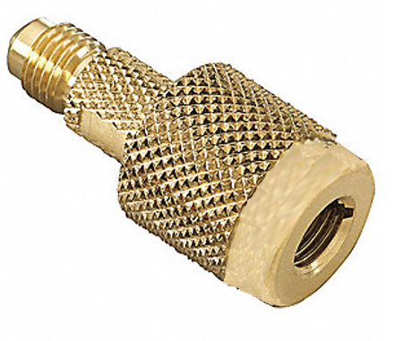
Methods To Recover Refrigerant (2) (From Small Appliances)
Connections between the refrigeration system and the reclaiming equipment will generally be made through gauge set hoses for small appliances. Refrigerant hoses must have a shutoff within 12 inches of the service end. It is preferable that the refrigerant hoses have low-loss fittings and/or quick-couplers to minimize refrigerant loss due to the connecting and disconnecting of the hoses.

Slide 15
Methods To Recover Refrigerant (3) (From Small Appliances)
For active refrigerant removal systems, after verifying that the system has a refrigerant charge, connect the recovery equipment and proceed to operate the equipment until a vacuum of 4” (102mm) of mercury is pulled. If icing occurs, mild heat can be applied to speed up the process. For example, if a defrost heater is present under the compressor, it could be activated.

Slide 16
Methods To Recover Refrigerant (4) (From Small Appliances)
For system-dependent passive recovery refrigerant removal, the maximum amount of refrigerant that a system can contain to be eligible for this removal option is listed at 15 lbs. If the compressor works, connect the recovery equipment via the gauge set hoses to an EPA-approved reclaiming cylinder that has no pressure or is in a vacuum. For many small appliances, the gauge hoses are attached to a service valve. When no valve is present, a self-tapping service valve may be used. The EPA directs equipment manufacturers to provide line stubs for attaching said self-tapping service valves. The refrigerant is removed from the high-side with the compressor running. The refrigerant is considered fully removed when the system vacuum is at 4” of mercury vacuum, or when 90% of the refrigerant is removed.

Slide 17
Methods To Recover Refrigerant (5) (From Small Appliances)
When using a passive system where the compressor is inoperable, refrigerant must be removed from both the high and low sides. The system sizing limit of 15 pounds of refrigerant still applies. Adding heat to the refrigeration system components and softly tapping on them with a rubber hammer may decrease the time it takes to remove the refrigerant. At least 80% of the refrigerant must be removed using this method.

Slide 18
Final Steps In Recovery
All solderless (self-tapping) fittings should be removed from the system after repairs and before recharging occurs.
Reclaimed refrigerant cylinders must be labeled for refrigerant type (do not fill over 80%).
If a cylinder contains an unknown mixture, the cylinder needs to be labeled as an unknown mixture of refrigerants.
Purge refrigerant line sets and removal equipment.

Slide 19
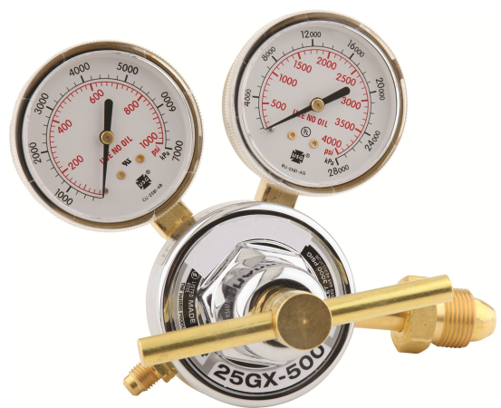
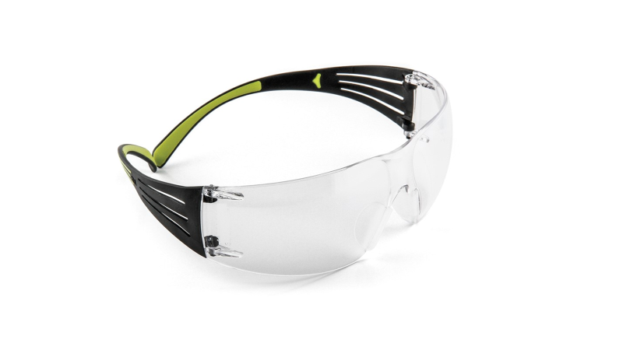
Safety
Small appliance safety tips in brief:
Phosgene gas (COCl₂) can be a byproduct of brazing when a refrigerant containing chlorine (Cl) is or has been in a refrigeration system. Brazing on any system that contained a refrigerant with chlorine in it should be done in a well-ventilated location.
Check for proper grounding of an EPA approved recovery device before removing flammable refrigerant (make sure the recovery equipment is grounded).
Nitrogen tank regulators should be rated for use in refrigeration applications.
To avoid skin contact, chemical-resistant, butyl-coated safety gloves are recommended for handling refrigerant.
Safety glasses should meet OSHA requirements

Slide 20
Safety
Never use a vacuum pump as a refrigerant recovery device—its inlet is only designed to operate at 0 psi or in a vacuum.
Do not overfill recovery cylinders. Use a scale or cylinders equipped with internal tank safety floats that cut off the refrigerant flow at 80% full.
Refrigeration equipment containing flammable refrigerants must display safety markings meeting relevant requirements (see Figure 25). Only use recovery equipment that is rated for the flammable refrigerant in the system.

