Slide 1
Duct Design Basics Lesson 3 Calculations

Slide 2
Residential Example 3.3

Slide 3
Example – Residential System
Given:
Blower 1050 CFM @ 0.55 IWC
Component Pressure Loss Total = 0.29
TEL = 168 + 169 = 337 ft.
100 CFM
130 CFM
100 CFM
140 CFM
110 CFM
90 CFM
80 CFM
80 CFM
400 CFM
100 CFM
120 CFM
650 CFM
Galvanized Duct

Slide 4
Example – Residential System
Given:
Blower 1050 CFM @ 0.55 IWC
Component Pressure Loss Total = 0.29
TEL = 168 + 169 = 337 ft.
100 CFM
130 CFM
100 CFM
140 CFM
Available Static Pressure = 0.55 – 0.29 = 0.26
110 CFM
90 CFM
80 CFM
80 CFM
400 CFM
100 CFM
120 CFM
650 CFM
Galvanized Duct

Slide 5
Example – Residential System
Given:
Blower 1050 CFM @ 0.55 IWC
Component Pressure Loss Total = 0.29
TEL = 168 + 169 = 337 ft.
169 ft
100 CFM
130 CFM
100 CFM
140 CFM
110 CFM
168 ft
90 CFM
80 CFM
80 CFM
400 CFM
100 CFM
120 CFM
650 CFM
Galvanized Duct

Slide 6
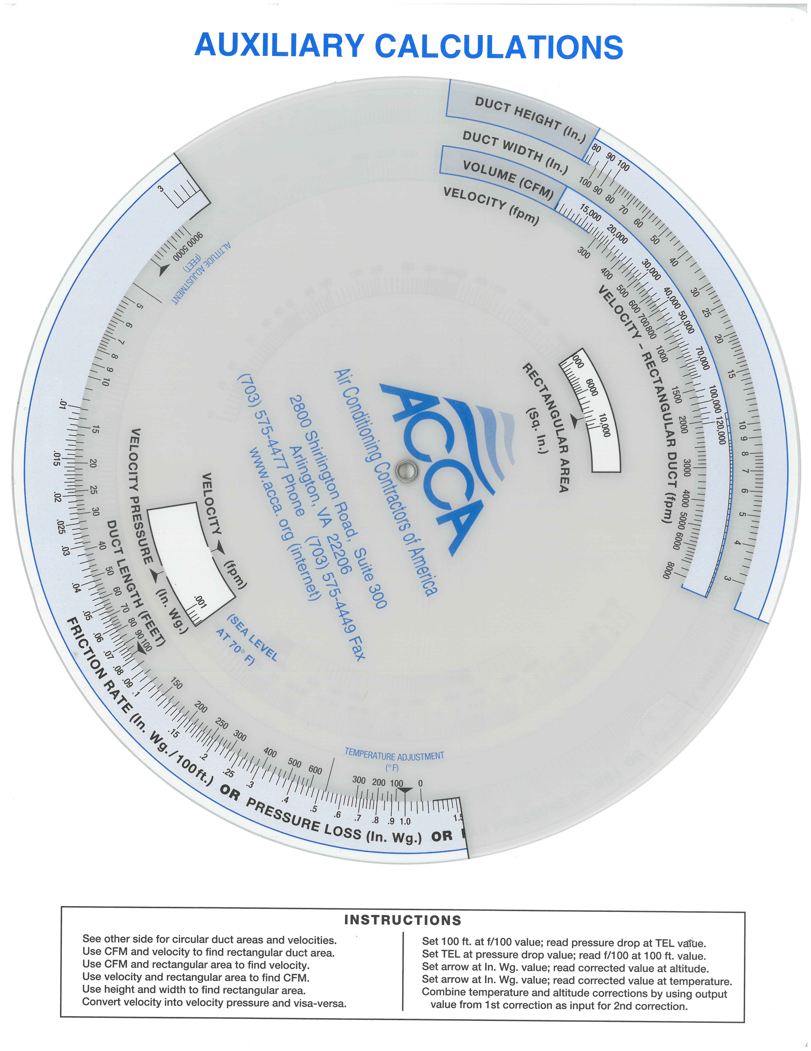
Example – Residential System
337 ft. aligned with 0.26 pressure loss

Slide 7
Example – Residential System
337 ft. aligned with 0.26 pressure loss
Friction Rate = 0.0766

Slide 8
Example – Residential System
Friction Rate 0.0766 and:
290 CFM
370 CFM
1050 CFM
100 CFM
130 CFM
100 CFM
140 CFM
1050 CFM
110 CFM
370 CFM
90 CFM
290 CFM
80 CFM
80 CFM
400 CFM
100 CFM
120 CFM
650 CFM
Galvanized Duct

Slide 9
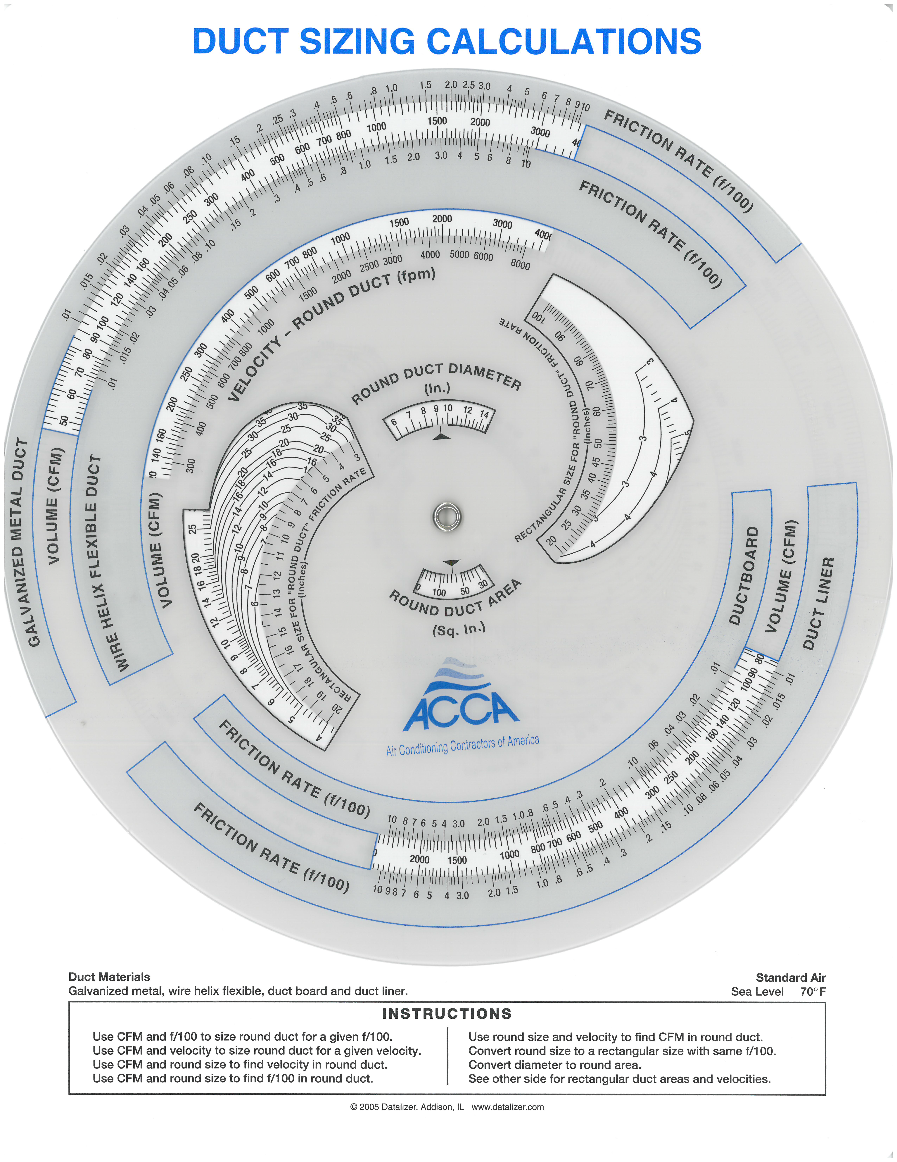
Example – Residential System
Friction Rate 0.0766 and 290 CFM

Slide 10
Example – Residential System
Friction Rate 0.0766 and 290 CFM
7 x 10 will work

Slide 11
Example – Residential System
Friction Rate 0.0766 and:
290 CFM
370 CFM
1050 CFM
100 CFM
130 CFM
100 CFM
140 CFM
1050 CFM
110 CFM
370 CFM
90 CFM
290 CFM
80 CFM
80 CFM
400 CFM
100 CFM
120 CFM
650 CFM
Galvanized Duct

Slide 12
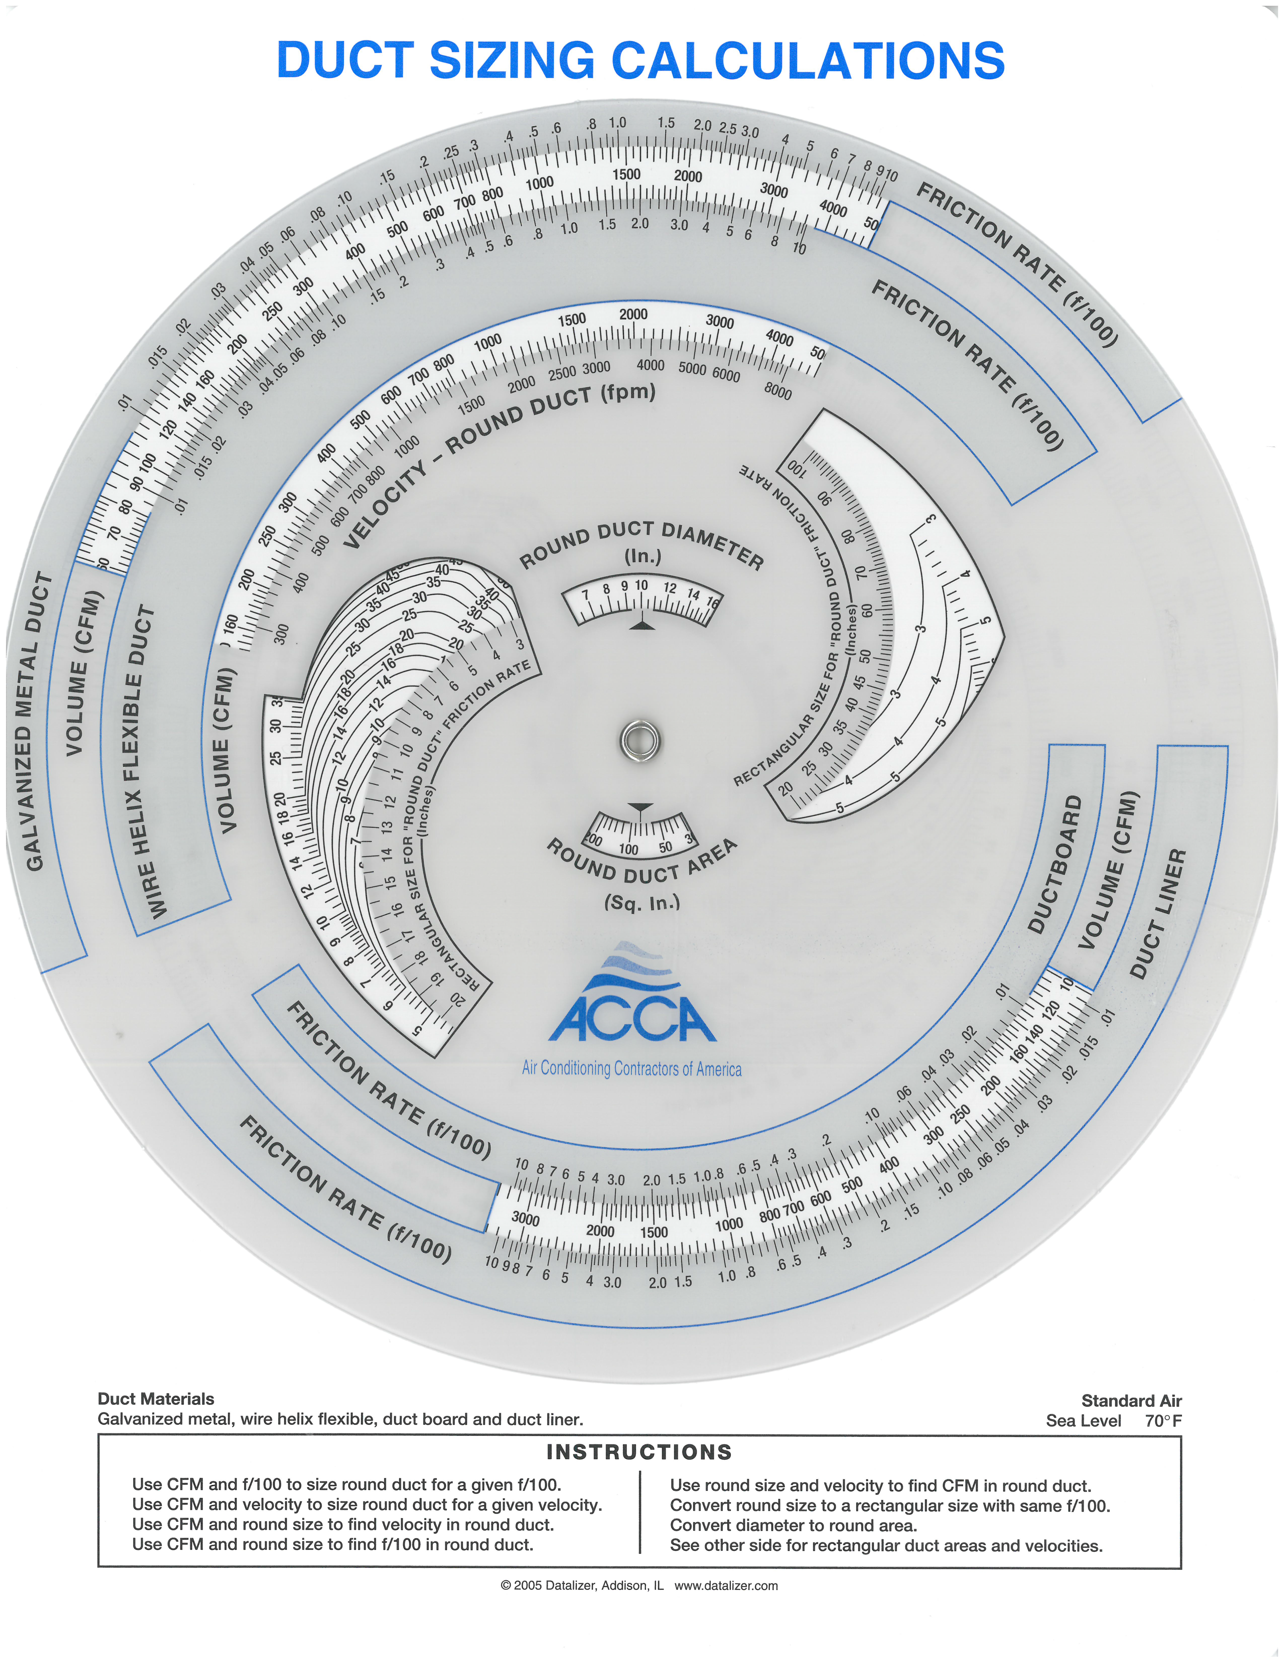
Example – Residential System
Friction Rate 0.0766 and 370 CFM
7 x 12 will work

Slide 13
Example – Residential System
Friction Rate 0.0766 and:
290 CFM
370 CFM
1050 CFM
100 CFM
130 CFM
100 CFM
140 CFM
1050 CFM
110 CFM
370 CFM
90 CFM
290 CFM
80 CFM
80 CFM
400 CFM
100 CFM
120 CFM
650 CFM
Galvanized Duct

Slide 14
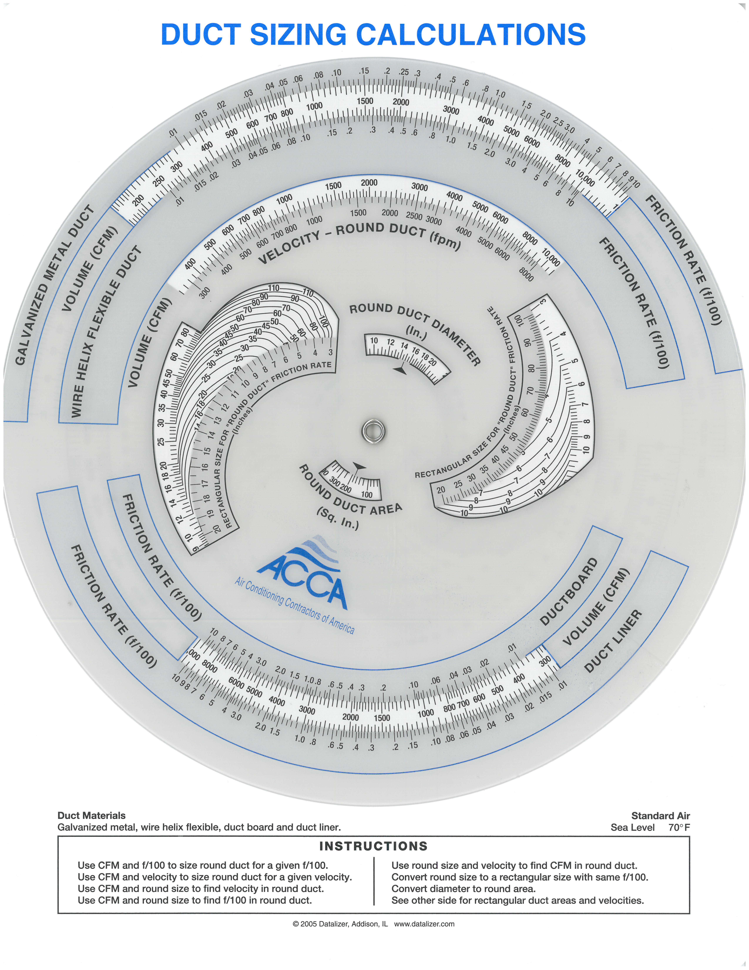
Example – Residential System
Friction Rate 0.0766 and 1,050 CFM
7 x 30 or 14 x 14 will work

Slide 15
Example – Residential System
Friction Rate 0.0766 and 1,050 CFM
7 x 30 or 14 x 14 will work
So will a 15” Round Duct

Slide 16
Example – Residential System
Friction Rate 0.0766 and:
290 CFM
370 CFM
1050 CFM
100 CFM
130 CFM
100 CFM
140 CFM
1050 CFM
110 CFM
15” Round
370 CFM
90 CFM
290 CFM
80 CFM
80 CFM
400 CFM
100 CFM
120 CFM
650 CFM
Galvanized Duct

Slide 17
Example – Residential System
10” Round
Friction Rate 0.0766 and:
290 CFM
370 CFM
1050 CFM
100 CFM
130 CFM
100 CFM
140 CFM
1050 CFM
110 CFM
15” Round
370 CFM
90 CFM
290 CFM
80 CFM
80 CFM
400 CFM
100 CFM
120 CFM
650 CFM
Galvanized Duct

Slide 18
Example – Residential System
10” Round
Friction Rate 0.0766 and:
290 CFM
370 CFM
1050 CFM
100 CFM
130 CFM
100 CFM
140 CFM
1050 CFM
110 CFM
15” Round
370 CFM
90 CFM
290 CFM
80 CFM
80 CFM
400 CFM
100 CFM
120 CFM
10” Round
650 CFM
Galvanized Duct

