Slide 1
Day 2 Part 4 Technician’s Guide & Workbook for Home Evaluation and Performance Improvement

Slide 2
3.0 Comprehensive Performance Audit Heating and Cooling Systems 3.6

Slide 3
HVAC Duct System Inspection

Slide 4
Evaluating Duct Distribution Systems
Duct distribution systems must be evaluated to include the following items:
Record the type of ductwork.
Sheet metal, externally insulated
Sheet metal, internally insulated
Fibrous glass duct board
Flexible duct

Slide 5
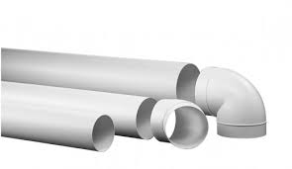
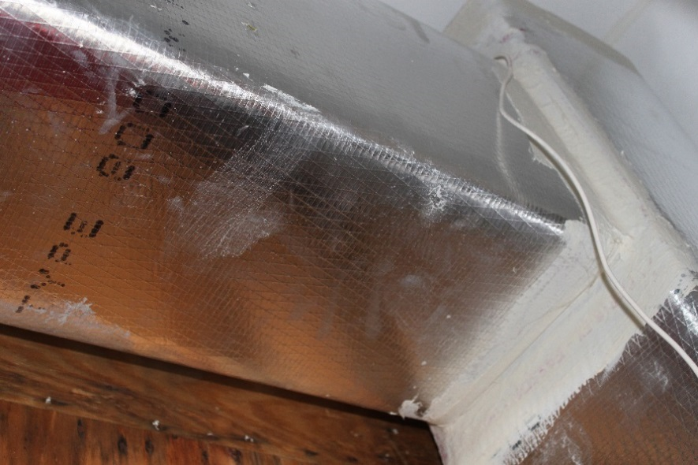
Duct Materials

Slide 6
Evaluating Duct Distribution Systems
Record the R-value of duct insulation.
Visually inspect and record obvious duct leakage, and any indications of previous duct sealing problems. Duct leakage testing may be part of the inspection process, and may become part of all HVAC upgrades.

Slide 7
Duct Insulation R-Value

Slide 8
Duct Insulation R-Value

Slide 9
Duct Insulation R-Value

Slide 10
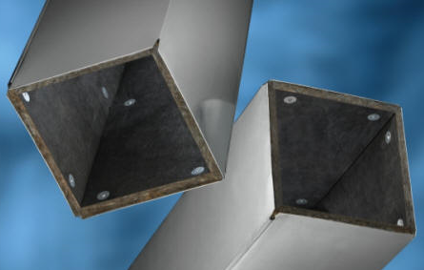
Duct Insulation R-Value

Slide 11
Duct Insulation R-Value

Slide 12
DUCT SEAL VISUAL

Slide 13
DUCT SEAL VISUAL

Slide 14
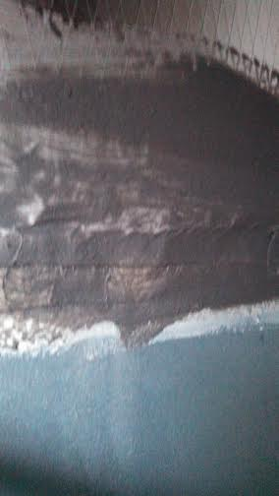
DUCT SEAL VISUAL

Slide 15
Acceptable Documentation
Written or recorded records (e.g., photo) of Duct insulation values and of any openings, cracks, or leaks in the insulation.
Written or recorded records (e.g., photo) of damage to duct (squashed, disconnected, etc.).

Slide 16
Exhaust System Inspection

Slide 17
Exhaust Fans
The following items must be recorded for all exhaust fans:
Location.
Measured flow rate.
Quantity.

Slide 18
Exhaust Fans
Determination of whether they are vented to the outdoors.
Determine and record the type of foundation: crawl space, basement, or slab, along with venting and insulation locations.

Slide 19
ERV & HRV

Slide 20
ERV & HRV
Filters

Slide 21
ERV & HRV
Filters

Slide 22
ERV & HRV
Filters

Slide 23
Kitchen Exhaust Fans

Slide 24
Kitchen Exhaust Fans

Slide 25
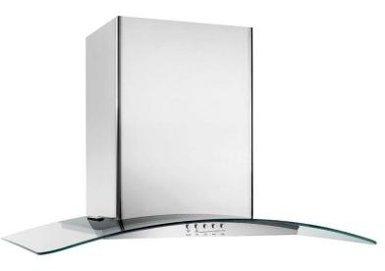
Kitchen Exhaust Fans

Slide 26
Acceptable Documentation
Written or recorded records (e.g., photo) of Exhaust Fans and airflow measurements.
Technician’s Name
Date of measurements
Tools used and calibration data
Measured airflow

Slide 27
Distribution Temperature Differences
Standard 12 requires the measurement of the distribution systems temperature difference (TD) to evaluate duct insulation related heat losses. TD is a snapshot test that can be used for getting a general sense on whether an HVAC system is cooling, or heating air. If the test is done on a mild day, it may not show the same results it would on a design day where the outside temperature was extreme. Warning: for temperature drops between the supply and return when the system is cooling the air: if there is high humidity, the removal of the moisture will lower the temperature difference.

Slide 28
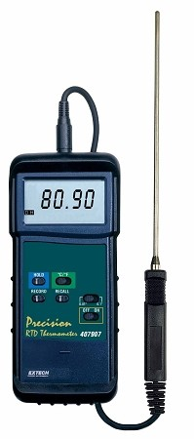
Acceptable Procedures
The air within the duct distribution system shall not lose or gain excessive amounts of heat as the air travels through the distribution system and into the conditioned space. This procedure is not aimed at determining the duct distribution effectiveness. Rather, it is to help identify duct problems associated with poor, or no insulation, duct leakage, discontinued runs, or long runs, low airflow, etc. Thermometers used shall:
Have a temperature sensing probe at least 15” long (to better get an average temperature),

Slide 29
Acceptable Procedures
Be capable of measuring sensible heat levels from 0 to 200°F (degrees Fahrenheit),
Have a resolution of 0.1°F,
Have an accuracy rate of + 2.5%,
Be calibrated as required by the manufacturer and have evidence of the calibration.

Slide 30
Step 1 Acceptable Procedures
Energize the HVAC system in heating or cooling mode as appropriate for the season and allow the system to reach steady state. All measurements shall be taken in less than 5 minutes (so the outcome is based on the same period of time and hopefully, the same air entering and discharge temperatures).

Slide 31
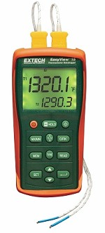
Step 1 Acceptable Procedures
For best results, the technician may use multiple thermometers or a digital meter that can read temperature from numerous locations at the same time. If more than one thermometer is used, the adjusted tolerances for each must be known and they must be calibrated so they read the same temperature at one location.

Slide 32
Step 1 Acceptable Procedures
NOTE: Infrared thermometers only take the reflected surface temperatures, not actual air temperatures, and the area measured becomes larger the further away the object being measured is from the tool.

Slide 33
Step 2 Acceptable Procedures
Measure the temperature at the return inlet (within 1” of the grille face), the return plenum (within 12” of the equipment), the supply plenum (within 42” of the heat exchanger), and at the supply outlet (within 1” of the register/diffuser face). The temperature measurements must be representative of average temperature over the area for the grille, plenum, or diffuser/register.

Slide 34
Step 2 Acceptable Procedures
NOTE: Temperature measurements taken in the heating mode at the supply plenum must be taken out of the line-of-sight from any fossil fuel combustion or electric resistance heat exchangers.

Slide 35
Step 3 Acceptable Procedures
Subtract the measurements from each end of the duct, and that is your temperature difference.
Example: Supply at outlet 120F supply out of site from the heat exchanger 125F.
125F – 120F = 5F heat loss

Slide 36
Acceptable Documentation
Written documentation for room air temperature at the diffuser and the discharge temperature at the main trunk before the first takeoff.
Test date.
Location.
Name of Technician.
Pictures and notes on items identified.

Slide 37
Duct Leakage Testing 4.3

Slide 38
Duct Leakage Testing
The Technician needs to perform a qualitative test of all accessible ducting to determine opportunities for sealing. Qualitative duct testing is covered in this guide. However, if an initial visual inspection finds faults/defects in the duct system indicating substantial duct leakage, a qualitative test shall not be required, but these faults/defects shall be recorded.

Slide 39
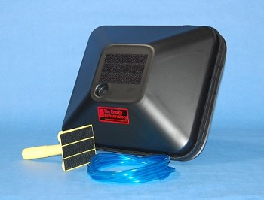
Step 1 PRESSURE PAN TEST
Prepare the house for an envelope leakage test and depressurize the house by 50 Pa (This test is often done in conjunction with the envelope leakage test because it will indicate when that leakage to the outside is through the ducting system).

Slide 40
Step 2 PRESSURE PAN TEST
Combination of gasketed pan and tape, this is typically done on registers or grilles that are larger than the gasketed pan. Tape is applied to the perimeter of the duct covering, leaving an uncovered area in the middle that is just smaller than the gasketed pan. The pressure difference is then read by covering that opening with the gasketed pan.

Slide 41
Step 3 PRESSURE PAN TEST
Record the pressure in the duct with reference to the house:
At the pressure tap on the gasketed pan,
Or
A static pressure probe inserted through the tape.
Remove the cover at the conclusion of each register or grille test.

Slide 42
Step 4 PRESSURE PAN TEST
Determine the median and the highest measured pan difference for all duct coverings. Compare the values to the comparative benchmark values: the median value should not be higher than 3 Pa, and no register or grille should be greater than 8Pa.

Slide 43
Step 4 PRESSURE PAN TEST
Form simply gets filled in

Slide 44
Step 1 Blower Door Assisted Smoke Test
This test is also generally done in conjunction with the blower door test also called the pressurization or depressurization test. When the leakage is established using the blower door. A fan powered unit is attached to the duct and the HVAC grilles and registers are all sealed up.

Slide 45
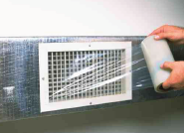
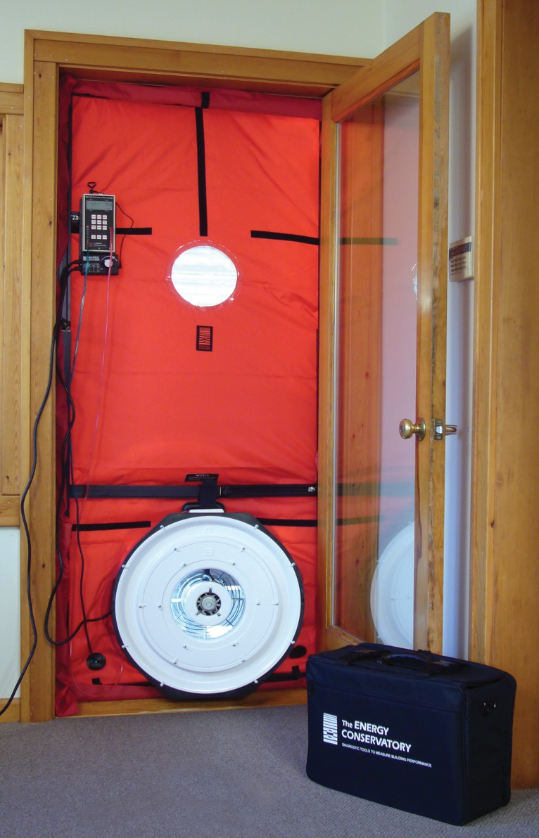
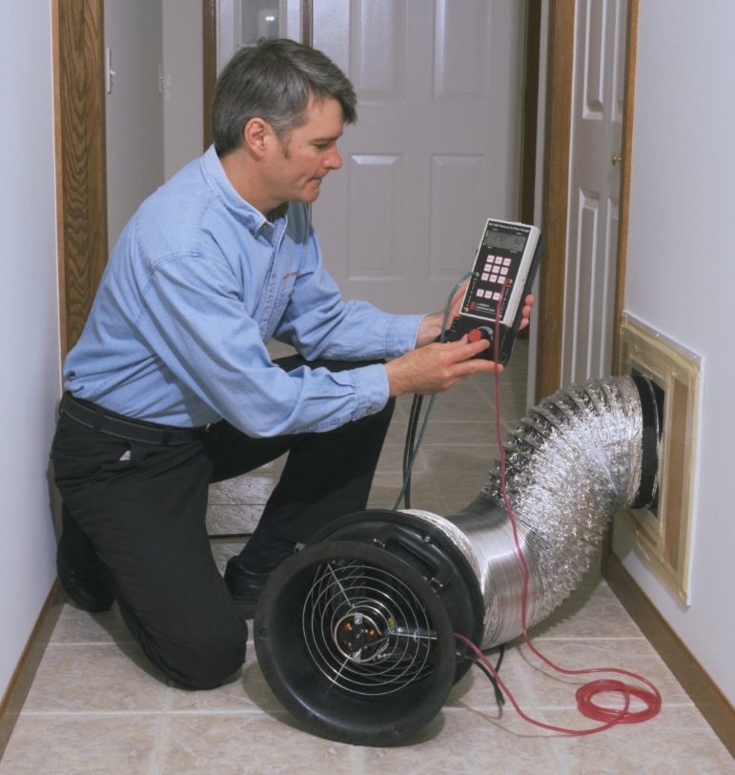
Step 1 Blower Door Assisted Smoke Test
This test is also generally done in conjunction with the blower door test also called the pressurization or depressurization test. When the leakage is established using the blower door. A fan powered unit is attached to the duct and the HVAC grilles and registers are all sealed up.

Slide 46
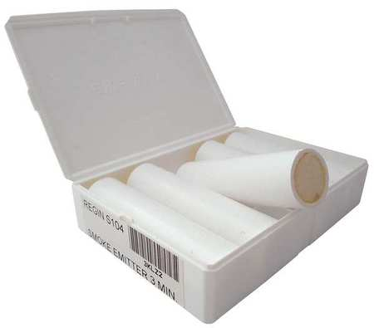
Step 2 Blower Door Assisted Smoke Test
The Technician injects a non-toxic smoke into the fan pressurization device that is maintaining a duct pressure difference of 25 Pa relative to the duct surroundings.

Slide 47
Step 3 Blower Door Assisted Smoke Test
The Technician visually inspects all accessible portions of the duct systems for escaping smoke; escaping smoke indicates a leak in the duct and the Technician then marks the locations of leaks.

Slide 48
Step 1 Airflow Comparison Method
For this method the air handler or furnaces is turned on and set to run at the maximum speed for the duration of the testing.

Slide 49
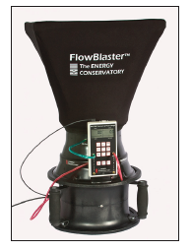
Step 2 Airflow Comparison Method
Each supply and return grille, diffuser, and register (duct cover) in the distribution system will have their airflows measured and recorded individually. The Technician should list the supply and return registers on separate lists. It is recommended for residential airflow on supply registers that a fan powered flow measuring capture device be used .

Slide 50
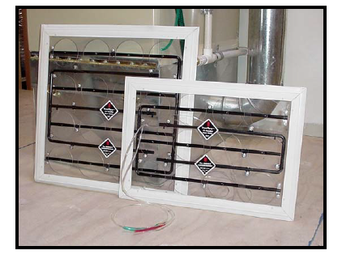
Step 2 Airflow Comparison Method
Note: When there is no return ducting, a pressure differential measuring type of tool may be used for measuring the return airflow at the unit.

Slide 51
Step 3 Airflow Comparison Method
The supply CFM is the subtracted from the return CFM (ignore any negative values). That number is divided by the Lower of the two values and multiplied by 100 to get the percent of leakage.
_
[
[
÷ Lower X 100 = ?

Slide 52
Step 3 Airflow Comparison Method
Sample Calculation: Supply airflow total equals 1226 CFM and return total equals 1132 CFM thus,
1226 – 1132 = 94. Since the return is the lower number: 94 ÷ 1132 X 100 = 8.3% duct leakage.
_
[
[
÷ Lower X 100 = ?

Slide 53
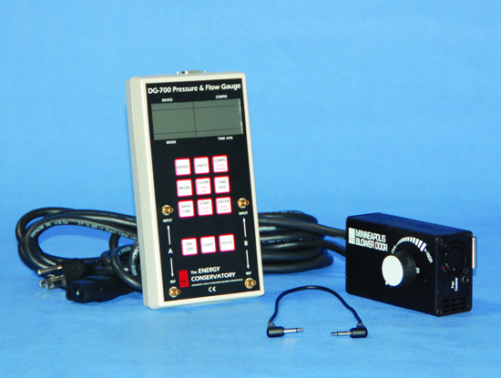
Quantitative Duct Leakage Test @ 25 Pa

Slide 54
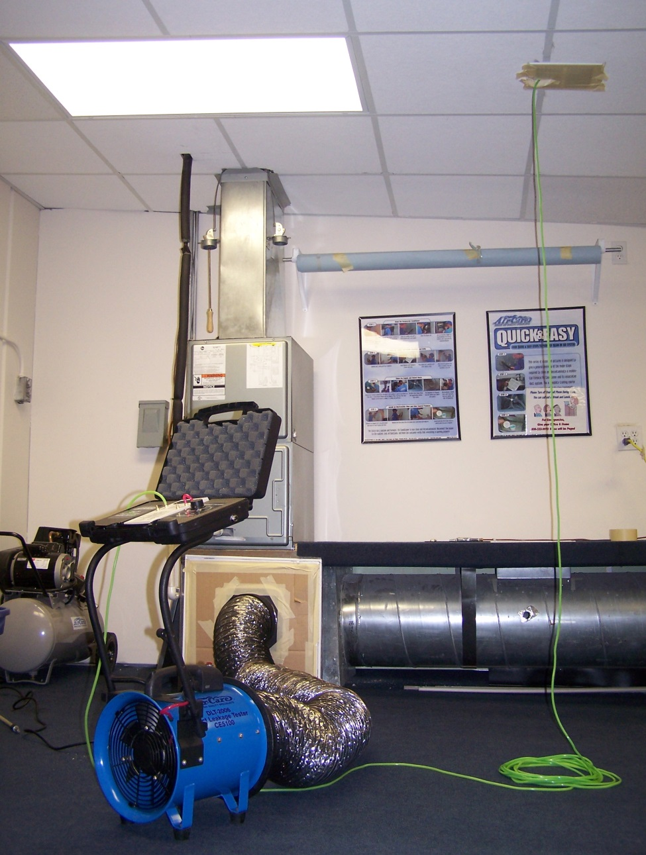
Quantitative Duct Leakage Test @ 25 Pa

Slide 55
SMACNA Method Or AHJ
May require higher pressure in Pa.
May have additional specified procedures.

Slide 56
Acceptable Documentation
Written documentation for HVAC equipment to include Model and serial numbers.
Test date.
Location.
Name of Technician.
Pictures and notes on items identified.

