Slide 1
Duct Design Basics Lesson 4 Manual D Primer

Slide 2
Manual D Basics TEL 4.2

Slide 3
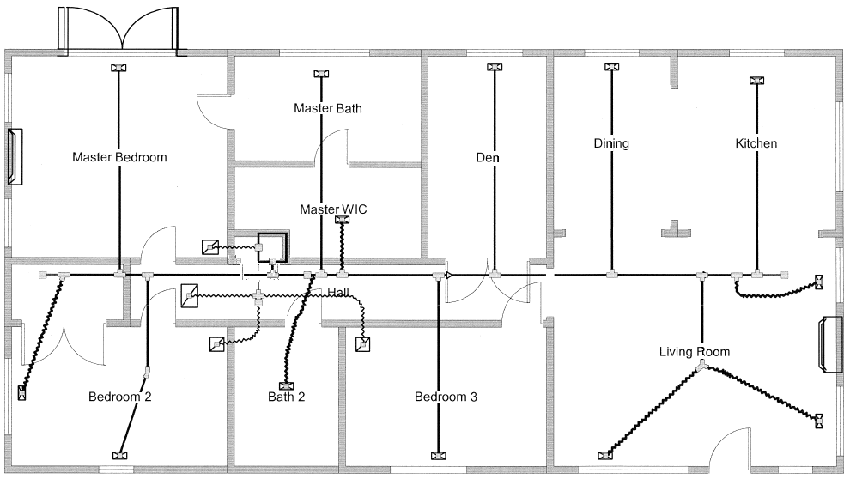
Duct Sketch/Drawing

Slide 4
Duct Sketch/Drawing
1
2
13
12
11
3
1
2
10
3
4
6
4
9
5
7
8

Slide 5
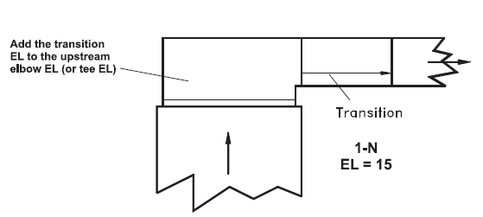
Duct Sketch/Drawing
1
2
13
12
11
1N EL 15
9P EL 70
2P EL 35
Galvanized Round Duct
1
3
1
2
2
10
9O EL 15
3
3
4
6
Flex Round Duct
4
2P 5 or more EL 75
9
5
7
8
4K EL 30

Slide 6
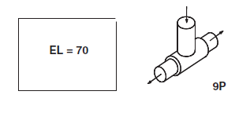
Duct Sketch/Drawing
1
2
13
12
11
1N EL 15
9P EL 70
2P EL 35
Galvanized Round Duct
1
3
1
2
2
10
9O EL 15
3
3
4
6
Flex Round Duct
4
2P 5 or more EL 75
9
5
7
8
4K EL 30

Slide 7
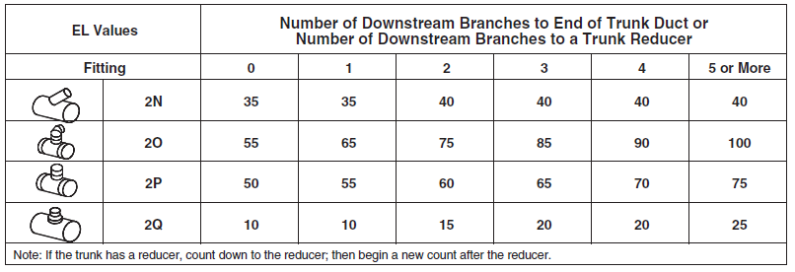
Duct Sketch/Drawing
1
2
13
12
11
1N EL 15
9P EL 70
2P EL 35
Galvanized Round Duct
1
3
1
2
2
10
9O EL 15
3
3
4
6
Flex Round Duct
4
2P 5 or more EL 75
9
5
7
8
4K EL 30

Slide 8
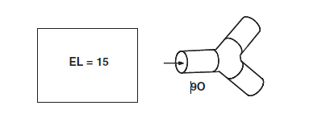
Duct Sketch/Drawing
1
2
13
12
11
1N EL 15
9P EL 70
2P EL 35
Galvanized Round Duct
1
3
1
2
2
10
9O EL 15
3
3
4
6
Flex Round Duct
4
2P 5 or more EL 75
9
5
7
8
4K EL 30

Slide 9
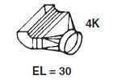
Duct Sketch/Drawing
1
2
13
12
11
1N EL 15
9P EL 70
2P EL 35
Galvanized Round Duct
1
3
1
2
2
10
9O EL 15
3
3
4
6
Flex Round Duct
4
2P 5 or more EL 75
9
5
7
8
4K EL 30

Slide 10
Duct Sketch/Drawing
1
2
13
12
11
1
3
1
2
2
10
3
3
4
6
4
9
5
7
8

Slide 11
TEL
Branch ducts have individual lengths. Thus, they
have individual TELs.
It would follow that the FR for each individual
branch can be adjusted using the actual TEL.

Slide 12
TEL
Branch ducts have individual lengths. Thus, they
have individual TELs.
It would follow that the FR for each individual
branch can be adjusted using the actual TEL.
System (maximum) TEL = 100 + 380 = 480

Slide 13
SUPPLY TEL
The ducted return’s equivalent length is calculated
And it gets added into the TEL. Thus, the TEL
Becomes the entire duct system’s length.
For our example in this section the supply duct’s TEL
for diffuser S1 is the longest at 380 ft:
FR = PD x 100 ÷ TEL
FR = 0.2 x 100 ÷ 380 = 0.052

Slide 14
SUPPLY TEL
The ducted return’s equivalent length is calculated
And it gets added into the TEL. Thus, the TEL
Becomes the entire duct system’s length.
For our example in this section the supply duct’s TEL
for diffuser S1 is the longest at 380 ft:
FR = PD x 100 ÷ TEL
FR = 0.2 x 100 ÷ 380 = 0.052
What happens when the return duct’s R2 of 100 ft
is added in?

Slide 15
SUPPLY + RETURN TEL
The ducted return’s equivalent length is calculated
And it gets added into the TEL. Thus, the TEL
Becomes the entire duct system’s length.
For our example in this section the supply duct’s TEL
for diffuser S1 is the longest at 380 ft
Included the 200 ft. Supply duct: FR = PD x 100 ÷ TEL
FR = 0.2 x 100 ÷ 380 = 0.052
What happens when the return duct’s R2 of 100 ft
is added in?
FR = 0.2 X 100 ÷ 480 = 0.042

Slide 16
System FR = 0.042 and TEL = 480; Use the system
FR to calculate the S1 duct size on a duct slide rule:
S1 CFM = 500 cfm @ 0.042 IWC

Slide 17
System FR = 0.042 and TEL = 480; Use the system
FR to calculate the S1 duct size on a duct slide rule:
S1 CFM = 500
Supply Trunk Considerations for Noise
Conservative = 700 FPM
Maximum = 900 FPM

Slide 18
Set the velocity to 700 FPM at 500 CFM and find the related FR.

Slide 19
Set the velocity to 700 FPM at 500 CFM and find the related FR.
Looks Like 0.069 and 12” duct

Slide 20
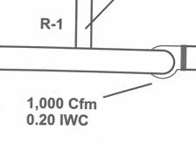
Set the velocity to 700 FPM at 500 CFM and find the related FR.
Looks Like 0.069 and 12” duct
FR = 0.2 X 100 ÷ 480 = 0.042

