Slide 1
Technician’s First Guide and Workbook Section 22: Appendices (1)

Slide 2
Appendix A: Temperature Differentials In Residential Applications
ACCA Manuals provide contractors with clear design guidance and help ensure that HVAC systems provide customers with desired comfort levels in a safe, reliable, and affordable way. Table 1 (next page) has recommended values for the temperature differences between spaces in single zone and multi zone systems. Recommended values are not mandated. Recommended values may not even be possible to maintain during extreme weather conditions. Further, it should be noted that temperature differential measurements, should be measured in the center of the room, and at a height equal to the height of the thermostat (approximately 5 ft from the floor). Additionally, exterior wall surface temperatures, depending on insulation values, ratings of windows and doors, and solar loads will normally vary by more than 2ºF from the central area of the room’s temperature.

Slide 3
Table 1
Residential Single-Zone and Multi-Zone Systems Minimum / Maximum Recommended Values for Comfort and Safety
Comfort Item | Heating | Cooling
Thermostat set-point (design) | 70ºF | 75ºF
Relative humidity (RH)¹ | 30% RH maximum (20-30% RH is desirable) | 55% RH maximum (25-50% RH is desirable)
Dry-Bulb temperature at the thermostat | ± 2ºF | Set point temperature ± 3ºF (single-zone) Set-point temperature ± 2ºF (multi-zone)
Dry-Bulb temperature difference in any conditioned room (related to room with thermostat) | ± 2ºF | single-zone ± 3ºF multi-zone ± 2ºF
Recommended Maximum Room-to-room temperature differences (i.e., same level) | 4ºF | single-zone 6ºF multi-zone 4ºF
Recommended Maximum Floor-to-floor temperature differences | 4ºF | single-zone 6ºF multi-zone 4ºF
Ideal Floor temperature (slab floors or floors over unconditioned space) | 65ºF minimum at 4 in. above the floor for 70ºF thermostat setting [not applicable near outside walls] | N/A
Humidification / Dehumidification optional, but desirable in many situations. The potential for visible or concealed condensation determines maximum RH for a specific dwelling in a specific location.

Slide 4
Room Temperature Differentials
Temperature differentials between floor levels, or rooms that have different heating/cooling requirements, can be improved by setting the blower for continuous operation. However, to be effective, the air distribution system outlets must be properly sized and located. Additionally, a sealed, low-resistance return path is required for each space.

Slide 5
Controlling Room Temp. Differentials
An energy efficient approach to controlling temperature differentials would be to utilize high-efficiency HVAC systems with variable-speed fan motors and zonal capabilities. Then, areas within the home that have unique or different heating/cooling loads can be controlled individually without affecting the temperatures in the other zones. For example, a bedroom over a garage may need to be a separate zone to remain comfortable because heating and cooling loads are markedly different from other upstairs rooms that are over conditioned space.

Slide 6
Drafts
Another common temperature problem arises when the diffuser throw is aimed at a seating area or onto a bed. Research has determined that when air velocity exceeds 50 feet per minute the area in the path of the airflow will feel cold and drafty (ASHRAE 2009 Fundamentals Handbook, Draft section 9.14.). This is especially true when the unit is in the heating mode. Adjusting the direction of the airflow or changing diffuser location, size, or design may be necessary to allow the proper amount of airflow into the area without creating uncomfortable drafts that are perceived by occupants as uncomfortable. For example, duct design may need to be changed or adjustment dampers may need to be installed.

Slide 7
Single Zone System
Single zone systems are the most common type of HVAC system found in residential construction. The entire home is heated and cooled by one HVAC unit with one thermostat controlling the temperature. That thermostat is generally located in a central place; possibly, near the return grill. When an HVAC system has been properly designed and installed, the temperature at the thermostat’s location will remain fairly constant. Note: Thermostat control ranges can vary depending on the thermostat selected and whether it is in the heating or cooling mode. For homes with two or more levels, a single zone system will likely result in the temperature difference between floor levels being greater than the temperature difference between rooms on the same floor.

Slide 8
Multi-Zone System
Multi zone systems have, as their name implies, more than one zone. When there are areas within the home that have different heating / cooling requirements, the only way to ensure that they will be comfortable is by turning them into separate zones. Each individual zone is controlled independently by its own thermostat. Some zones could have additional types of HVAC equipment installed for specific applications. For example, radiant heat is often used in bathroom floors, or a separate heat pump is common for an area that has a unique heating / cooling requirement like a sunroom.

Slide 9
Airflow Control Problems
Further complicating temperature control in a residence is the unpredictability of airflow. Due to an abundance of complicated interrelated factors, air balancing is not a science; it is an art based on scientific principles. HVAC equipment is designed to deliver heating and cooling through the metered distribution of air in cubic feet per minute (CFM), at designated temperatures (Hydronic systems, without fan power, use convection to heat the surrounding air.). Care is taken to size the duct to deliver air at static pressures equivalent to the air volume required for each room. Balancing is done with doors closed to simulate worst-case scenarios but, in the average home, variables can change airflow volumes to individual locations after the system is balanced. For example, an oven exhaust hood could be left on and since airflow follows the path of least resistance, the rooms where the supply is changed could be on the opposite side of the house and vary depending on which doors are opened or closed in other rooms.

Slide 10
Humidity (1)
Willis Carrier was the first to chart humidity as it related to comfort. From his original research, all modern psychrometric comfort charts have evolved. Two typical psychrometric comfort charts are on the next page. They have shaded areas that represent the portion of the chart where temperature and humidity will remain comfortable for most people. Notice on the chart, for summer conditions, as humidity increases the temperature needs to drop for the average person to remain comfortable. As can be seen on the chart, for winter the opposite happens; as the humidity decreases the temperature needs to increase for the average person to be comfortable.

Slide 11
Humidity (2)
For most people to remain comfortable, the ideal relative humidity level is approximately 50%. Manual J supports this number by using humidity design values of 45%, 50%, and 55%. To realize the promised energy savings of high SEER HVAC systems, designs need to include humidity control. If humidity control is left out, the homeowner will defeat the operational energy savings by lowering the thermostat in the summer and raising it in the winter (just trying to stay comfortable.

Slide 12
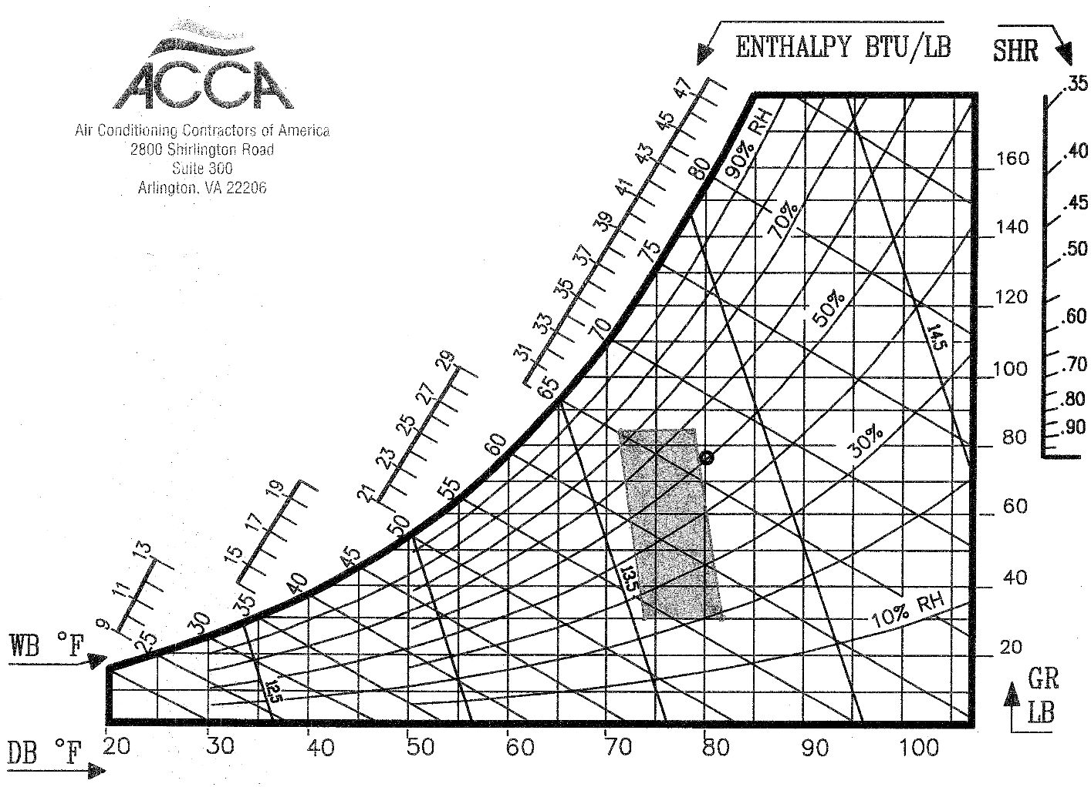
Summer Comfort Zone

Slide 13
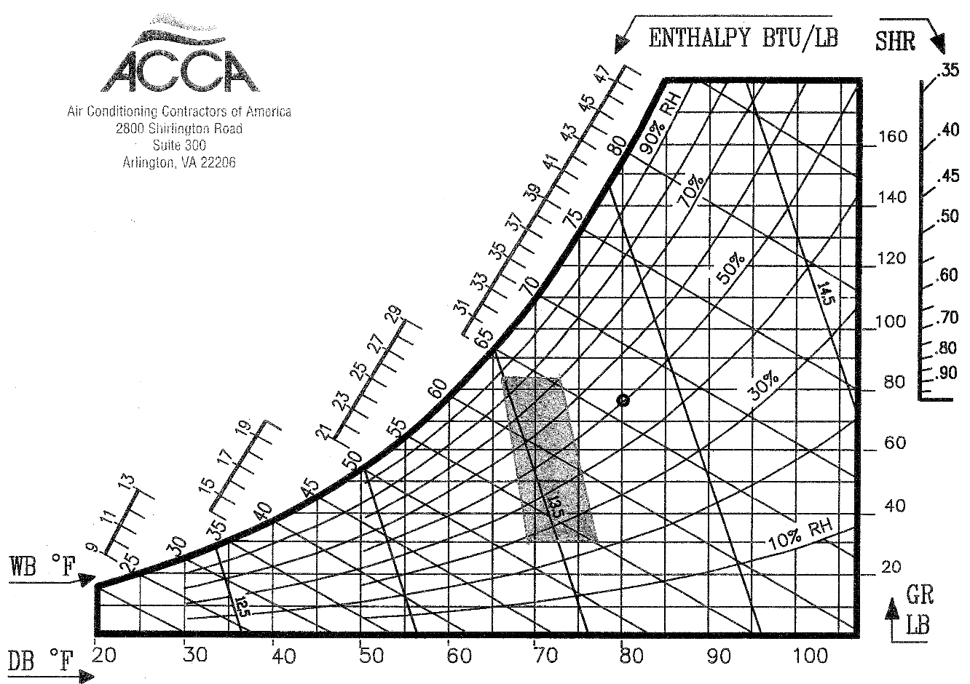
Winter Comfort Zone

Slide 14
Conclusion
Properly designing and installing an HVAC system goes a long way towards temperature problems. The good news is HVAC systems designed and installed utilizing the QI Standard are more likely to operate comfortably, efficiently, and within the desired temperature ranges most of the time.
The average customer may never fully appreciate the complexity or amount of work that goes into the design/installation process. However, that customer will appreciate the comfortable environment provided by a properly designed and installed HVAC system.

Slide 15
Lessons Learned
You should now know what temperatures are expected to be normal within a homes different rooms.
You should now be able to explain why a draft will feel uncomfortable.
You should now be able to look up the comfort zone and see if the operating conditions are within it.
You should now be able to explain how humidity can cause people to react to temperature.

