Slide 1
Technician’s First Guide and Workbook Section 16: System Installation Basics (4)

Slide 2
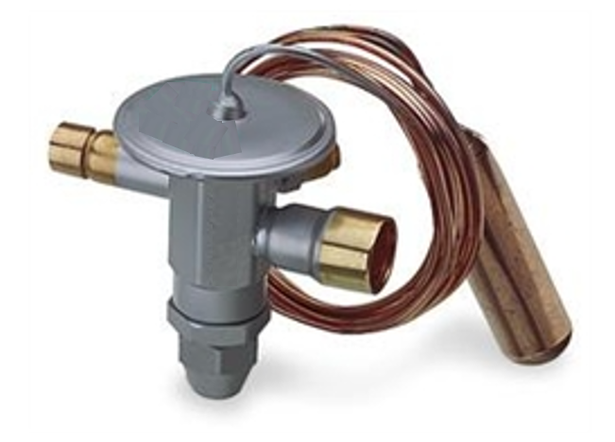
Sub-Cooling Refrigerant Charge Method
Subcooling is a refrigerant charging method that is designed for systems with a thermostatic expansion valve (TXV). Subcooling measurement results are then compared to equipment manufacturer’s data to evaluate the refrigerant charge. Improper charging will lower the life expectancy, efficiency, and capacity of the unit.

Slide 3
Sub-Cooling Test (heat pumps)
This test can’t be done on a heat pump in the heating mode. It is always the best practice to follow equipment manufacturer’s subcooling test procedures. Generally, to perform this test, the outdoor dry bulb temperature should be above 60ºF. However, equipment manufacturer’s directions may vary and should be consulted.

Slide 4
Sub-Cooling Test Procedure (1)
The temperature probe should be located as close to the liquid line connection at the condenser as possible. Subcooling requires an accurate temperature measurement of the liquid line (sometimes referred to as high-side line).

Slide 5
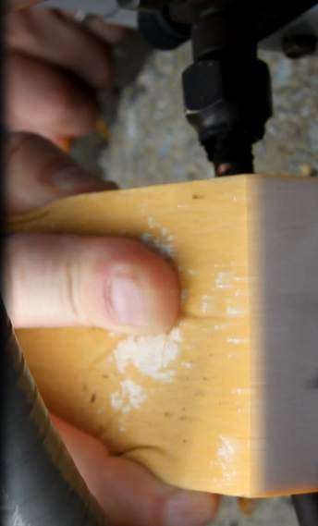
Sub-Cooling Test Procedure (2)
It is important to ensure that the pipe has been cleaned (lightly sanded down to provide a clean mating surface and the temperature probe is securely attached because good clean contact is required for accurate readings.

Slide 6
Sub-Cooling Test Procedure (4)
Subcooling is the difference between the measured temperature readings in the liquid line and the temperature obtained by the pressure conversion. Thus, it can be calculated using a standard gauge set by using the equipment manufacturer’s charts or tables, determine if the subcooling is within 3ºF of the equipment manufacturer’s specified optimal number.

Slide 7
Gauge Set Sub Cooling

Slide 8
Typical OEM Sub-Cooling Chart

Slide 9
Sub-Cooling Test Evaluation
If the subcooling is not within 3ºF of the equipment manufacturer’s specified optimal subcooling, take the following action:
If the reading is less than the specified value: add a few ounces of refrigerant and wait 15 minutes and test again. Continue this process until the measured subcooling is within the specified subcooling range.
If the reading is greater than the specified value: a few ounces of refrigerant will need to be removed and placed in a new recovery cylinder or one with the same type of refrigerant in it. Wait 15 minutes and test again. Continue this process until the measured subcooling is within the specified subcooling range.

Slide 10
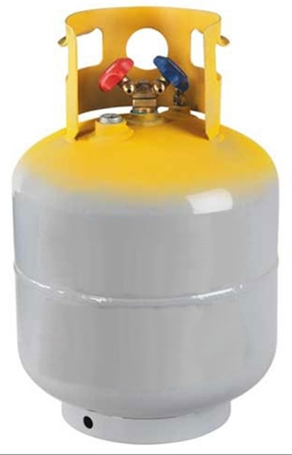
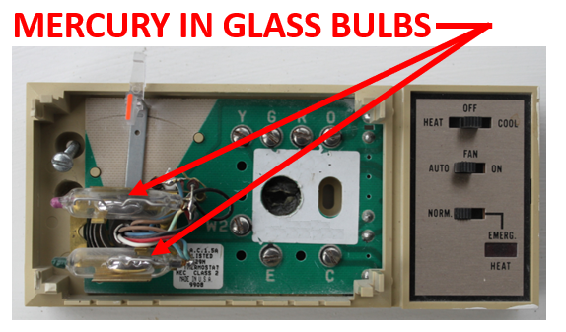
Recycling

Slide 11
Summary
A good entry level technician leaves no trace of having been in a home when they leave other than a neatly done installation of a properly operating HVAC system. A great one has also made a list of supplies that need to be replaced, and has placed all the tools and materials back in their proper place in the truck. One of the best things about working in a trade is the pride in workmanship and the feeling of accomplishment that one feels after finishing a well-done job.

Slide 12
Field Story
The lead technician said the new systems “were charged and ready to go.” They were on the rooftop of a 12-story condo with numerous line lengths depending on how many floors the tubing sets dropped. One question caused most of the systems to be pumped down and have another vacuum and leak check performed. Two extra days of work for a crew of six was started with a simple question based on the OEM directions for long vertical refrigerant runs: did you replace the orifice pistons that came with the heat pumps to those specified in the OEM’s guidance for the various long vertical lengths of the refrigerant piping in this building?

Slide 13
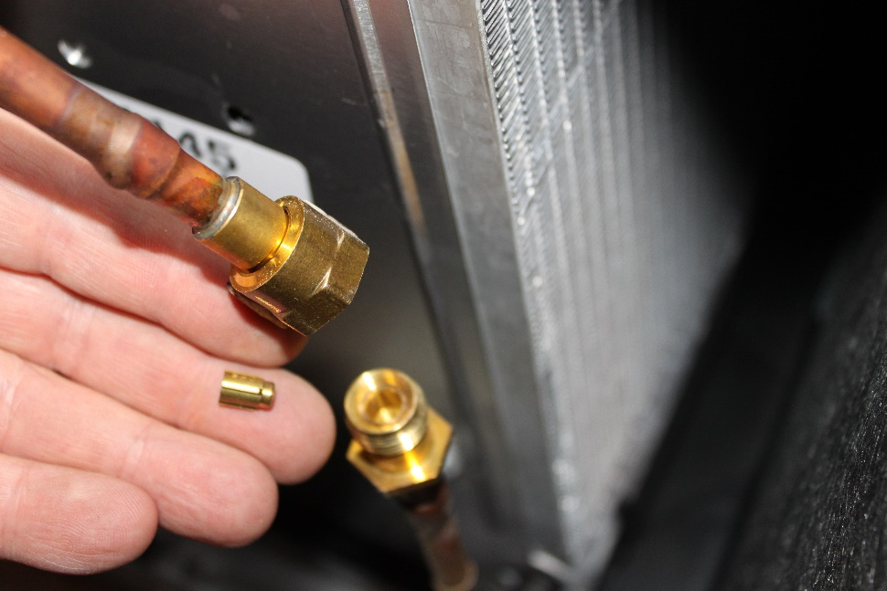
Piston

Slide 14
Lessons Learned
You should now be able to explain what type of expansion device equipment must have for a sub-cooling refrigerant charge test to be done.
You should now be able to explain how to perform a sub-cooling refrigerant test.
You should now be able to explain what to do when the sub-cooling measurement is high or low.
You should now be able to explain why recycling is important to do.

