Slide 1
Manual J8ae -2011 SPEEDSHEET Long House Room Loads

Slide 5
MJae SPEEDSHEET

Slide 6
MJae SPEEDSHEET
Free download available at:
WWW.ACCA.ORG/SPEEDSHEET

Slide 7
MJae SPEEDSHEET
Long house room load calculation using the SPEEDSHEET:

Slide 8
SPEEDSHEET Location

Slide 9
SPEEDSHEET Location
Blue and Yellow Colored Boxes on the Speedsheet are either
a scroll down choice, or fill in automatically:
Can Not Be Changed!

Slide 10
SPEEDSHEET Location T
White boxes with red lettering may be changed if required by local code exceptions.

Slide 11
SPEEDSHEET Location

Slide 12
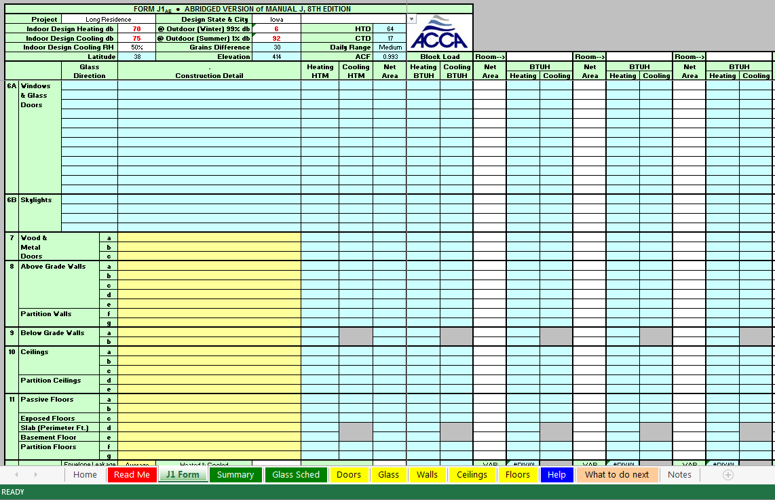
SPEEDSHEET Glass

Slide 13
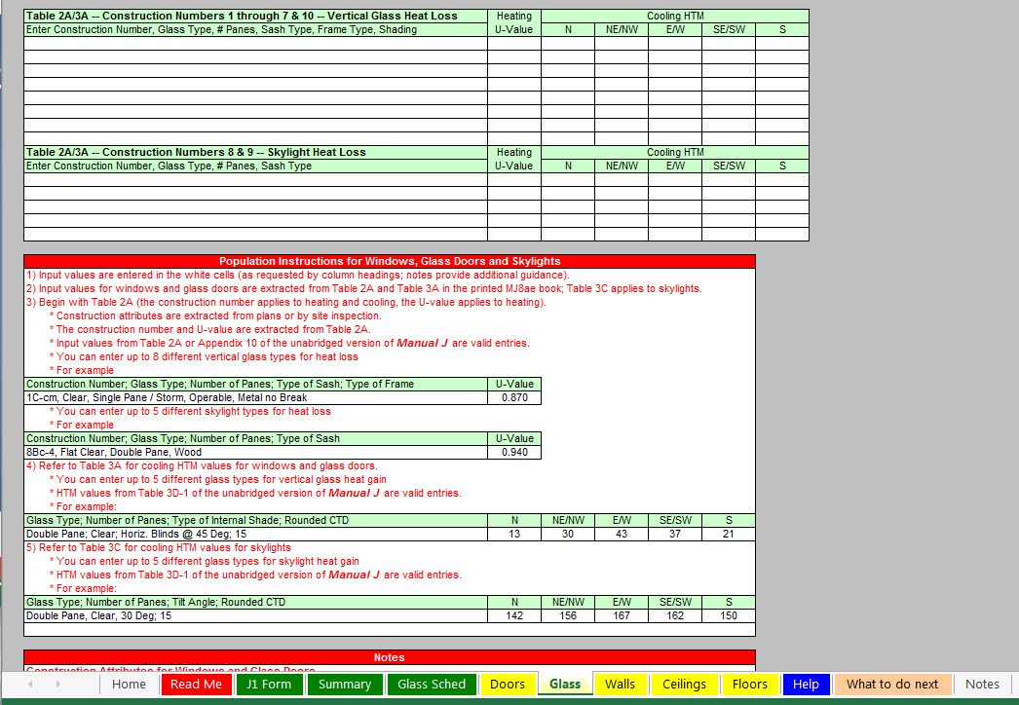
SPEEDSHEET Glass

Slide 14
SPEEDSHEET Glass
Type in values from Table 2A/3A in the Manual J8

Slide 15
SPEEDSHEET Glass

Slide 16
SPEEDSHEET Glass

Slide 17
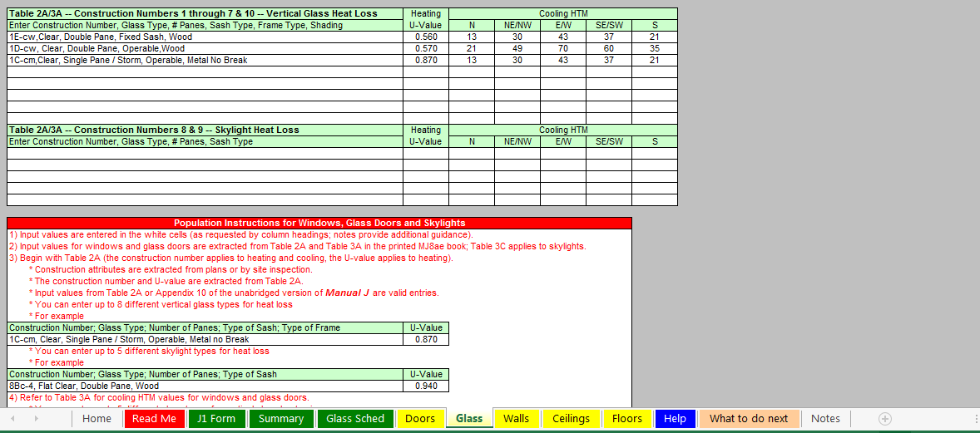
SPEEDSHEET Glass

Slide 18
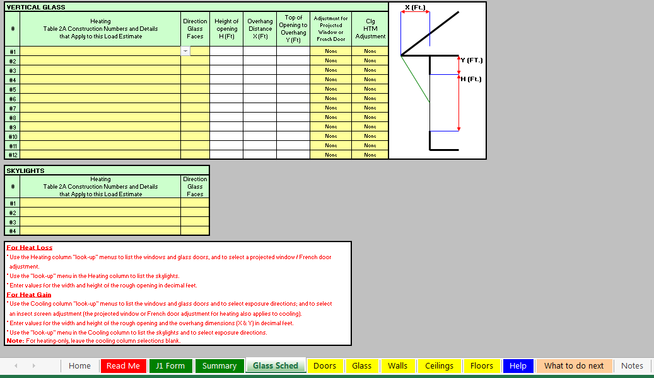
SPEEDSHEET Glass

Slide 19
SPEEDSHEET Glass

Slide 20
SPEEDSHEET Glass

Slide 21
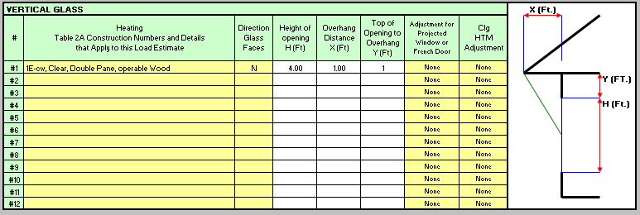
SPEEDSHEET Glass

Slide 22
SPEEDSHEET Glass

Slide 23
SPEEDSHEET Glass

Slide 24
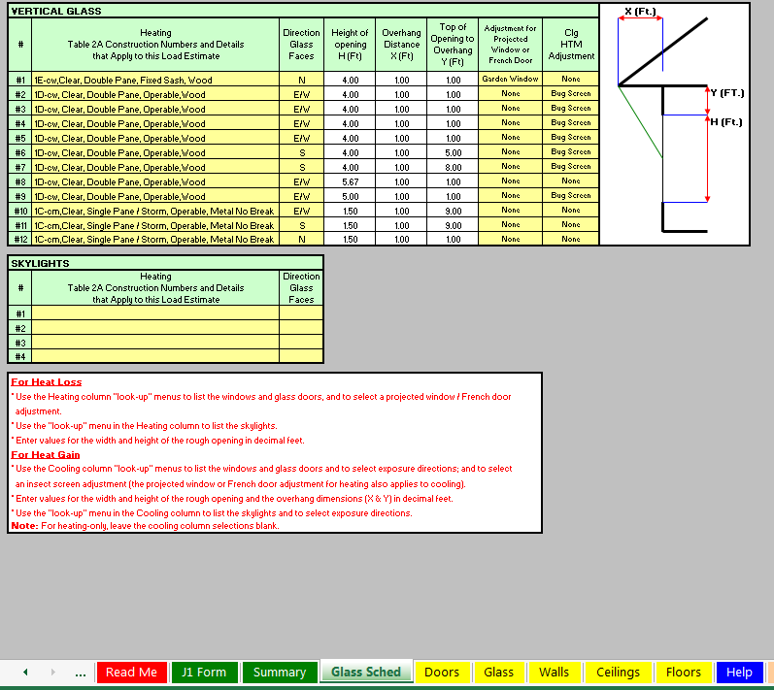
SPEEDSHEET Glass
No sky lights so, proceed to doors.

Slide 25
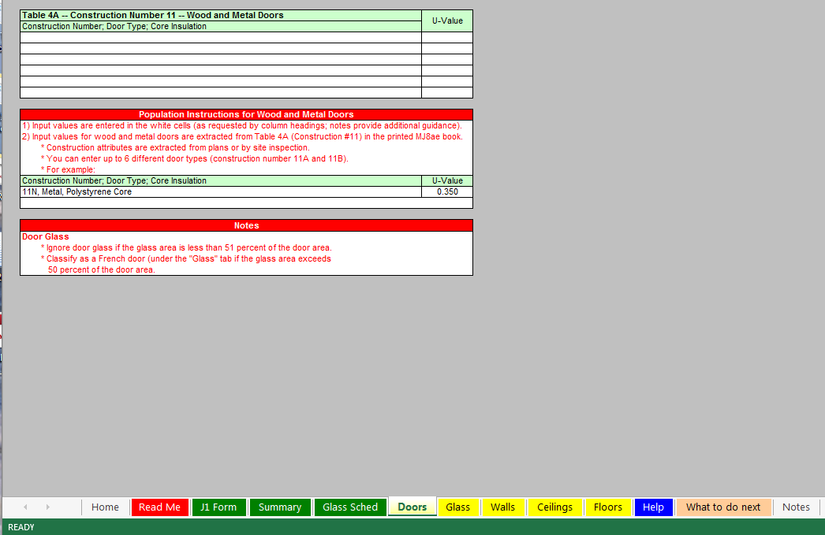
SPEEDSHEET Doors

Slide 26
SPEEDSHEET Doors

Slide 27
SPEEDSHEET Doors

Slide 28
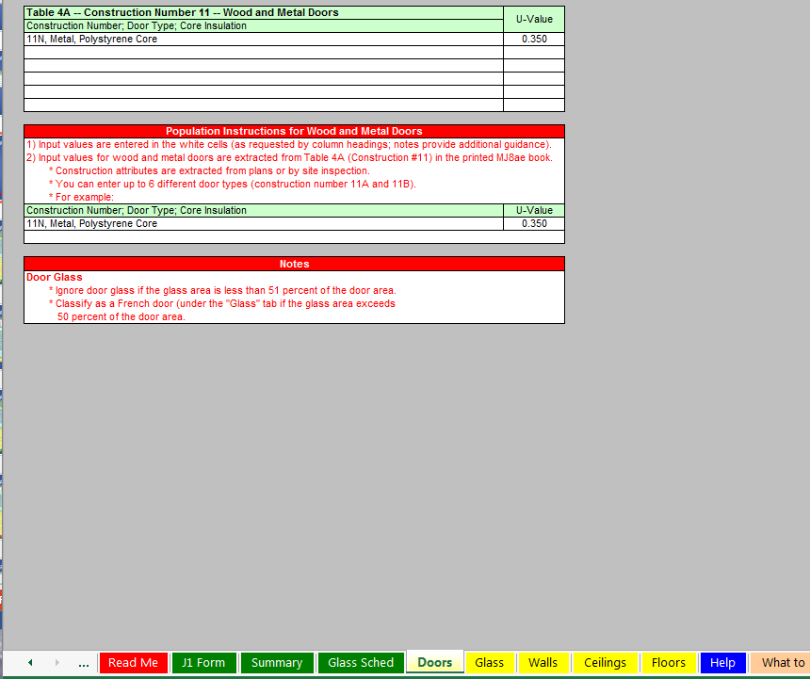
SPEEDSHEET Doors

Slide 29
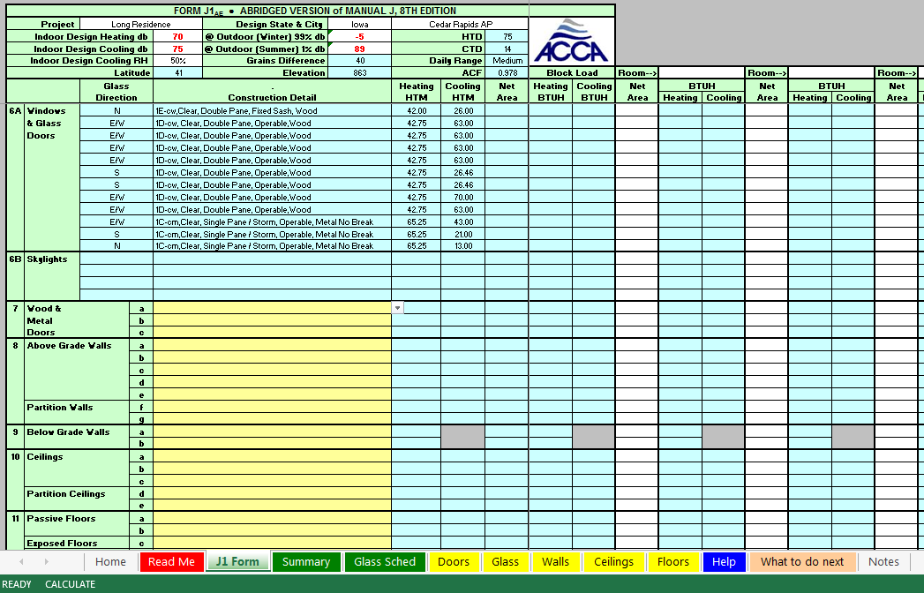
SPEEDSHEET Doors

Slide 30
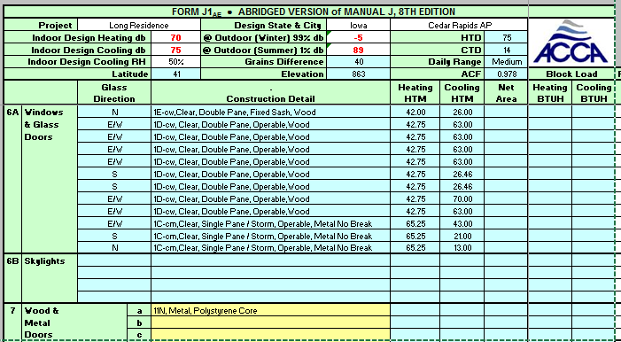
SPEEDSHEET Doors

Slide 31
SPEEDSHEET Doors

Slide 32
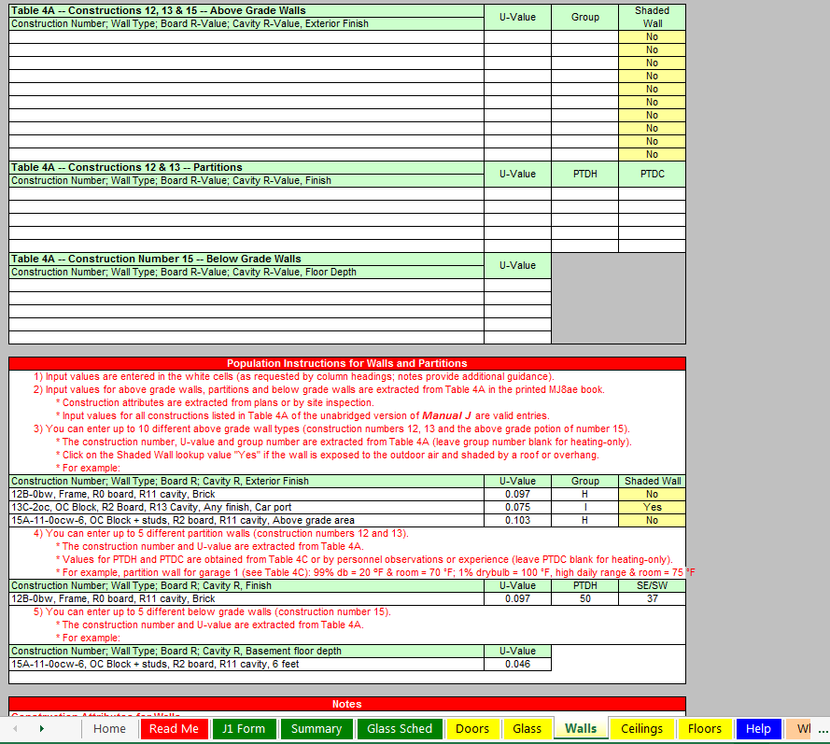
SPEEDSHEET Walls

Slide 33
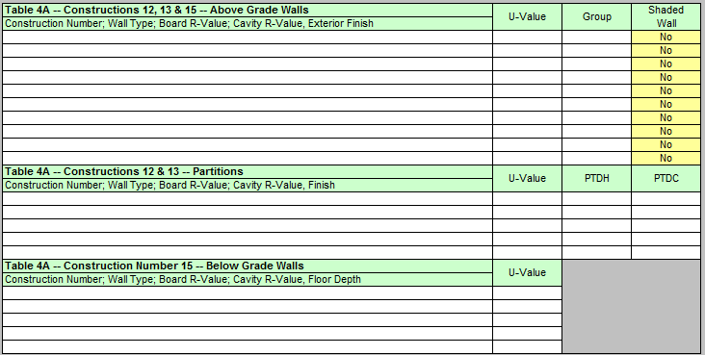
SPEEDSHEET Walls

Slide 34
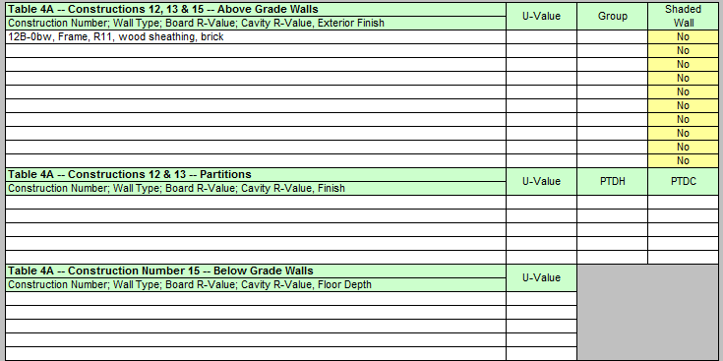
SPEEDSHEET Walls

Slide 35
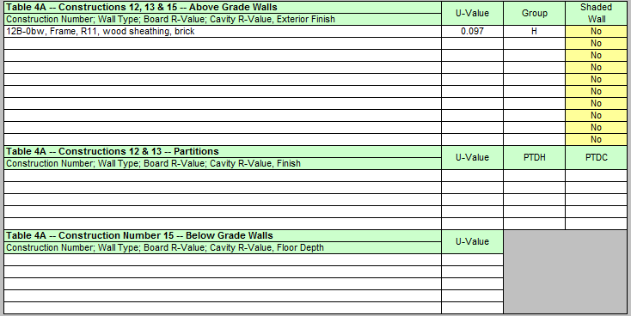
SPEEDSHEET Walls

Slide 36
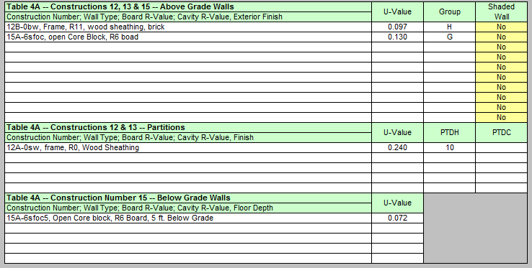
SPEEDSHEET Walls

Slide 37
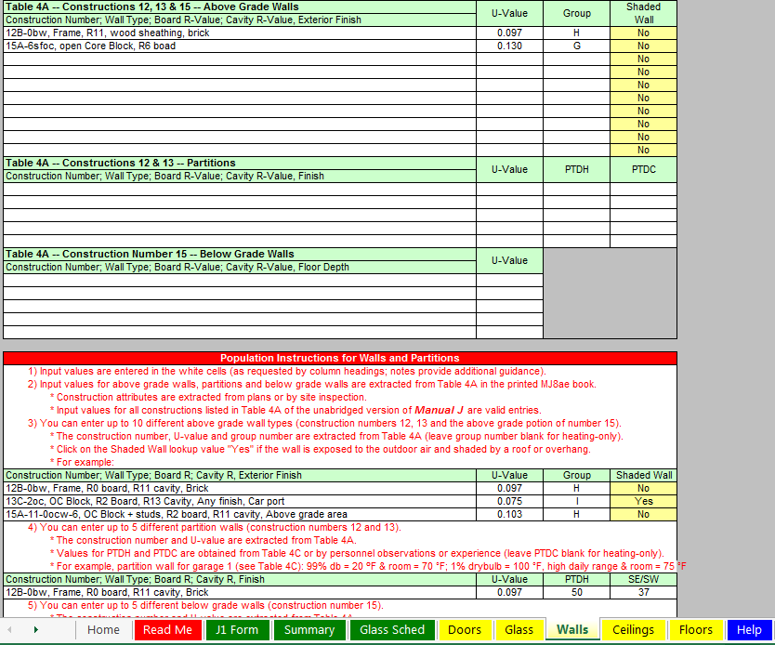
SPEEDSHEET Walls

Slide 38
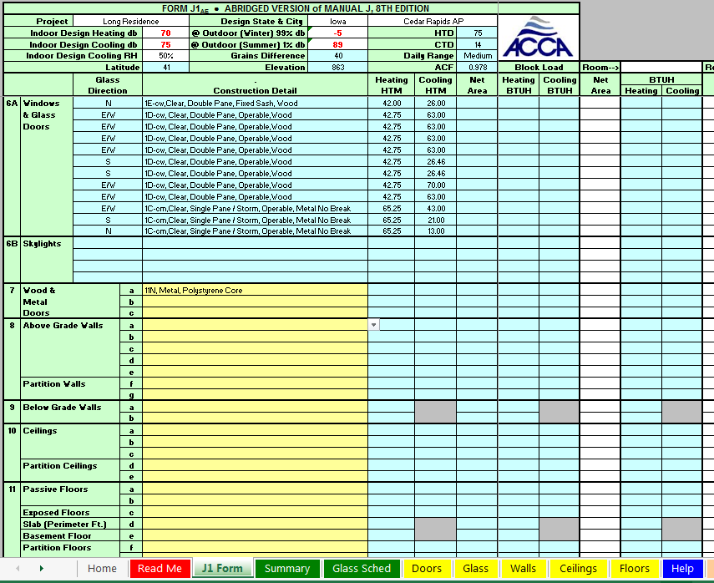
SPEEDSHEET Walls

Slide 39
SPEEDSHEET Walls

Slide 40
SPEEDSHEET Walls

Slide 41
SPEEDSHEET Walls

Slide 42
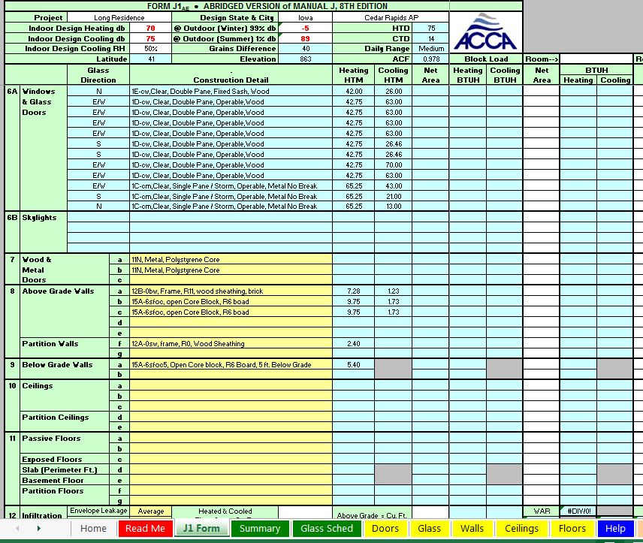
SPEEDSHEET Walls

Slide 43
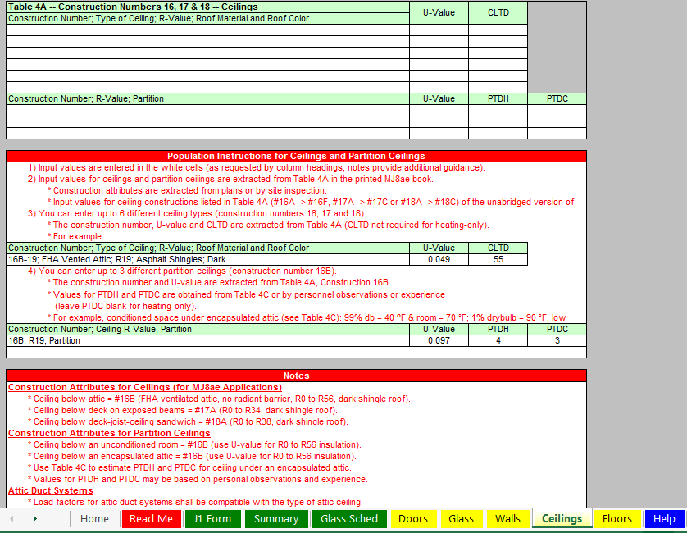
SPEEDSHEET Ceilings

Slide 44
SPEEDSHEET Ceilings

Slide 45
SPEEDSHEET Ceilings

Slide 46
SPEEDSHEET Ceilings

Slide 47
SPEEDSHEET Ceilings

Slide 48
SPEEDSHEET Ceilings

Slide 49
SPEEDSHEET Ceilings

Slide 50
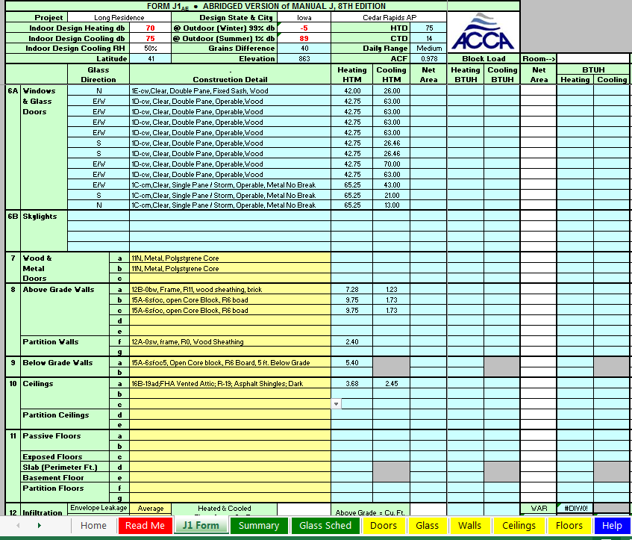
SPEEDSHEET Floors

Slide 51
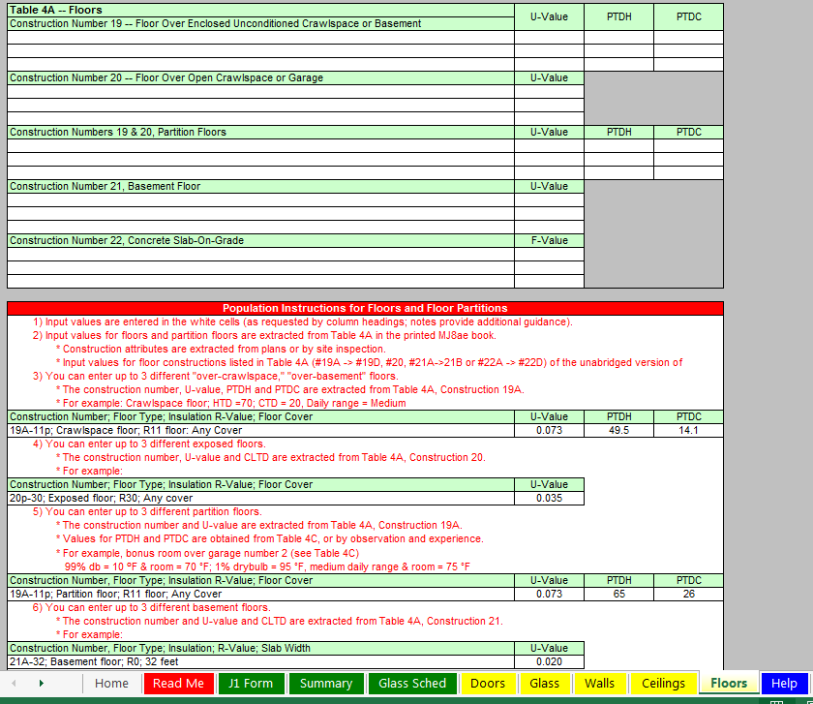
SPEEDSHEET Floors

Slide 52
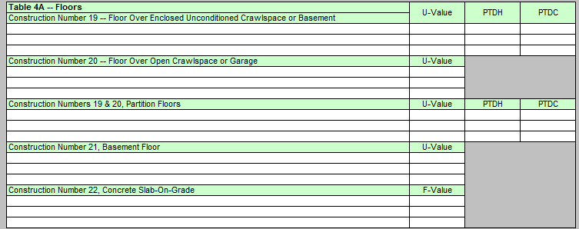
SPEEDSHEET Floors

Slide 53
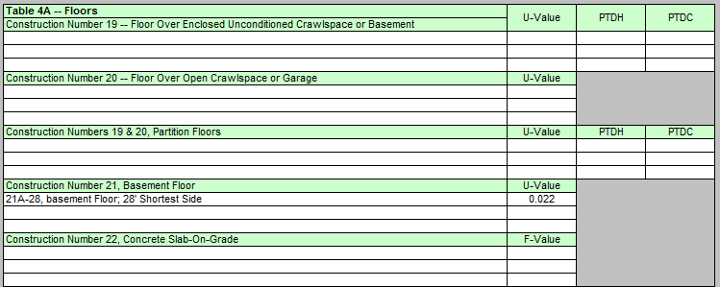
SPEEDSHEET Floors

Slide 54
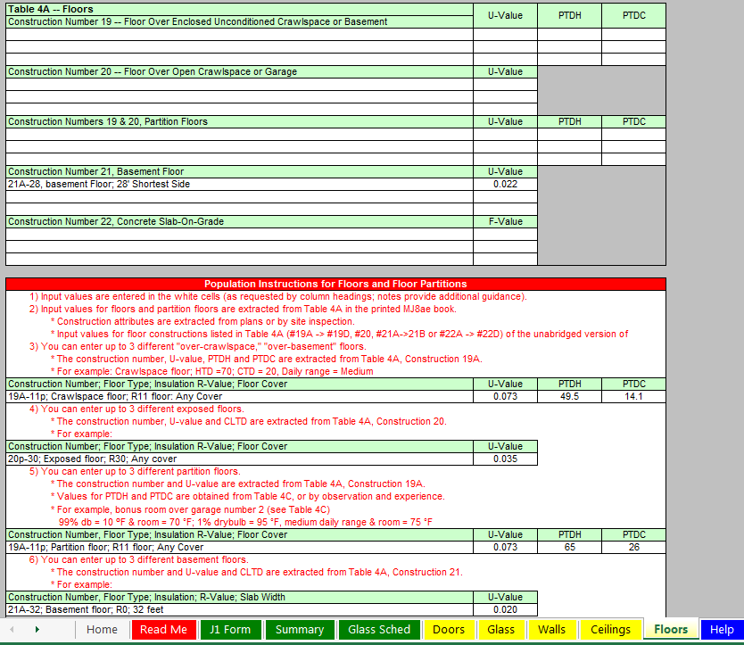
SPEEDSHEET Floors

Slide 55
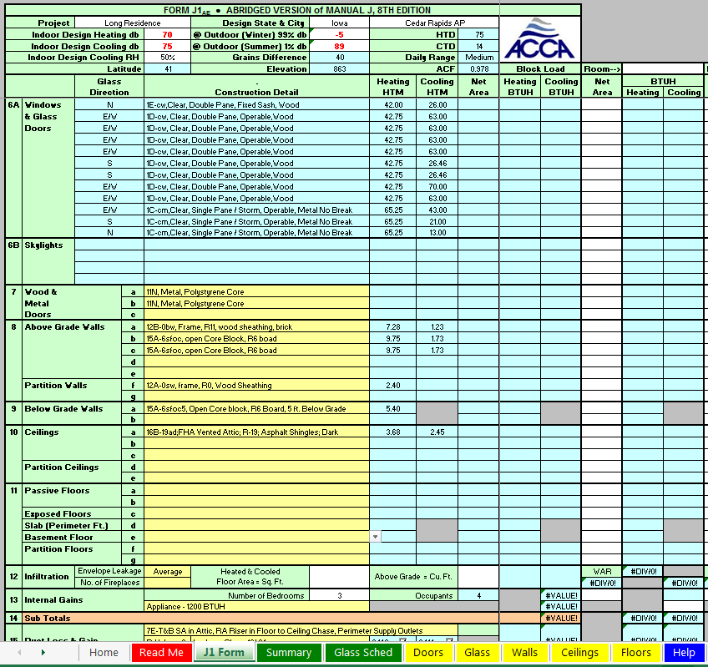
SPEEDSHEET Floors

Slide 56
SPEEDSHEET Floors

Slide 57
SPEEDSHEET Floors

Slide 58
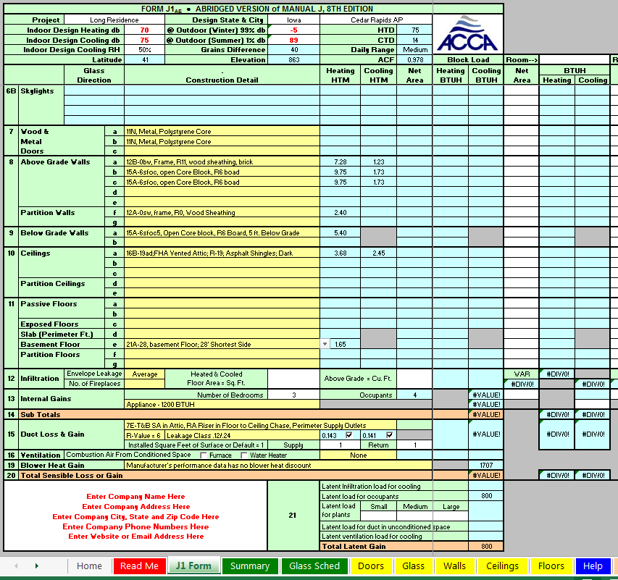
SPEEDSHEET Infiltration

Slide 59
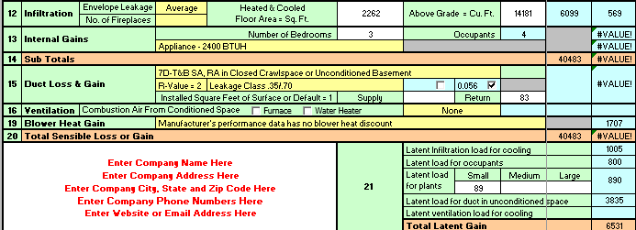
SPEEDSHEET Infiltration
From the drawings, total heated and cooled area in sq. ft:
(29 x 27) + ( 1,479) = 2,262
Note: Shop area not included has it’s own heat and no cooling.

Slide 60
SPEEDSHEET Infiltration
From the drawings above grade heated and cooled
Volume in Cu. Ft:
(3 x 29 x 27) + ( 1479 x 8) = 14,181

Slide 61
SPEEDSHEET Room Load
Line 12: Infiltration
Note: Manual J8 eyeball interpolations resulted in values of 6,944 and 565 respectively.

Slide 62
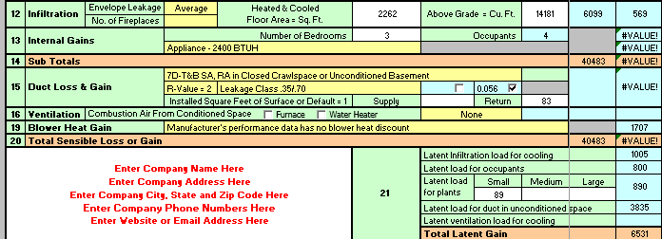
SPEEDSHEET Internal Gains

Slide 63
SPEEDSHEET Internal Gains
Occupants = number of bedrooms + 1

Slide 64
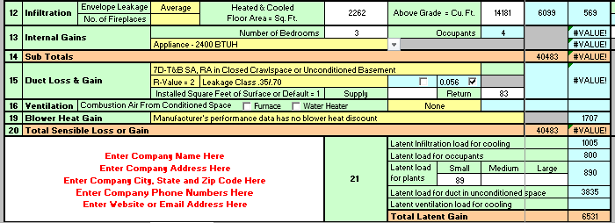
SPEEDSHEET Internal Gains
Appliance BTUH selected 2,400

Slide 65
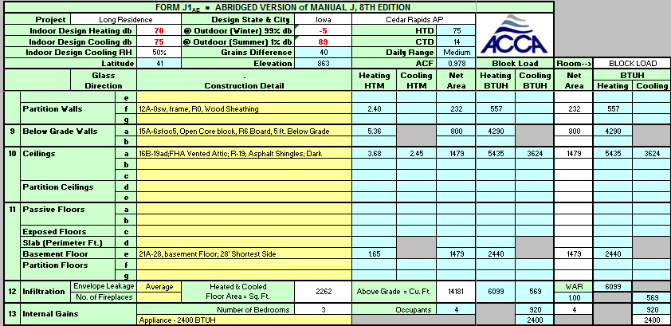
SPEEDSHEET Block Load
Line 13: Internal Gains

Slide 66
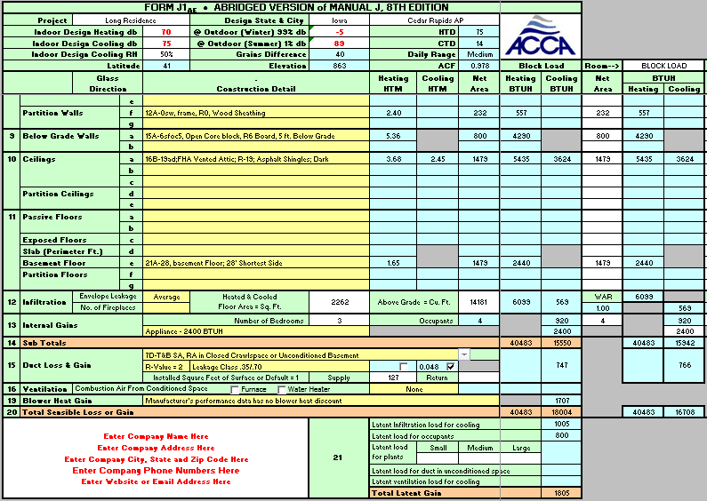
SPEEDSHEET Block Load
Line 14: Total Sensible Loss or Gain Sub Totals (nothing to fill in)

Slide 67
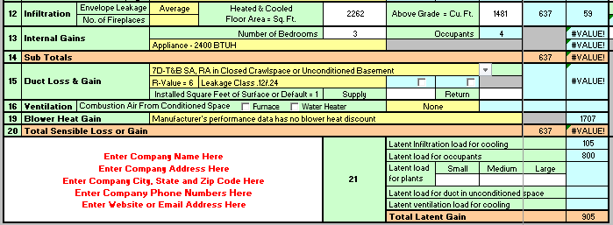
SPEEDSHEET Duct Loss & Gain
Note: ½ of the duct is in the uncooled basement. Thus, it is all exposed to a latent heat gain when the cooling system shuts down. No heat loss will be calculated for heating since the areas have auxiliary heating.

Slide 68
SPEEDSHEET Duct Loss & Gain

Slide 69
SPEEDSHEET Duct Loss & Gain

Slide 70
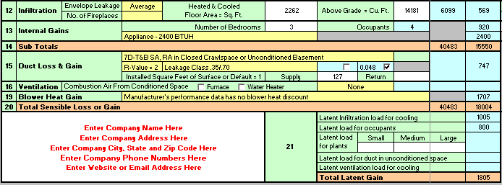
SPEEDSHEET Duct Loss & Gain
127= Supply duct installed sq. ft. surface area.
Note: 0.048 is exact interpolation value. Thus, latent load is less than in text which uses
an “eyeball interpolation”.

Slide 71
SPEEDSHEET Duct Loss & Gains
Line 15: Duct Loss & Gains
Note: In J8 different value of 0.56 (eyeball)

Slide 72
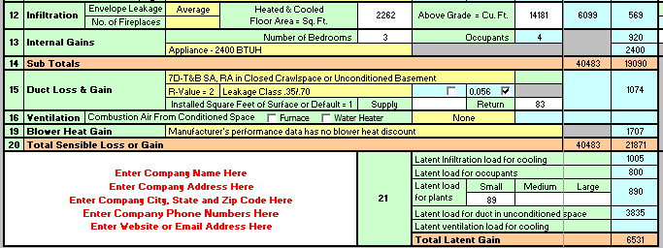
SPEEDSHEET Ventilation
No ventilation air added.

Slide 73
SPEEDSHEET Ventilation
Line 16: No ventilation & no combustion air.

Slide 74
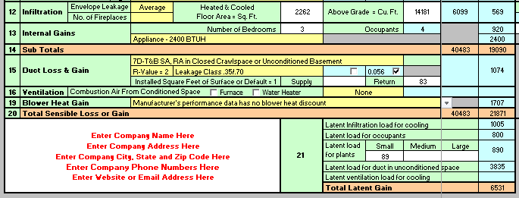
SPEEDSHEET Blower Heat Gain

Slide 75
SPEEDSHEET Blower Heat Gains
No lines 17 & 18 on Speedsheet* Line 19: Blower Heat Gains
*Not supported in the Jae: Line 17 is for winter humidification loads, and Line 18 is for piping loads.

Slide 76
SPEEDSHEET Block Load
Line 20: Total Sensible Loss or Gain…..Nothing to enter.

Slide 77
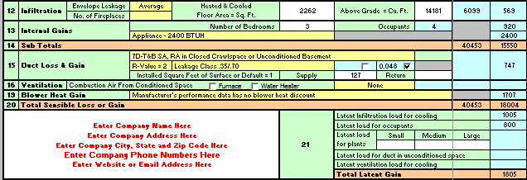
SPEEDSHEET Plants Latent Load
No plants.

Slide 78
SPEEDSHEET Block Load
Line 21: Latent Load Occupants
Note: In J8 wrong value of 1,200 printed

Slide 79
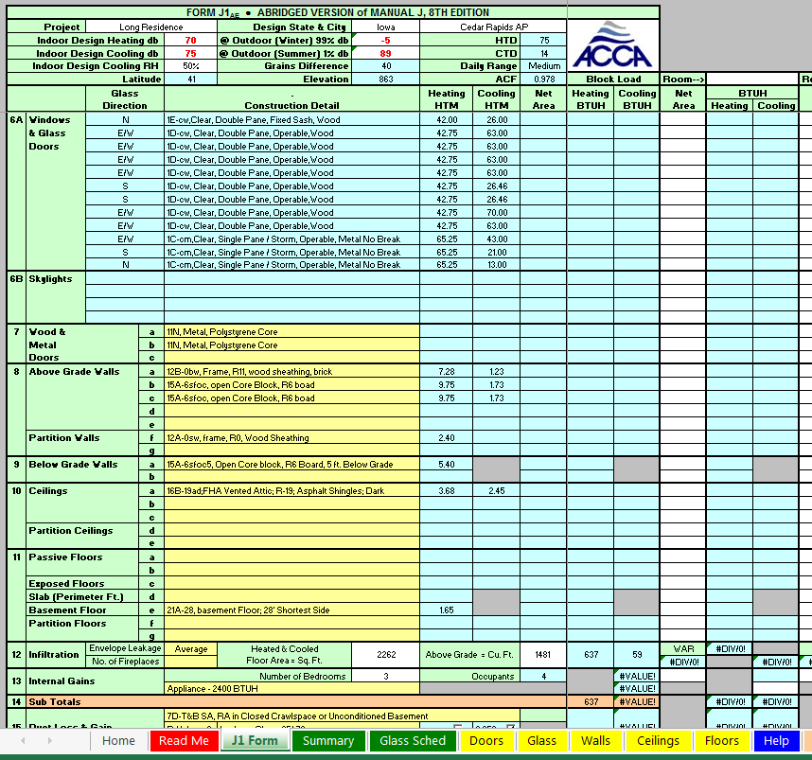
SPEEDSHEET Room Load

Slide 80
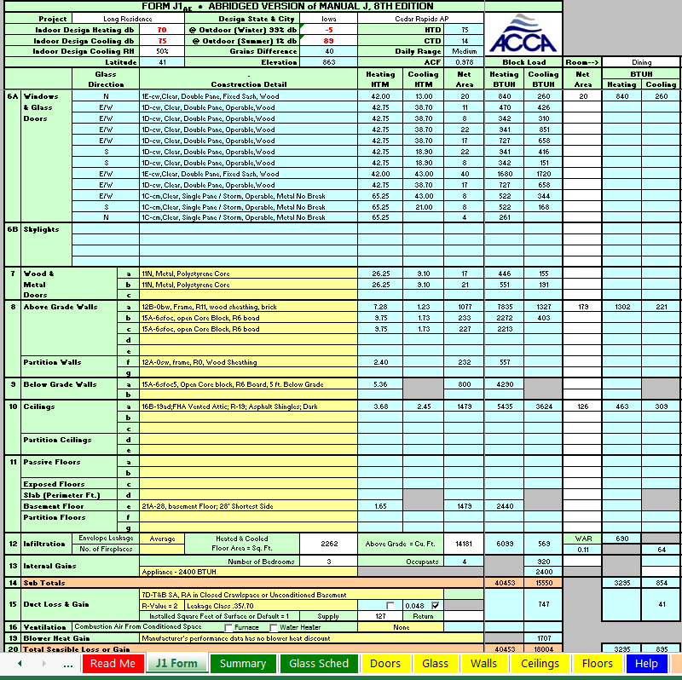
SPEEDSHEET Room Loads

Slide 81
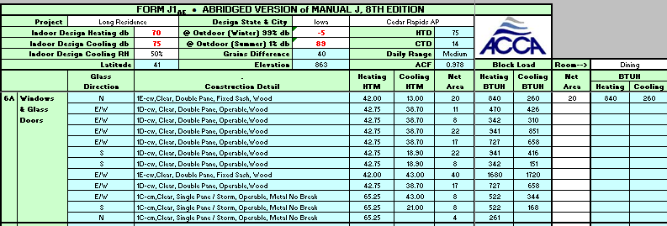
SPEEDSHEET Room Loads Dinning Room
North facing window in dinning room, net area = 20

Slide 82
SPEEDSHEET Room Loads Dinning Room
No doors in dining room. Thus, no entry.

Slide 83
SPEEDSHEET Room Loads Dinning Room
Exterior wall type net area = 179

Slide 84
SPEEDSHEET Room Loads Dinning Room
Ceiling type net area = 126

Slide 85
SPEEDSHEET Room Loads Dinning Room
Totals For Dinning Room
Heating = 3,295 BTUH
Cooling = 895 BTUH

Slide 86
SPEEDSHEET Room Loads Dinning Room
All remaining rooms are filled out
using the same process: simply fill in
the net area for each included item.
Totals For Dinning Room
Heating = 3,295 BTUH
Cooling = 895 BTUH

Slide 87
SPEEDSHEET Room Loads Living Room
Totals For Living Room
Heating = 4,274 BTUH
Cooling = 2,780 BTUH

Slide 88
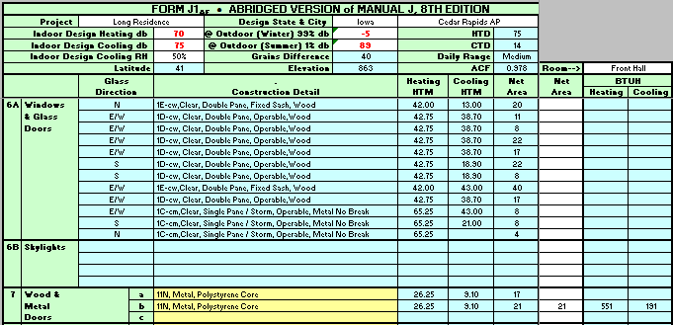
SPEEDSHEET Room Loads Front Hall
Front Hall includes a door net area = 21

Slide 89
SPEEDSHEET Room Loads Front Hall
Totals For Front Hall
Heating = 1,497 BTUH
Cooling = 565 BTUH
Note: No Window

Slide 90
SPEEDSHEET Room Loads Bedroom 1 (Master)
Totals For Bedroom 1
Heating = 4,246 BTUH
Cooling = 2,165 BTUH
Two people added for master.

Slide 91
SPEEDSHEET Room Loads Bedroom 1 (Master)
Totals For Bedroom 1
Heating = 4,246 BTUH
Cooling = 2,165 BTUH
Two windows in Master Bedroom
facing two different directions.

Slide 92
SPEEDSHEET Room Loads Bedroom 1 (Master)
Totals For Bedroom 1
Heating = 4,246 BTUH
Cooling = 2,165 BTUH

Slide 93
SPEEDSHEET Room Loads Bathroom 2
Totals For Bathroom 2
Heating = 805 BTUH
Cooling = 265 BTUH
Note: Bathroom 2 based on drawing.

Slide 94
SPEEDSHEET Room Loads Bedroom 2
Two windows in bedroom facing
in different directions.

Slide 95
SPEEDSHEET Room Loads Bed Room 2
One person placed in Bedroom 2.

Slide 96
SPEEDSHEET Room Loads Bed Room 2
Totals For Bedroom 2
Heating = 3,559 BTUH
Cooling = 1701 BTUH

Slide 97
SPEEDSHEET Room Loads Bedroom 3
One person added to Bedroom 3.

Slide 98
SPEEDSHEET Room Loads Bed Room 3
Totals For Bedroom 3
Heating = 2,044 BTUH
Cooling = 1,446 BTUH

Slide 99
SPEEDSHEET Room Loads Bathroom 1
Totals For Bathroom 1
Heating = 1,421 BTUH
Cooling = 654 BTUH

Slide 100
SPEEDSHEET Room Loads Kitchen
1,000 BTUH appliance load added.

Slide 101
SPEEDSHEET Room Loads Kitchen
Totals For Kitchen
Heating = 1,780 BTUH
Cooling = 1,845 BTUH

Slide 102
SPEEDSHEET Room Loads Laundry
500 BTUH appliance load added.

Slide 103
SPEEDSHEET Room Loads Laundry
Totals For Laundry
Heating = 2,184 BTUH
Cooling = 1,051 BTUH

Slide 104
SPEEDSHEET Room Loads Hall & Closets
Totals For Hall & Closets
Heating = 606 BTUH
Cooling = 404 BTUH

Slide 105
SPEEDSHEET Room Loads Rec Room
900 BTUH appliance load added.
Note: The 900 load is per Manual J Table 6A values

Slide 106
SPEEDSHEET Room Loads Rec Room
Totals For Rec Room
Heating = 8,253 BTUH
Cooling = 1,895 BTUH

Slide 107
SPEEDSHEET Room Loads Work Shop (Not Cooled)
Totals For Work Shop
Heating = 3,408 BTUH
Cooling = 38
Note: Speedsheet has 38 BTUH
cooling for infiltration.

Slide 108
SPEEDSHEET Room Loads Utility Room (Not Cooled)
Totals For Utility Room
Heating = 3,080 BTUH
Cooling = 0 in J8 text.
Note: Speedsheet has 37 BTUH
cooling for infiltration.

Slide 109
SPEEDSHEET Room Loads Utility Room (Not Cooled)
All rooms are filled out.
Totals:
Totals For Utility Room
Heating = 3,080 BTUH
Cooling = 0 in J8 text.
Note: Speedsheet has 37 BTUH
Cooling for Infiltration

Slide 110
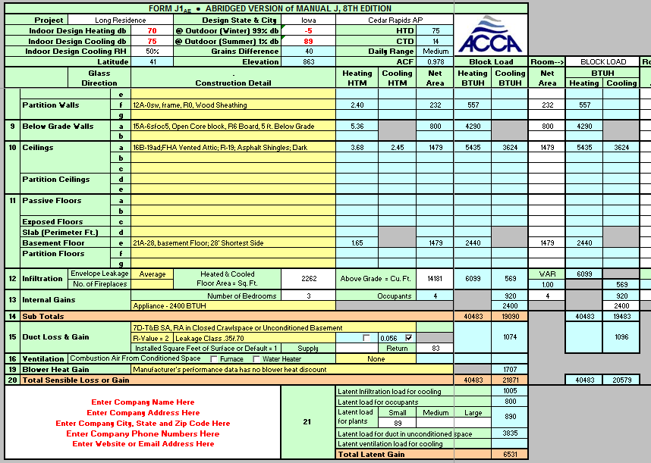
SPEEDSHEET Block Load
Sensible Gain + Latent Gain = Cooling Load 18,004 + 1,805 = 19,809
Heating Load Sensible Only = 40,453

Slide 111
SPEEDSHEET Block Load
Sensible Gain + Latent Gain = Cooling Load 18,004 + 1,805 = 19,809
In J8: 18,130 + 1,798* = 19,928 or 0.59% more
Heating Load Sensible Only = 40,453
In J8: 41,304 or 2.01%
*Corrected for typo of 1,200 instead of 800 on line 21B in Manual J8

Slide 112
SPEEDSHEET Block Load
Thus; “eyeball interpolations by author” within 2%

Slide 113
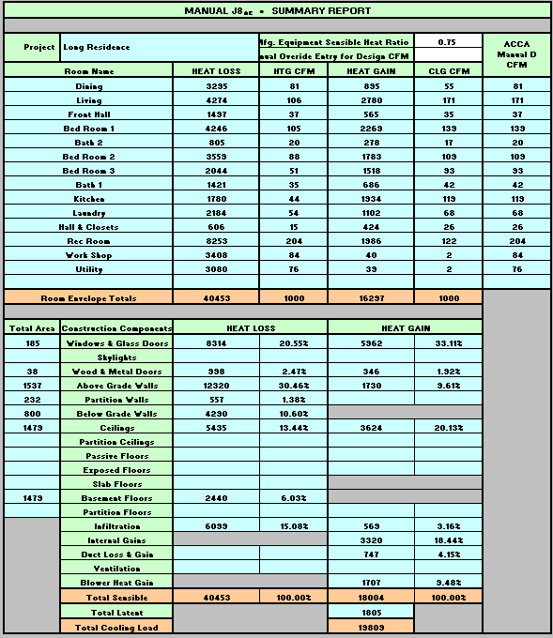
SPEEDSHEET Full Load Summary Report

Slide 114
SPEEDSHEET Full Load Summary Report
You should now be able to do a block load.
Using the speedsheet calculate how much the loads change when the windows are single pane and have no shading?
Hint: Use different values from Table 2A

Slide 115
Instructor Notes
Manual J8 used a different heated square footage for the shop with a space heater. To do this with the Speedsheet you would need to do two separate sheets. Thus, the Speedsheet uses the heated and cooled volume (not including the shop area).
The J8 form line 21 B has a typo or error for occupant latent heat. Should be 4 occupants at 200 = 800 (not 1,200).
The eyeball interpolation and rounding differences found in the Speedsheet totals makes a small difference in the total values.
WAR is the wall area ratio. For a Block load it is 1, and for Room X Room loads the individual room percentages add up to 1.

