Slide 1
Maria’s Restaurant Chapter 2 Section 8

Slide 2
Cooling Design Information

Slide 3
Heating Design

Slide 4
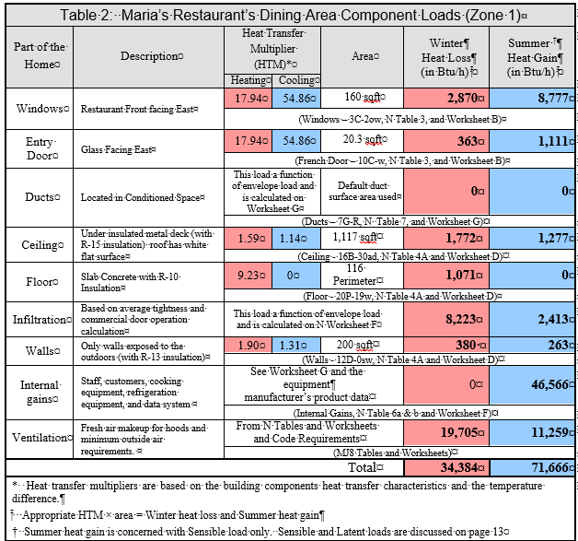
Zone 1 Equipment Selection

Slide 5
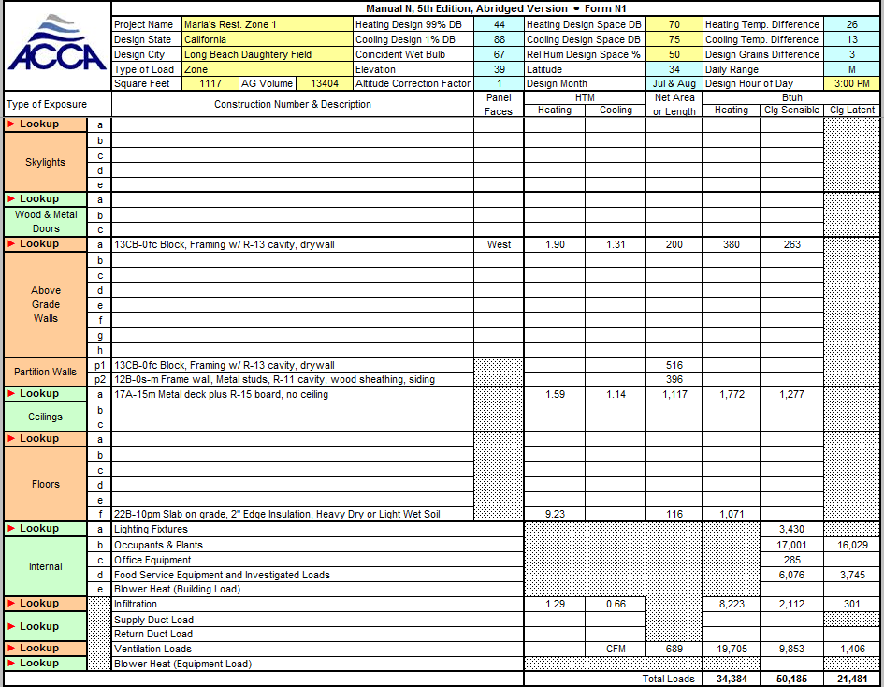
Manual N Zone 1 Heating Load
34,384 Btuh Total Heating Load

Slide 6
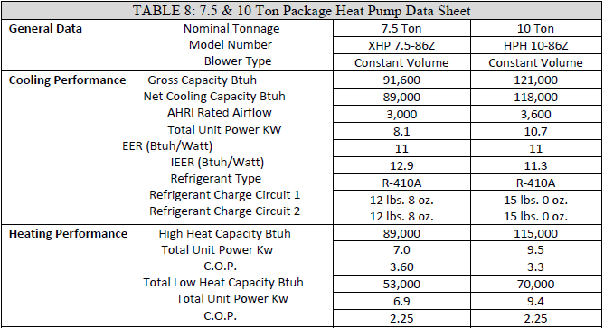
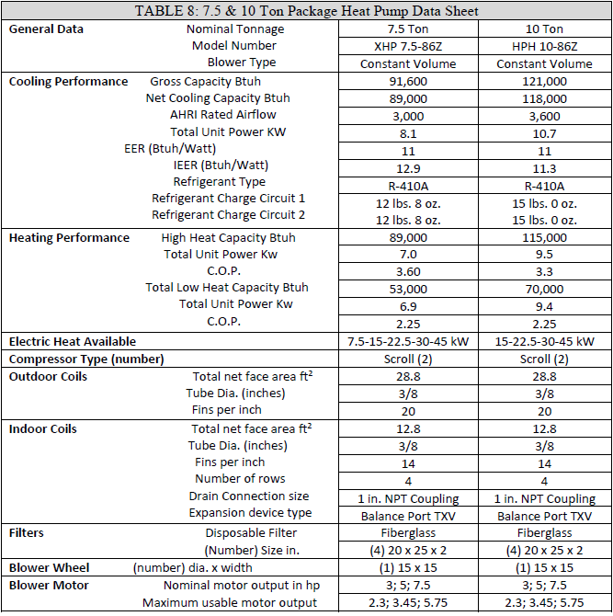
Zone 1 Heating Data Sheet
Zone 1 Heating 7.5 Ton Unit
Design Load 34,384
High Heat Rating 89,000
Low Heat Rating 53,000
89,000 ÷ 34,384 × 100 = 258%
53,000 ÷ 34,384 × 100 = 154%

Slide 7
Expanded Equipment Heating Data
44^{O}F
34,384 Btuh Total Heating Load
Interpolation for 44^{O}F @ 2,400 CFM is 81,790 Btuh
81,790 ÷ 34,384 × 100 = 238%
From Low Speed OEM Data:
51,600 ÷ 34,384 × 100 = 150%

Slide 8
Zone 1 Manual N Cooling Load
50,185 Btuh Sensible Cooling Load
21,481 Btuh Latent Cooling Load
71,666 Btuh Total Cooling Load

Slide 9
Manual N Zone 1 Cooling Load in Tons
71,666 ÷ 12,000 = 5.97

Slide 10
Zone 1 Cooling Data Sheet
Zone 1 Cooling 7.5 Ton Unit
Design Load 71,666
Gross Load Rating 91,600
Net Load Rating 89,000
91,600 ÷ 71,666 × 100 = 128%
89,000 ÷ 71,666 × 100 = 124%

Slide 11
6 Ton Unit Total Cooling Calculations
6-ton unit (same OEM) with a maximum cooling capacity at 2,880 CFM of 78,200 Btuh
78,200 ÷ 71,666 × 100 = 109% of design
Works for Sensible Heat

Slide 12
6 Ton Unit Meet 100% Latent Heat?
However, the 6-ton unit cannot meet the latent heat capacity, it only provides 20,500 Btuh for latent heat removal.
The required minimum value is 21,484. Thus, it could only provide 95% of the required moisture removal.
Does not work Latent Heat Load

Slide 13
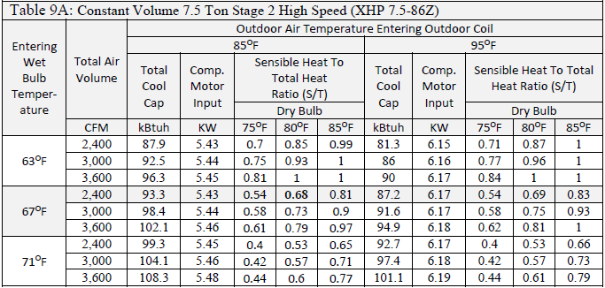
Zone 1 Expanded Data
Design Load @ 2,400 CFM
At 88^{O}F is 71,666 Btuh
Interpolated Load 91,470
91,470 ÷ 71,666 × 100 = 128%
88^{O}F

Slide 14
Latent Load for 7.5 Ton Unit
85^{O}F air entering the outdoor coil, and an entering wet bulb of 67^{O}F at the indoor coil with 2,400 CFM passing through it, the Total capacity in kBtuh is 93.3 kBtuh;
At 95^{O}F the Total capacity in kBtuh is 87.2 (at a 67 ^{O}F return WB); thus, our interpolated value for our 88^{O}F design location would be 91.47 kBtuh (see Math Review for interpolation directions).

Slide 15
Latent Load for 7.5 Ton Unit
In this example, in order to find the latent value we again interpolate using the 80^{O}F dry bulb return air values or simply look at the two values 0.68 and 0.69 and find the value of 0.68 to be close enough.
Based on table values, at full capacity our sensible cooling ÷ total cooling = 0.68 so, 0.68 × 91,470 Btuh = sensible heat = 62,199.6 or 62,200 Btuh. Thus, the latent cooling capacity must be 93,300 – 62,200 = 31,100 Btuh ( more than 21,382).
Works for Latent Heat

Slide 16
Manual CS Mild Climate Sizing Limits
Sensible capacity exceeds sensible load.
Latent capacity exceeds latent load.
X Total capacity less than 1.15 × Total Load
1.15 × 71,666 = 82,416 (6.87 tons max size)
Note for multi speed compressor units 0.90 to 1.20 × Total Load
89,000 ÷ 71,666 × 100 = 124%

Slide 17
OEM 6 Ton to 7.5 Ton Sizing Gap
CS: Total capacity less than 1.15 × Total Load
(Note: for multi speed compressor units 0.90 to 1.20 × Total Load)
OEM expanded data for high speed:
89,000 ÷ 71,666 × 100 = 124%
Options if AHJ won’t allow the slight oversizing:
Variable compressor speed for 0.90 to 1.30 × Total Load.
Another brand that has a 7 ton rooftop unit.
Two smaller systems

Slide 18
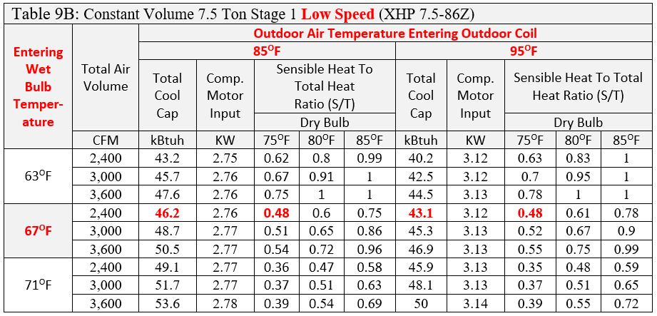
Table 9B

Slide 19
Table 9B Question 1
Using Table 9B on Page 37 in Maria’s Restaurant Guide & Workbook, find the total cooling capacity in Btuh for the XHP 7.5-86Z in operating in low speed on an 85^{O}F outdoor temperature, and with a return air wet bulb temperature of 67^{O}F and a fan CFM of 3,000.

Slide 20
Table 9B Question 1
For an outdoor temperature of 85^{O}F the capacity is 48,700 Btuh and for an outdoor temperature of 95^{O}F it is 45,300 Btuh. Note: kBtuh means 1,000 Btuh so the 48.7 is multiplied by 1,000 to get Btuh.

Slide 21
Table 9B Question 2
Using Table 9B on Page 37 in Maria’s Restaurant Guide & Workbook, find the total latent capacity in Btuh for the XHP 7.5-86Z in operating in low speed with a return air wet bulb temperature of 67^{O}F on an 85^{O}F day, with a fan CFM of 3,000 and a 75 ^{O}F outdoor dry bulb temperature.

Slide 22
Table 9B Question 2
From the chart: at 85^{O}F the sensible over total heat ratio is 0.51 thus, with a total capacity of 48,700 Btuh our sensible capacity would be 48,700 × 0.51 = 24,837
Note: to double check simply divide 24,837 by 0.51 and make sure it equals 48,700 .
Thus, the latent capacity would be 48,700 – 24,873 = 23,827 Btuh

Slide 23
Table 9B Question 3
Find the sensible if the latent heat is 42,840 and the total capacity is 126,000.

Slide 24
Table 9B Question 3
The total minus the latent equals the sensible. Thus, 126,000 – 42,840 = 83,160 Btuh
Note: 126,000 × 0.66 = 83,160 Btuh

Slide 25
Table 9C Question 1
Using Table 9C on Page 38 in Maria’s Restaurant Guide & Workbook, find the total latent capacity in Btuh for the XHP 10-86Z in operating in high speed with a return air wet bulb temperature of 67^{O}F and a fan CFM of 3,200 with a 85^{O}F outdoor dry bulb temperature.

Slide 26
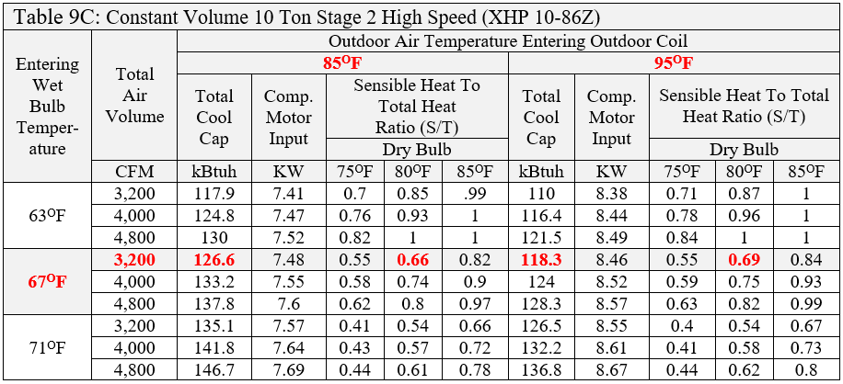
Table 9C Question 1
From the chart: at 3,200 CFM & 80^{O}F Dry Bulb the sensible over total heat ratio is 0.66 thus, with a total capacity of 126,600 Btuh our latent capacity would be 126,600 × (1 - 0.66) = 43,044 Note: Took a short cut, the previous method works for this example too.

Slide 27
Table 9C Question 2
Find the sensible heat for the previous example where the latent heat is 43,044 and the total capacity is 126,600.

Slide 28
Table 9C Question 2 Answer
The total minus the latent equals the sensible. Thus, 126,600 – 43,044 = 83,556 Btuh
Alternate approach: 126,600 × 0.66 = 83,556 Btuh

Slide 29
Field Notes
Changing fan speed and thus, the CFM changes the performance of the commercial equipment. This often happens when a pulley position is changed so the wrong size belt can be put on to get it running. The change in performance may then become the cause of many call backs and the change does not get caught.

