Slide 1
Lesson 1 Friction Chart Primer 1.2 Friction Chart

Slide 2
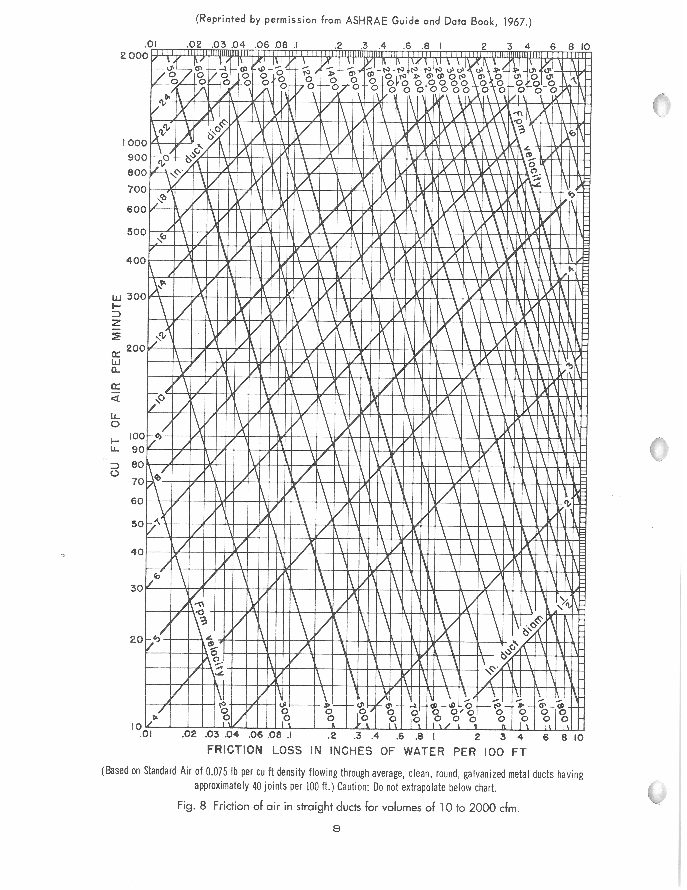
Friction Chart
The Friction Chart is a
graphic representation
of the friction rate loss
in inches of water column
for each 100 feet of duct.

Slide 3
Friction Chart A
Friction of air in straight
ducts per 100 ft for air volumes from 10 to 2,000 CFM
Note: Standard Air of 0.075 lb per cu ft flowing through average, clean, round, galvanized metal ducts having approximately 40 joints per 100 ft.

Slide 4
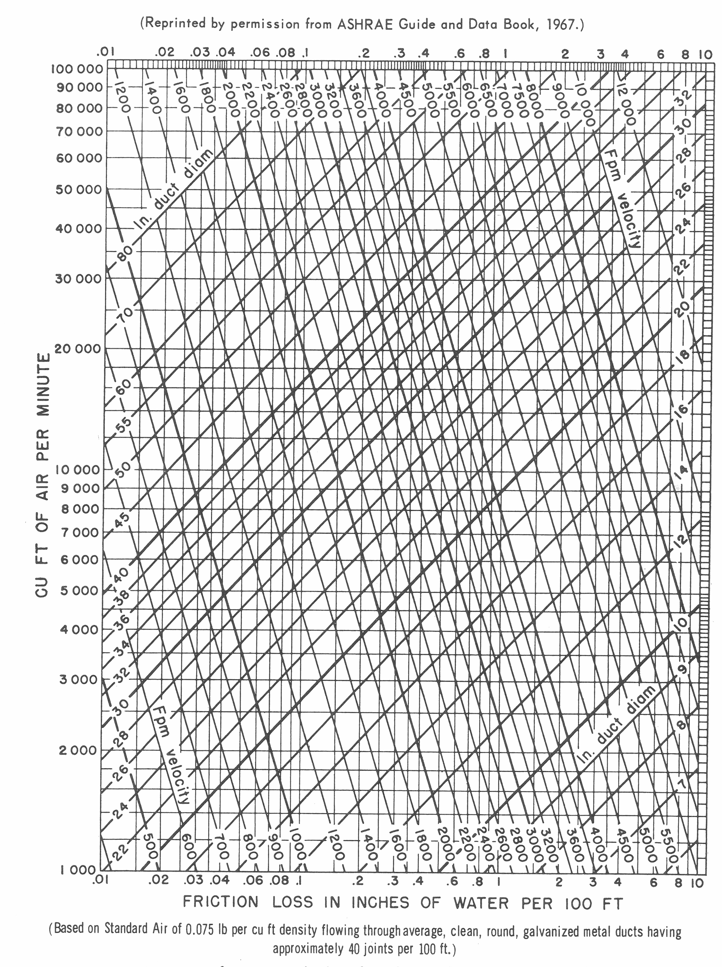
Friction Chart B
Friction of air in straight
ducts per 100 ft for air volumes from1,000 to 100,000 CFM
Note: Standard Air of 0.075 lb per cu ft flowing through average, clean, round, galvanized metal ducts having approximately 40 joints per 100 ft.

Slide 5
Friction Chart
Knowing any two values
on the Friction Chart
allows you to find the
others. Values on the
chart are:
CFM of air
Friction loss per 100ft
FPM velocity of air
Duct diameter (inches)

Slide 6
Friction Chart A
Friction of air in straight
ducts per 100 ft for air volumes of 10 to 2000 CFM
Note: Standard Air of 0.075 lb per cu ft flowing through average, clean, round, galvanized metal ducts having approximately 40 joints per 100 ft.

Slide 7
Friction Chart B
Friction of air in straight
ducts per 100 ft for air volumes of 1,000 to 100,000 CFM
Note: Standard Air of 0.075 lb per cu ft flowing through average, clean, round, galvanized metal ducts having approximately 40 joints per 100 ft.

Slide 8
Friction Chart A
Friction Loss in inches
of water column per
100 ft (.01 to 10)
is on the bottom and
top of The chart

Slide 9
Friction Chart A
Cubic feet of air per
minute is on the left
side of The chart

Slide 10
Friction Chart A
Velocity in feet of air
per minute is shown
by angled vertical lines
On the chart
(200-over 5,500 fpm on
this chart)

Slide 11
Friction Chart A
Duct diameter in inches
(1.5”-28” on this chart)

Slide 12
Friction Chart A
Duct diameter in inches
(between 1.5”-28” on
this chart)

Slide 13
Friction Chart A
Values between the lines
may be interpolated.
For example 13” duct
would be between 12”
and 14” (shown as a
green line)

Slide 14
Friction Chart A
Find the duct diameter
needed in order to
provide 600 CFM of
Airflow at 0.2” of SP

Slide 15
Friction Chart A
Find the duct diameter
needed in order to
provide 600 CFM of
Airflow at 0.2” of SP
Step 1: 600 CFM line

Slide 16
Friction Chart A
Find the duct diameter
needed in order to
provide 600 CFM of
Airflow at 0.2” of SP
Step 1: 600 CFM line
Step 2: 0.2” SP line

Slide 17
Friction Chart A
Find the duct diameter
needed in order to
provide 600 CFM of
Airflow at 0.2” of SP
Step 1: 600 CFM line
Step 2: 0.2” SP line
Step 3: locate duct size
on the cross over point
or the next size to the
left (10” dia duct)

Slide 18
Friction Chart A
Find the duct diameter
needed in order to
provide 600 CFM of
Airflow at 0.2” of SP
Step 1: 600 CFM line
Step 2: 0.2” SP line
Step 3: locate duct size
on the cross over point
or the next size to the
Right (10” dia duct)
Note: the velocity in the duct
can also be found on the chart,
it is approximately 1,100 FPM

Slide 19
Friction Chart A
Find the duct diameter
needed in order to
provide 600 CFM of
Airflow at 0.2” of SP
Step 1: 600 CFM line
Step 2: 0.2” SP line
Step 3: locate duct size
on the cross over point
or the next size to the
Right (10” dia duct)

