Slide 1
Technician’s First Guide and Workbook Section 11: Hydronic System Basics (1)

Slide 2
Hydronic System Basics
Ground water heat pumps and hydronic systems are making a comeback. Today’s technician may see an increasing number of hydronic systems during their career. In many parts of the country boiler systems still are the best way to heat homes. There are now small chillers that are used for residential equipment available. Add in the growing demand for pumping and piping systems for ground water heat pump systems and understanding how water flows through hydronic systems becomes an important HVAC system category for technicians to understand.

Slide 3
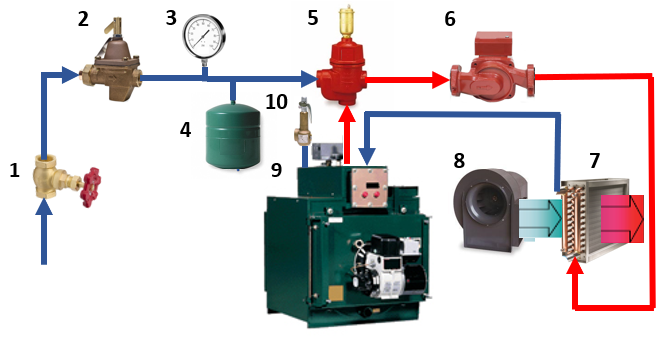
Single Loop Hydronic System Components

Slide 4
1 Supply Water Shut-Off-Valve

Slide 5
2 Water Pressure Regulating Valve

Slide 6
3 Pressure Gauge

Slide 7
4 Expansion Tank

Slide 8
5 Enhanced Air Separator & Auto Vent

Slide 9
6 Water Circulator Pump

Slide 10
7 Heat Exchange Coil

Slide 11
9 Boiler

Slide 12
10 High Pressure/Temperature Safety valve

Slide 13
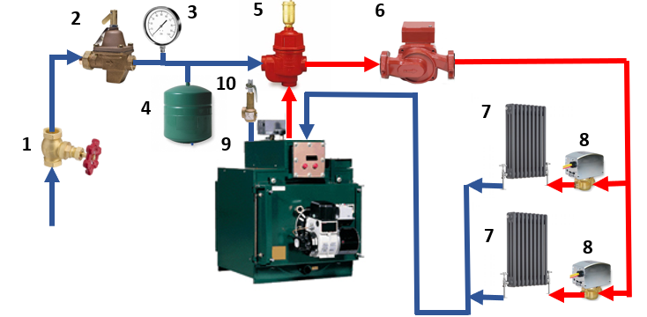
Another Typical Configuration

Slide 14
7 Radiators & 8 Zone Valves

Slide 15
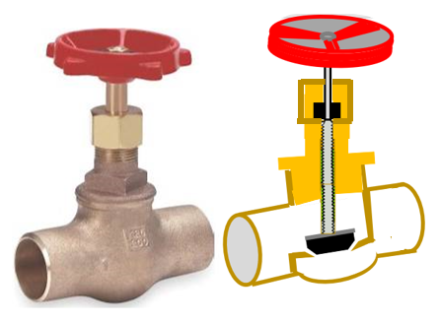
Globe Valves

Slide 16
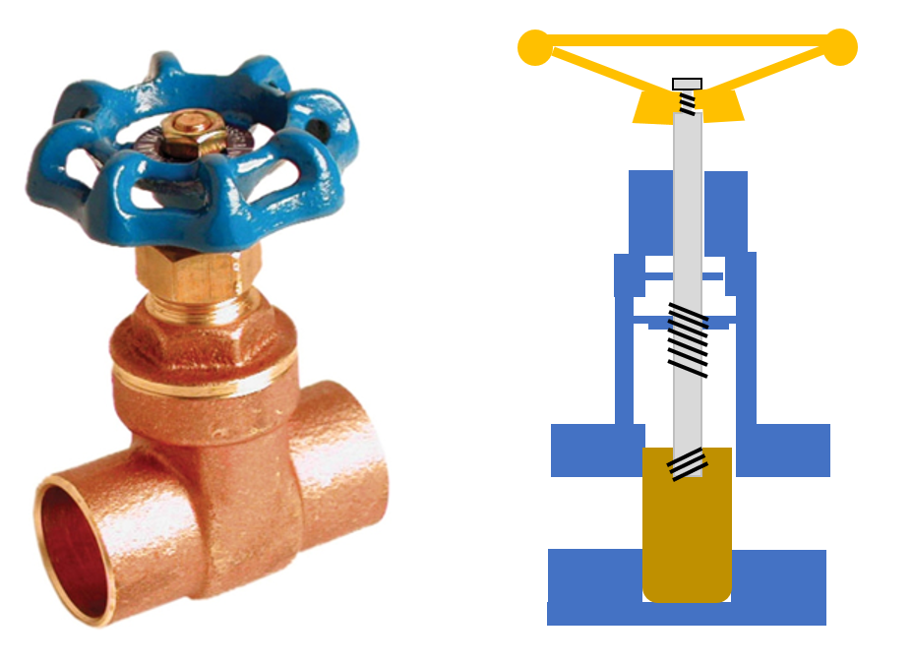
Gate Valves

Slide 17
Ball Valves

Slide 18
Lessons Learned
You should now be able to identify a circulating pump on a hydronic system.
You should now be able to identify a safety valve and explain why the size is important.
You should now be able to identify a pressure regulator on a hydronic system.
You should now be able to identify an expansion tank in a hydronic system.
You should now be able to Identify an air separator and an auto vent in a hydronic system.

