Slide 1
Duct Design Basics Lesson 3 Calculations

Slide 2
Evaluating Designs 3.2

Slide 3
Residential Duct Sizing
Flow Rate (CFM) Values
Available Static Pressure
Total Effective Length
Design Friction-Rate Value
Runout and Trunk Section Sizing
Velocity Check
Example – Residential System

Slide 4
Flow Rate (CFM) Values
Residential duct system designers generally start
with a sketch or a drawing of the duct system needed to deliver airflow to and from each room or area.
CFM values are assigned based on the CFM per BTU
load calculation values assigned to those rooms or
areas.
The final CFM value should be based on a combination of Manual J and Manual S values

Slide 5
Flow Rate (CFM) Values
Example:
Room CFM = Blower CFM x Room Load ÷ Equipment Sizing Load
Where:
Blower CFM = the System’s total CFM
Room Load = the designed total Load for the room or area
Equipment sizing Load = the total Load for the system
Find the Room CFM for a room with a 1,800 BTU load where the total load is 24,000 BTU and the Blower CFM total is 1,200
Room CFM = 1,200 x 1,800 ÷ 24,000 = 90 CFM
Note: For more detail see Manuals J, D, and S

Slide 6
Available Static Pressure
The Static Pressure that is available to make the correct airflow
pass through all of the duct and fittings is equal to the blower table pressure minus the pressure drops across everything in the duct system (that is not included in the blower table SP).

Slide 7
Total Equivalent (or Effective) Length
Once the CFM airflow rates are known for each room and
the duct sketch or drawing is done:
The lengths of supply and return duct can be added up using the total equivalent length method (TEL).
Straight duct runs are simply measured by length.
For fittings:
Manual D lists a fitting’s equivalent length (EL) value that can be used for determining a duct run’s TEL.
Pictured: A manual D fitting listed as 6K
with an EL of 10 for a return duct.

Slide 8
Blower Performance

Slide 9
Duct Performance

Slide 10
Design Friction-Rate Value
F/100 = ASP x 100 ÷ TEL
Where:
F/100 = Design Friction-Rate Value
ASP = Available Static Pressure
TEL = Total Equivalent Length of the path with the most resistance (usually the longest duct run)

Slide 11
Design Friction-Rate Value
Find the supply duct design friction rate for a system that is 250 ft long (TEL) and operates at 1.5 IWC
F/100 = ASP x 100 ÷ TEL
F/100 = 1.5 x 100 ÷ 250 = 0.6

Slide 12
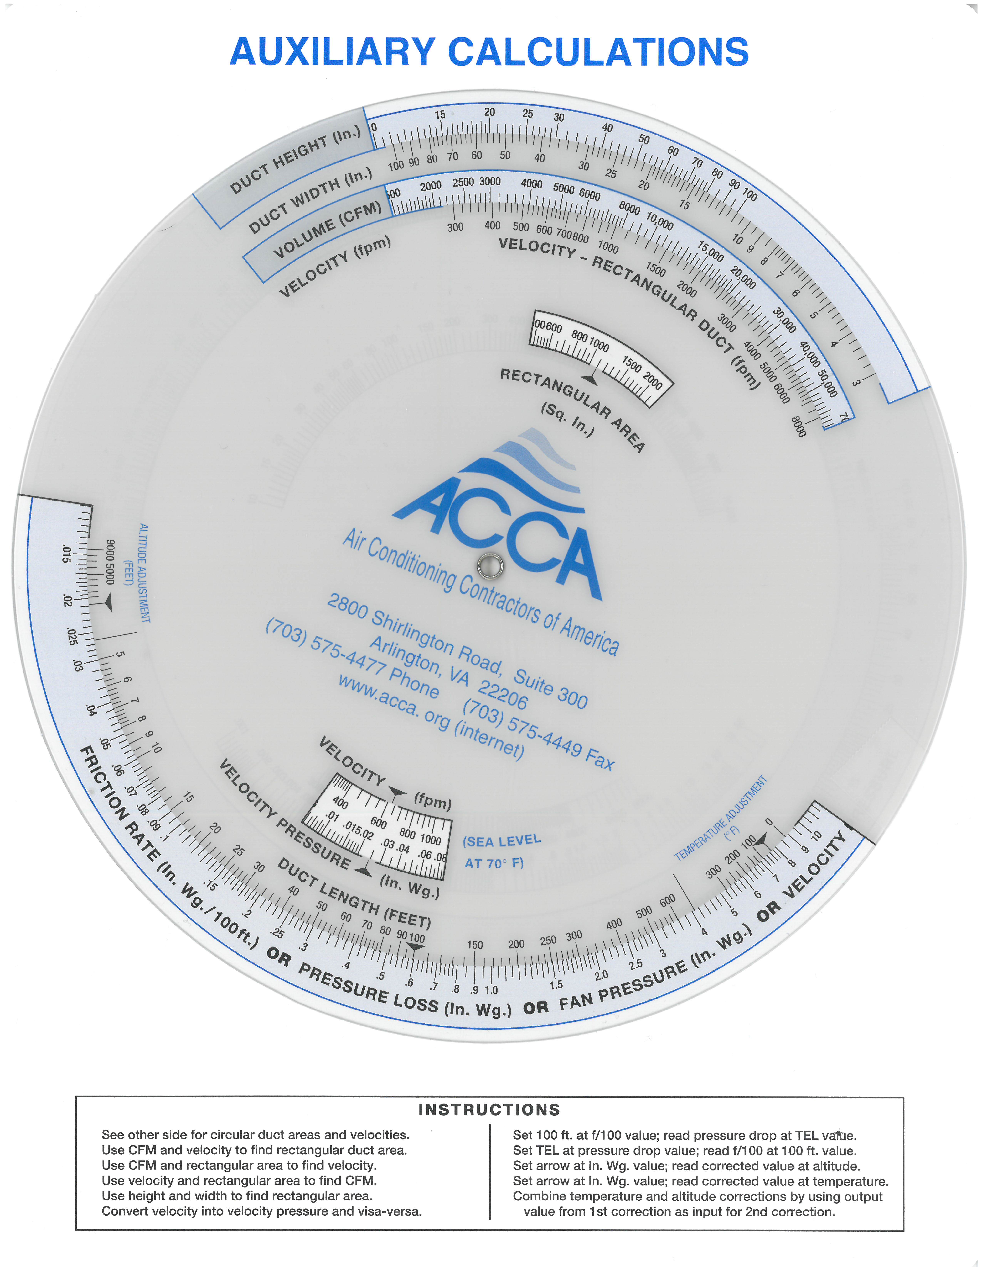
Design Friction-Rate Value
Find the supply duct design friction rate for a system that is 250 ft long (TEL) and operates at 0.15 IWC
F/100 = ASP x 100 ÷ TEL

Slide 13
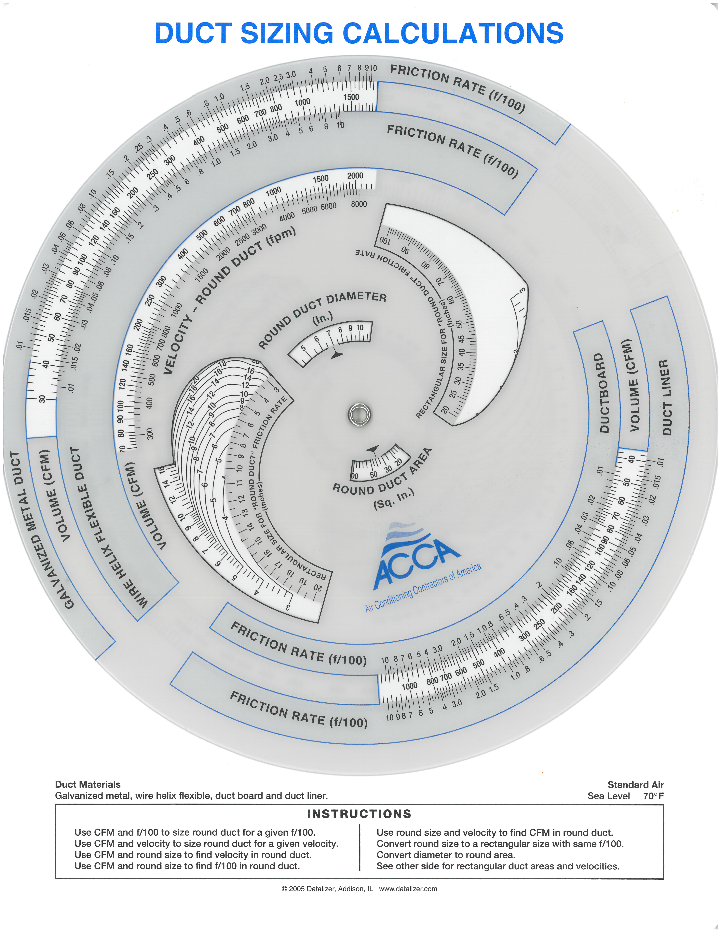
Runout and Trunk Section Sizing
Use the design friction rate (0.60) to find the duct trunk size for any CFM. For example, use 300 CFM on Wire Helix Scale:

Slide 14
Velocity Check
Use the design friction rate (0.60) to find the duct trunk size for any CFM. For example, use 300 CFM on Wire Helix Scale:

Slide 15
Velocity Check
Use the design friction rate (0.60) to find the duct trunk size for any CFM. For example, use 300 CFM on Wire Helix Scale:
Velocity = 1,160 FPM

Slide 16
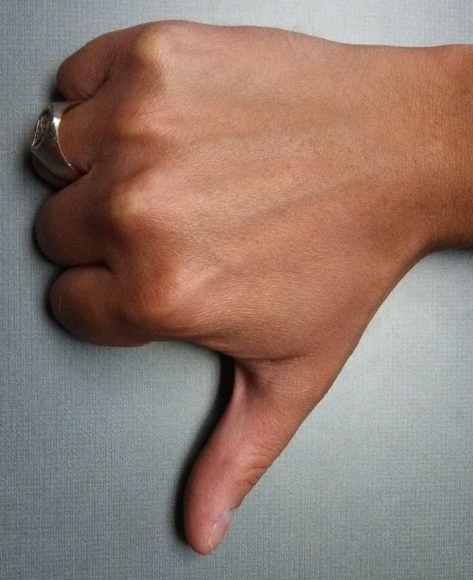
Maximum Recommended Velocities
 | Supply |  | Return
 | Rigid | Flex | Rigid | Flex
Trunks | 900 | 700 | 700 | 700
Runouts | 900 | 700 | 700 | 700
Velocity Check
Use the design friction rate (0.60) to find the duct trunk size for any CFM. For example, use 300 CFM on Wire Helix Scale:
Velocity = 1,160 FPM

Slide 17
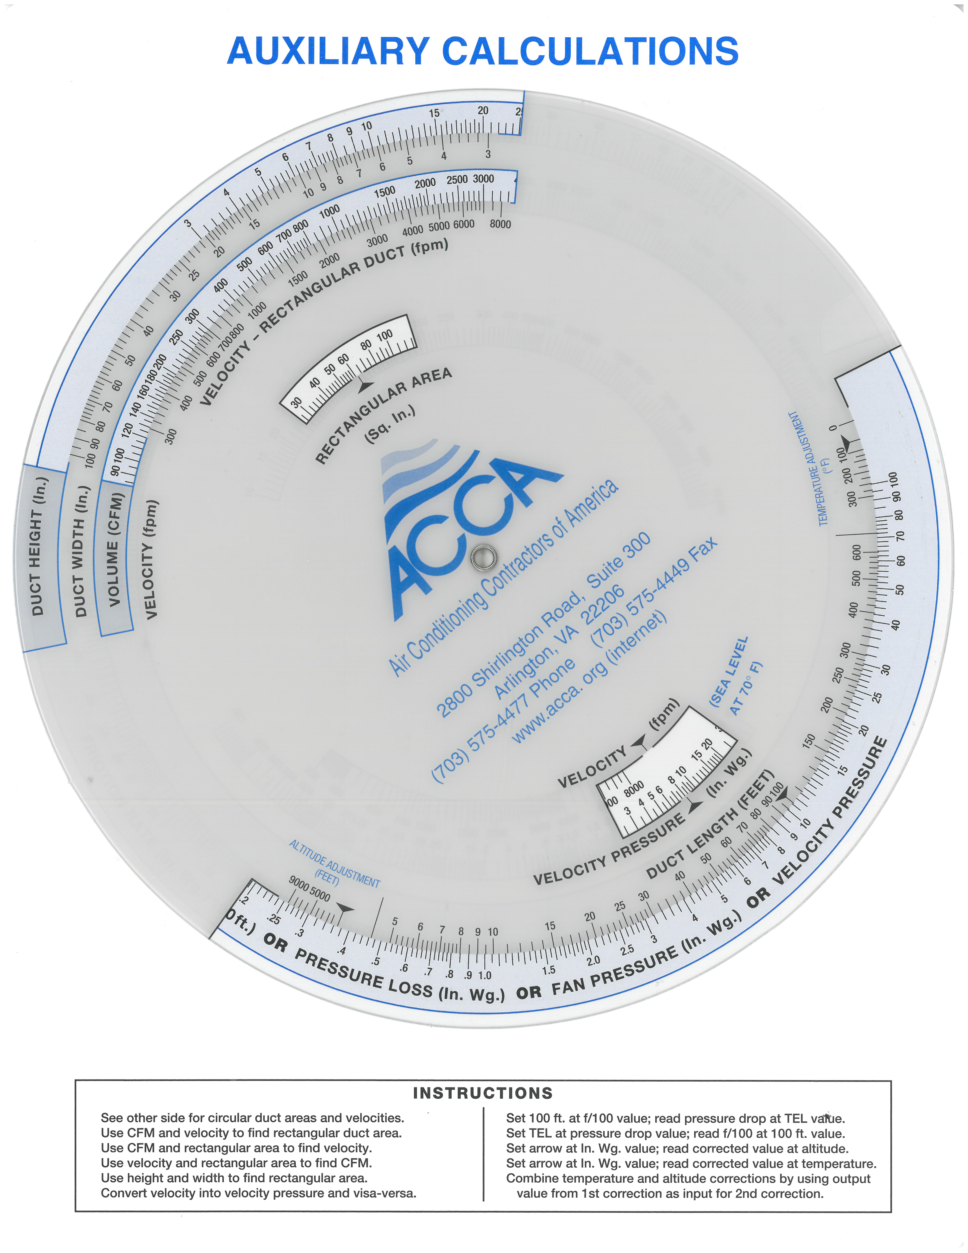
Velocity Check
Search for Duct Size where you get 700 FPM For 300 CFM

Slide 18
Velocity Check
Search for Duct Size where you get 700 FPM For 300 CFM

Slide 19
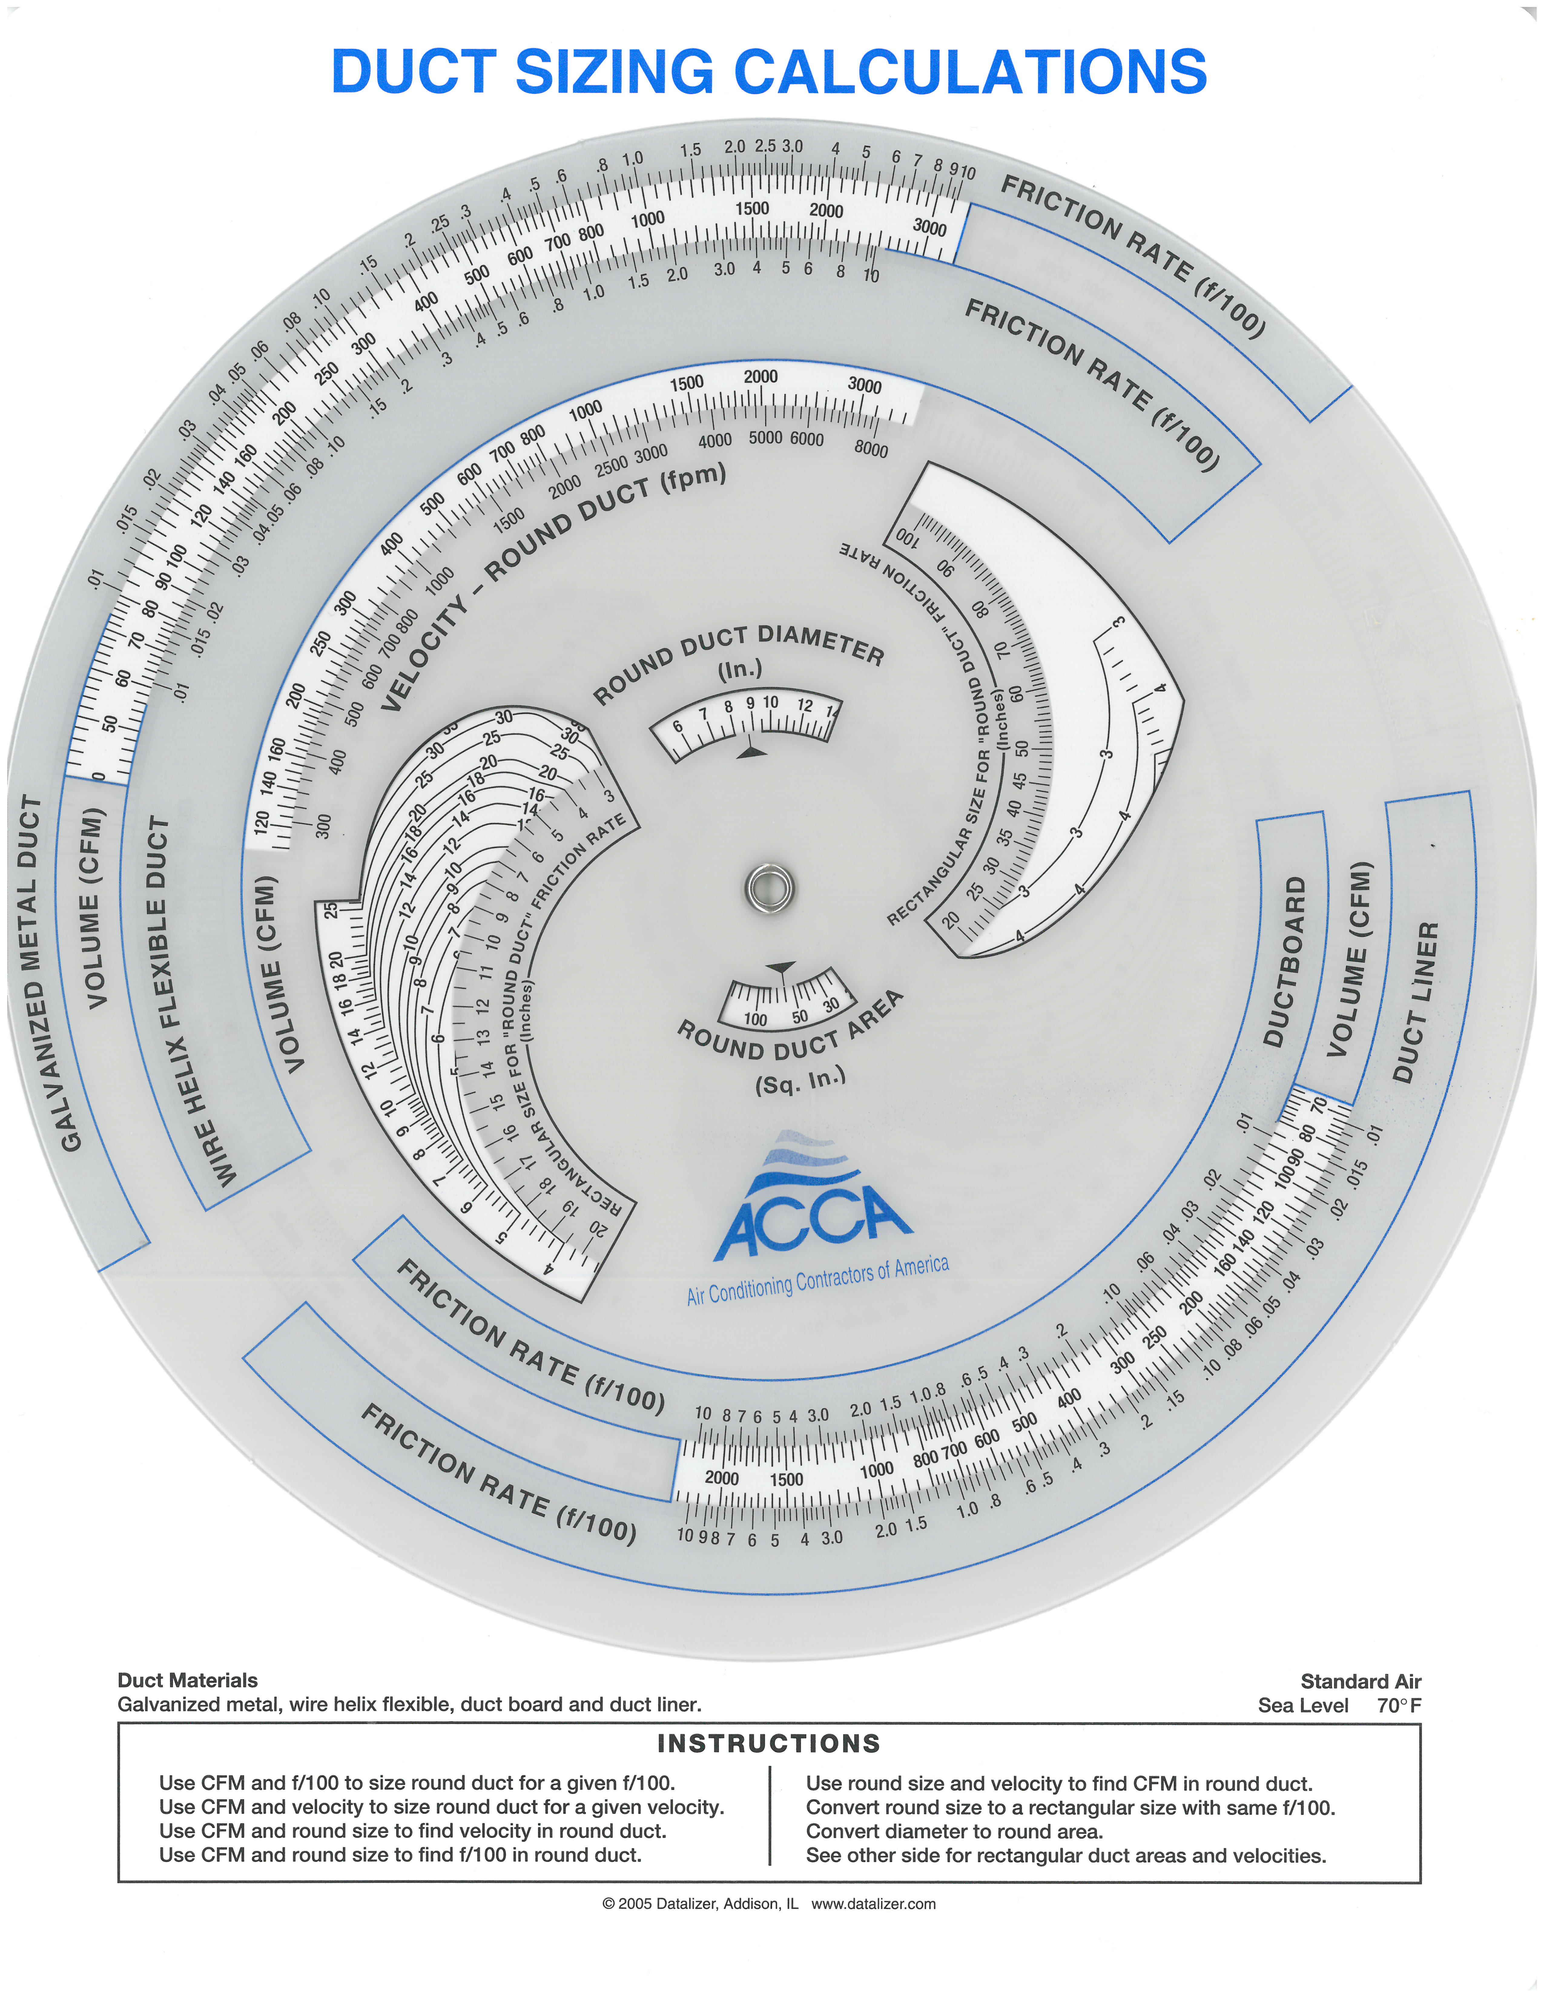
Velocity Check
Use the Size 8 x 8 and 300 CFM to find the new design FR

Slide 20
Velocity Check
Use the Size 8 x 8 and 300 CFM to find the new design FR
New Design FR = 0.19

