Slide 1
Duct Design Basics Lesson 4

Slide 2
Knowledge & Skills for Manual D 4.1

Slide 3
Knowledge and Learned Skills Needed
to Understand Manual D
Load Calculations Manual J
Equipment Performance Data Manual S
Understanding Duct Performance (Friction Chart)
Calculate Equivalent (Effective) Length
Calculate Pressure Drop for External Components
Calculate Available Pressure
Use Friction Rate to Size Duct
Understand Velocity-Noise Relationship

Slide 4
Knowledge and Learned Skills Needed
to Understand Manual D
Load Calculations Manual J
Equipment Performance Data Manual S
Understanding Duct Performance (Friction Chart)
Calculate Equivalent Length
Calculate Pressure Drop for External Components
Calculate Available Pressure
Use Friction Rate to Size Duct
Understand Velocity-Noise Relationship

Slide 5
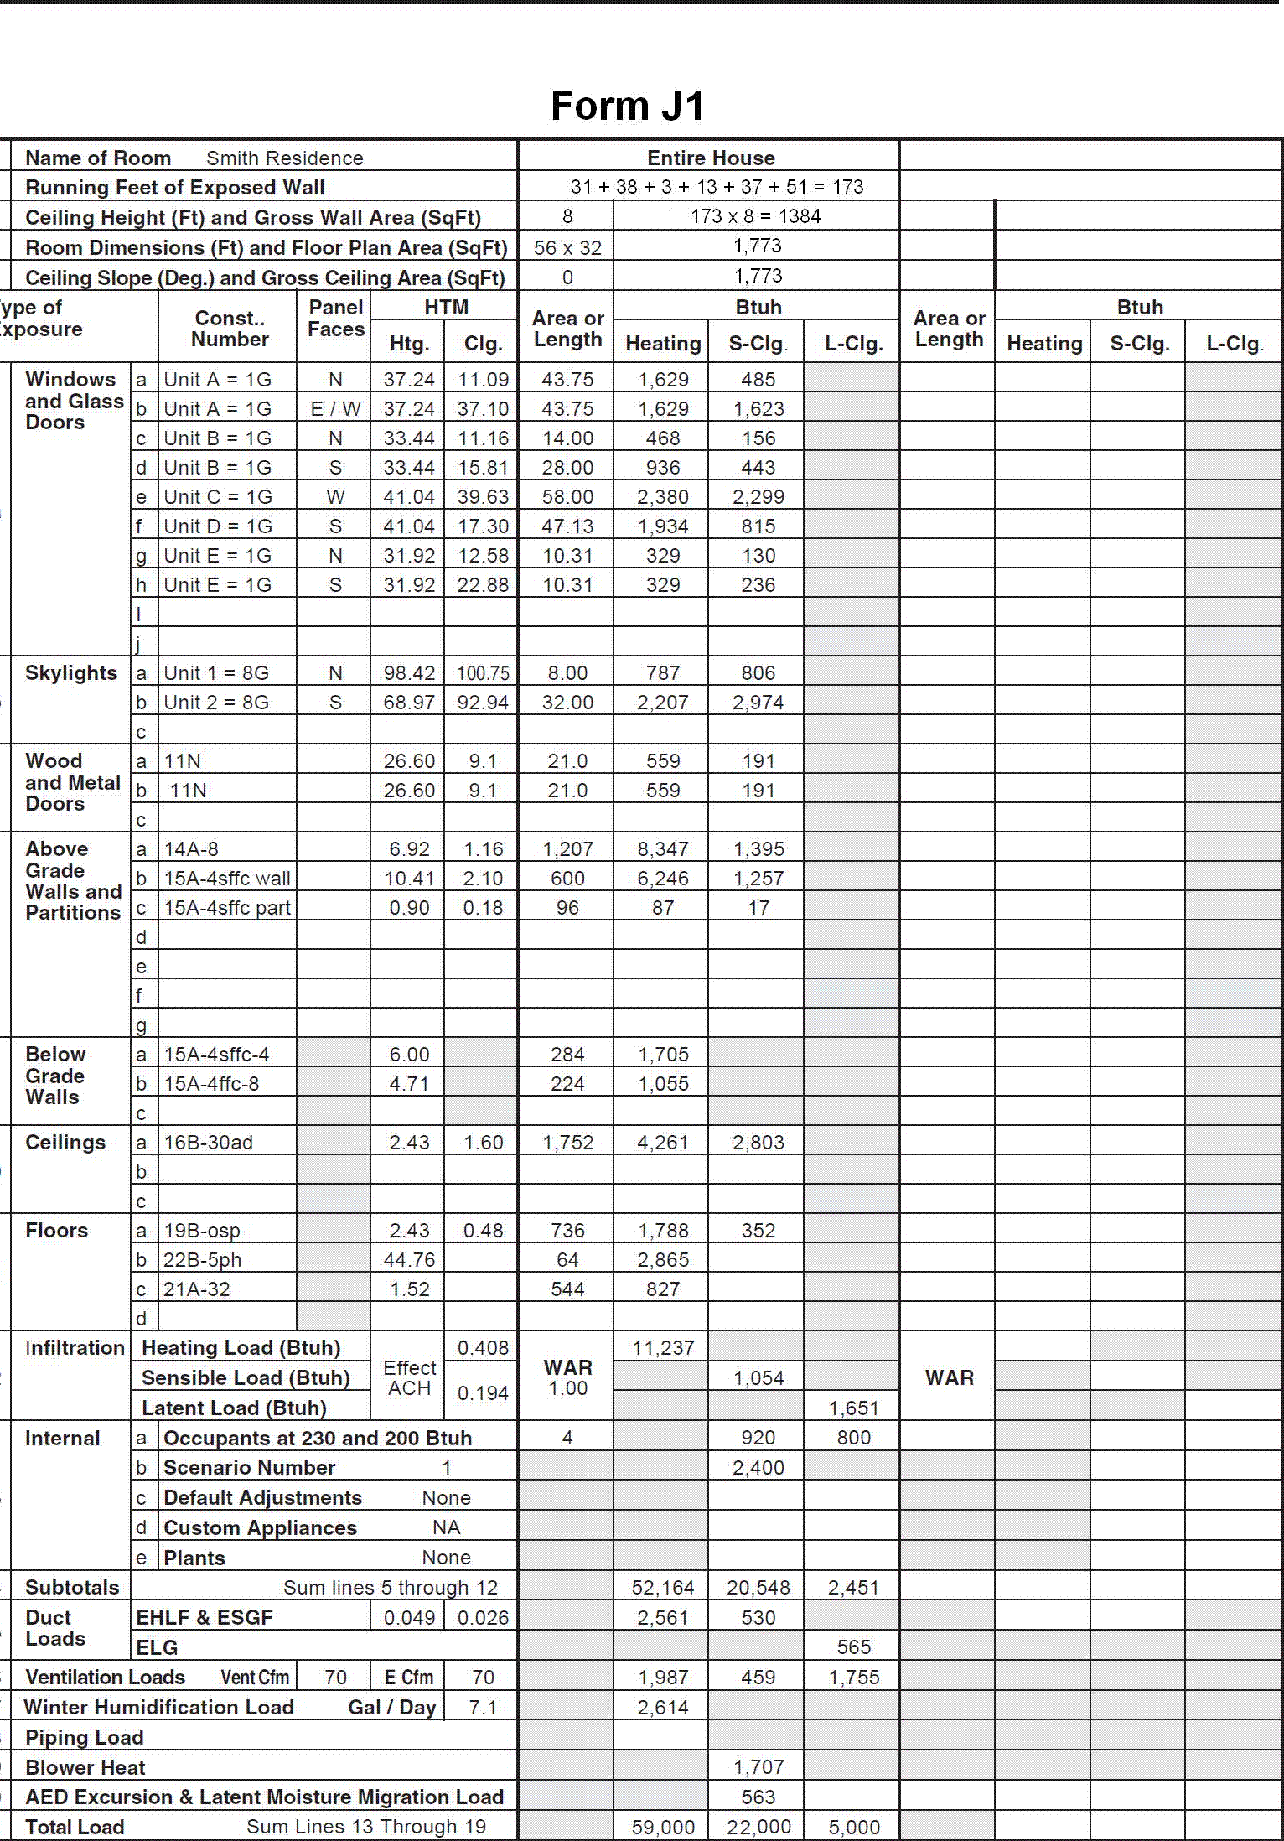
Knowledge and Learned Skills Needed
to Understand Manual D
Manual J

Slide 6
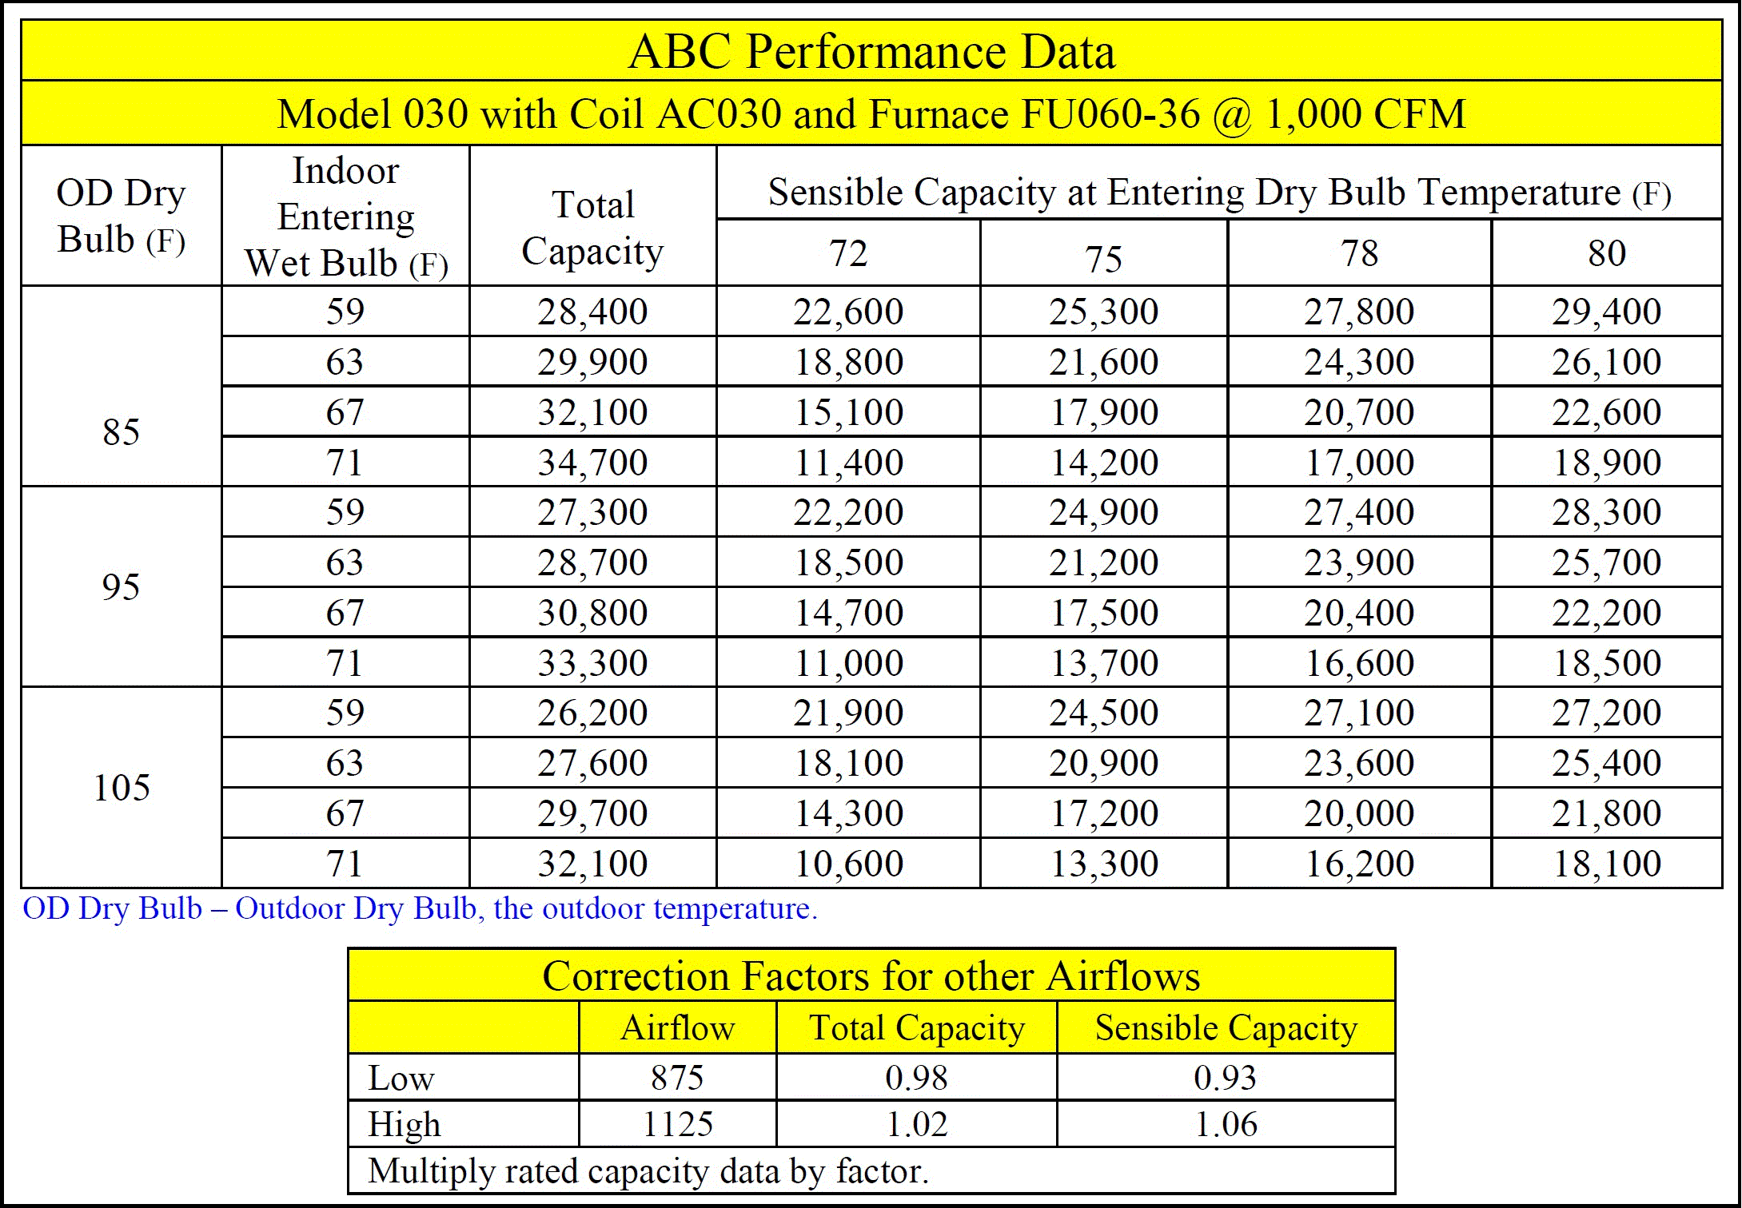
Knowledge and Learned Skills Needed
to Understand Manual D
Manual S

Slide 7
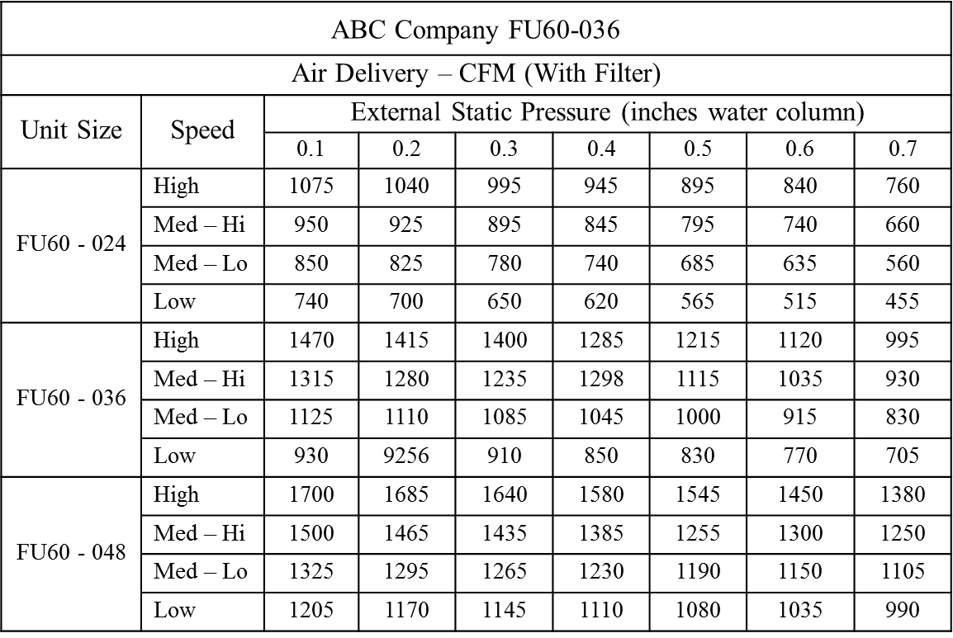
Knowledge and Learned Skills Needed
to Understand Manual D
Manual S

Slide 8
Knowledge and Learned Skills Needed
to Understand Manual D
Understanding Duct Performance (Friction Chart)
Calculate Equivalent (Effective) Length
Calculate Pressure Drop for External Components
Calculate Available Pressure
Use Friction Rate to Size Duct
Understand Velocity-Noise Relationship

Slide 9
Knowledge and Learned Skills Needed
to Understand Manual D
Understanding Duct Performance (Friction Chart)
Calculate Equivalent (Effective) Length
Calculate Pressure Drop for External Components
Calculate Available Pressure
Use Friction Rate to Size Duct
Understand Velocity-Noise Relationship

Slide 10
Friction Rate
Pressure drop is the pressure loss between any
two points in a duct system in inches of water
Column (IWC).

Slide 11
Pressure Drop
Friction rate (FR) is the pressure drop at a
specific distance:
200 ft

Slide 12
Pressure Drop and Friction Rate
FR = PD x 100 ÷ TEL
TEL = Total equivalent length & PD = Pressure drop
200 ft

Slide 13
Pressure Drop and Friction Rate
FR = PD x 100 ÷ TEL
TEL = Total equivalent length & PD = Pressure drop
200 ft
PD = .02 IWC

Slide 14
Pressure Drop and Friction Rate
FR = PD x 100 ÷ TEL
FR = 0.02 x 100 ÷ 200 = 0.01
200 ft
PD = .02 IWC

Slide 15
Pressure Drop and Friction Rate
What if the duct length was 20 ft?
FR = 0.02 x 100 ÷ 20 = 0.1
200 ft
PD = .02 IWC

Slide 16
Equivalent (Effective) Length
Once the FR is known a duct slide rule or friction
chart can be used to select the duct size.
200 ft
PD = .02 IWC

