Slide 1
Duct Design Basics Lesson 4 Manual D Primer

Slide 2
Available Static Pressure 4.4

Slide 3
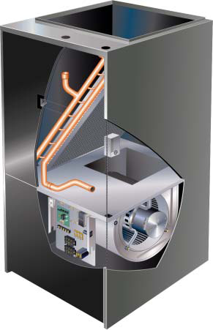
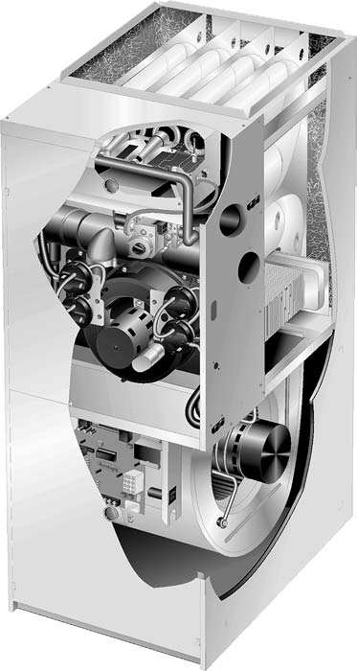
Pressure Drop for Airside Components
Only duct has been shown thus far!
Anything placed in the duct that is not included in
The equipment manufacturer’s external static pressure (ESP)
rating needs to be included in the System friction loss total.
ESP

Slide 4
Pressure Drop for Airside Components
Only duct has been shown thus far!
Anything placed in the duct that is not included in
The equipment manufacturer’s external static pressure (ESP)
rating needs to be included in the System friction loss total.
Filters
Coils
Diffusers & Grilles
Heating Elements
Humidifier
Balancing damper
ESP = 0.50

Slide 5
Available Static Pressure (ASP)
Step 1: Manufacturer’s blower data
XYZ Brand ESP 0.50 @ 1,200 CFM (wet coil, filter included)
Step 2: Calculate Component Losses
Filters--------------------------- N/A
Coils----------------------------- N/A
Diffusers & Grilles----------- 0.065
Heating Elements------------ 0.02
Humidifier--------------------- 0.03
Balancing damper----------- N/A (Bad Idea)
Total--------------------------------- 0.115 IWC

Slide 6
Pressure Drop for Airside Components
Only duct has been shown thus far!
Anything placed in the duct that is not included in
The equipment manufacturer’s external static pressure (ESP)
rating needs to be included in the System friction loss total.
Filters
Coils
Diffusers & Grilles
Heating Elements
Humidifier
Balancing damper
ESP = 0.70

Slide 7
Available Static Pressure (ASP)
Step 1: Manufacturer’s blower data
XYZ Brand ESP 0.70 @ 1,200 CFM (wet coil, filter included)
Step 2: Calculate Component Losses
Filters--------------------------- N/A
Coils----------------------------- 0.13
Diffusers & Grilles----------- 0.065
Heating Elements------------ 0.02
Humidifier--------------------- 0.03
Balancing damper----------- N/A
Total--------------------------- 0.245 IWC

Slide 8
Available Static Pressure (ASP)
Step 3: Available Static Pressure (ASP)
ASP = ESP – CPL = 0.70 – 0.245 = 0.455 IWC
Step 4: Total Effective Length (TEL)
Supply Duct TEL + Return TEL = 121 + 274 = 395 Feet
Step 5: Friction Rate Design Value
FR = ASP x 100 ÷ TEL = 0.455 x 100 ÷ 395 = 0.115 IWC/100

Slide 9
Available Static Pressure (ASP)
Step 3: Available Static Pressure (ASP)
ASP = ESP – CPL = 0.70 – 0.245 = 0.455 IWC
Step 4: Total Effective Length (TEL)
Supply Duct TEL + Return TEL = 121 + 274 = 395 Feet
Step 5: Friction Rate Design Value
FR = ASP x 100 ÷ TEL = 0.455 x 100 ÷ 395 = 0.115 IWC/100

Slide 10
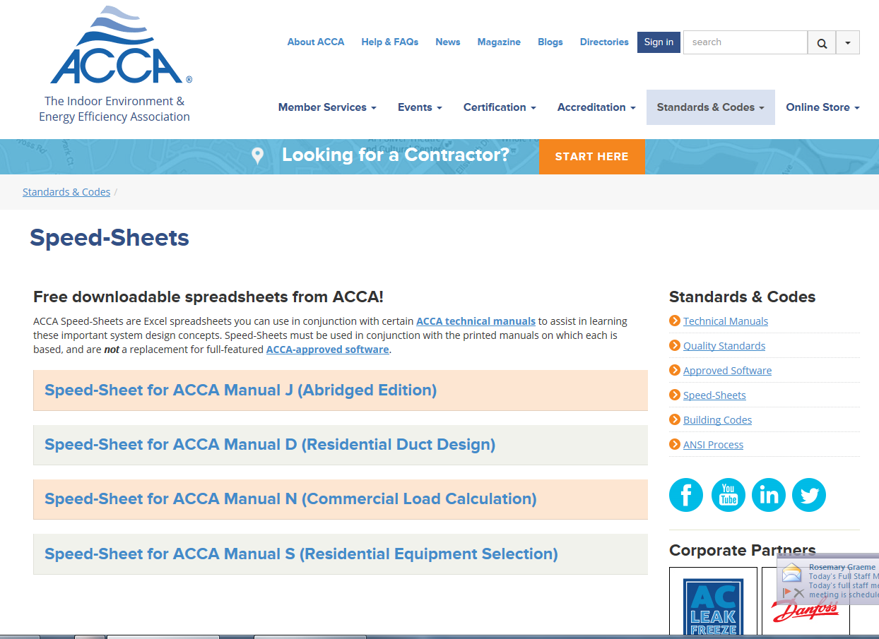
www.acca.org/speedsheet

Slide 11
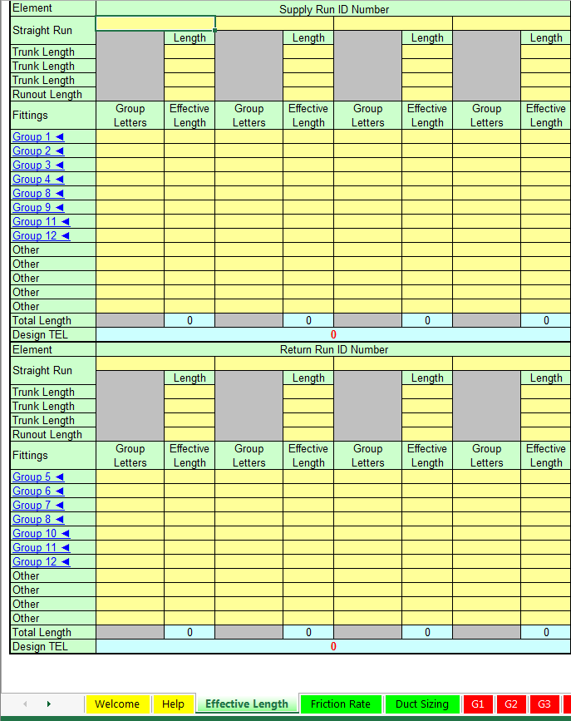
www.acca.org/speedsheet

Slide 12
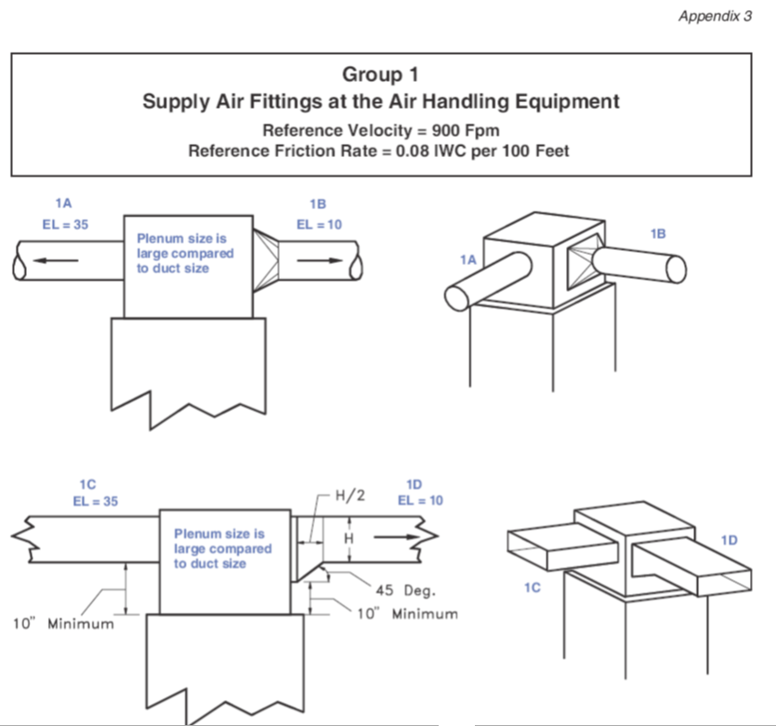
www.acca.org/speedsheet

Slide 13
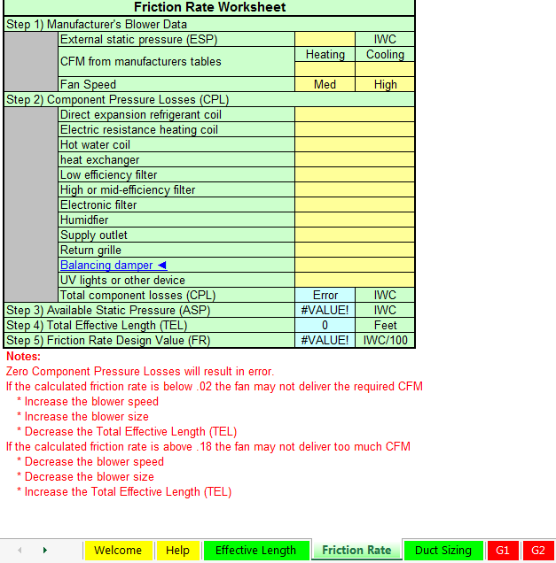
www.acca.org/speedsheet

Slide 14
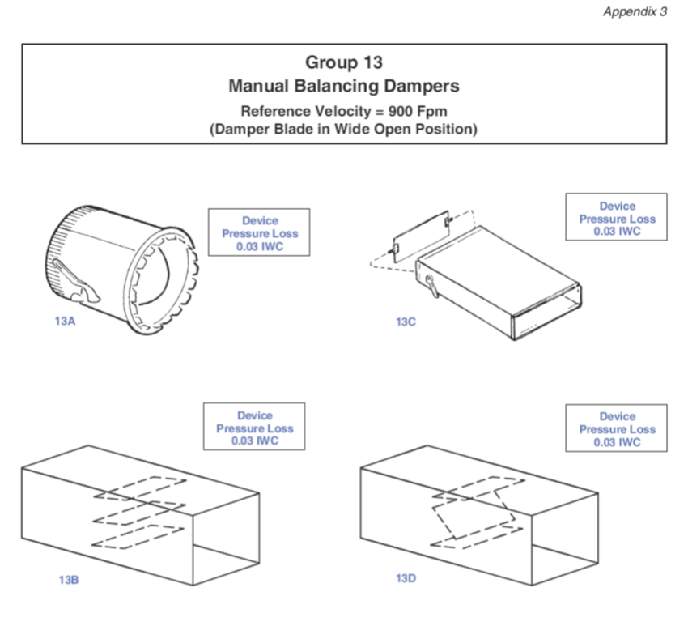
www.acca.org/speedsheet

Slide 17
Manual D Normative Sections
Section 1 – Basic Duct Sizing Principles
Section 2 – System Operating Point
Section 3 – Blowers
Section 4 – System Performance Issues
Section 5 – Air Distribution System Design
Section 6 – Duct Sizing Calculations
Section 7 – Air-Zoned Systems

Slide 18
Manual D Informative Sections
Section 8 – Sizing Rigid Constant CFM Duct Sys.
Section 9 – Sizing Flexible Constant CFM Duct Sys.
Section 10 – Sizing Rigid Air-Zoned Duct Sys.
Section 11 – Sizing Flexible Air-Zoned Duct Sys.
Section 12 – Sizing Two-Zone Bi-Level Duct Sys.
Section 13 – Zone Damper Retrofit

Slide 19
Manual D Normative Appendices
Appendix 1 – Tables and Equations
Appendix 2 – Friction Charts, Duct Slide Rules and
Equivalency Tables
Appendix 3 – Fitting Equivalent Lengths
Appendix 4 – Fitting Equivalent Length Adjustments
Appendix 5 – Terminology

Slide 20
Manual D Informative Appendices
Appendix 6 – Duct Construction Standards
Appendix 7 – Standard of Care and Continuity
Appendix 8 – Residential Air Distribution Sys.
Appendix 9 – Equipment and Air-Side Components
Appendix 10 – Duct Sys. Efficiency
Appendix 11 – Duct Leakage and Sys. Interactions
Appendix 12 – Air Quality Issues
Appendix 13 – Noise

Slide 21
Manual D Informative Appendices
Appendix 14 – Testing and Balancing
Appendix 15 – Air Velocity for Ducts and Grilles
Appendix 16 – Excess Length and Sag in Flex. Duct
Appendix 17 – Symbols and Abbreviations
Appendix 18 – Manual D Worksheets

