Slide 1
Part 9 Technician’s Guide & Workbook for Duct Diagnostics and Repair

Slide 2
Section 4.1: Inspection & Testing

Slide 3
Inspection and Testing
Step | Description | Discussion
1 | Inspect the duct system | Evaluating a duct system’s efficiency begins with visual inspection. This means looking for telltale signs that a duct system needs repair.
2 | Test for duct leakage | Air leakage from ducts is important not only because of its energy costs, but also because many of the comfort, health and safety problems that arise in duct systems are caused by air leakage.
3 | Measure the system airflow rate | Efficiency of the duct system depends not only on duct leakage, but also on duct leakage as a fraction of fan flow. Low fan flow is one of the major causes of poor air conditioner performance.
4 | Determine what actions to take | Sometimes it will be obvious what needs to be done. Other times, there will be a question of how much effort to put into duct repair.

Slide 4
Review Section 1 Visual Inspection
Section 1 drawing the duct system sketches should include the locations of the following:
Damaged insulation or uninsulated ducts;
Disconnected, torn, or damaged ducts,
Abandoned ducts;
Inadequate return ducting;
Inadequate supply ducting;
Evidence of leakage

Slide 5
Review Section 3 Duct Location
Points to consider when developing duct design strategies:
Consider changing duct locations to conditioned space.
Consider upgrading insulation
Consider moving equipment to conditioned space.
Evaluate return and supply airflow paths for each conditioned space.

Slide 6
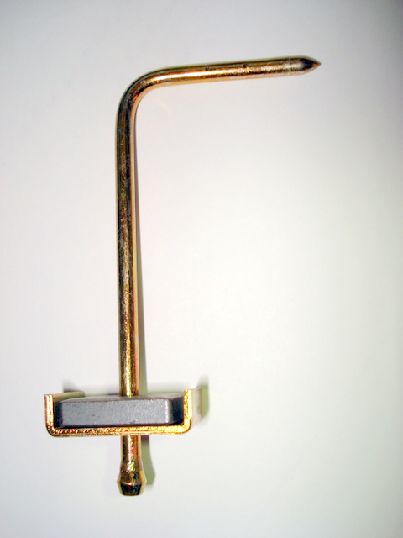
Static Pressure Testing Tools
Static Pressure Testing
AIR PRESSURE

Slide 7
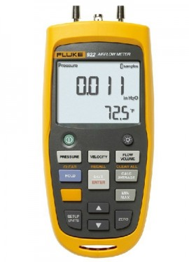
SP Measurement
Static Pressure Testing
AIR FLOW
_
+
0.20

Slide 8
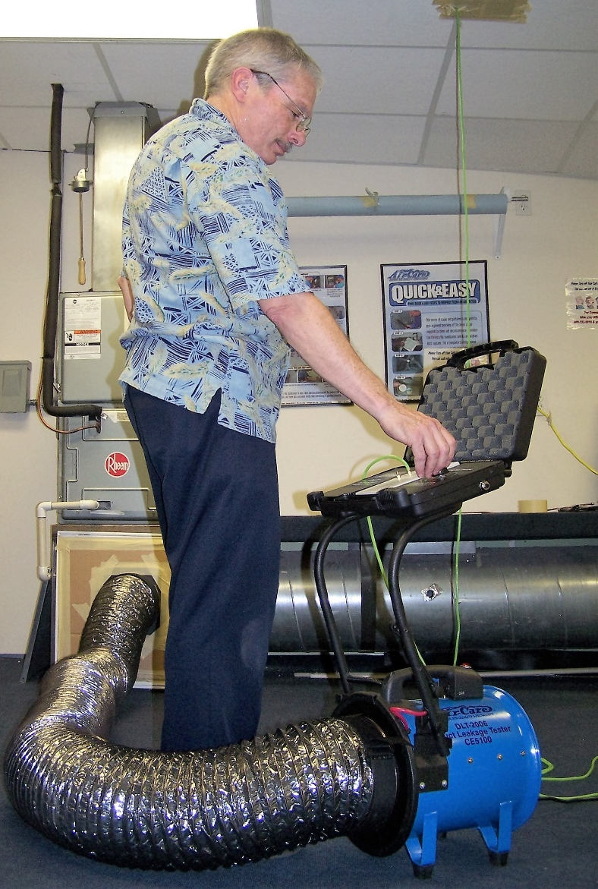
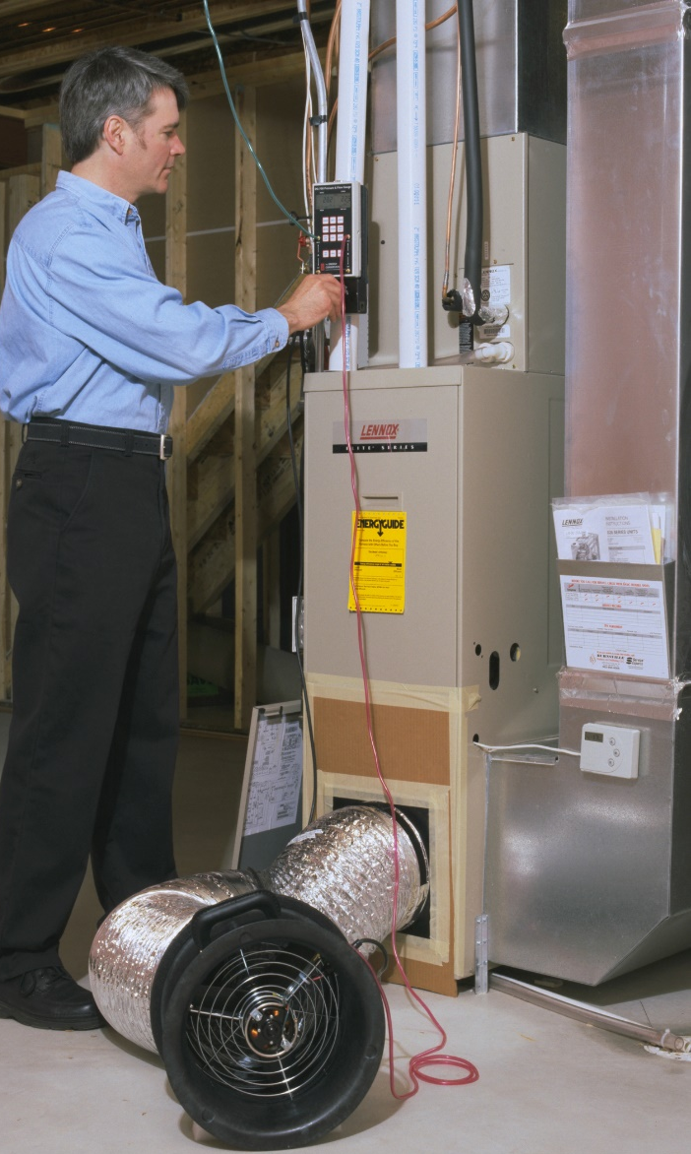
Duct Blower Installation
Meter
Connection
Fitting
Flex Duct
Fan

Slide 9
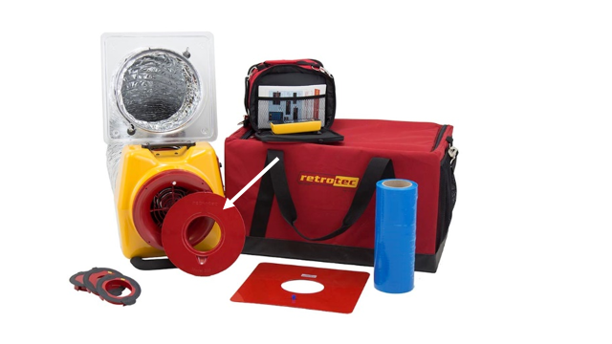
Duct Blower Orifice Rings
Orifice Rings

Slide 10
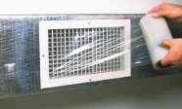
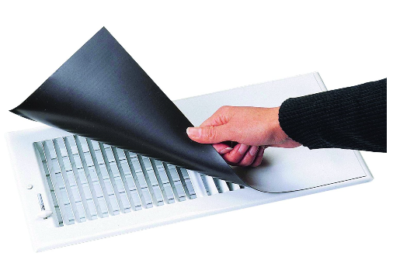
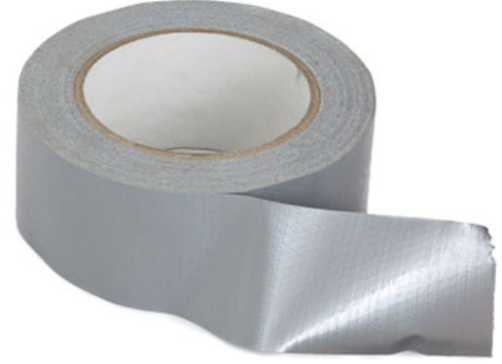
Duct Blower Test Set Up
Sealing Outlets

Slide 11
Lessons Learned
You should now be able to explain what to look for during a duct inspection.
You should be able to name the 4 steps for Testing and diagnosing Duct Systems.
You should now be able to explain how to set up a basic duct leakage test using a calibrated fan.
You should be able to explain where you may use left over duct tape on the truck.

