Slide 1
Technician’s First Guide and Workbook Section 5: HVAC Maintenance Tools (2)

Slide 2
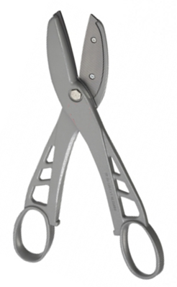
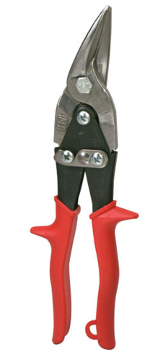
Sheet Metal Snips

Slide 3
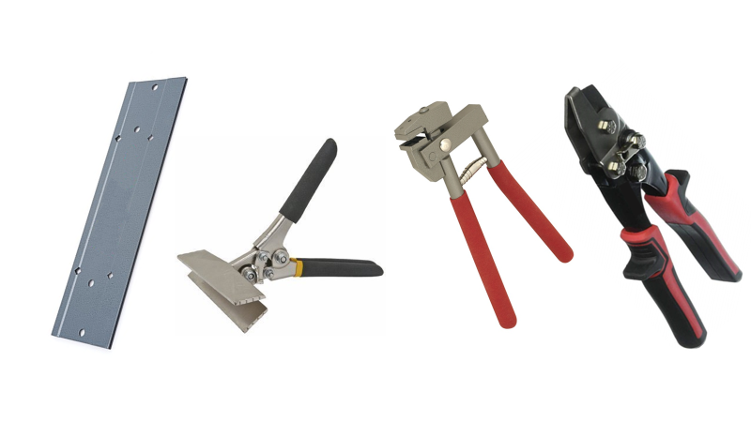
Common Sheet Metal Tools

Slide 4
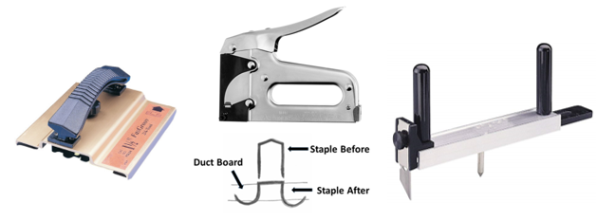
Common Duct Board Tools

Slide 5
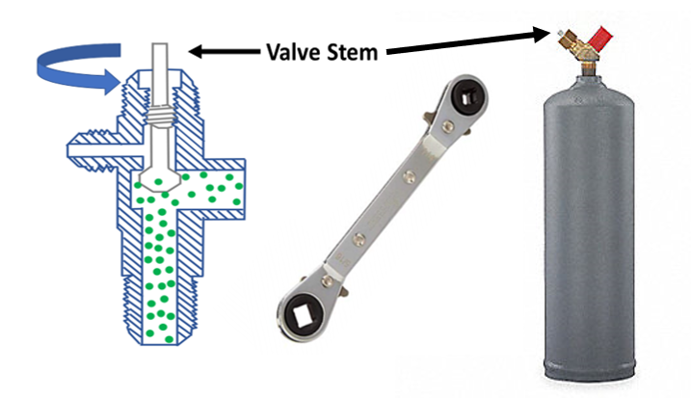
HVACR Specialty Tools

Slide 6
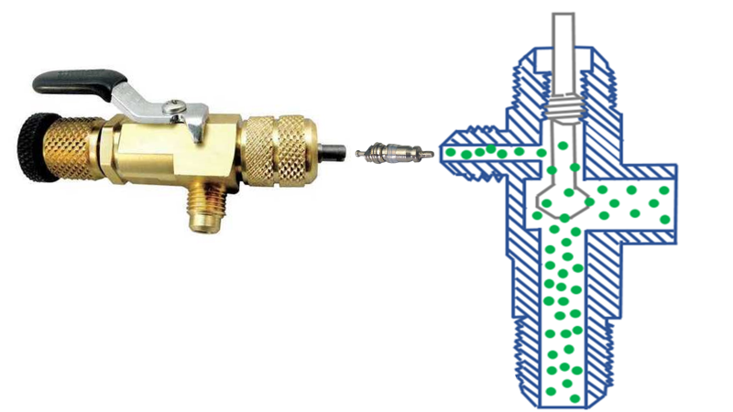
Valve Stem Removal Tool

Slide 7
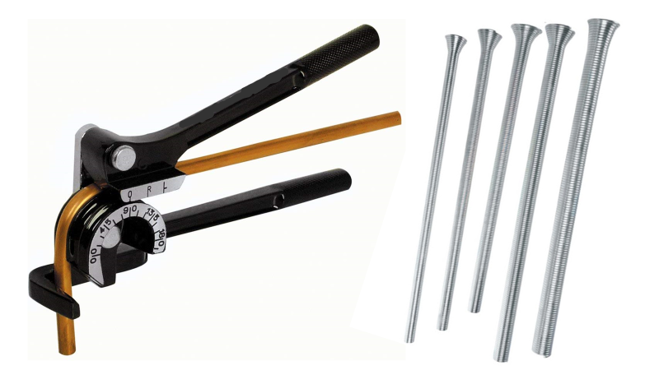
Refrigerant Pipe Bending Tools

Slide 8
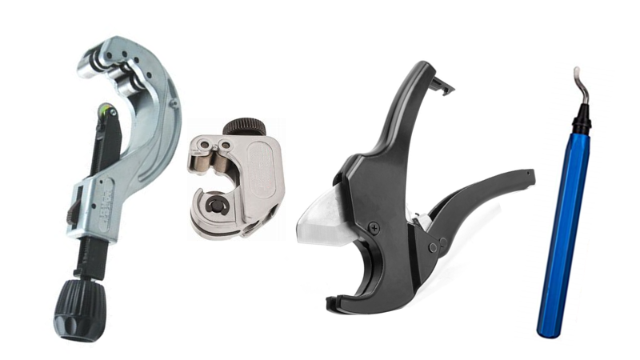
Pipe Cutting Tools

Slide 9
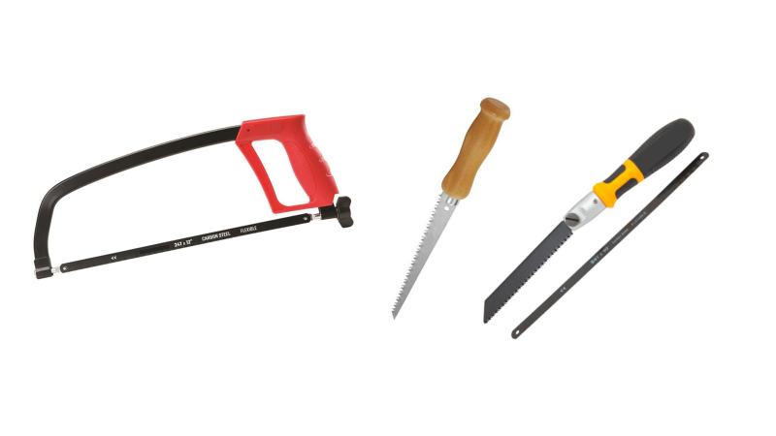
Common Saw Types

Slide 10
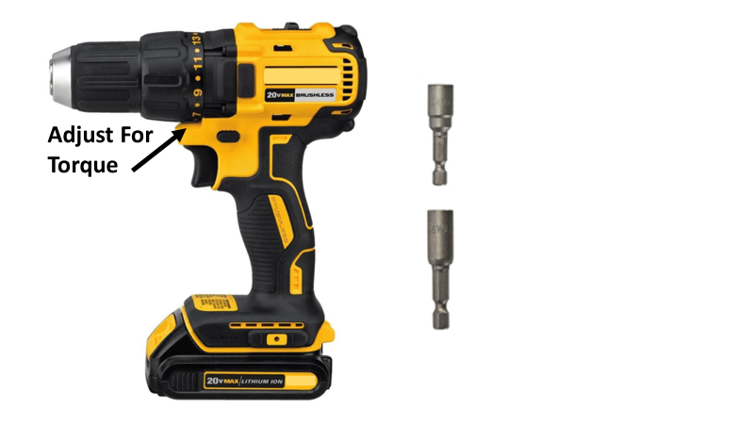
Battery Powered Drill

Slide 11
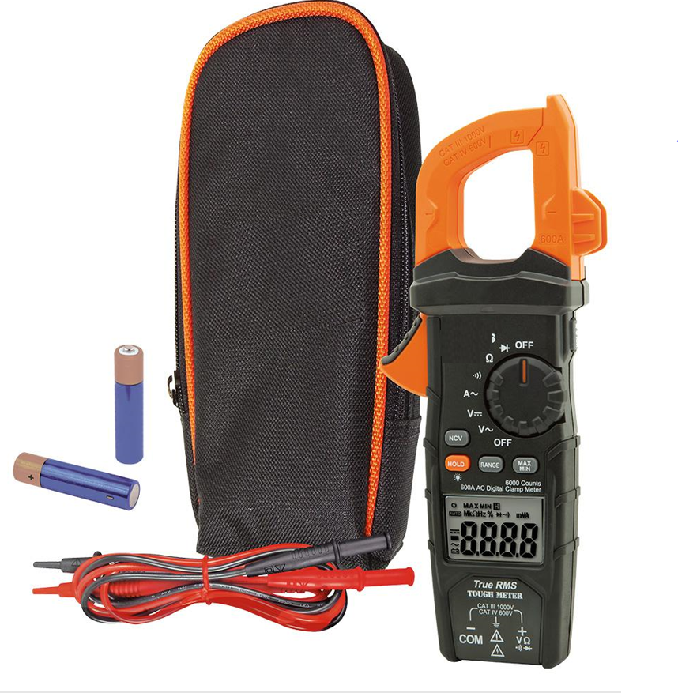
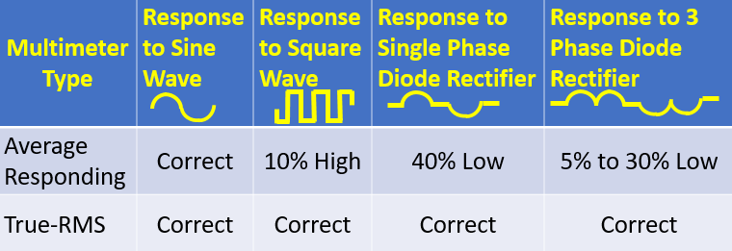
Multi-Meter With True RMS

Slide 12
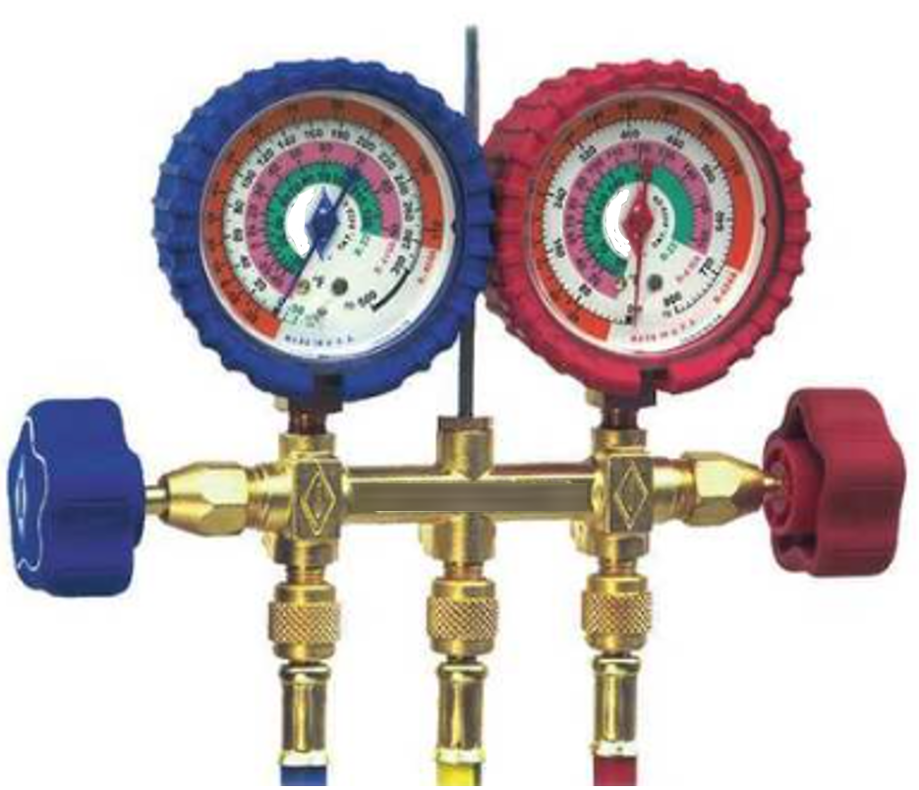
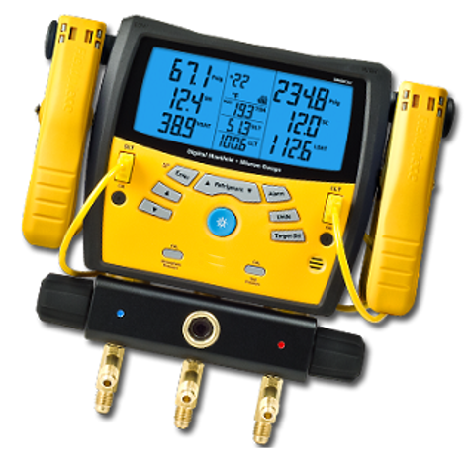
Refrigerant Gauges

Slide 13
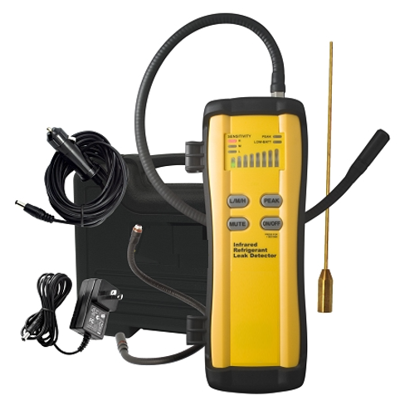
Refrigerant Leak Detection

Slide 14
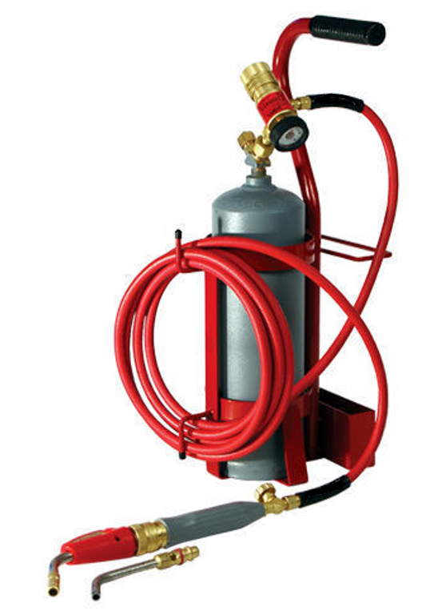
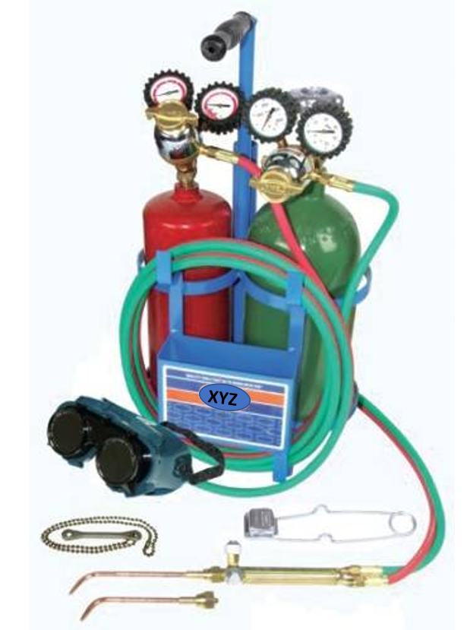
Brazing Tools

Slide 15
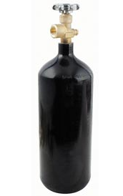
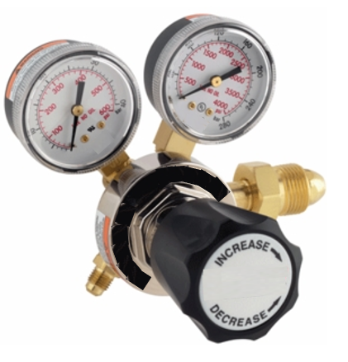
Leak, Pressure Test and Brazing

Slide 16
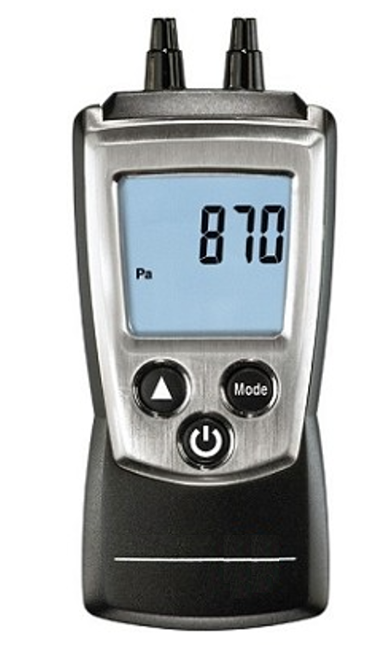
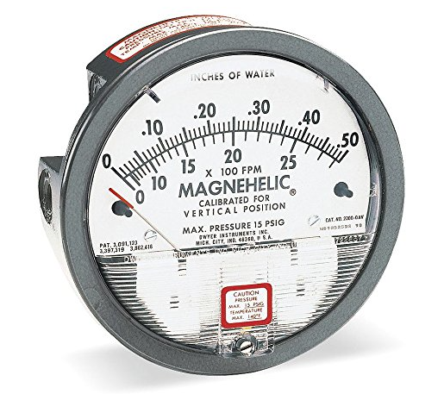
Pressure Differential Tools

Slide 17
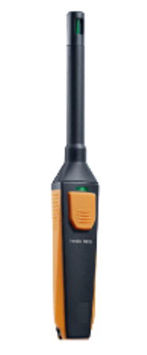
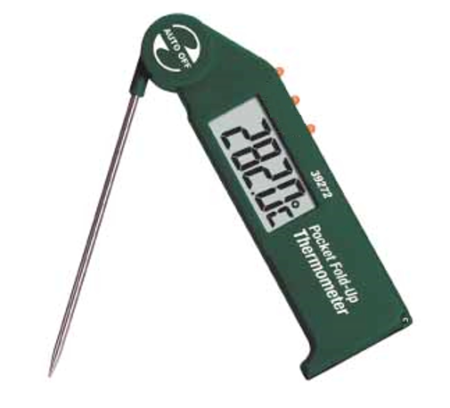
Temperature & Humidity Measuring Tools

Slide 18
Vacuum Tools

Slide 19
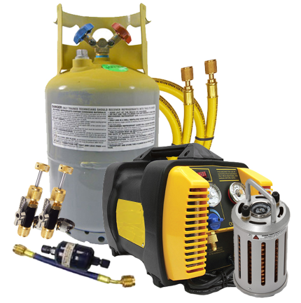
Refrigerant Recovery Tools

Slide 20
Lessons Learned
You should now be able to identify common types of sheet metal snips.
You should now be able to identify types of brazing tools.
You should now be able to explain why a vacuum needs to be pulled on an HVAC system that has been opened up for repairs.
You should now be able to recognize tools used for HVACR repairs and evaluations.

