Slide 1
Technician’s Guide and Workbook for Zoning Section 1: Introduction

Slide 2
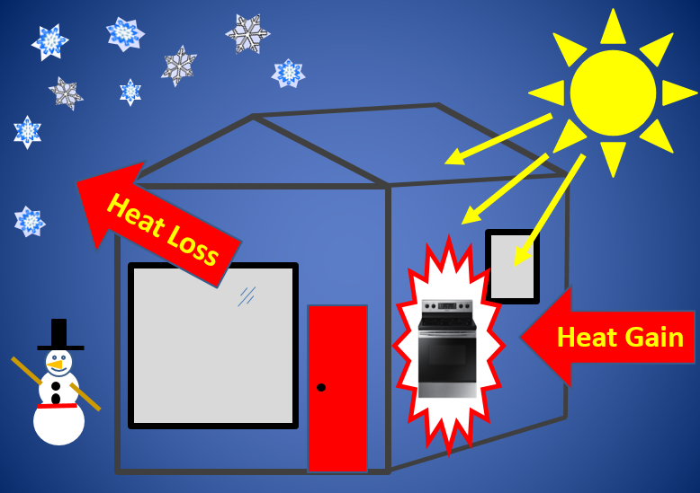
System Design Process

Slide 3
System Design Process

Slide 4
Temperature Variation Factors
Temperature variations are caused by the following:
Local solar gain changes.
Differing internal loads.
Hot air rising/cold air dropping (buoyancy).
Differences in loads for ceilings, walls, and floors.

Slide 5
Solar Heat Gain
Attic
Window)
Reflected

Slide 6
Differing Internal Loads
Bedroom
Play Room
Hobby
Room
Den
Kitchen
Laundry

Slide 7
Buoyancy
Hot Air Rises
Bedroom
Play Room
Hobby
Room
Den
Kitchen
Laundry
Cool Air Drops

Slide 8
Differences In Loads
Walls
Ceilings
Floors

Slide 9
Single Zone Performance
Only provides accurate temperature control in the room where the thermostat is located!
Open floor plans allow more rooms to be connected to the thermostat’s control area.
Balancing airflow by load will allow other areas with similar load patterns to maintain the same temperature

Slide 10
Single Zone Performance Challenges
Temperatures in isolated rooms may not be maintained.
Seasonal differences may cause one room to need heat while another needs cooling.
Room temperature swings may not match…causing a greater temperature difference.

Slide 11
Multi Zone Performance
More thermostats…more areas controlled!
Open floor plans still allow more rooms to be connected to the thermostat’s control area.
More options for balancing airflow by more than one area’s load allows areas with similar load patterns to maintain the same temperature.
Multiple zone systems can provide heating and cooling at the same time.

Slide 12
Multi Zone Performance Challenges
Many system types will not provide heating and cooling at the same time to two zones.
Supplemental heat may be needed so zones can be heated and cooled at the same time.
Return air pathways for systems must be balanced so the air from zones in another mode of operation (heating vs cooling) is not returned to the wrong unit.

Slide 13
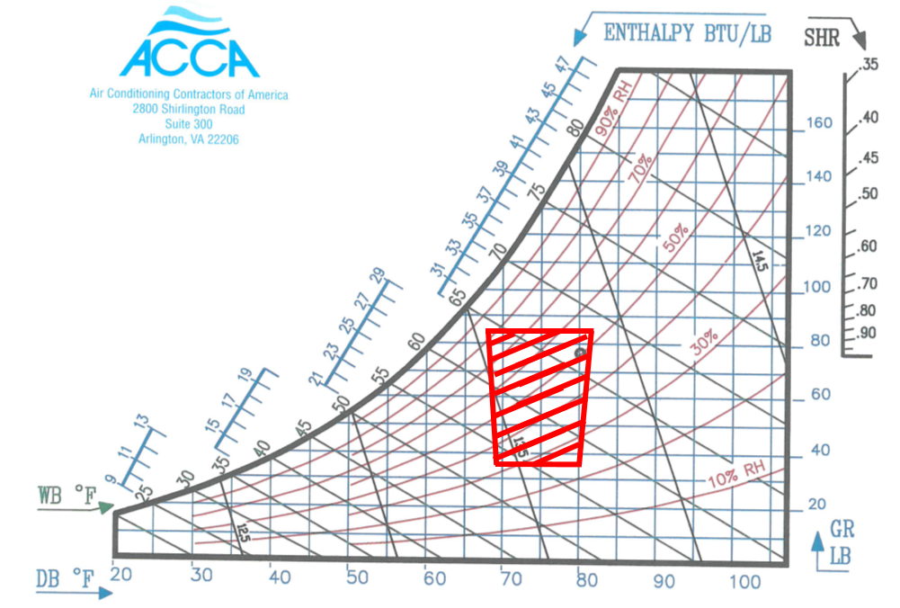
Comfortable Room Temperatures
Typical Manual J Design Temperatures are:
75^{O}F at 50% RH for Summer.
70^{O}F for Winter.

Slide 14
Comfortable Room Temperatures 1
What is the lowest humidity where most people will feel comfortable?

Slide 15
Comfortable Room Temperatures 2
What is the temperature and humidity in the center of the comfort chart?
75

Slide 16
Comfortable Room Temperatures 3
Will most people be comfortable at the following Temperature and Humidity?
75^{O}F at 70% RH.
75

Slide 17
Energy Usage
Zoning that is designed and installed properly will decrease the over-heating, and over-cooling of rooms due to the increase in thermostatically controlled areas.
Zoning can save energy when setback temperatures for unoccupied zones is utilized.
Poorly designed and installed zoning systems may use more energy.

Slide 18
Energy Calculations
Manual Zr States:
“A credible energy calculation must be sensitive to all the variables that affect equipment load patterns; and it must accurately model equipment capacity, efficiency, run time, and energy input for all possible scenarios for one year of average weather.”

Slide 19
Economics / Cost of Zoning
Based on the complexity of calculating energy usage and energy savings it is nearly impossible to accurately project the energy savings potential of a multi-zone system versus that of a single zone system.
Generally speaking, zoning systems will cost more to design, install, and maintain.
The main selling point should be additional comfort, not energy savings.

Slide 20
Don’t Guess and Give It A Shot!
Some types of HVAC equipment and configurations of Zoning equipment will not work together.
The installation, startup and documentation directions for both the HVAC system and the zone control system must be followed.
Do not try and guess what needs to be done to integrate the systems. Find out from the equipment distributors.

Slide 21
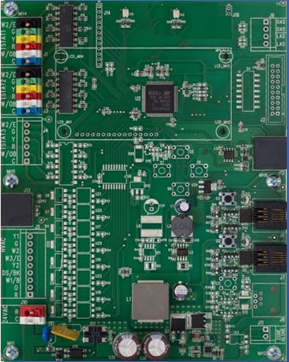
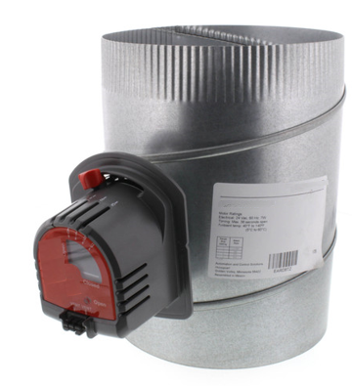
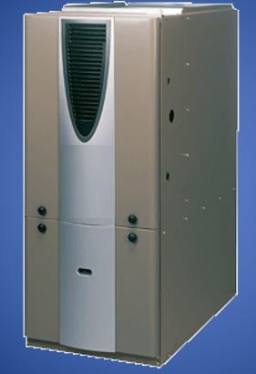
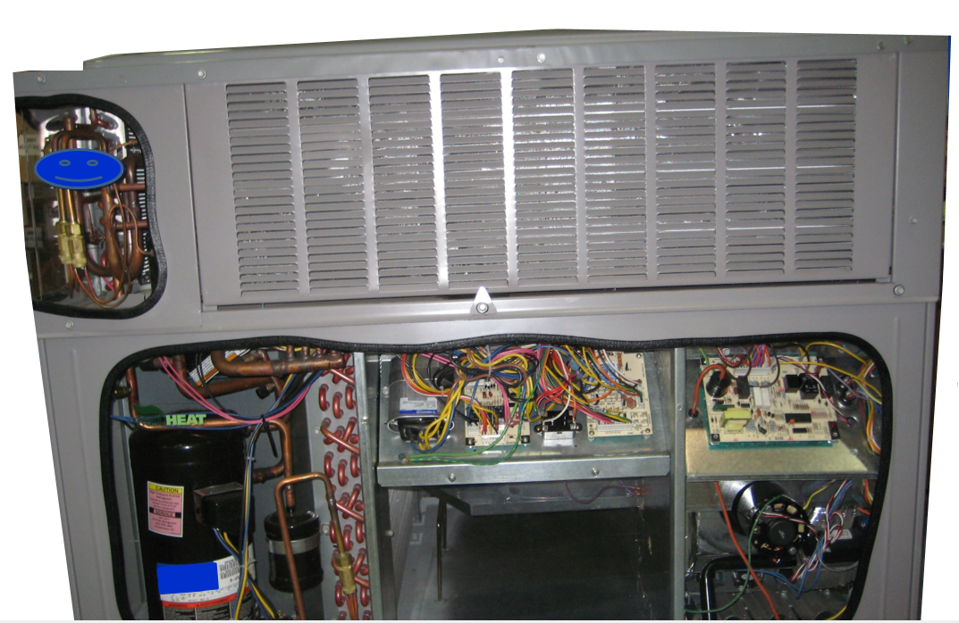
All Systems Operate Correctly!

Slide 22
You Are Responsible!
“If Zoning equipment, devices and controls are substituted for, or interlaced with. OEM equipment and controls, the practitioner is responsible for a design, installation, and a start-up that conforms to OEM guidance and ZEV guidance.”
OEM= Original Equipment Manufacturer
ZEV = Zone Equipment Vendor (or Manufacturer)

Slide 23
Field Notes
For comfort complaints, the first step is to listen!
Once you know where the hot and cold spots are you can measure temperature and humidity and see if they fall into the comfort range.
To answer a temperature complaint the first step is to make sure the thermostat is calibrated and working properly and the rooms are within the comfort range before jumping to other corrections such as adjusting the airflow.

