Slide 1
Day 1 Part 4 Technician’s Guide & Workbook for Home Evaluation and Performance Improvement

Slide 2
3.0 Comprehensive Performance Audit Fossil Fuel Appliances Health & Safety 3.2

Slide 3
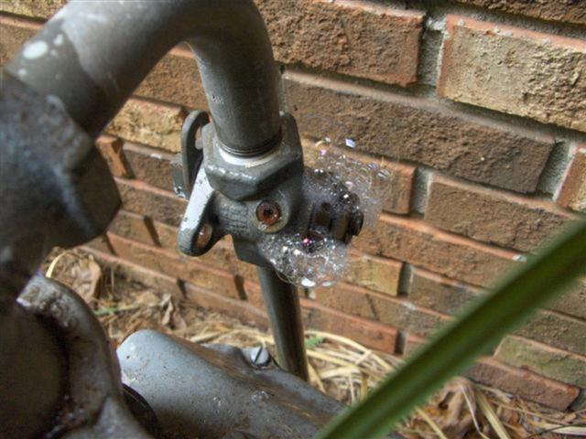
Gas/Oil Leakage Testing

Slide 4
Acceptable Documentation
Written or recorded records of where the leaks were located are required and shall be kept in the job file along with a copy of the homeowner’s notification.
Note: a good practice is to include a picture of the marked leakage locations in the job file.

Slide 5
Unvented Combustion Appliances

Slide 6
Unvented Combustion Appliances
ANSI Z21.11.2

Slide 7
Acceptable Documentation
Written or recorded records evidence of the location of the unvented appliance.
And
Written or recorded records evidence that the equipment is ANSI Z21.11.2 listed.
Or
Written or recorded records evidence of the total appliance input and homeowner notification if the appliance is not listed.

Slide 8
Combustion Appliance Zone Area (CAZ) Pre Test Area Measurement

Slide 9
CAZ Area Measurement Calculations
The volume of the space providing combustion air to fossil fuel appliances must be measured and, if provided, the net free area of openings which supply combustion air from an adjoining room or the outdoors, including any bird/insect screen on opening terminations. Acceptable procedures are:
National Fuel Gas Code (NFG) §9.3,
Or
Authority having jurisdiction (AHJ).

Slide 10
National Fuel Gas Code (NFG) §9.3
“Standard Method”
Requires a blower door leakage measurement’s results in air changes per hour (ACH).
ACH must be more than 0.40 per hour
Must calculate all of the rooms connected
Must add the total Btuh of all appliances in the connected rooms

Slide 11
Sample Problem 1
“Standard Method” Sample Problem
A 1,200 ft² home with 9 ft ceilings according to the blower door test has 0.50 ACH and a 148,000 Btuh gas furnace. Is there enough air leakage to support safe combustion?
First the ft³ is calculated:
1,200 ft² x 9 ft = 10,800 ft³

Slide 12
Sample Problem 1
Next divide 10,800ft³ by 50ft³ per 1,000 Btuh = 216 (how many 50ft³ areas of makeup air per hour there are in the home).
Next multiply the 216 by 1,000 Btuh to get the maximum combustion appliance total for the home:
216 X 1,000 = 216,000 Btuh

Slide 13
Sample Problem 1
The Btuh allowable for this leakage rate and home area is 216,000 Btuh
This leaky home could easily support the combustion air needs of the 148,000 Btuh Furnace

Slide 14
National Fuel Gas Code (NFG) §9.3
“Formula Method”
Where the infiltration rate is known and the ACH is less than 0.60: the minimum required volume can be calculated using one of two formulas.
The first is for appliances other than fan-assisted.
The second is for fan-assisted appliances.

Slide 15
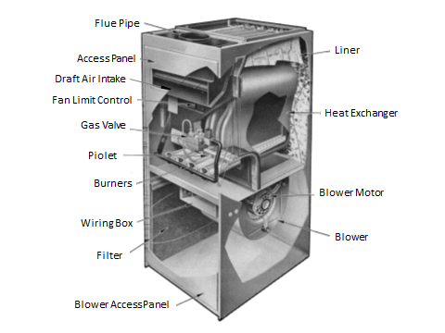
Fan Assisted vs Natural Draft

Slide 16
Fan Assisted vs Natural Draft
Fan Assisted

Slide 17
Fan Assisted vs Natural Draft
Natural Draft

Slide 18
Other Than Fan Assisted Formula
Naturally vented appliance (boiler or furnace) formula:
Required volume ≥ [21ft³ X all appliances input Btuh] ÷ [ACH X 1,000 Btuh]

Slide 19
Fan Assisted Formula
Fan assisted appliance (boiler or furnace) formula:
Required volume ≥ [15ft³ X for the fan assisted appliance input Btuh] ÷ [ACH X 1,000 Btuh]

Slide 20
Sample Problem 2
A 1,200 ft² home with 9 ft ceilings according to the blower door test has 0.50 ACH and a fan-assisted 148,000 Btuh gas furnace, a 48,000 Btuh oven, and a 60,000 Btuh domestic water heater. Will combustion ventilation air need to be added?
Note: ACH ˂ 0.60
First plug the numbers into the fan assisted formula to calculate the area for the furnace:
Required volume ≥ [15ft³ X 148,000 Btuh] ÷ [0.50 X 1,000 Btuh] ≥ 4,440ft³

Slide 21
Sample Problem 2
Next do the calculation using the formula for the naturally vented appliances:
Required volume ≥ [21ft³ X (60,000 + 48,000)] ÷ [0.50 X 1,000 Btuh] ≥ 4,536ft³
Next, add up the two for the total required volume:
4,440ft³ + 4,536ft³ = 8,970 ft³

Slide 22
Sample Problem 2
Next, compare the combined area to the required 8,970 ft³
Since the home area is 10,800ft³ and since 10,800ft³ ≥ 8,970 ft³ this home will pass these combustion air requirements.

Slide 23
Depressurization Test 1.9 (AKA CAZ Test)

Slide 24
Depressurization Test
Evidence that the combustion appliance operates safely during periods of depressurization generated by the occupants must be provided by the technician. A combustion appliance zone (CAZ) test is used to show that on the day the testing was done there were no pressure related problems that were negatively influencing the combustion process. CO safety measurements are monitored and recorded for safety when the CAZ test is being performed.

Slide 25
Depressurization Test
When the authority having jurisdiction provides requirements for CAZ testing that procedure must be followed. For other cases the procedure to follow for a CAZ test is to do the following 10 steps in order:
Step 1
Close all exterior windows and doors, and attic hatches. Temporary openings to the outside such as broken windows must be sealed.

Slide 26
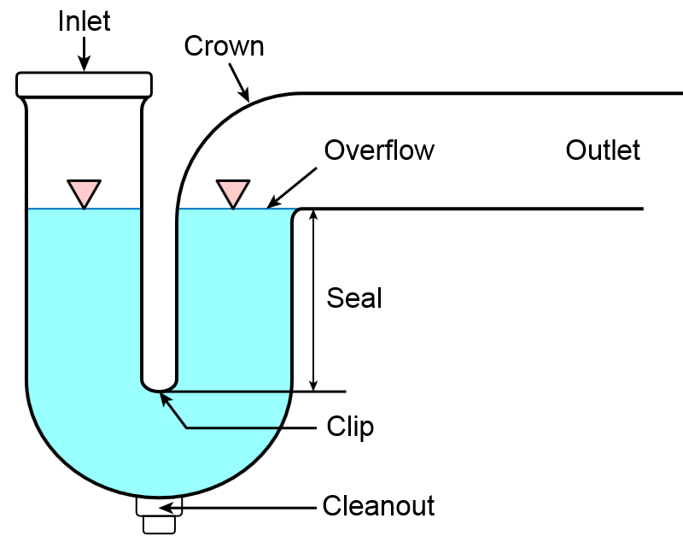
Depressurization Test
Step 2
Drain traps must all be filled with water

Slide 27
Depressurization Test
Step 3
Turn on all indoor fans: bathroom exhaust, range hood, clothes dryer, powered attic ventilation fans (with the exception of a whole house exhaust fans).
Step 4
Turn on the air handler fan. If the pressure differential in the CAZ with reference to the outdoors gets more negative, leave the air handler on; otherwise, turn it off.

Slide 28
Depressurization Test
Step 5
Open or close interior doors to the CAZ, rooms with exhaust fans (e.g., bathroom), or other interior rooms to achieve the highest pressure differential in the CAZ room with reference to (WRT) the outdoors.
Step 6
Make-up air systems, combustion air ducting, and ventilation systems are to remain as is.

Slide 29
Depressurization Test
Step 7
Ensure the vent or flue is at room temperature.
Step 8
Fireplace damper shall be closed or a simulator must be operating in the fireplace (camping stove, etc.) with fireplace damper open.

Slide 30
Depressurization Test
Step 9
Place the smallest Btu input appliance being tested into operation (per OEM instructions) first and adjust the thermostat so the appliance operates continuously.
Step 10
Test for spillage at the draft hood relief opening after five (5) minutes of operation. Use the flame of a match, candle, or smoke. The complete circumference of the draft hood relief opening shall be tested.

Slide 31
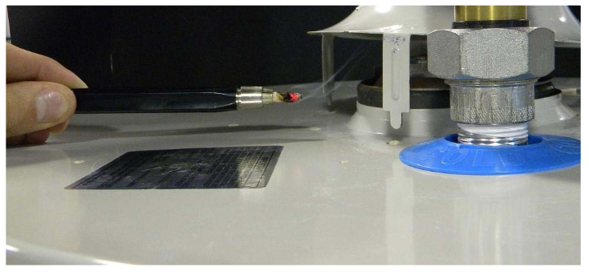
Spillage Test
If smoke or flame is pulled into the vent the combustion appliance passes. If draft is not established in 5 minutes around the complete circumference of the draft hood opening, then the combustion appliance fails the test.

Slide 32
Spillage Test
For additional fossil fuel appliances in the same room, turn on the next appliance being tested so it operates at the full input while the previous appliance continues to operate. Repeat step 10 on the appliance being tested.

Slide 33
Acceptable Documentation
Written or recorded records of CO measurements that were required for the home and a note that combustion drafting was working properly during the back draft test shall be kept in the job file. Additional records for a failed Back draft test include:
Evidence or written notification of a failed test
Evidence of homeowner notification
Evidence of repair work done before Home performance improvements were implemented
(Note: this can be based on a test at a later date that provides proof that the CO level problems have been addressed)

