Slide 1
5.0 Distribution Aspects (Section 5.1 Duct Leakage)

Slide 2
Duct Leakage
total duct leakage =
supply duct leakage + return duct leakage.

Slide 3
QI Duct Leakage Improvement Requirements New Duct
When ducts are located within the conditioned space, the leakage rate must not exceed 10% total duct leakage (airflow in CFM duct pressure 25 Pascals).
When ducts are located outside of the conditioned space, the leakage rate must not exceed 6% total duct leakage (airflow in CFM duct pressure 25 Pascals).
Per local code or authority having jurisdiction, if requirements exceed those listed above.

Slide 4
QI Duct Leakage Improvement Requirements New Duct
When ducts are located within the conditioned space, the leakage rate must not exceed 10% total duct leakage (airflow in CFM duct pressure 25 Pascals).
When ducts are located outside of the conditioned space, the leakage rate must not exceed 6% total duct leakage (airflow in CFM duct pressure 25 Pascals).
Per local code or authority having jurisdiction, if requirements exceed those listed above.

Slide 5
QI Duct Leakage Improvement Requirements Existing Duct
There can be no more than 20% total duct leakage (airflow in CFM duct pressure 25 Pascals)
The duct system is sealed / improved to reduce the existing leakage rate by 50%.
Per local code or authority having jurisdiction

Slide 6
QI Documentation Required
Documented Field Data recorded on start up sheet
Or
Documented field data recorded on service records
Or
Written job documentation or checklist in the installation file

Slide 7
QI Approved Duct Leakage Tests
Duct Pressurization Test @ 25 Pascal
Airflow Comparison Method (for existing systems)
ANSI/SMACNA Air Duct Leakage Test Manual
Duct Pressurization Test meeting AHJ requirements

Slide 8
QI Approved Duct Leakage Tests
Duct Pressurization Test @ 25 Pascal
Airflow Comparison Method (for existing systems)
ANSI/SMACNA Air Duct Leakage Test Manual
Duct Pressurization Test meeting AHJ requirements

Slide 9
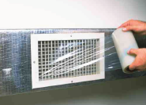
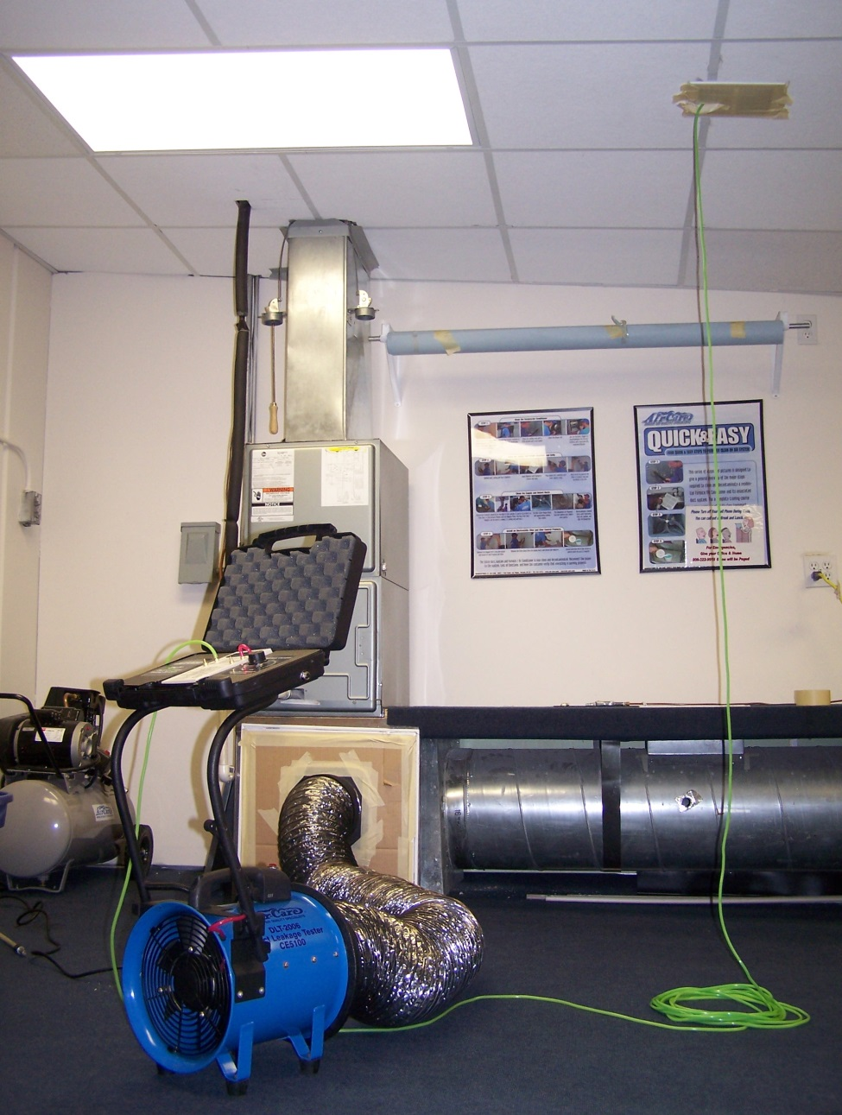
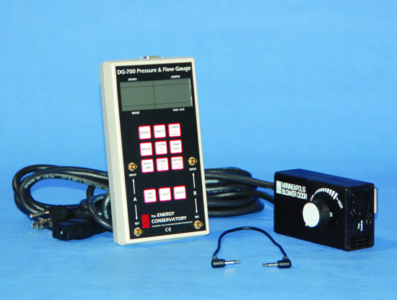
Duct Pressurization

Slide 10
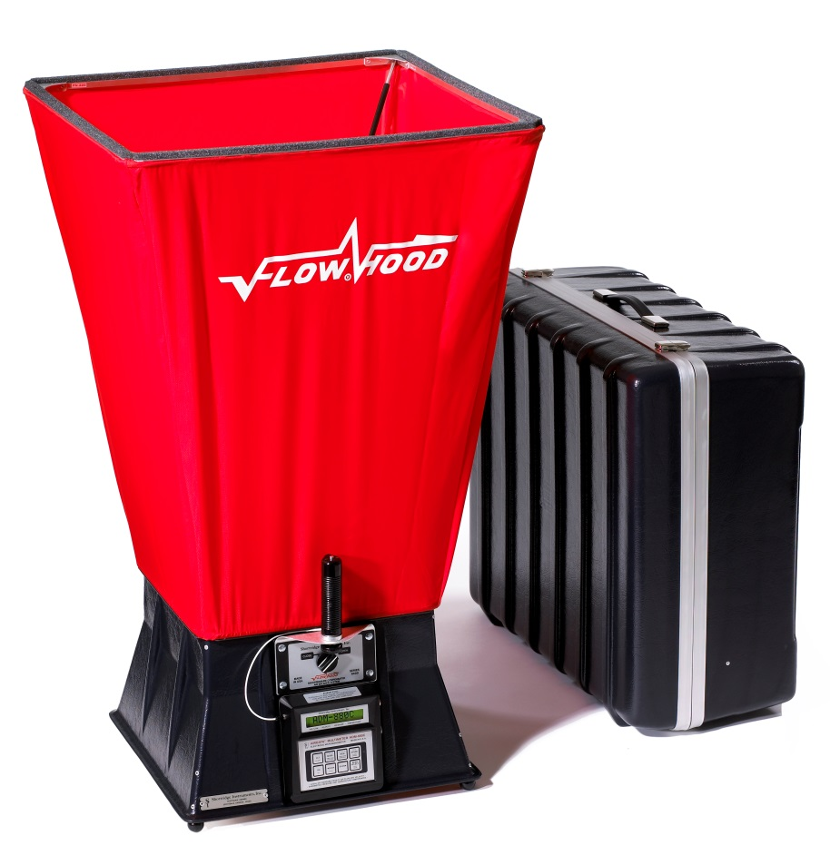
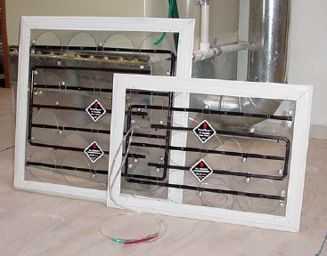
Airflow Comparison Method For Commercial Systems

Slide 11
Step 1 Airflow Comparison Method
For this method the air handler or furnaces is turned on and set to run at the maximum speed for the duration of the testing.

Slide 12
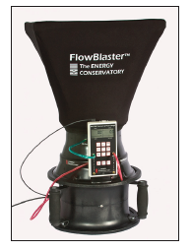
Step 2 Airflow Comparison Method
Each supply and return grille, diffuser, and register (duct cover) in the distribution system will have their airflows measured and recorded individually. The Technician should list the supply and return registers on separate lists. It is recommended for residential airflow on supply registers that a fan powered flow measuring capture device be used .

Slide 13
Step 2 Airflow Comparison Method
Note: When there is no return ducting, a pressure differential measuring type of tool may be used for measuring the return airflow at the unit.

Slide 14
Step 3 Airflow Comparison Method
The supply CFM is the subtracted from the return CFM (ignore any negative values). That number is divided by the Lower of the two values and multiplied by 100 to get the percent of leakage.
_
[
[
÷ Lower X 100 = ?

Slide 15
Step 3 Airflow Comparison Method
Sample Calculation: Supply airflow total equals 1226 CFM and return total equals 1132 CFM thus,
1226 – 1132 = 94. Since the return is the lower number: 94 ÷ 1132 X 100 = 8.3% duct leakage.
_
[
[
÷ Lower X 100 = ?

Slide 16
Step 3 Airflow Comparison Method
Sample Calculation: Supply airflow total equals 1226 CFM and return total equals 1132 CFM thus,
1226 – 1132 = 94. Since the return is the lower number: 94 ÷ 1132 X 100 = 8.3% duct leakage.
_
[
[
÷ Lower X 100 = ?

Slide 17
ANSI/SMACNA Air Duct Leakage Test Manual

Slide 18
Quantitative Duct Leakage Test @ 25 Pa
SMACNA has higher values
for Pa and is often done by
duct section.

Slide 19
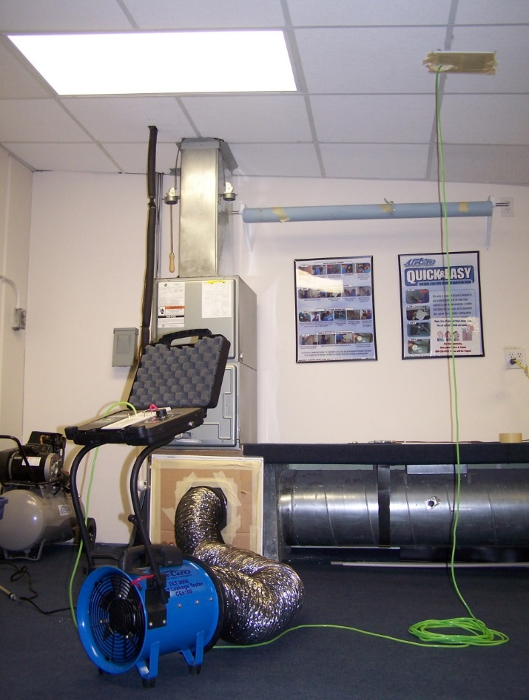
Duct Pressurization Meeting AHJ Requirements
When AHJ requires higher Pa values

Slide 20
Duct Leakage Testing
The Technician may perform a qualitative test of all accessible ducting to determine opportunities for sealing. Qualitative duct testing is not covered in this guide. However, if an initial visual inspection finds faults/defects in the duct system indicating substantial duct leakage, a qualitative test shall not be required, but these faults/defects shall be recorded.

Slide 21
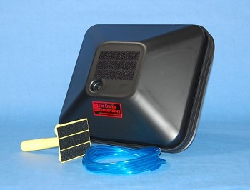
Step 1 PRESSURE PAN TEST
Prepare the house for an envelope leakage test and depressurize the house by 50 Pa (This test is often done in conjunction with the envelope leakage test because it will indicate when that leakage to the outside is through the ducting system).

Slide 22
Step 2 PRESSURE PAN TEST
Each grille, diffuser, and register (duct cover) in the distribution system will be tested individually. The Technician shall fully cover it using one of the following methods:
A gasketed pan with a sealed pressure tap,
Tape,

Slide 23
Step 2 PRESSURE PAN TEST
Combination of gasketed pan and tape, this is typically done on registers or grilles that are larger than the gasketed pan. Tape is applied to the perimeter of the duct covering, leaving an uncovered area in the middle that is just smaller than the gasketed pan. The pressure difference is then read by covering that opening with the gasketed pan.

Slide 24
Step 3 PRESSURE PAN TEST
Record the pressure in the duct with reference to the house:
At the pressure tap on the gasketed pan,
Or
A static pressure probe inserted through the tape.
Remove the cover at the conclusion of each register or grille test.

Slide 25
Step 4 PRESSURE PAN TEST
Determine the median and the highest measured pan difference for all duct coverings. Compare the values to the comparative benchmark values: the median value should not be higher than 3 Pa, and no register or grille should be greater than 8Pa.

Slide 26
Step 4 PRESSURE PAN TEST

Slide 27
Step 4 PRESSURE PAN TEST

Slide 28
Step 4 PRESSURE PAN TEST

Slide 29
Step 4 PRESSURE PAN TEST

Slide 30
Step 1 Blower Door Assisted Smoke Test
This test is also generally done in conjunction with the blower door test also called the pressurization or depressurization test. When the leakage is established using the blower door. A fan powered unit is attached to the duct and the HVAC grilles and registers are all sealed up.

Slide 31
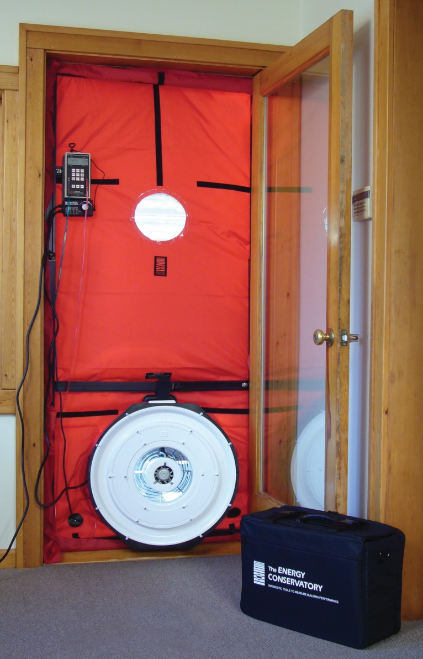
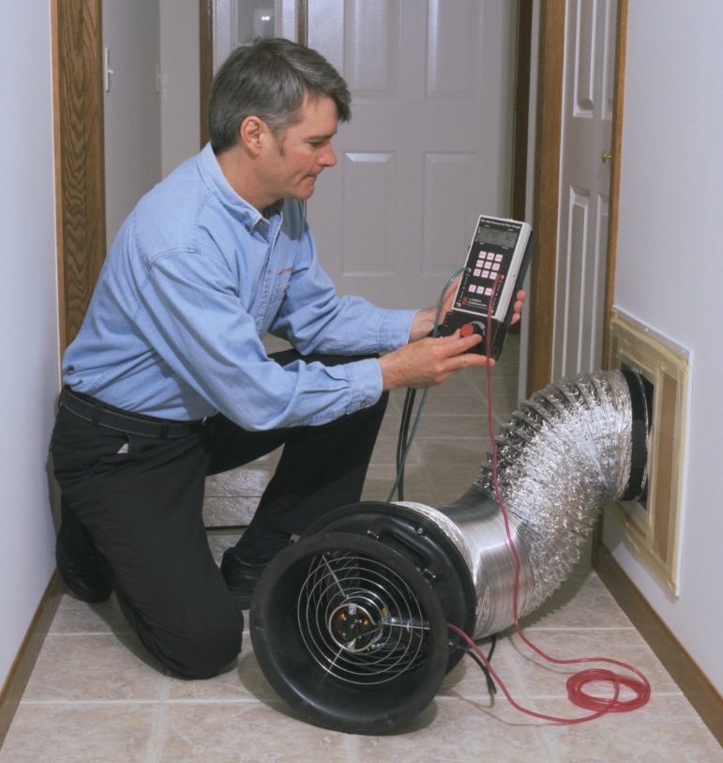
Step 1 Blower Door Assisted Smoke Test
This test is also generally done in conjunction with the blower door test also called the pressurization or depressurization test. When the leakage is established using the blower door. A fan powered unit is attached to the duct and the HVAC grilles and registers are all sealed up.

Slide 32
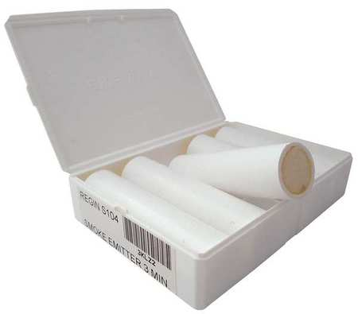
Step 2 Blower Door Assisted Smoke Test
The Technician injects a non-toxic smoke into the fan pressurization device that is maintaining a duct pressure difference of 25 Pa relative to the duct surroundings.

Slide 33
Step 3 Blower Door Assisted Smoke Test
The Technician visually inspects all accessible portions of the duct systems for escaping smoke; escaping smoke indicates a leak in the duct and the Technician then marks the locations of leaks.

