Slide 1
Technician’s First Guide and Workbook Section 7: Electrical Components and Electrical Measurement Part 1

Slide 2
Electrical Wire Usage Markings

Slide 3
Ohm’s Law (1)
Ohm’s Law is the foundational electrical formula that is especially useful when learning the system approach. The formula shows the relationship between the voltage, the amperage, and the resistance in and AC circuit. The Ohm is the unit name used for measuring resistance.

Slide 4
Ohm’s Law (2)
Ohm’s Law is written as a simple formula:
V= I × R
Where:
V is voltage (the electromotive force or differences in the two charges in the system).
Note: sometimes V is listed as E in text books
I is amperage (the current going through the system).
R is the resistance (the load of the system in ohms).

Slide 5
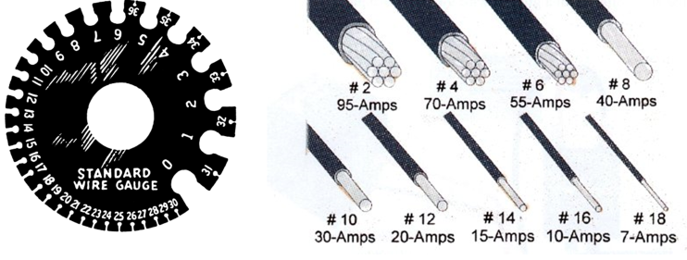
Ohm’s Law and Wire Size
Find the maximum safe resistance value in ohms for a 120v circuit with #12 size wire using Ohm’s Law, and the chart below.
V= I × R
110_{V}= 20_{A} × R_{Ω}
110_{V} ÷ 20_{A} = R_{Ω} = 5.5 ohms

Slide 6
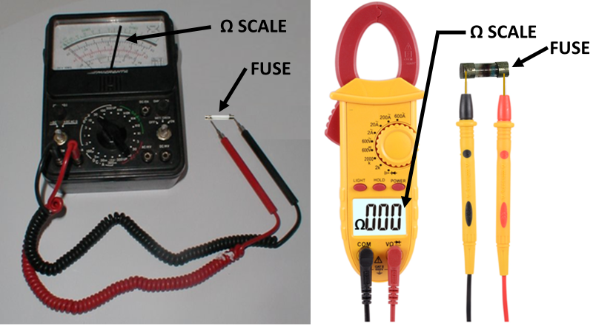
Measurements Using Ohm’s Law

Slide 7
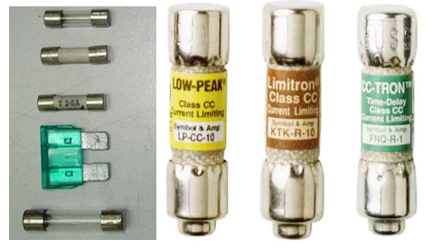
HVAC Fuses
DO NOT CHANGE THE SIZE OR TYPE OF FUSE.
Note: Fuse manufacturers use differing number systems.

Slide 8
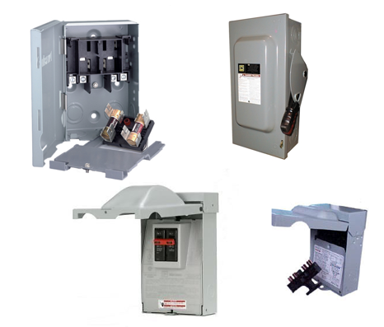
Safety Disconnect Switch

Slide 9
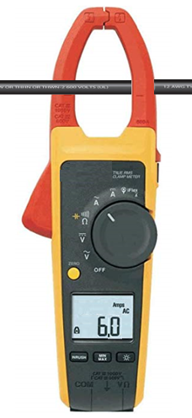
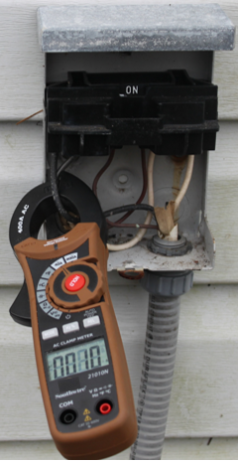
Amperage Measurement

Slide 10
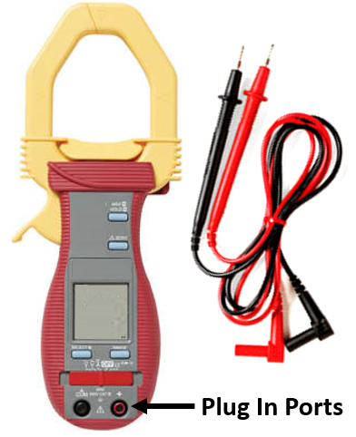
Typical Multimeter Test Probe Connection

Slide 11
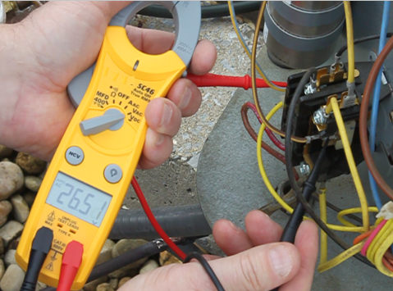
Low Voltage Measurement
Low voltage
Control wire
connections
One on each
side 24V

Slide 12
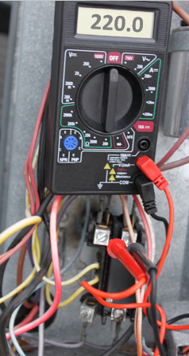
Line Voltage Measurement
Line voltage
often
Measured at
Spade
Connectors
on top of
wire connector
lugs or bolts
220V

Slide 13
Voltage Measurement

Slide 14
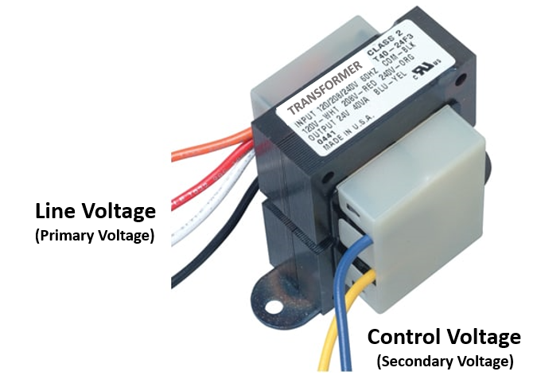
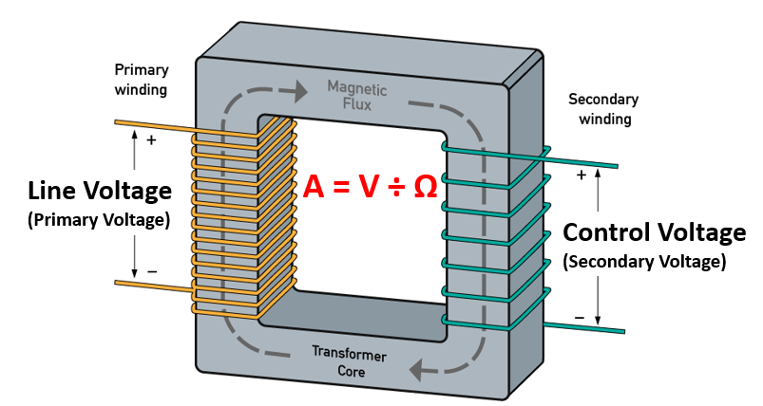
Control Voltage Transformer

Slide 15
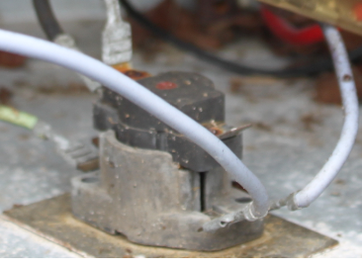
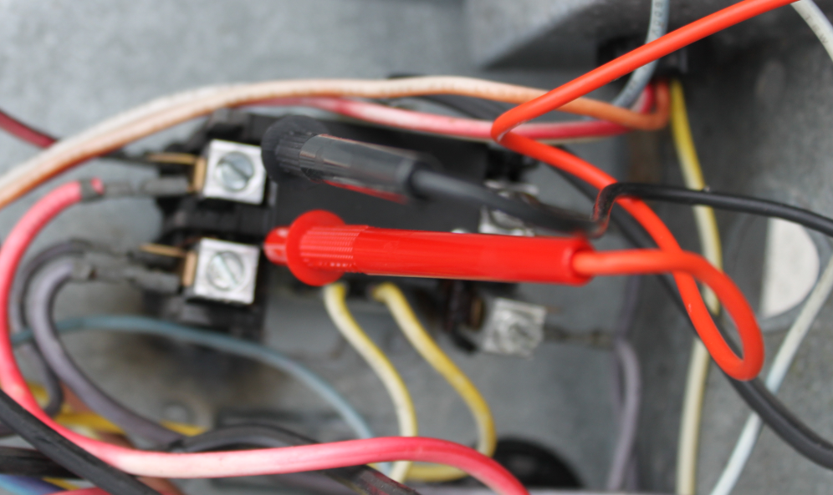
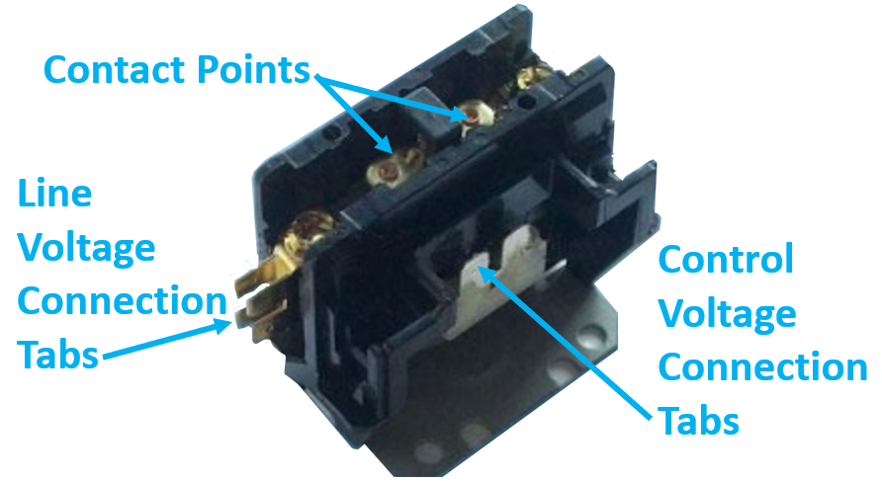
Control Relays/Contactors

Slide 16
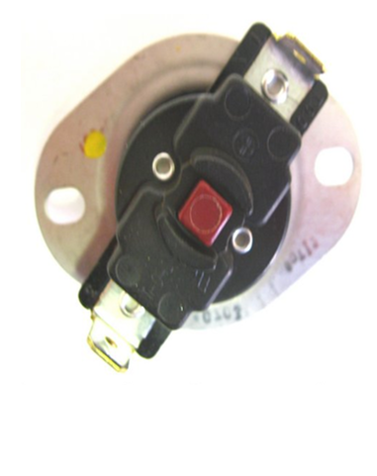
High Temperature Safety Switches

Slide 17
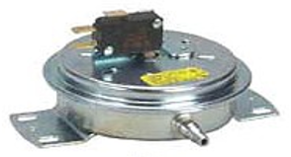
Pressure Switches

Slide 18
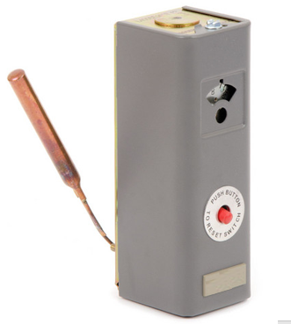
Temperature Switches

Slide 19
Lessons Learned
You should now be able to explain why wire type and size is important.
You should now be able to explain why fuse size and type is important.
You should now be able to use an ohm-meter to verify if a fuse is good or bad.
You should now be able to explain how to place meters proves for voltage measurements.
You should now be able to explain how to place a meter for amperage measurements.

