Slide 1
Part 13 Technician’s Guide & Workbook for Duct Diagnostics and Repair

Slide 2
Section 5.2: Safety and Comfort Issues

Slide 3
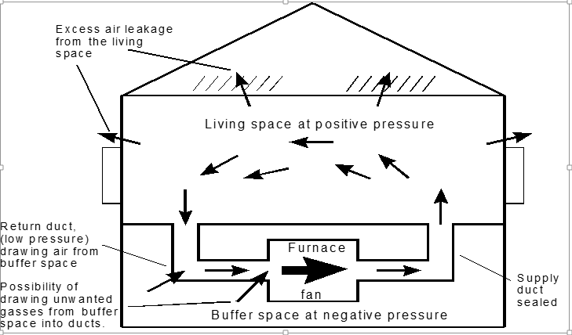
Isolation Zones Within Living Space

Slide 4
Assessing Furnace Rooms
Fan Settings Showing Furnace Room-to- Outside Pressure Difference Below -3 Pa | Assessment | Recommendations
No combination of fan use produces an adverse condition | The furnace room may contain leaky ducts on both the supply and return ducts. | If you seal supply ducts, do not leave return ducts in the furnace room unsealed.
Exhaust fans only (System fan off) | Depressurization exists, but it isn’t the fault of the duct system. | Customer should be informed, and you should make recommendations on how to alleviate the condition. Consider additional venting of the furnace room to the outside.
System fan only (Exhaust fan off) | The duct system is causing depressurization. | Duct sealing is almost certainly warranted, with particular attention to the air handler cabinet and return ducts in the furnace room. The other possibility is isolation of zones, a likely explanation if the effect is most pronounced when return airflows are blocked by closed doors.
Only When Exhaust Fans and System Fan are Both On | There is a cooperative effect between the exhaust fans and the system fan. | The problem may be alleviated by duct sealing. If not, additional venting of the furnace room to the outside may be needed.

Slide 5
Furnace Room Depressurization Test
When the minimum pressure in a room containing
combustion appliances is more negative than minus
three pascals (-3 Pa), there may be a problem. It is
likely that sealing the duct system will alleviate it,
although certain duct sealing strategies could make
it worse (e.g., if supply ducts in a furnace room are
sealed while leaky return ducts are left alone). This
is why it is very important to do this test both before
and after doing any work.

Slide 6
Furnace Room Depressurization Fix
If the depressurization situation is caused by
operation of exhaust fans, that situation should be
corrected. One example of this would be a finished
basement in which a clothes dryer is relegated to the
same small enclosure as the furnace and water
heater. This particular problem might be cleared
up by installing an additional ventilation louver
between the furnace room and the rest of the
basement.

Slide 7
More On Furnace Room Depressurization
For guidance on the combined combustion appliance
room’s required area design see ACCA’s Technician’s
Guide & Workbook for Home Performance and
Improvement.
Note: Also available on Qtech.

Slide 8
System Fan Caused Depressurization
When the pressure in the furnace room drops when
the system fan is turned on, it has two likely causes:
return duct leakage and/or
isolation of zones.

Slide 9
System Fan + Exhaust Fan Caused Depressurization
Duct testing and sealing is always the 1st step
recommended in this Guide & Workbook that may
eliminate the negative pressurization of a room.
When repairs to the duct is not enough to fix the
problem, increasing the ventilation of the furnace
room is recommended.

Slide 10
Ventilation for System Fan + Exhaust Fan Caused Depressurization
Ventilation can be increased by increasing the
opening for the outside air or increasing the size of
the combustion area by opening the room up to the
rest of the basement (or living space if applicable).
Severe depressurization of the furnace room (-6 Pa
or worse) may lead to flame rollout in certain types
of equipment, such as atmospheric gas burners.

Slide 11
Fire Places & Wood Stoves
If the building has a fireplace or wood stove, the
room in which it is located should be tested for
depressurization by treating this room as if it were
the furnace room. The customer can also be asked
about evidence of chimney back-drafting.
If ashes are blown into the room after the fire dies
down, or if the customer complains of physical
symptoms associated with the use of the stove or
fireplace.

Slide 12
Problem Symptoms for Fire Places & Wood Stove
Fire Place & Wood Stove list of physical symptoms:
Irritated eyes or throat.
Sinus or lung problems.
Bronchitis or pneumonia.
Lung inflammation or swelling.
More frequent symptoms from existing lung
diseases like asthma or emphysema.

Slide 13
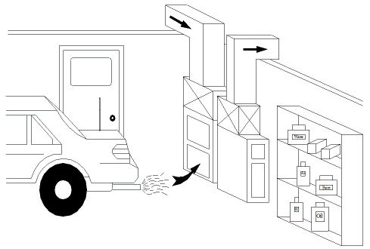
Other Safety Issues

Slide 14
Thermal Comfort Issues

Slide 15
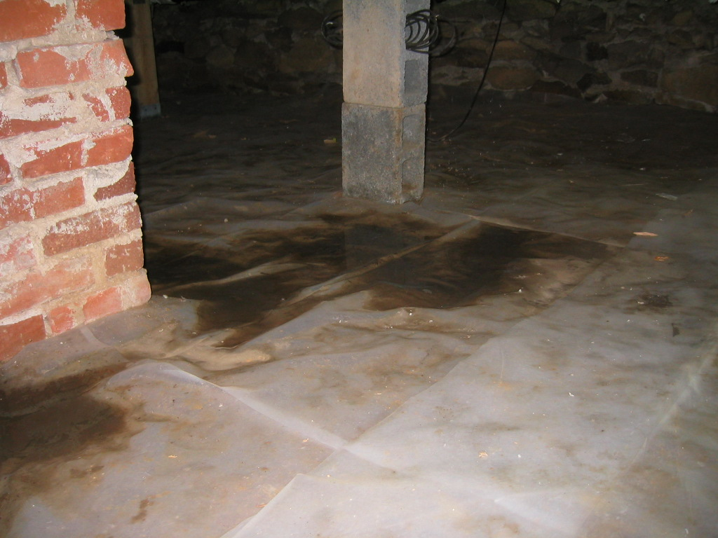
Moisture Related Thermal Comfort Issues

Slide 16
Thermal Comfort Issues

Slide 17
Lessons Learned
You should now be able to explain what a furnace depressurization test is.
You should now be able to explain why some air temperature and humidity combinations may be uncomfortable to occupants.
You should now be able to identify safety issues related to depressurization.
You should be able to explain where moisture problems may be coming from.

