Slide 1
Technician’s First Guide and Workbook Section 9: Airflow Basics (1)

Slide 2
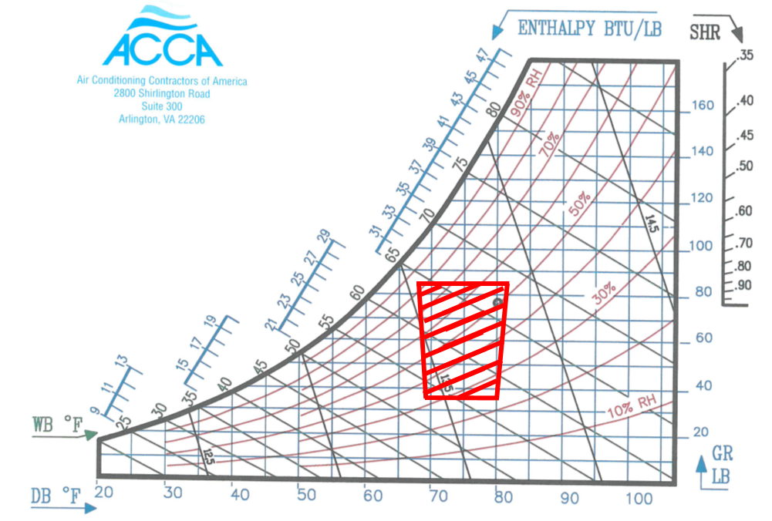
Airflow Introduction

Slide 3
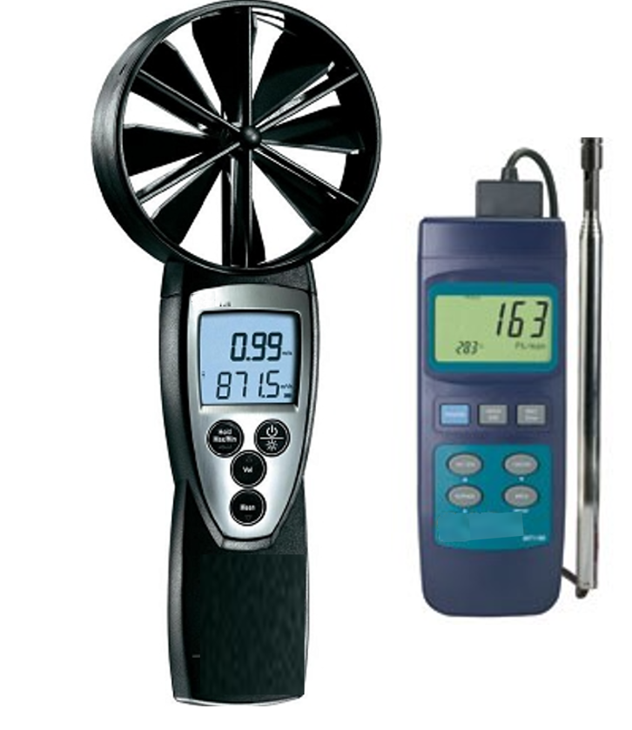
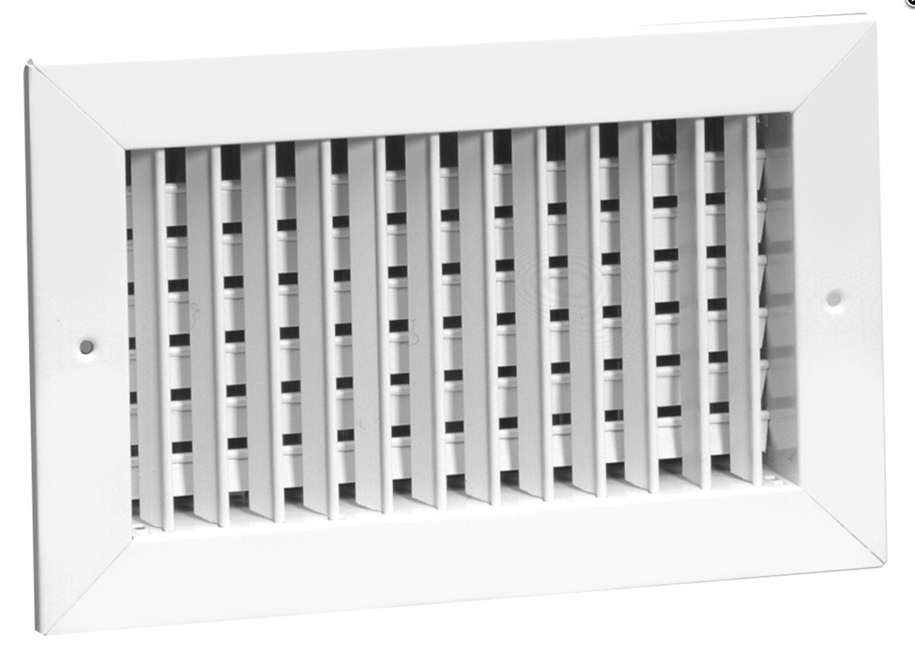
Airflow Introduction

Slide 4
Ak to CFM
Diffuser and grille manufacturing companies publish Ak values for diffusers and grilles. Those numbers can be used to convert measured flow in FPM to CFM by simply multiplying the measured FPM by the Ak factor.

Slide 5
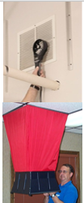
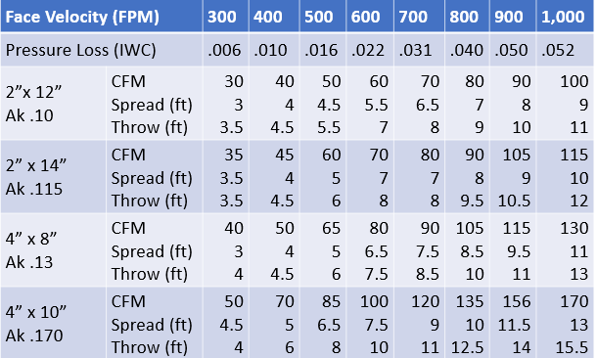
Measuring CFM of Registers & Grilles

Slide 6
Ak to CFM Example
Diffuser and grille manufacturing companies publish Ak values for diffusers and grilles. Those numbers can be used to convert measured flow in FPM to CFM by simply multiplying the measured FPM by the Ak factor.
Example: The 8”× 15” diffuser in the top left corner has an OEM Ak value of 0.69 and the average velocity of airflow measured using the veined anemometer in the top right corner was 145 FPM. What is the airflow leaving that diffuser in CFM?
0.69 × 145 = 100 CFM

Slide 7
BTUh to CFM of Airflow
BTU required (called the load) to CFM is used to calculate the airflow needed:
CFM = Load ÷ (1.1 × ACF × TD)
Where:
CFM = Cubic feet per minute of air flow.
Load = BTUh (the BTUs used in an hour)
1.1 = a conversion factor rounded off (sometimes 1.08 is used for slightly more accuracy).
ACF = Air Correction Factor (for altitude and Temperature (See Appendix C: Air Correction Factor Table).
TD = the difference in the room temperature and the supply air temperature

Slide 8
12,000 British Thermal Units (BTU)
The amount of heat the air transfers is calculated in British Thermal Units (BTU). For example, in air conditioning a commonly used number is 12,000 BTU, that is called a ton of cooling.

Slide 9
Airflow Math Sample
Calculate the heating airflow in CFM required for a 70^{O}F room is at sea level if the discharge air is from a furnace is 110^{O}F and the room design load is 4,400 BTUh:
TD = 110 -70 = 40 ^{O}F
CFM = Load ÷ (1.1 × ACF × TD) First there is no air correction factor needed.
CFM = 4,400 ÷ (1.1 × 40) = 100 CFM
Note: ACF = 1 at sea level and is generally ignored for HVAC calculations up to an elevation of 2,000 ft., and for typical HVAC design temperatures.

Slide 10
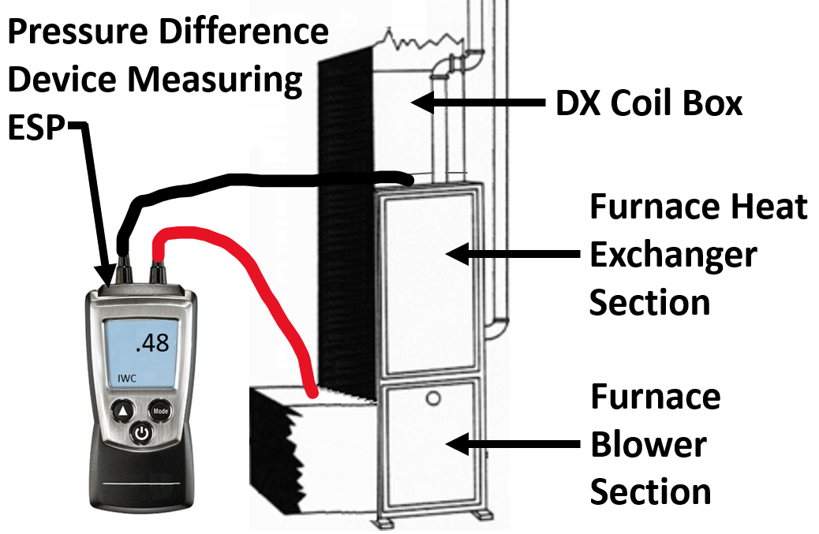
Airflow Verification by ESP

Slide 11
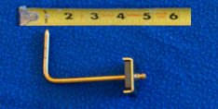
Tools for Airflow Verification by ESP

Slide 12
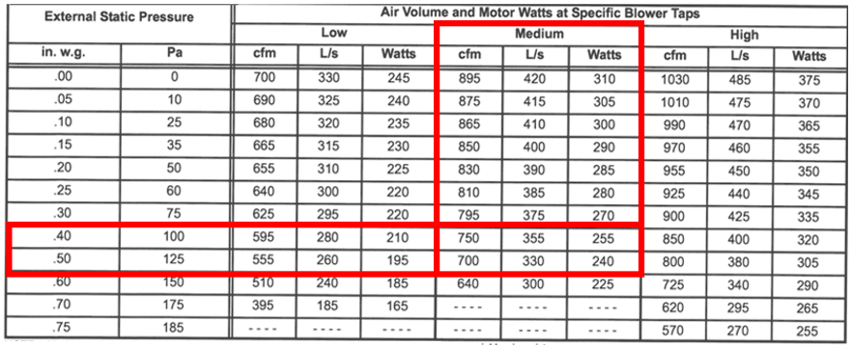
Manufacturer ESP Table

Slide 13
Sample OEM Chart Application
Previously in the electrical section the OEM fan speed settings were discussed. To calculate system CFM using our OEM chart, let’s say we have verified that the fan is on medium speed and we measured 0.48 ESP on our furnace.

Slide 14
Interpolation of OEM Chart Values
The OEM table values will need to be interpolated to get a CFM since 0.48 IWC at medium speed is between two chart numbers:
40-50 = 10 and 40-48 = 8
8 ÷10 = 0.8
750 - 700 = 50
0.8 × 50 = 400
The interpolated CFM value is: 750 – 40 = 710 CFM

Slide 15
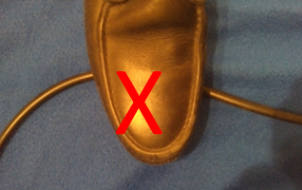
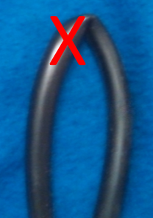
Measured ESP Values Need to Be Correct

Slide 16
Lessons Learned
You should now be able to explain why airflow speeds temperature and humidity all combine to make a person comfortable or not.
You should now be able to calculate CFM given a OEM Ak and a FPM measured airflow coming out of a diffuser or grille.
You should now be able to measure ESP on an OEM Box.
You should now be able to use an OEM chart to evaluate what the CFM output of the unit is.

