Slide 1
Technician’s Guide and Workbook for Zoning Section 4: Zoning Load Calculations

Slide 2
Zoning Load Calculations
Load calculations need to be understood by field technicians before they can be successfully implemented.
This section discusses how zones are selected and how they interact at different times of day.

Slide 3
Load Calculation Basics
First step: a block load for equipment sizing is done so the equipment size can be determined. The equipment selected has expanded data on airflow that is used to determine main duct trunk sizes.
Second step: a load is done for the air distribution components such as branch ducts, zone damper sizing, supply outlet sizing and local auxiliary equipment sizing.

Slide 4
Block Load
Whole house as one large room.

Slide 5
Survey or Building Plan Review
When a technician has access to the Manual J load calculation, it is a good practice to review it and make sure it is accurate. For example, if the attic insulation is missing, or if the direction the house is facing is wrong….there may be a problem that needs to be fixed before proceeding with an installation.

Slide 6
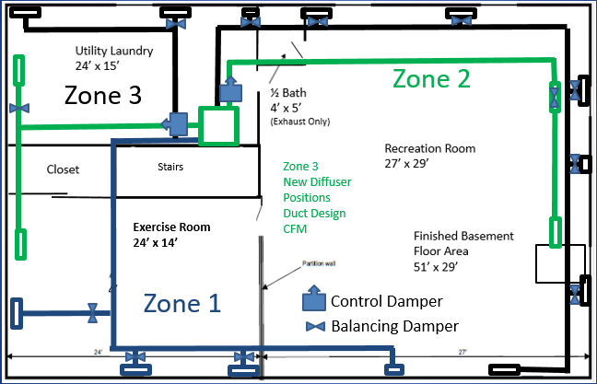
Air Distribution Component Based Load
Duct system sizing used to convert CFM to load.

Slide 7
Survey or Duct Design Plan Review
When a technician has access to the Duct Design calculation, it is a good practice to review it and make sure it is accurate. For example, make sure the CFM value is equal to or greater than the Manual J value for each room. Make sure all areas on the design are included in the construction plans and parts lists.

Slide 8
Airflow Design Numbers
Airflow to individual rooms in a Manual J cooling load is rarely equal to airflow for a Manual J heating load. Further, the Manual D duct design is based on the larger of the two Manual J airflow values. To make things slightly more confusing for technicians, the final test and balance design airflow provided to the space is different than every airflow value that was covered previously.

Slide 9
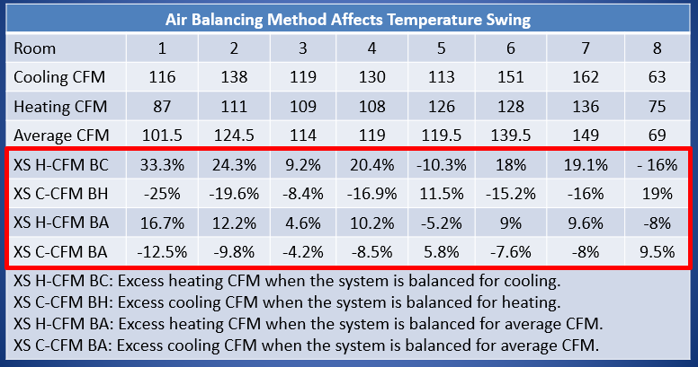
Airflow Design Comparison

Slide 10
Totals From The Previous Table
Cooling CFM (A total of 992 CFM when rooms are added together.).
Heating CFM (A total of 880 CFM when rooms are added together.).
Average CFM (A total of 936 CFM when rooms are added together.).
Plus, using the larger of the cooling and heating for duct design would provide a total of 1017 CFM.

Slide 11
Understanding The Table Calculations
XS H-CFM BC = Excess heating CFM when the system is balanced for cooling (in room 1) using the Manual J design values:
[(116 ÷ 87) – 1] × 100 = 33.3%

Slide 12
Understanding The Table Calculations
XS C-CFM BH = Excess cooling CFM when the system is balanced for heating (in room 1) using the Manual J design values:
[ (87 ÷ 116) -1] × 100 = -25%

Slide 13
Understanding The Table Calculations
XS C-CFM BH = Excess cooling CFM when the system is balanced for heating (in room 8) using the Manual J design values:
[ (63 ÷ 75) -1] × 100 = -16%

Slide 14
Understanding The Table Calculations
XS C-CFM BH = Excess heating CFM when the system is balanced for heating (in room 8) using the Manual J design values:
[ (75 ÷ 63) -1] × 100 = 19%

Slide 15
Average Approach
The average approach gets us closer to a design value that will offer reasonable comfort for heating and cooling. If the system is balanced for the excess value for heating becomes 16.7% of the design CFM, and for cooling it -12.5% or 12.5% low on airflow. Obviously, one could calculate an airflow value that was slightly lower and get an equal percentage for both values.

Slide 16
Field Balancing Applications
In the field, the final CFM balancing values would be based on the measured blower CFM value. For example, based on the totaling of our heating and cooling CFM values: cooling calls for 992 CFM and heating calls for 880 CFM. If there is a two-speed blower setting that can come close to satisfying both, a technician would balance for either heating or cooling at the design speed and then double-check-and-make-sure the final airflows for both heating and cooling were within 20% of the balancing design for both modes of operation (heating and cooling / high speed and low speed).

Slide 17
Using Data For Thermostat Placement
Based on the 8 room/zone values the rooms with the best C÷H ratio can be calculated:
116 ÷ 87 = 1.33
138 ÷ 111 = 1.24
119 ÷ 109 = 1.09
130 ÷ 108 = 1.20
113 ÷ 126 = 0.89
151 ÷ 128 = 1.18
162 ÷ 136 = 1.19
63 ÷ 75 = 0.84

Slide 18
Block Fenestration Load vs Hour Of the Day
30,000
25,000
20,000
15,000
10,000
5,000
0
1.3 × Average
Block for Total Glass
Average
BTUH
9 10 11 12 13 14 15 16 17 18 19
Hour of the Day

Slide 19
Zone Fenestration Load vs Hour Of the Day
30,000
25,000
20,000
15,000
10,000
5,000
0
1.3 × Average
Block for Total Glass
Average
BTUH
Zone 1 (N & E)
Zone 3 (W)
Zone 2 (S)
9 10 11 12 13 14 15 16 17 18 19
Hour of the Day

Slide 20
Everyone Knows When The Sun Is Out

Slide 21
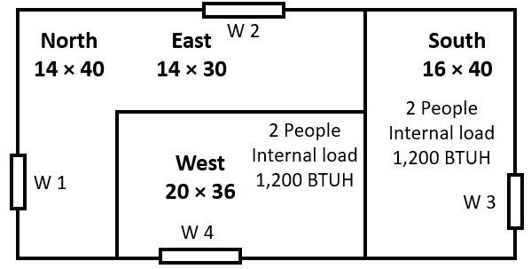
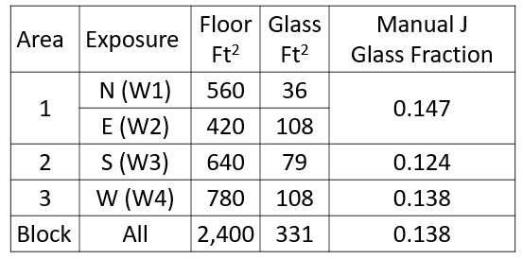
AED- Adequate Exposure Diversity

Slide 22
Calculations Using Manual D
Area/zone 1 = 16,551 BTUH
Area/zone 2 = 8,438 BTUH
Area/zone 3 = 16,524 BTUH
Total BTUH for room loads = 41,513
Total BTUH for Block Load = 32,759

Slide 23
Calculations Using Manual J Zone Branch Values
Area/zone 1 = 19,036 BTUH
Area/zone 2 = 11,684 BTUH
Area/zone 3 = 19,560 BTUH
Total BTUH for room loads = 50,280
Total BTUH for Block Load = 32,759

Slide 24
What Causes The Difference?
Glass loads are the main cause of the difference between the two loads shown above.
The block load is the sum of the three zone glass loads. For this home’s zones, the block load remains safely below 1.3 times the block average line for the whole day.

Slide 25
Glass Load Excursions
30,000
25,000
20,000
15,000
10,000
5,000
0
1.3 × Average
Block for Total Glass
Average
BTUH
Zone 1 (N & E)
1.3 × Average
Zone 3 (W)
Zone 2 (S)
Average
9 10 11 12 13 14 15 16 17 18 19
Hour of the Day

Slide 26
Glass Load Excursions
30,000
25,000
20,000
15,000
10,000
5,000
0
Block for Total Glass
Average
Zone 3 (W)
BTUH
Zone 1 (N & E)
Excursion
1.3 × Average
Zone 2 (S)
Average
9 10 11 12 13 14 15 16 17 18 19
Hour of the Day

Slide 27
Zoning by Exposure 4-5 PM
4,500
4,000
3,500
3,000
2,500
2,000
1,500
1,000
500
West 1
East 1
West 2
BTUH
West 3
East 2
9 10 11 12 13 14 15 16 17 18 19
Hour of the Day
4-5 PM

Slide 28
Field Notes
The complaint is simple, this room gets warm in the afternoons in the summer and then, go figure, it gets too warm in the winter in the late afternoon.
If the room has a lot of glass and faces south and/or west it could be the system design did not handle glass load excursions well.
Based on the how warm it gets, adding a window film, or an overhang might resolve the problem. Ask an AC contractor and the answer will usually be an auxiliary unit or zoning. Ask a window contractor….

