Slide 1
Part 15 Technician’s Guide & Workbook for Duct Diagnostics and Repair

Slide 2
Section 5.3: Comfort “War” Stories Part 2

Slide 3
Stories 5 & 6
Measure the airflow from the register with a AMD
As mentioned earlier, the airflow can be reverse engineered by measuring the room’s area and the CFM at the supply registers and return grilles. An Air Measuring Device (AMD) can be used to measure the rate at which air flows through any register. As noted earlier for flows below 500 CFM, a fan powered AMD is recommended, and for higher flows a commercial unit is recommended. The airflow rate into the cold room is measured

Slide 4
Stories 5 & 6
with the AMD and divided by the room area in square feet (ft²). This provided CFM per ft². That area per CFM may then be compared to similar rooms, another method is to compare the result to the CFM per ft² for the whole building (this approach is best for commercial spaces where CFM per ft² is often different in perimeter and interior rooms). Where all of the conditioned spaces are similar, the number can be found by dividing the airflow through the furnace by the total condition space area in ft².

Slide 5
Stories 5 & 6
If the ratio for the room is about less than 80% of that for the house, insufficient supply air is probably a major cause of the problem.
Story 5: A cold room with a single supply register was found to have 40 cfm of supply air for a room area of 175 ft². The conditioned area of the building was 1950 ft², and the measured fan flow rate was 1050 cfm. Taking the cfm/ft² for the building (1050/1950) gave 0.54 cfm/ft² as a benchmark. Calculating cfm/ft² for the room

Slide 6
Stories 5 & 6
If the ratio for the room is about less than 80% of that for the house, insufficient supply air is probably a major cause of the problem.
yielded 40/175, or 0.229 cfm/ft², and 0.229/0.54 = 42.2%, a value well below 80% of design. Low supply airflow is a major cause of the problem.
Example 6: A cold room with a single supply register was found to have 80 cfm of supply air for a room area of 175 ft².

Slide 7
Stories 5 & 6
The conditioned area of the house was 1950 ft², and the measured fan flow rate was 1050 cfm. Taking the cfm/ft² for the building (1050/1950) gave 0.54 cfm/ft² as a benchmark. Calculating cfm/ft² for the room yielded 80/175, or 0.457, and .457/.54 x 100 = 84.6%. Thus, since the supply airflow is above 80% of the design value, low supply airflow is probably not the major cause of the problem. As mentioned earlier in this section, the most likely culprit left is the air’s return path.

Slide 8
Stories 5 & 6
One easy/quick way to find out if a comfort problem is return airflow related is to leave the room door open. If the comfort problem goes away it is return airflow related. In this case opening the door made the room comfortable, and a jump duct was installed so the room had a return air path when the door was closed.

Slide 9
Story 7
Adjusting the airflow from the register by static pressure calculations
When in the field, shortcuts that save steps are a great thing to know about. When you know the CFM through a duct and the SP you can calculate a new CFM based on the change in SP. It is often easier to use the place where the duct static pressure can be read and the formula to calculate the related change in CFM than it is to measure the CFM again.

Slide 10
The formula is: SP_{FINAL} = SP_{BEGINNING} ÷ (CFM_{BEGINNING} ÷ CFM_{FINAL})² where:
CFM_{BEGINNING} is the measured airflow in cubic feet per minute for the duct trunk (can be several diffusers added together or a traverse).
CFM_{FINAL} is the desired final airflow in cubic feet per minute for the branch (can be several diffusers added together or a traverse).
SP_{BEGINNING} is the measured static pressure at the measured CFM.
SP_{FINAL} is the measured static pressure that will provide the final CFM desired through the branch (can be several diffusers added together or a traverse).

Slide 11
Story 7
Story 7: There was a lack of airflow to the main bedroom in the home and the technician used a fan-powered AMD to measure the airflows at all of the other supply registers. It was not surprising the one hardest to reach and measure safely was the one that had way more it’s share of airflow. The supply register was located high on the wall in a two story entrance hall ceiling in the entrance of a house. There was easy access to the branch that ran over to it where a balancing damper had been located in the equipment closet on the 2nd floor.

Slide 12
Story 7
After setting up a ladder and measuring 422 CFM with a fan powered flow hood (with a helper holding the ladder while he bent over in an awkward angle to hold the AMD) the technician decided to drill a SP measurement port in the branch between the damper and the supply diffuser and rather than climbing use the formula to adjust the damper. The SP was measured at 0.55 and he need the airflow to that register to be 250. At what SP should the technician set the damper?

Slide 13
Story 7 (Fan Law 2)
SP_{FINAL} = SP_{BEGINNING} ÷ (CFM_{BEGINNING} ÷ CFM_{FINAL})²
SP_{FINAL} = 0.55 ÷ (422 ÷ 250)²
SP_{FINAL} = 0.55 ÷ (1.688)²
SP_{FINAL} = 0.55 ÷ 2.85 (rounded off from 2.849344)
SP_{FINAL} = 0.19 (rounded off again)
The technician closed down the balancing damper until the SP was at 0.19. The master bedroom airflow was improved and became within 80% of design.

Slide 14
Story 7
If the technician wanted to get more airflow into the master bedroom, all of the other supply registers would have to be measured again and the one that was the highest above the design value would be shut down at the balancing damper to the design value. Once that process was done (it may take adjusting several supply lines), and the master bedroom had the correct airflow (within 5%), the technician could go back and recheck the SP on the entrance hall trunk and if necessary close it down again until it was at 0.19.

Slide 15
Story 7
The adjustment handle was locked down, marked and screwed into position so it would not easily be moved again. Note: It is even better if the insulation covering it is repaired and sealed so no one will move the damper in the future.
Note: For more instruction on air balancing see ACCA’s Manual B Balancing and Testing Air and Hydronic Systems.

Slide 16
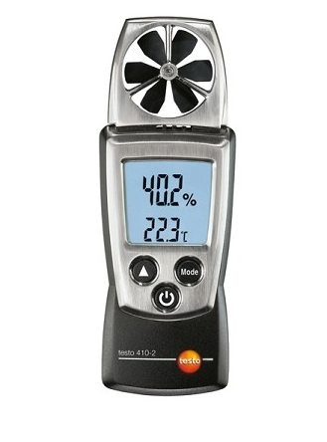
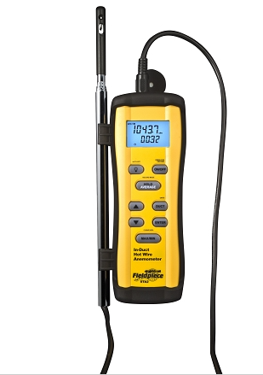
Thermal Comfort
When dealing with drafts, four rules of thumb will help when adjusting damper and register positions:
For cooling, most people complain about a draft when they feel an airflow of over 75 feet per minute.
For heating, most people feel a draft when the airflow is over 50 feet per minute.
As humidity decreases in the air, people tend to want the temperature set higher (and vice versa).
Women have more sensitive skin than men, and can feel temperature changes men cannot feel.

Slide 17
Thermal Comfort
When the customer identifies a room, rooms, or the whole building as being chronically under-conditioned, a trained technician should be able to solve the problem and explain to the building owner how the work was completed. Although one may always install a larger air conditioner, or an auxiliary heating or cooling unit serving a poorly conditioned room, doing so to hide a duct problem that causes the building to heat and cool the whole neighborhood is not a professional approach.

Slide 18
Lessons Learned
You should now be able to use AMD measured airflow to evaluate the CFM delivered to a room.
You should now be able to use Fan Law 2 to calculate the new SP needed to provide the required CFM to an area.
You should now be able to explain why a room feels drafty and recommend a fix.

