Slide 1
Day 1 Part 1 Technician’s Guide & Workbook for Home Evaluation and Performance Improvement

Slide 2
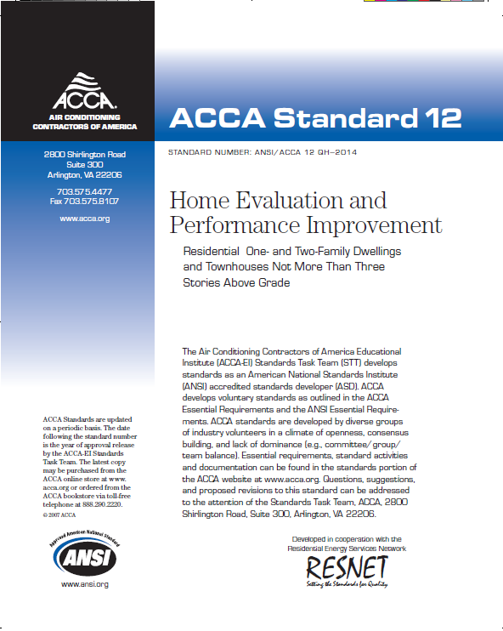
ACCA Standard 12
ANSI/ACCA 12 QH-2014 Existing Home Evaluation and Performance Improvement

Slide 3
Comprehensive Performance Audit 3.0 1.0 Purpose; 2.0 Scope; 3.1 Interview

Slide 4
Purpose
The Home Evaluation and Performance Improvement Standard establishes the minimum criteria by which deficiencies in existing residential buildings are identified by audit, improvement opportunities are assessed, scopes of work are finalized, work is performed in accordance with industry recognized procedures, and improvement objectives are met.

Slide 5
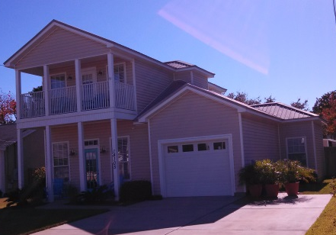
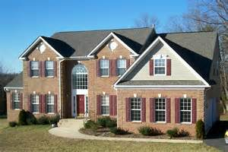
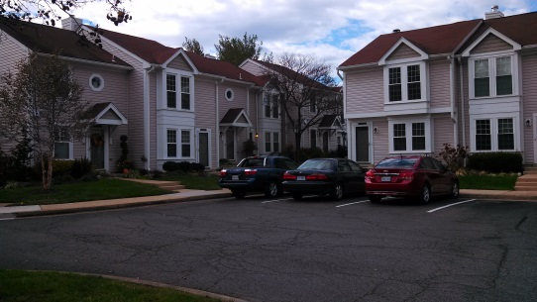
Scope
The Home Evaluation and Performance Improvement Standard applies to site-constructed or manufactured one- and two-family dwellings and townhouses not more than three stories above grade in height.

Slide 6
3.0 Comprehensive Performance Audit Interview 3.1

Slide 7
Comprehensive Performance Audit
Comprehensive performance audits collect information about the residence.
Measurements, tests, and observations are required to gather information for many areas of the home.

Slide 8
Comprehensive Performance Audit
Comprehensive performance audits collect information about the residence.
Measurements, tests, and observations are required to gather information for many areas of the home.

Slide 9
Interview
The interview is where the first information is gathered based on the homeowner’s opinion on how their home is operating and what their perceived performance problems are. Often they will think everything is OK and they are only seeking methods for reducing energy consumption.

Slide 10
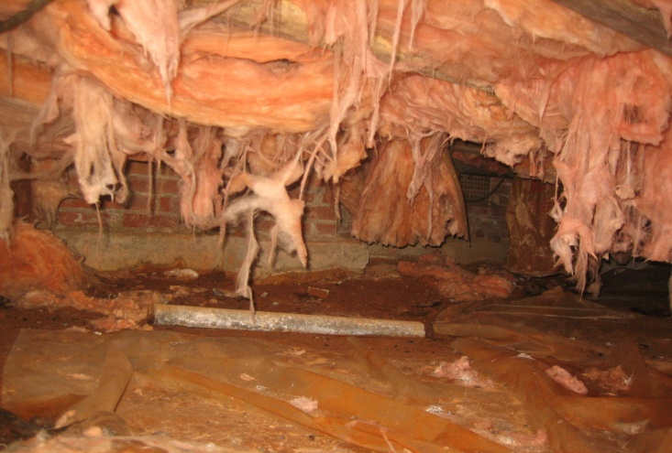
Interview

Slide 11
Basic Interview Questions
Do you own or rent the home? (Note: Renters must have express written permission from building owner prior to having an audit performed.)
How many people live (or work) in this building?
What year was your building built?
How long have you lived there, and how long do you plan to stay?
Of what improvements or changes in the building are you aware?

Slide 12
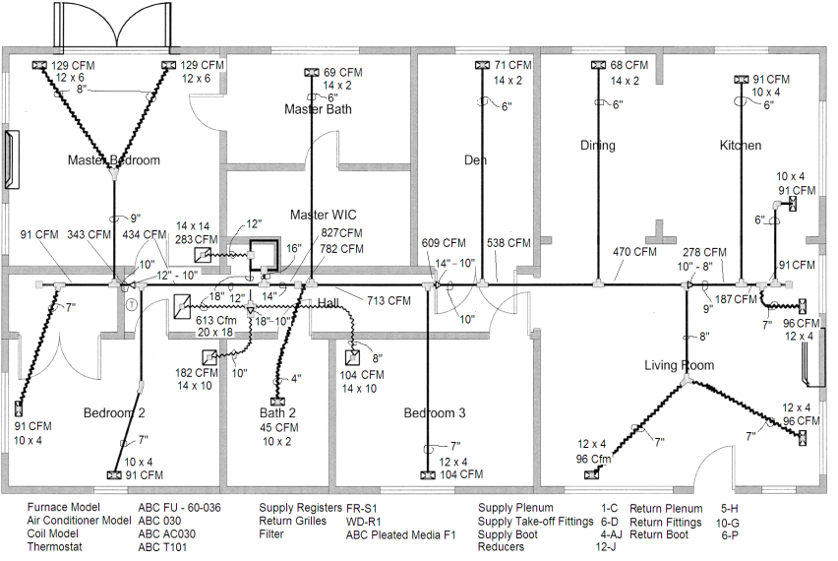
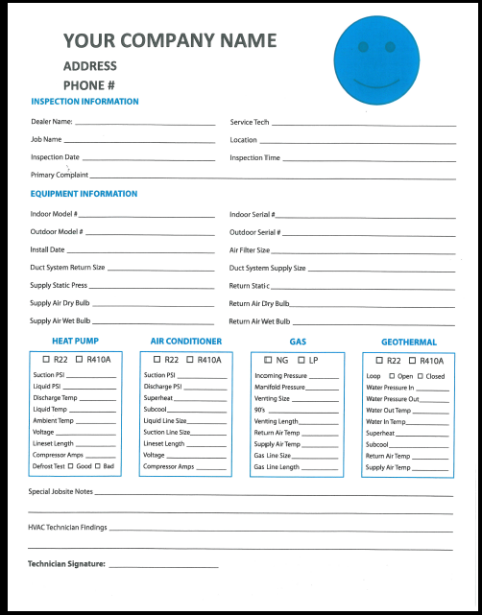
Basic Interview Questions
Do you have a set of building plans (architectural, as-built, material or equipment specifications or data sheets, etc.?)
6.

Slide 13
Basic Interview Questions
Do you have high utility bill complaints?
Do you have complaints about condensation on windows, any plumbing or roof leaks, dripping ducts, or other building components including moisture problems near the foundation?
Do you have the last 12 months of utility usage (electric, gas, fuel oil, etc.) records or bills?

Slide 14
Comfort Related Questions
Do you have any hot or cold rooms?
Do you have other comfort complaints? (Gather specific information: where in the building are they uncomfortable, the cause of discomfort: drafts, temperature, noise, and the remedy they use [e.g., covering a register, adjusting the thermostat, avoiding the room/space, etc.])
Where do you feel drafts or where is it drafty?

Slide 15
Comfort Related Questions
How often do you open your windows instead of using the air conditioner to maintain comfort?
Do you have any indoor air quality issues?
Does anyone in the house suffer from health issues (allergies, asthma, temperature issues, odors/smells, etc.)?
Do you have any health related air filtration requirements?

Slide 16
Comfort Related Questions
How often do you change the filter in the HVAC system(s)?
When was the last time you had the HVAC system checked for maintenance?
Do you know how to use the programmable thermostat?
Do you have a lot of dust in the house?

Slide 17
Home Systems Utility Related Questions (appliances, lighting, water etc.)
Do you use compact fluorescent or light emitting diode (LED) light

Slide 18
Home Systems Utility Related Questions (appliances, lighting, water etc.)
Do you turn on the kitchen exhaust fan when cooking?
Do you turn on the bath exhaust fan when bathing/showering?
Do you have a heated swimming pool? How is the pool heated? When do you use it? How long does the pump run? Is the swimming pool or spa inside your building? If so, how is that space ventilated?

Slide 19
Combustion Safety Questions
Do you have any wood-burning stoves or fireplaces in the building? If so, how do you use them? Do they have outside air for combustion?
Do you have any unvented fireplaces or space heaters in the building? If so, how do you use them and how is combustion air provided during operation?

Slide 20
Acceptable Documentation
Written or recorded responses for all of the 26 questions and for any follow up questions need to be kept in the job file.

Slide 21
Math Review Basics

Slide 22
Using Multiplication and Division

Slide 23
Division
80 ÷ 5 = 16
Also written as:
5 80
6
1
5
3
0
30
0

Slide 24
Multiplication and Division
6 x 5 x 4 = 120
4 x 6 x 5 = 120
10 ÷ 5 x 4 = ?
10 ÷ (5 x 4) = 1/2
(10 ÷ 5) x 4 = 8
(10 x 4) ÷ 5 = 8

Slide 25
Multiplication and Division
0.56 x 0.35 = ?
0.56 x 0.35 = .196
0.56 ÷ 0.35= ?
0.56 ÷ 0.35 = 1.6
0.56 x 0.007 = .00392
0.56 ÷ 0.007 = 80
0.007 ÷ 0.56 = 0.0125

Slide 26
Multiplication and Division
What is 6 feet 3 inches in feet?
1 foot = 12 inches
3 inches = 3 ÷ 12 = 0.25 feet
6 + 0.25 = 6.25 feet

Slide 27
Area Calculations
For Squares and rectangles the area (A) is equal to length (L) x width (W) or A = L x W
Width
Length

Slide 28
Area Calculations
A = L x W
Square L = W = 3
3 x 3 = 9 Square Something
Width = 3
Length = 3

Slide 29
Area Calculations
For Squares and rectangles the area (A) is equal to length (L) x width (W) or A = L x W
Width = 6 feet 3 inches
Length = 3 feet

Slide 30
Area Calculations
For Squares and rectangles the area (A) is equal to length (L) x width (W) or A = L x W
Width = 6 feet 3 inches =
6 + (3 ÷ 12) = 6.25 feet
Length = 3 feet
A = L x W = 3 x 6.25 = 18.75 square feet

Slide 31
Area of a Circle
A = 3.14 x R x R
Radius = R
Diameter = 2 x R

Slide 32
Area of a Circle
A = 3.14 x R x R
Radius = ½ D = 4 inches
Diameter = 8 inches
A = 3.14 x 4 x 4
A = 50.24 square inches

Slide 33
Area of a Circle
A in square inches = A in square feet
12 x 12 = 144
50.24 ÷ 144 = ?
A = 50.24 square inches
0.3488888888888…

Slide 34
Measuring Surface Area

Slide 35
Area of a Triangle
For any triangle with a right angle the area is the length multiplied by the width (of the two legs meeting at the right angle) divided by 2.

Slide 36
Area of a Right Triangle
For any triangle with a right angle the area is the length multiplied by the height of the two legs where the right triangle is divided by 2.
90º
90º
90º
90º
90º = right angle

Slide 37
Area of a Triangle
For any triangle with a right angle the area is the length multiplied by the height of the two legs where the right triangle is divided by 2.
90º
90º
Length
90º
90º
Width

Slide 38
Area of a Triangle
Length times width divided by 2.
90º
90º
Length 8’
90º
90º
Width 14’

Slide 39
Area of a Triangle
Length times width divided by 2.
8 X 14 ÷ 2 = 56 Sq. Ft.
Length 8’
90º
Width 14’

Slide 40
Area of a Triangle
A = h_{b} X b ÷ 2

Slide 41
Area of a Triangle
A = h_{b} X b ÷ 2
h_{b}
90º
90º
b

Slide 42
Area of a Triangle
A = h_{b} X b ÷ 2 =
h_{b}= 6’
90º
90º
b = 14’
A = 6 X 16 ÷ 2 = 48 Sq. Ft.

Slide 43
Area of a Triangle
Calculate the wall area for the following drawing:
3.66 ft
8.0 ft
18.75 ft

Slide 44
Area of a Triangle
Calculate the wall area for the following drawing:
3.66 ft
8.0 ft X 18.75 ft = 150 ft²
8.0 ft
18.75 ft

Slide 45
Area of a Triangle
Calculate the wall area for the following drawing:
3.66 ft
h_{b}
b
18.75 ft
8.0 ft
3.66 ft X 18.75 ft ÷ 2 = 34.3 ft²

Slide 46
Area of a Triangle
Calculate the wall area for the following drawing:
3.66 ft
34.3 ft²
8.0 ft
150 ft²
18.75 ft

Slide 47
Area of a Triangle
Calculate the wall area for the following drawing:
3.66 ft
34.3 ft²
8.0 ft
150 ft²
150 ft² + 34.3 ft² = 184.3 ft²
18.75 ft

