Slide 1
Technician’s First Guide and Workbook Section 10: Airflow Basics (2)

Slide 2
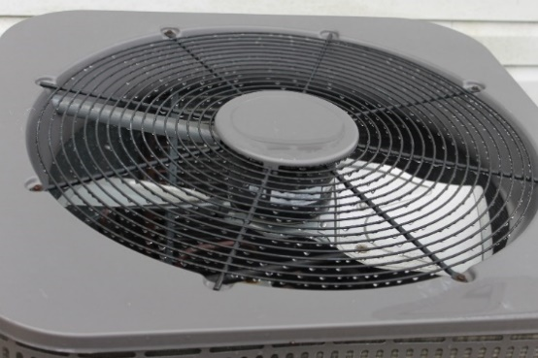
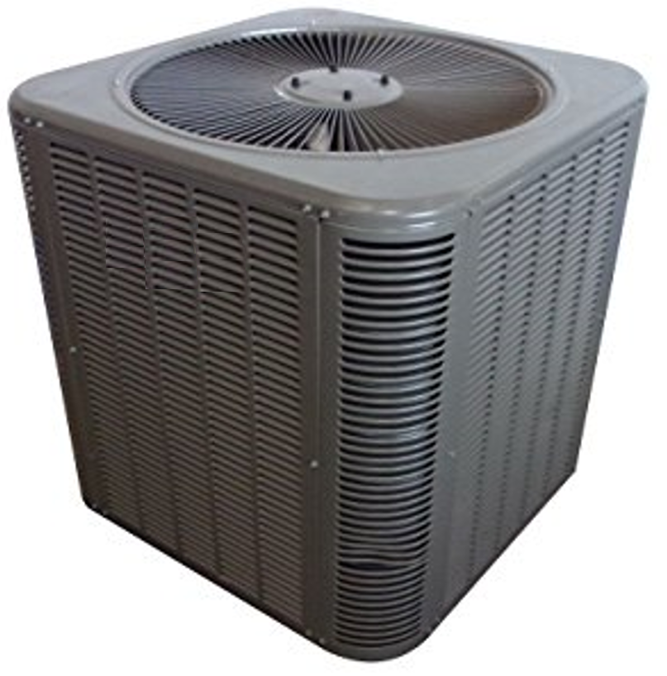
Condenser Airflow
Fan Law 1 shows that a percentage change in fan speed results in an equivalent percentage change in fan CFM. Fan Law 1: CFM_{Beginning}÷ CFM_{Final} = RPM_{Beginning}÷ RPM_{Final}.
One easy way to verify the correct condenser airflow using a replacement blade is to measure the amps and volts and verify the Watt total is equivalent to the equipment’s blower motor name plate value. A wattage calculation will also identify blades that have been put on upside down (upside down they will move approximately 1/3 of the required airflow and the wattage will be low).

Slide 3
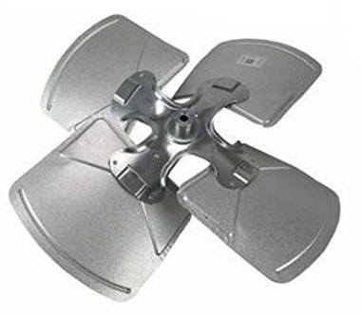
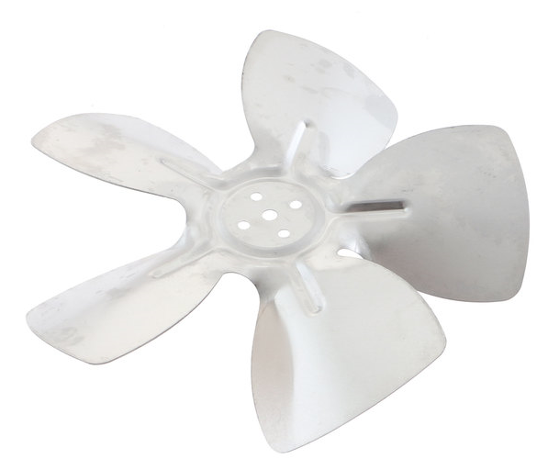
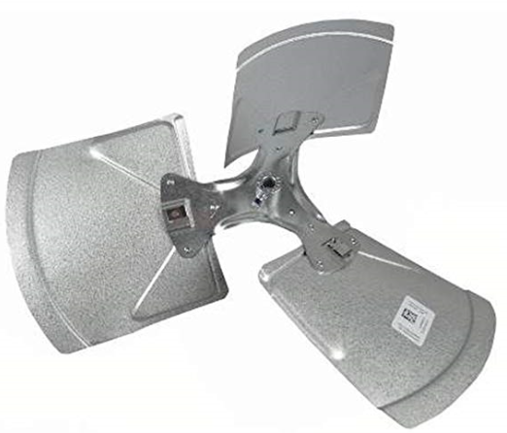
Condenser Airflow Watts
Remember the formula for watts? It was: W = V × I
Where:
W= watts (power) Note kW = 1000 watts
V= Voltage
I = amperage

Slide 4
Calculating Condenser Airflow Watts (1)
Example: a condenser fan motor is rated to operate at 75 W and has a measured 240V input voltage. What amperage would verify the fan is operating properly?
75 = 240 × I OR: I = 75 ÷ 240 = 0.3125 amps

Slide 5
Calculating Condenser Airflow Watts (2)
If a technician measured 238V at 0.32 amps in the field is the condenser fan CFM correct?
W = 238 × 0.32 = 76.16 Watts
0.32 ÷ 0.3125 × 100 = % of design Amps = 102%
76.16 ÷ 75 × 100 = % of design Watts = 101%
YES: since that is within 5% the system is operating correctly.

Slide 6
Airflow Across Evaporator Coils
Many of the coil manufacturers also have tables that provide the airflow going across the coil based on the ESP pressure drops. The pressure drops are measured using a pressure differential meter connected to two static pressure probes. One probe is placed so it measures the SP entering the coil, the other one is placed so it is measuring the SP of the air leaving the coil. Note: there are different charts for a wet and dry coil.

Slide 7
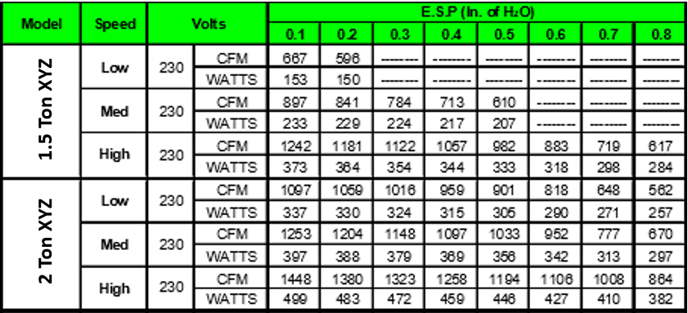
Typical Evaporator Coil Chart

Slide 8
Reading An Evaporator Coil Chart

Slide 9
Airflow Through Duct Systems
Airflow through duct systems should be measured and duct leakage should be measured when a system is installed or updated.
An industry standard method for measuring airflow inside of ducts called Traversing.

Slide 10
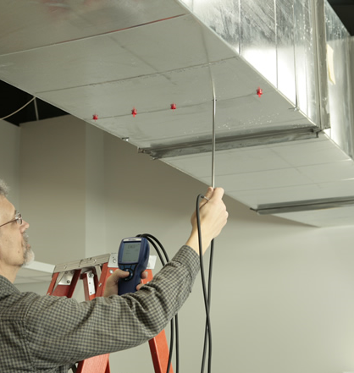
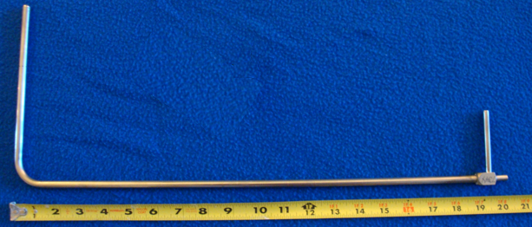
Tools For Traversing

Slide 11
Duct Leakage Testing
Duct flow leakage measurement is generally done using a calibrated fan. The system’s supply duct SP is measured and marked down. The system is then shut off and the supply diffuser outlets and return grilles are sealed shut. A calibrated fan is then generally connected to a return grill and taped so there is no air leakage at the connection. The calibrated fan is then turned on and the fan speed is turned up until the duct maintains a pressure of 25 Pascale (Pa). The Supply duct SP is again noted for use with the calibrated fan’s meter, or chart in calculating the duct leakage in CFM.

Slide 12
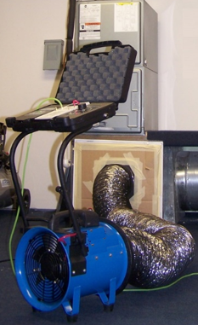
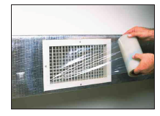
Duct Leakage Testing Tools

Slide 13
Traversing Patterns

Slide 14
Combustion Cycle
The combustion cycle in a furnace or boiler generally includes the following:
System calling for heat causes ignition of a piolet flame (Note: there is a purge cycle if there is a burner with a blower where the blower comes on and clears out the combustion chamber and verifies airflow before the ignition of the piolet is ignited).
Piolet flame is verified, and the main fuel valve is opened.
Main flame is verified, and the system runs until the thermostat is satisfied.
Main flame shuts down, ignition and piolet light remain off.
For most modern systems the combustion cycle is followed with a cool down period where the blower fan remains on for a short period of time to remove more heat from the heat exchanger. Thus, increasing efficiency.

Slide 15
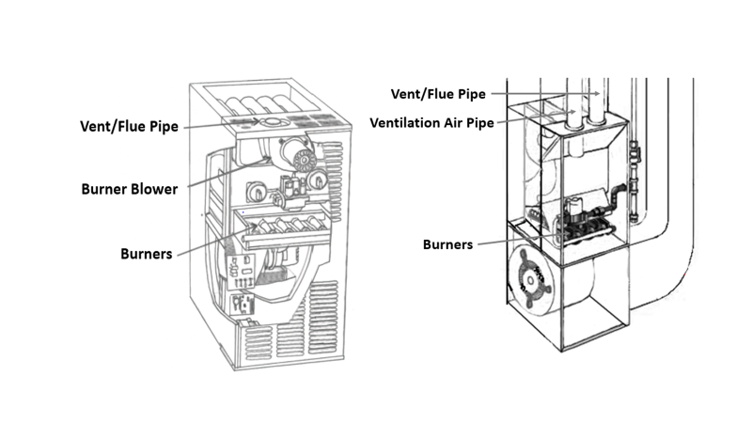
Location of Vent/Flue Piping

Slide 16
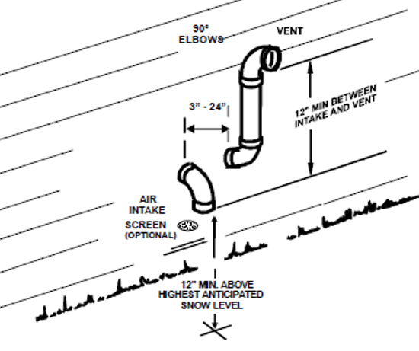
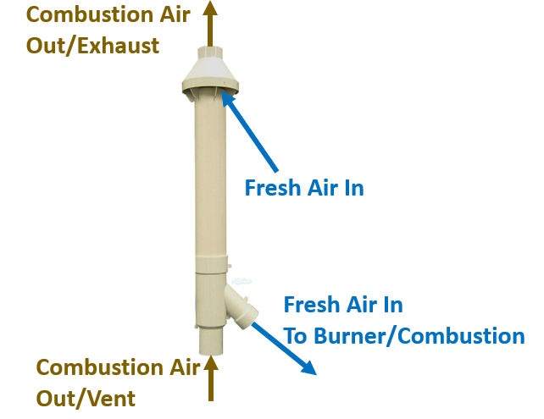
Combustion Venting

Slide 17
Lessons Learned
You should now be able to use a measured amperage and voltage to calculate Watts and evaluate airflow for a condenser fan based on wattage.
You should now be able to explain how the pressure drop across an evaporator coil can be used to evaluate airflow.
You should now be able to identify tools needed to measure airflow by the traverse method .
You should now be able to explain the steps in the combustion cycle.
You should now be able to Identify Vent/Flue piping.

