Slide 1
Day 4 Part 2 Technician’s Guide & Workbook for Home Evaluation and Performance Improvement

Slide 2
Implementing Identified Performance Improvements (IIPI) 6.0

Slide 3
IIPI Safety 6.1

Slide 4
IMPLEMENTING IDENTIFIED PERFORMANCE IMPROVEMENTS (IIPI)
The Technician who is in charge of the contracted performance and safety retrofit installation must make sure that the building performance improvement(s) selected by the homeowners are all done in accordance with recognized industry standards and good practices.

Slide 5
IMPLEMENTING IDENTIFIED PERFORMANCE IMPROVEMENTS (IIPI)
The Technician cannot make any exclusions or variations from the prescribed work scope that result in the home operating improperly, or that will increase the risk of flue gas spillage, back-drafting, carbon monoxide production, or moisture problems within the home.

Slide 6
IMPLEMENTING IDENTIFIED PERFORMANCE IMPROVEMENTS (IIPI)
Slide presentation 6.2 covered sections 5.1 through 5.7 in 12 QH. Those sections cover specific items for the main areas addressed in the standard the Technician needs to be aware of during the implementation phases of the home improvement project.

Slide 7
IMPLEMENTING IDENTIFIED PERFORMANCE IMPROVEMENTS (IIPI)
It should be noted that the items listed are a basic outline and the manufacturers details for installation need to be followed and all of the local code requirements need to be met too.

Slide 8
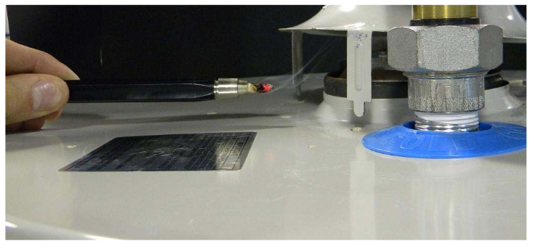
IIPI Safety
CO, spillage, and drafting issues need to be addressed by implementing repairs and/or installing the appliance in compliance with local codes and the appliance manufacturer’s installation instructions. Full instructions for the Technician on combustion appliance testing and inspection are provided in previous presentations.
(1.9, 3.6 & 5.1)

Slide 9
IIPI Safety
Combustion air for fuel burning appliances must be done in accordance with one or more of the following as previously described:
§9.3 of the 2015 National Fuel Gas Code,
§304 of the 2012 International Fuel Gas Code or manufacturer’s installation instructions for gas-fired appliances,

Slide 10
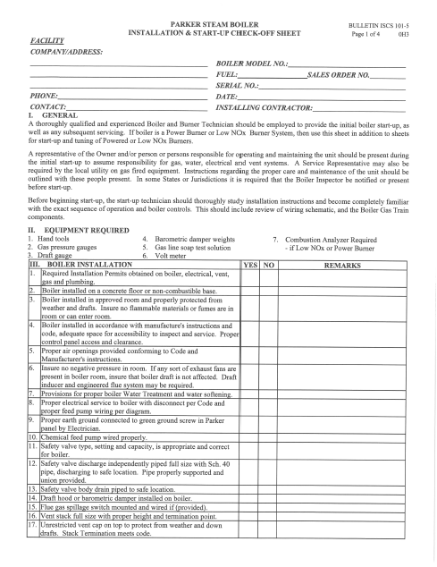
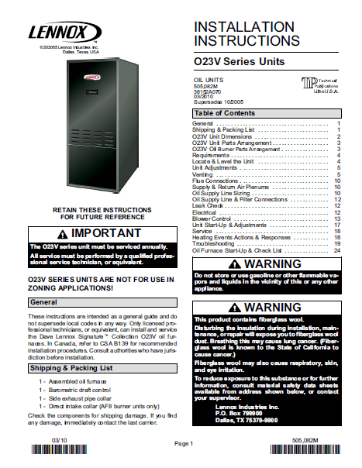
IIPI Safety
OEM instructions, unless not available then: §G2407 of the 2012 International Residential Code for appliances other than gas-fired appliances.

Slide 11
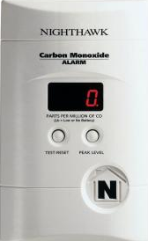
IIPI Safety
CO detectors shall be installed in accordance with OEM instructions and 2012 International Residential Code §R315.

Slide 12
IIPI Safety
When measures are performed that improve the envelope tightness and a Radon test has not been included in the contract, the Technician should recommend that a Radon test be done upon completion of the selected building improvements. Note: If Radon is found upon the completion of the work, the Technician will probably need that copy of the owner’s refusal to consider Radon as part of the original proposal (see Slide Presentation 6.9 Test Out Procedures).

Slide 13
Acceptable Documentation
CO Detector Information
CO Spillage Test documentation
Records for other safety related testing done. For example Radon testing.

Slide 14
IIPI Envelope 6.2

Slide 15
Leakage Types

Slide 16
Ventilation = Leakage

Slide 17
Temperature Difference

Slide 18
Pressure Differences

Slide 19
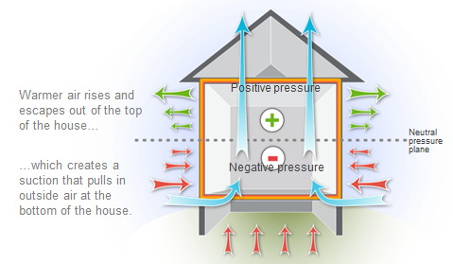
Stack Effect

Slide 20
Wind Direction

Slide 21
IIPI Envelope
Air sealing measures need to be prioritized to reduce the stack effect and inhibit moisture migration into attics and other interstitial spaces. Additionally, an effective and continuous thermal and pressure boundary shall be established through the installation of appropriate air sealing and insulation measures.

Slide 22
IIPI Envelope
Air sealing and insulation strategies shall be designed to align the thermal and pressure boundaries to create a single continuous thermal envelope for the entire home. The following items should be considered when planning to accomplish those goals:

Slide 23
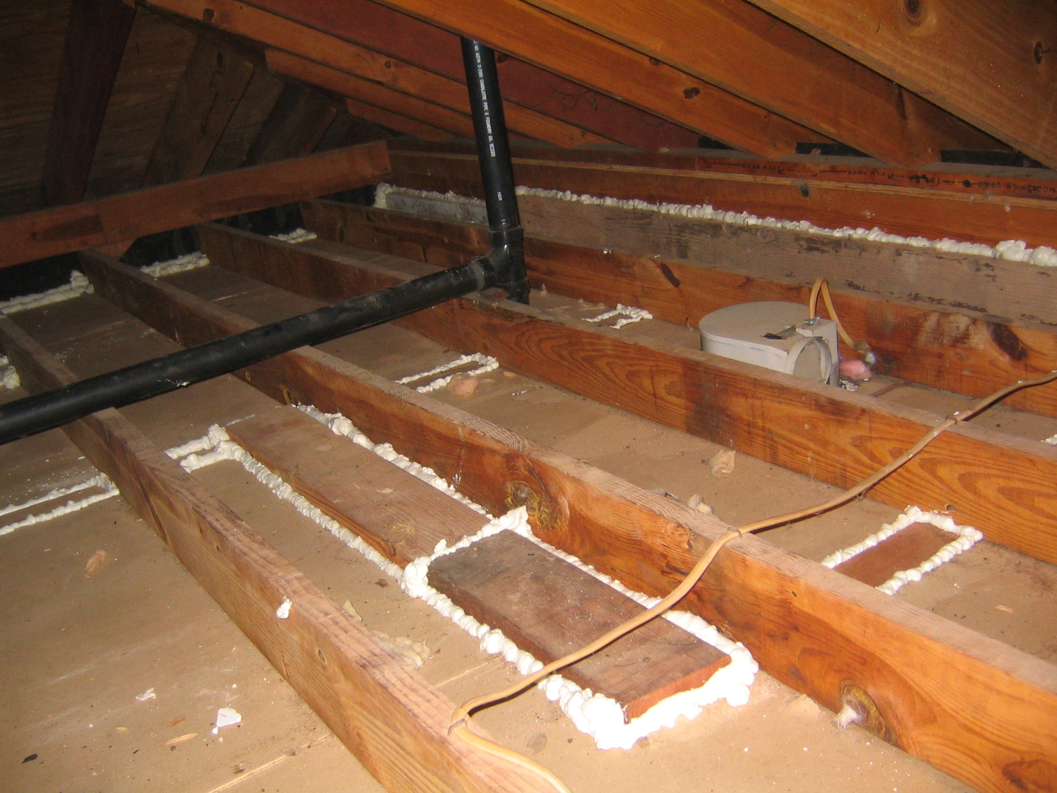
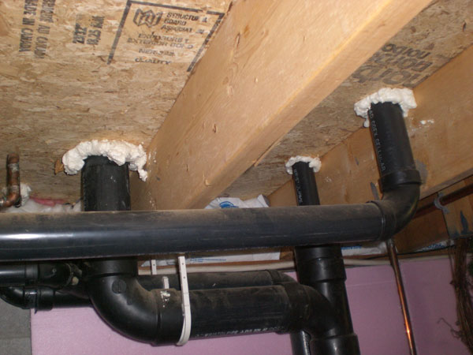
IIPI Envelope
Air leakage paths need to be found and sealed when they exist between attached, or drive-under garages, and the living space.

Slide 24
IIPI Envelope
When leakage paths are through enclosed cavities that cannot be accessed for sealing using conventional air sealing techniques, the following applications are acceptable to reduce airflow through the building envelope:

Slide 25
IIPI Envelope
Installation of high density pneumatically applied insulation - which complies with the insulation manufacturer’s directions.
Installation of air impermeable foam insulation.

Slide 26
IIPI Envelope
Whenever air sealing represents 15% or more of the total building shell area, or whenever ducts outside the thermal envelope are sealed, the work scope must include pre-and post-installation blower door testing. So, if it was left out of the proposal…it still must be done and verified by the Technician who is overseeing the job.

Slide 27
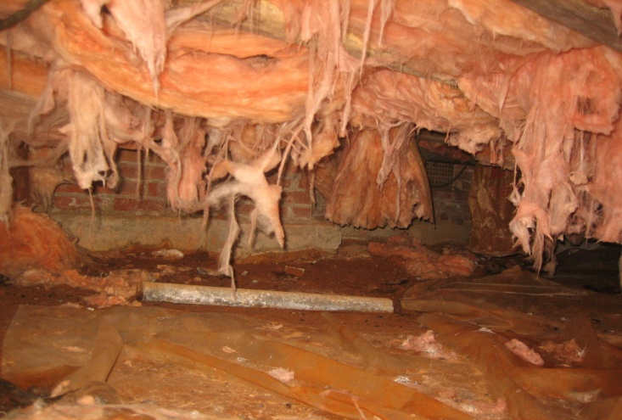
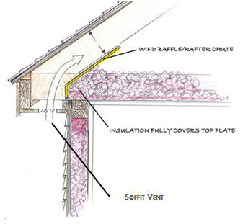
IIPI Envelope
All existing interior or exterior moisture issues shall be remediated prior to air sealing the building shell.
Attic venting shall be in accordance with 2012 International Residential Code §R806 Roof Ventilation.

Slide 28
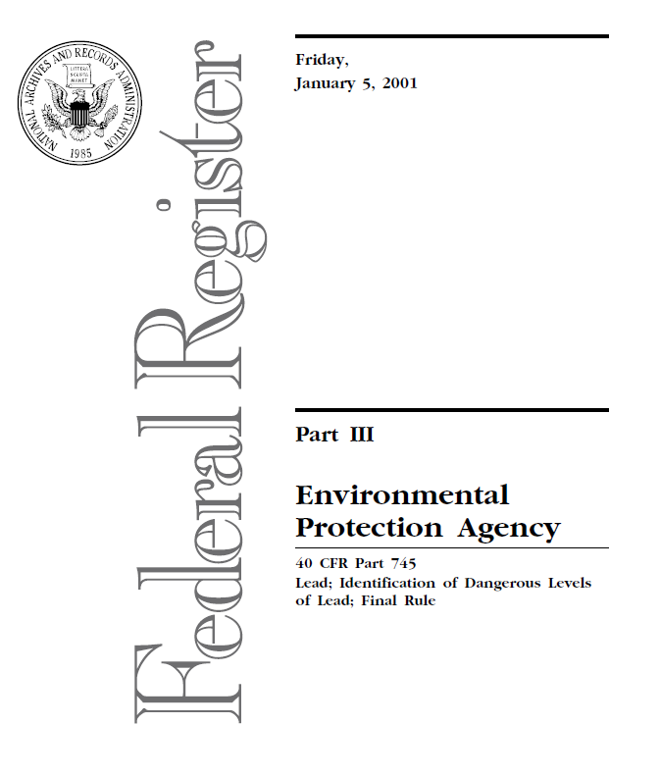
IIPI Envelope
Repairs and renovations to pre-1978 homes that have evidence of lead paint: must have lead mitigation plans that comply with the EPA’s Renovation, Repair, and Painting (RRP) Program Rule (40 CFR Part 745).

Slide 29
Acceptable Documentation
Records of repairs for moisture problem areas.
Lead abetment records where required.
Records for attic venting.
Documentation of sealing completed.

Slide 30
IIPI Ventilation 6.3

Slide 31
IIPI Ventilation
Where there are no code requirements for the design of outside/makeup air, that air should be set to comply with ASHRAE 62.2-2013 requirements, and should also meet the 2012 International Energy Code (IECC) requirements.

Slide 32
ASHRAE 62.2
Before OA solutions can be selected, the amount of OA required must be determined. ASHRAE 62.2 specifies three acceptable methods for determining the OA. When using any of these methods to determine OA, the total required ventilation rate (Q_{tot}) of OA must be greater than, or equal to, exhaust rates from kitchens and bathrooms.

Slide 33
ASHRAE 62.2
Before OA solutions can be selected, the amount of OA required must be determined. ASHRAE 62.2 specifies three acceptable methods for determining the OA. When using any of these methods to determine OA, the total required ventilation rate (Q_{tot}) of OA must be greater than, or equal to, exhaust rates from kitchens and bathrooms.

Slide 34
ASHRAE 62.2
Minimum exhaust rates for kitchens are 100 CFM intermittent or 5 air changes per hour (based on kitchen area), and for each bathroom, 50 CFM for intermittent applications, or 20 CFM for constant operation. However, for designs where there are less than 5 air changes per hour in the kitchen, vented range hoods are required Including appliance-range hood combinations.

Slide 35
62.2 Ventilation Table Method
Ventilation Air Requirements in CFM
Floor Area ft² | Number of Bedrooms
 | 1 | 2 | 3 | 4 | 5
Less Than 500 | 30 | 38 | 45 | 53 | 60
501-1000 | 45 | 53 | 60 | 68 | 75
1001-1500 | 60 | 68 | 75 | 83 | 90
1501-2000 | 75 | 83 | 90 | 98 | 105
2001-2500 | 90 | 98 | 105 | 113 | 120
2501-3000 | 105 | 113 | 120 | 128 | 135
3001-3500 | 120 | 128 | 135 | 143 | 150
3501-4000 | 135 | 143 | 150 | 158 | 165
4001-4500 | 150 | 158 | 165 | 173 | 180
4501-5000 | 165 | 173 | 180 | 188 | 195

Slide 36
62.2 Ventilation Sample Home
A two-bedroom house with a 1,525 ft² conditioned floor area .as per ASHRAE 62.2.
When using Table 1a, the values provided are for 2 persons in a studio (or in a one-bedroom), and if the number of occupants is known, and greater than the table values, the additional occupants must be accounted for by adding 7.5 CFM per additional person to the table value.

Slide 37
62.2 Ventilation Table Method
Ventilation Air Requirements in CFM
Floor Area ft² | Number of Bedrooms
 | 1 | 2 | 3 | 4 | 5
Less Than 500 | 30 | 38 | 45 | 53 | 60
501-1000 | 45 | 53 | 60 | 68 | 75
1001-1500 | 60 | 68 | 75 | 83 | 90
1501-2000 | 75 | 83 | 90 | 98 | 105
2001-2500 | 90 | 98 | 105 | 113 | 120
2501-3000 | 105 | 113 | 120 | 128 | 135
3001-3500 | 120 | 128 | 135 | 143 | 150
3501-4000 | 135 | 143 | 150 | 158 | 165
4001-4500 | 150 | 158 | 165 | 173 | 180
4501-5000 | 165 | 173 | 180 | 188 | 195

Slide 38
62.2 Ventilation Table Method
Ventilation Air Requirements in CFM
Floor Area ft² | Number of Bedrooms
 | 1 | 2 | 3 | 4 | 5
Less Than 500 | 30 | 38 | 45 | 53 | 60
501-1000 | 45 | 53 | 60 | 68 | 75
1001-1500 | 60 | 68 | 75 | 83 | 90
1501-2000 | 75 | 83 | 90 | 98 | 105
2001-2500 | 90 | 98 | 105 | 113 | 120
2501-3000 | 105 | 113 | 120 | 128 | 135
3001-3500 | 120 | 128 | 135 | 143 | 150
3501-4000 | 135 | 143 | 150 | 158 | 165
4001-4500 | 150 | 158 | 165 | 173 | 180
4501-5000 | 165 | 173 | 180 | 188 | 195

Slide 39
62.2 Ventilation Table 1a Method
Ventilation Air Requirements in CFM
Floor Area ft² | Number of Bedrooms
 | 1 | 2 | 3 | 4 | 5
Less Than 500 | 30 | 38 | 45 | 53 | 60
501-1000 | 45 | 53 | 60 | 68 | 75
1001-1500 | 60 | 68 | 75 | 83 | 90
1501-2000 | 75 | 83 | 90 | 98 | 105
2001-2500 | 90 | 98 | 105 | 113 | 120
2501-3000 | 105 | 113 | 120 | 128 | 135
3001-3500 | 120 | 128 | 135 | 143 | 150
3501-4000 | 135 | 143 | 150 | 158 | 165
4001-4500 | 150 | 158 | 165 | 173 | 180
4501-5000 | 165 | 173 | 180 | 188 | 195

Slide 40
62.2 Ventilation Table 1b Method
Ventilation Air Requirements in Cfm
Floor Area ft² | Number of Bedrooms
 | 1 | 2 | 3 | 4 | 5
Less Than 500 | 30 | 40 | 45 | 55 | 60
501-1000 | 45 | 55 | 60 | 70 | 75
1001-1500 | 60 | 70 | 75 | 85 | 90
1501-2000 | 75 | 85 | 90 | 100 | 105
2001-2500 | 90 | 100 | 105 | 115 | 120
2501-3000 | 105 | 115 | 120 | 130 | 135
3001-3500 | 120 | 130 | 135 | 145 | 150
MoreThan 3501 | 135 | 145 | 150 | 160 | 165

Slide 41
62.2 Ventilation Formula Method
The formula is:
Q_{tot}= 0.03 A_{floor} + 7.5 x (N_{br}+ 1)
Where:
Q_{tot}= Total required ventilation rate in cubic feet per minute (CFM)
A_{floor} = Floor area in square feet
N_{br} = Number of bedrooms. Not to be less than one; used to estimate the number of occupants for design purposes.

Slide 42
62.2 Ventilation Formula Method
The formula is:
Q_{tot}= 0.03 A_{floor} + 7.5 x (N_{br}+ 1)
OA_{cfm} = 0.03 (1525) + [7.5 x (2+ 1)] = 68.25 CFM

Slide 43
62.2 Ventilation Alternative Method
ASHRAE allows practitioners to use any alternative OA formulas that provide equivalent results to the ASHRAE 62.2 Table Rates.

Slide 44
Additional 62.2 Ventilation Formulas
For infiltration credits and intermittent operation calculations, see:
Appendix 1 Technician’s Guide & Workbook for Home Evaluation and Performance Improvement.
Or
If you are an ACCA Member Technical Bulletin 1-2014

Slide 45
Ventilation Installation
The Technician needs to install ventilation systems in accordance with OEM instructions. The system must also meet the local code requirements, and must be installed to meet the accepted industry practices. The following two requirements must also be met:

Slide 46
Ventilation Installation
Mechanical ventilation airflow shall be measured in accordance with §5 in the Technician’s Guide & Handbook for Quality Installations as outlined in ANSI/ACCA 5 QI -2015.

Slide 47
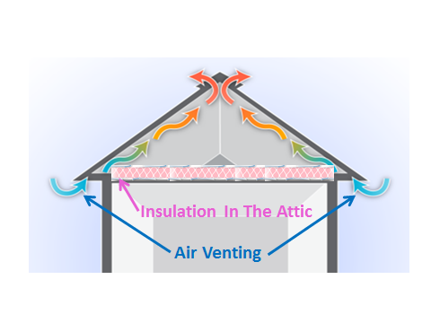
Ventilation Installation
Attic ventilation shall not be installed without first verifying the presence of an effective air barrier and thermal barrier between the attic and the living space. Refer to local codes for minimum requirements for insulation and ventilation.

Slide 48
Acceptable Documentation
Documentation for the airflow measurements that meet the ventilation requirements should include the following:
Test date.
Location.
Name of Technician.
Data on the test equipment including models and serial numbers.
Calculations and copies of the airflow data sheets.
A copy of the ASHRAE 62.2 calculations, or the local code requirement calculations.

