Slide 1
Technician’s Guide & Workbook for Duct Diagnostics and Repair

Slide 2
Section 4.3: System Verification

Slide 3
Verifying System Fan Flow
A variety of methods have been used to measure airflow in ducts. Methods accepted by the HVAC industry in ANSI/ACCA 5 QI-2015 include the following:
CFM/Static Pressure (using equipment manufacturer’s tables )
Traversing the duct
Flow Grid Measurement
Pressure Matching Method
Temperature Rise Method (for heating only applications)

Slide 4
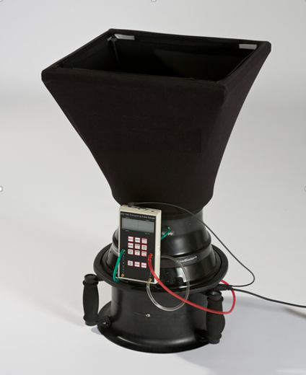
AMD Airflow Measurement

Slide 5
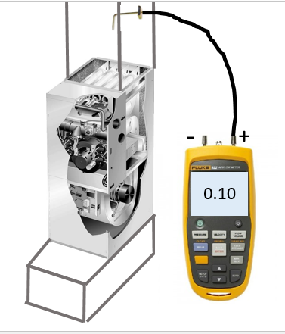
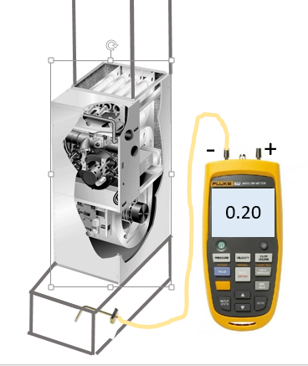
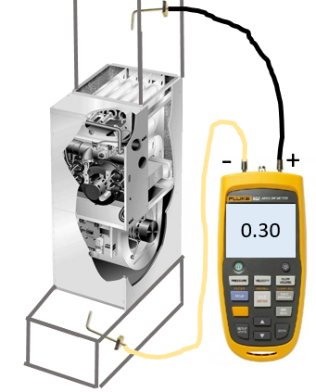
ESP Measurements
+
=

Slide 6
Finding CFM Using ESP Measurements
External Static Pressure |  | Air Volume and Motor Watts at Specific Blower Taps
 |  | Low Speed |  |  | Medium Speed |  |  | High Speed
In. wg | Pa | Cfm | L/s | Watts | Cfm | L/s | Watts | Cfm | L/s | Watts
.00 | 0 | 700 | 330 | 245 | 895 | 420 | 310 | 1030 | 485 | 375
.05 | 10 | 690 | 325 | 240 | 875 | 415 | 305 | 1010 | 475 | 370
.10 | 25 | 680 | 320 | 235 | 865 | 410 | 300 | 990 | 470 | 365
.15 | 35 | 665 | 315 | 230 | 850 | 400 | 290 | 970 | 460 | 355
.20 | 50 | 655 | 310 | 225 | 830 | 390 | 285 | 955 | 450 | 350
.25 | 60 | 640 | 300 | 220 | 810 | 385 | 280 | 925 | 440 | 345
.30 | 75 | 625 | 295 | 215 | 795 | 375 | 270 | 900 | 425 | 335
.40 | 100 | 595 | 280 | 210 | 750 | 355 | 255 | 850 | 400 | 320
.50 | 125 | 555 | 260 | 195 | 700 | 330 | 240 | 800 | 380 | 305
.60 | 150 | 510 | 240 | 185 | 640 | 300 | 225 | 725 | 340 | 290
.70 | 175 | 395 | 185 | 165 | ----- | ----- | ----- | 620 | 295 | 265
.75 | 185 | ----- | ----- | ----- | ----- | ----- | ----- | 570 | 270 | 255

Slide 7
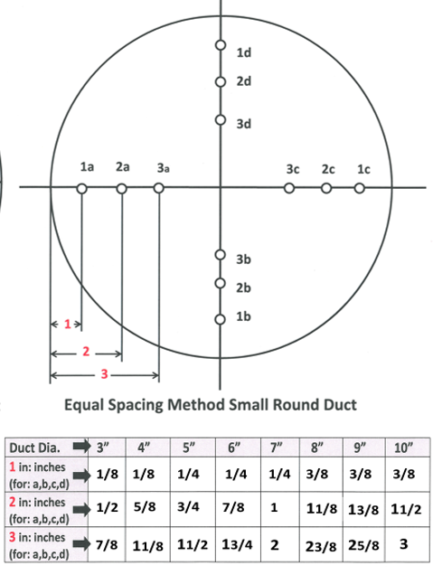
Traversing Duct

Slide 8
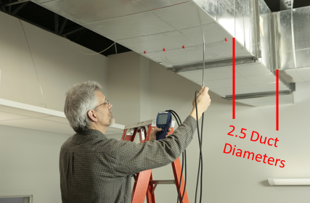
Traversing Tools

Slide 9
Pressure Matching

Slide 10
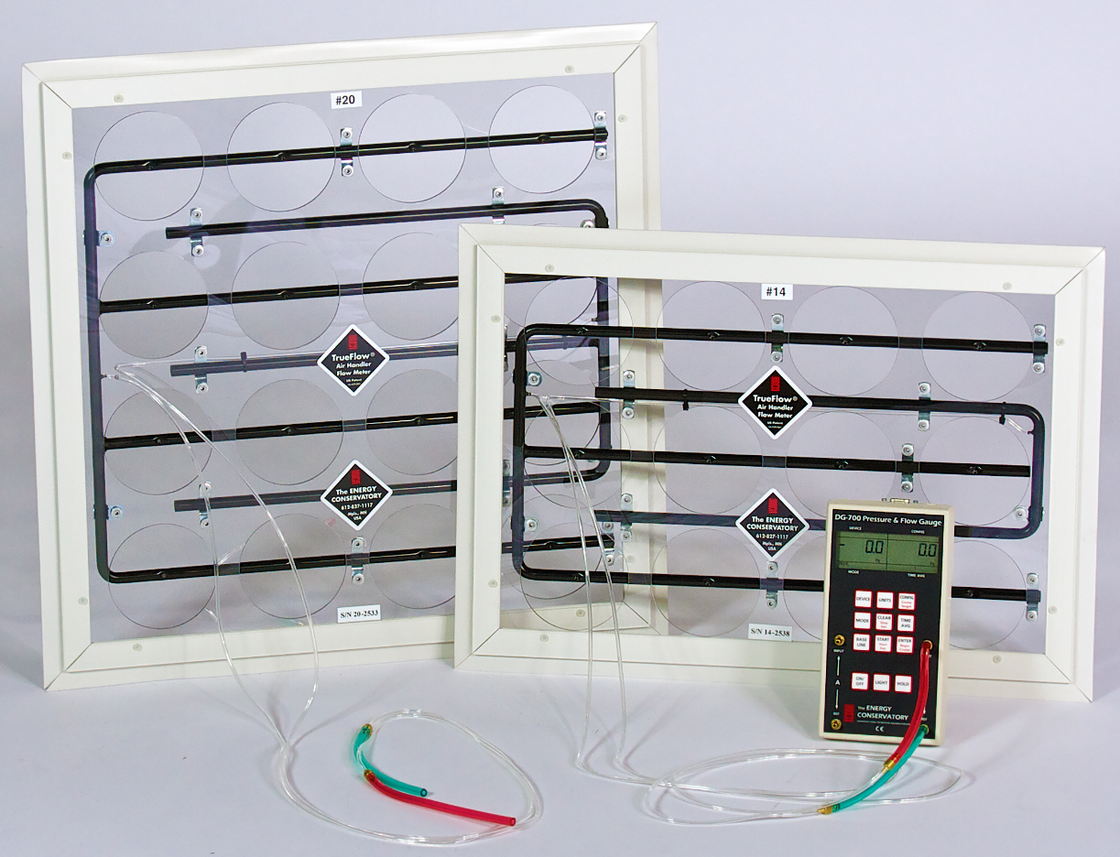
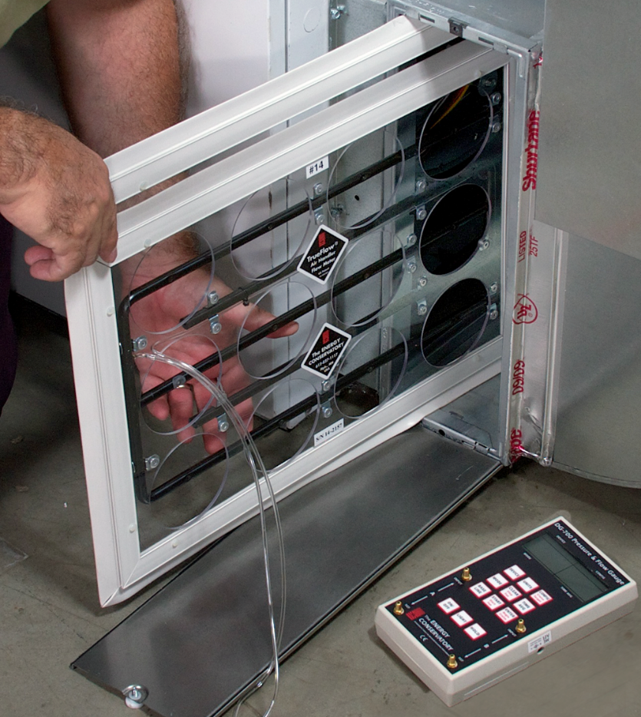
Flow Grid Method

Slide 11
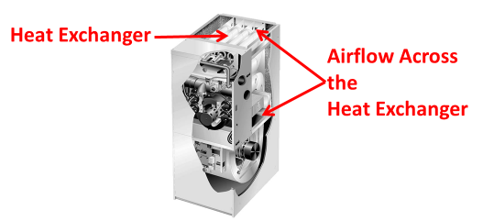
Temperature Rise Method
Heat Exchanger
Airflow Across
The
Heat Exchanger

Slide 12
Step 4 Deciding What To Do
The final step in the procedure is to develop a course of action to propose to your customer. There are two general approaches to making this decision:
ANSI/ACCA 5 QI-2015 HVAC Quality Installation Specification minimum requirements;
Program Guidelines

Slide 13
Duct Leakage ANSI/ACCA 5 QI-2015
For new construction, test using any one of the three options:
Ducts (100%) located inside the thermal envelope have no more than 10% total duct leakage (airflow in CFM),
or
ii. Ducts (any portion) located outside the thermal envelope have no more than 6% total duct leakage (airflow in CFM),
or
iii. Per local code or the AHJ.

Slide 14
ANSI/ACCA 5 QI-2015
b. For existing construction, test using any one of the three options:
i. No more than 20% total duct leakage (airflow in CFM),
or
ii. 50% improvement on existing leakage rate, or until 5.1.1.b.i. is achieved,
or
iii. Per local code or the AHJ.

Slide 15
Lessons Learned
You should now be able to explain why the final test after repairs should be to verify that the required airflow is passing through the equipment.
You should now be able to name several methods for proving that the airflow through the HVAC system is correct.
You should be able to verify airflow meets ANSI/ACCA 5 QI-2015 requirements.

