Slide 1
Duct Design Basics Lesson 2

Slide 2
Duct Design Basics Lesson 2 Using the Duct Slide Rule 2.2

Slide 3
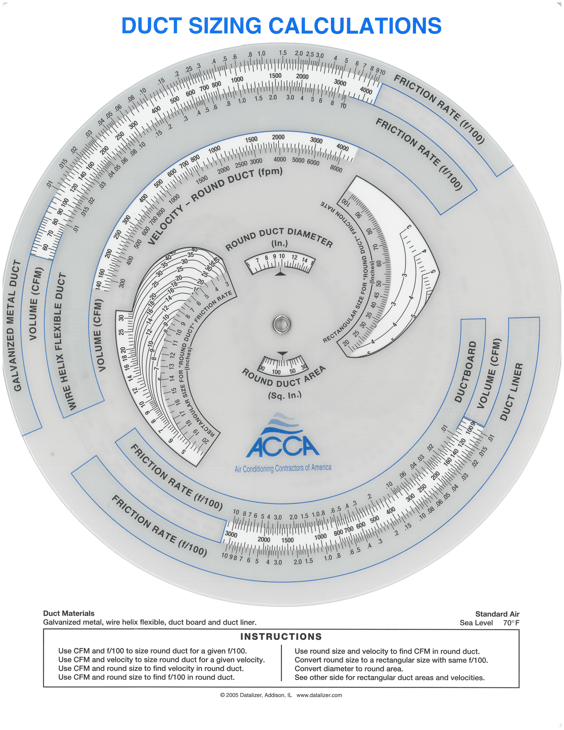
Given 200 CFM and Friction Rate 0.03 Find the Round Galvanized Duct Diameter

Slide 4
Given 200 CFM and Friction Rate 0.03 Find the Round Galvanized Duct Diameter

Slide 5
Given 800 CFM through round Galvanized Duct and a a Friction Rate 1.0 Find the Duct Size

Slide 6
Given 8” round Galvanized Duct a Friction Rate 0.01 Find the CFM

Slide 7
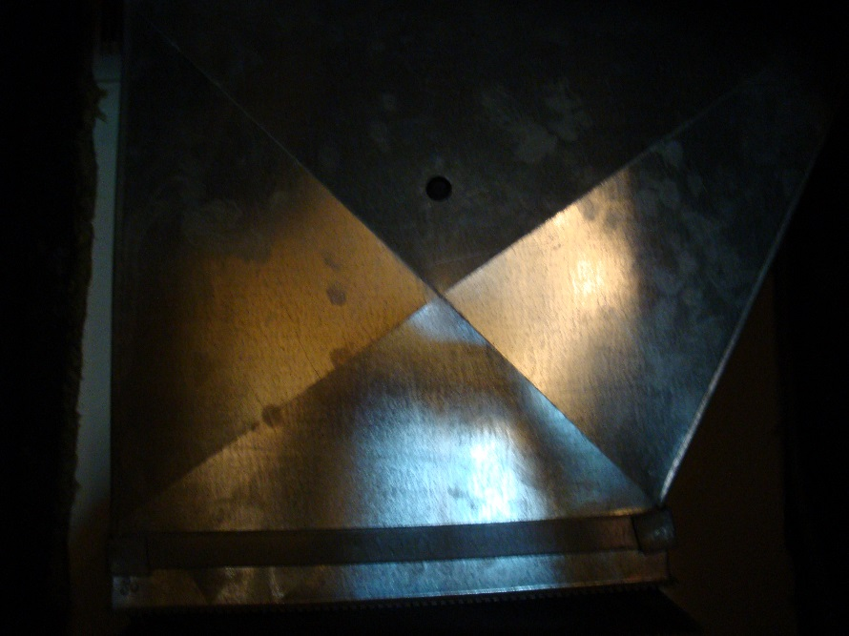
ACCA’s Duct Slide Rule Has Friction Rate Scales for Four Common Duct Materials:
Galvanized Metal Duct
Wire Helix Flex Duct
Duct Board
Duct Liner

Slide 8
ACCA’s Duct Slide Rule Has Friction Rate Scales for Four Common Duct Materials:
Galvanized Metal Duct
Wire Helix Flex Duct
Duct Board
Duct Liner

Slide 9
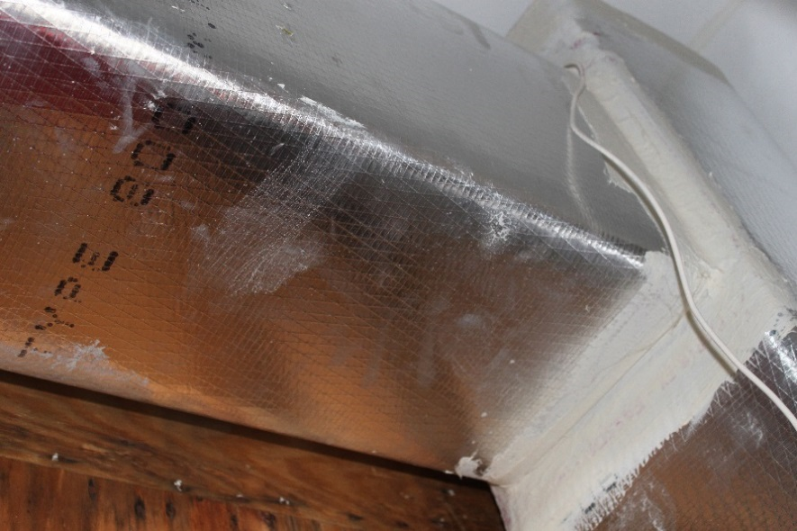
ACCA’s Duct Slide Rule Has Friction Rate Scales for Four Common Duct Materials:
Galvanized Metal Duct
Wire Helix Flex Duct
Duct Board
Duct Liner

Slide 10
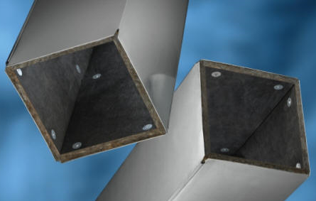
ACCA’s Duct Slide Rule Has Friction Rate Scales for Four Common Duct Materials:
Galvanized Metal Duct
Wire Helix Flex Duct
Duct Board
Duct Liner

Slide 11
ACCA’s Duct Slide Rule Has Friction Rate Scales for Four Common Duct Materials:
Galvanized Metal Duct
Wire Helix Flex Duct
Duct Board
Duct Liner
Note: For other materials select the type of duct on the Slide Rule based on the roughness indexes. For example Stainless Steel would use the Galvanized Metal Duct scale and Concrete duct is comparable to Wire Helix Flex Duct so that scale would be used.

Slide 12
Round to Rectangular Conversions

Slide 13
Convert 8” Round Duct to Rectangular Duct

Slide 14
Round to Rectangular Conversions
π x r² = 3.14 x 4² = 50.24

Slide 15
Round to Rectangular Conversions
Thus Duct Length x Duct Width must be ≥ 50.24
π x r² = 3.14 x 4² = 50.24

Slide 16
Round to Rectangular Conversions
Thus Duct Length x Duct Width must be ≥ 50.24
π x r² = 3.14 x 4² = 50.24

Slide 17
Round to Rectangular Conversions
Note: the friction rate and the CFM have not moved
That means any combination of length times width
On the chart will work the same.

Slide 18
Round to Rectangular Conversions
For example:
4 x 15 Duct = 60 sq. in. and has the same friction rate
And CFM values

Slide 19
Round to Rectangular Conversions
For example:
3 x 23 Duct = 69 sq. in. and has the same friction rate
And CFM values

Slide 20
Round to Rectangular Conversions
For example:
3 x 23 Duct = 69 sq. in. and has the same friction rate
And CFM values

