Slide 1
Maria’s Restaurant Chapter 2 Section 7

Slide 2
Equipment Selection Process
For Heating: For Cooling:
Forced Air Forced Air
Fossil fuel furnaces (gas or oil) Electric Air Conditioner
Stoves burning wood or fuel pellets Air source heat pump
Air source heat pump Evaporative Cooler (Swamp cooler)
Electric furnace or resistance heat Geothermal or water source heat pump
Geothermal or water source heat pump Chilled water
Variable refrigerant flow Variable Refrigerant Flow
Hydronic Heat Hydronic Cooling
Boiler (hot water or steam heat) Radiant
Geothermal or water source heat pump Chilled Beam
Electric water heater
Fossil fuel water heater

Slide 3
Three Basic Design Factors
Cooling coil airflow – Generally expressed in these blower speed intervals:
Low - High,
Low – Medium – High,
Low – Medium Low - Medium High - High.
Variable
Outdoor air temperature – This is the temperature of the air around the outdoor condensing coil, sometimes called the condenser air temperature. (Keep in mind this temperature may not exactly match what is listed on the manufacturer’s data, so we may have to interpolate.)
Condition of air entering the indoor coil – OEMs use either a dry bulb temperature, a wet bulb temperature, or may ask for some dry bulb – wet bulb combination.

Slide 4
Cooling Design Information

Slide 5
Heating Design

Slide 6
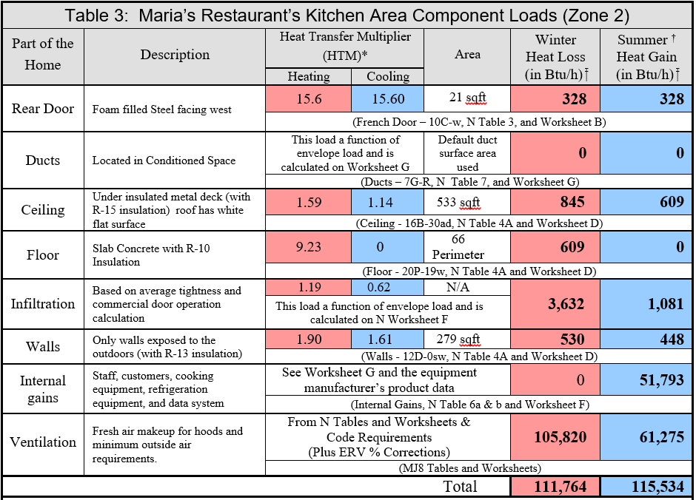
Zone 2 Total Load

Slide 7
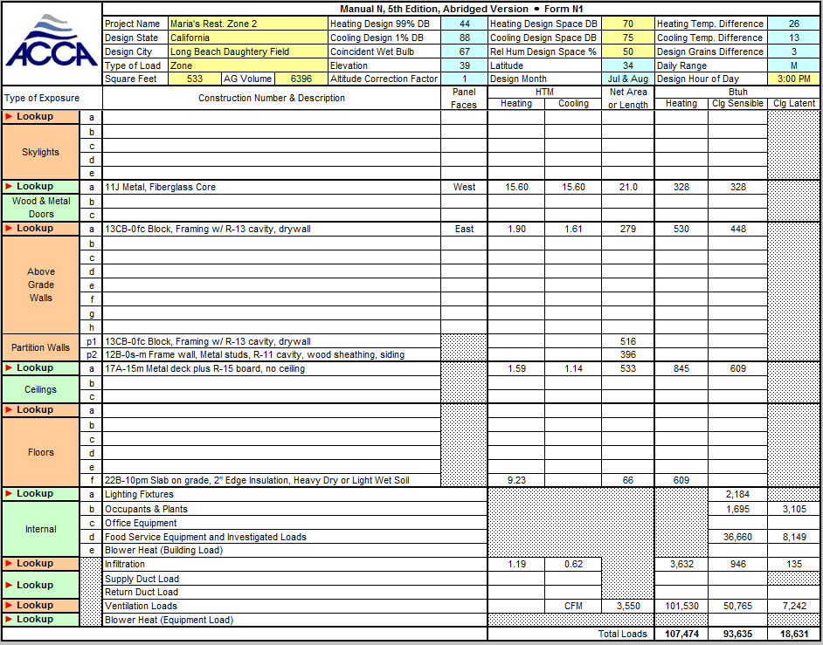
Manual N Zone 2 Heating Load
107,764 Btuh Total Heating Load
(With ERV Load added)

Slide 8
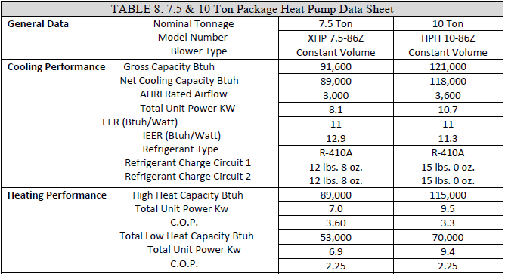
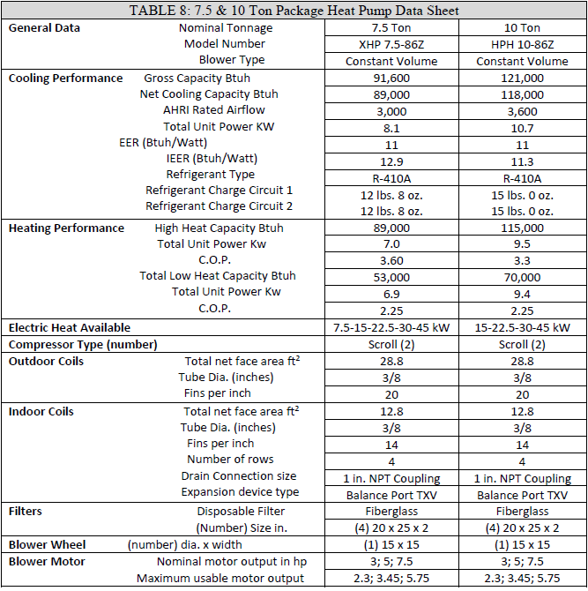
Zone 2 Heating Data Sheet
Zone 2 Heating 10 Ton Unit
Design Load 107,764
High Heat Rating 115,000
Low Heat Rating 70,000
115,000 ÷ 107,764 × 100 = 107%
70,000 ÷ 107,764 × 100 = 65%

Slide 9
Zone 2 Manual N Cooling Load
96,495 Btuh Sensible Cooling Load
19,039 Btuh Latent Cooling Load
115,534 Btuh Total Cooling Load

Slide 10
Zone 2 Manual N Cooling Load In Tons
115,534 ÷ 12,000 = 9.63

Slide 11
Zone 2 Cooling Data Sheets
Zone 2 Cooling 10 Ton Unit
Design Load 115,534
Gross Load Rating 121,000
Net Load Rating 118,000
121,000 ÷ 115,534 × 100 = 105%
118,000 ÷ 115,534 × 100 = 102%

Slide 12
But Wait!
AHRI tests and publishes information pertaining to the “data plate” seasonal efficiency of electric air conditioners and heat pumps. The AHRI published efficiency and capacity ratings are based on the following special set conditions:
The unit is tested at 400 CFM per ton
The outdoor dry bulb (DB) temperature is 95°F
The DB temperature of the air entering the cooling coil is 80°F
The indoor/entering wet bulb5 (EWB) temperature is 67°F (equivalent to 80°F DB and 50% Rh).

Slide 13
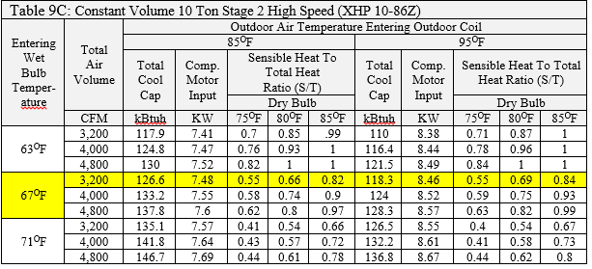
Expanded Data For “10 Ton” Equipment
88^{O}F

Slide 14
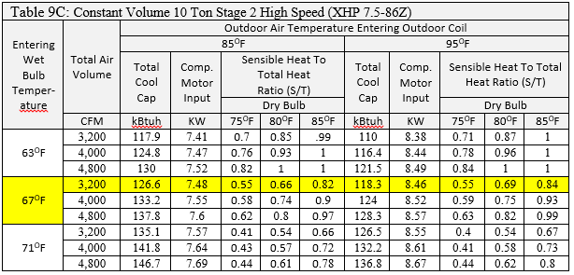
Expanded Data For “10 Ton” Equipment
88^{O}F
Our interpolated value for our 88^{O}F design location would be 124.9 kBtuh

Slide 15
Expanded Data For “10 Ton” Equipment
88^{O}F
At full capacity, our sensible cooling ÷ total cooling = 0.67
so, 0.67 × 124,900 Btuh = sensible heat = 83,683 Btuh.
Thus, the latent cooling capacity must be 124,900 – 83,683 = 41,217 Btuh.

Slide 16
Manual CS Cooling Requirements OK
Thus, the selected unit will meet our design requirements for cooling.
124,900 ÷ 115,534 × 100 = 108% of the design value for total cooling.
The latent heat value of 41,217 Btuh exceeds the design value of 19,039 Btuh so it passes too.
Manual CS recommends selecting unit less than 115% of the load calculation where, the sensible capacity exceeds the sensible load and the latent value exceeds the latent load.

Slide 17
Zone 2 Manual N Heating Load
At 3,200 CFM: interpolating between 45 ^{O}F and 25 ^{O}F; a total heating capacity of 106,250
100.4% of the design….OK, it works on heat pump alone for heating
105,820 Btuh

Slide 18
Interpolation 1
Using the chart above interpolate for the KBtuh value for an entering wet bulb temperature of 63^{O}F and 4,000 CFM at 90^{O}F

Slide 19
Interpolation 1
Easy Interpolation because it is at the midpoint between 85^{O}F and 95 ^{O}F. Thus the two values can be added and divided by 2.
(124.8 + 116.4) ÷ 2 = 120.6 kBtuh

Slide 20
Interpolation 2
Using the chart above interpolate for the KBtuh value for an entering wet bulb temperature of 67^{O}F and 4,000 CFM at 87^{O}F

Slide 21
Interpolation 2
Step 1: Temperature Total Difference: 95^{O}F - 85 ^{O}F = 10
Step 2: Temperature Ratio Factor: 95 – 87 = 8
Step 3: Temperature Ratio: 8 ÷ 10 = 0.8
Step 4: kBtuh total Difference: 133.2 – 124 = 9.2
Step 5: Temperature Ratio × kBtuh Total = 0.8 × 9.2 = 7.36
Step 6: 124 + 7.36 = 131.36 kBtuh

Slide 22
Interpolation 3
Using the chart above interpolate for the KBtuh value for an entering wet bulb temperature of 67^{O}F and 4,800 CFM at 92^{O}F

Slide 23
Interpolation 3
Step 1: Temperature Total Difference: 95^{O}F - 85 ^{O}F = 10
Step 2: Temperature Ratio Factor: 95 – 92 = 3
Step 3: Temperature Ratio: 3 ÷ 10 = 0.3
Step 4: kBtuh total Difference: 137.8 – 128.3 = 9.5
Step 5: Temperature Ratio × kBtuh Total = 0.3 × 9.5 = 2.85
Step 6: 128.3 + 2.85 = 131.15 kBtuh

Slide 24
Field Notes
Two common mistakes found in the field are equipment that was sized based on the rated load values not the expanded values and equipment installed, started up and left running right like it came out of the box.
Only technician’s that can look at the expanded data, and then set up a system to run at the correct CFM can make a system run as designed.
Note: Sometimes the only way it can meet the latent cooling load requirements.

