Slide 1
Day 3 Part 3 Technician’s Guide & Workbook for Home Evaluation and Performance Improvement

Slide 2
Assessment Table Values for Envelope, Ventilation

Slide 3
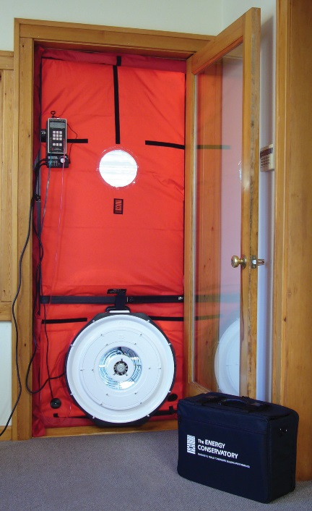
Envelope

Slide 4
Envelope

Slide 5
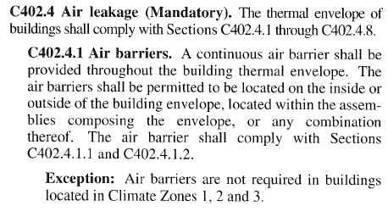
Envelope

Slide 6
Envelope

Slide 7
Climate Zones

Slide 8
Air Barrier / Vapor Retarder
Moisture can be transferred by weather driven water, or carried in the form of humidity within the air passing through moisture retarders. It has been proven time and again that all building materials will leak under the right conditions. Hence, humidity control is a major consideration when designing home systems for comfort. A strong understanding of the infiltration properties of building materials is needed to install systems that efficiently control moisture transfer and humidity.

Slide 9
Air Barrier / Vapor Retarder
Permeance of water vapor is a performance evaluation; 1 perm-inch equals the passage of 1 grain of vapor through 1 ft² of a 1 inch thick piece of the material in 1 hour.
Permeability is tested and rated by one of two standards: ASTM D1653 or ASTM E96.
Materials with perm rates that are 0.1 or less are considered as vapor impermeable and are used for vapor barriers.

Slide 10
Air Barrier / Vapor Retarder
Materials with perm rates higher than 0.1 and less than or equal to 1 are considered to be semi-impermeable by vapor and are used as vapor retarders.
Materials with perm rates higher than 1 and less than or equal to 10 are considered to be semi-permeable. Thus, moisture vapor can flow through.
Material with perm rates higher than 10 are considered permeable. Thus, moisture vapor can easily flow through.

Slide 11
Air Barrier / Vapor Retarder
The proper evaluation of existing vapor retarder/barrier and air barrier performance is often a key factor for consideration whenever potential energy savings plans are being developed. Additionally, preventing future damage to a home’s structural and finish components will be dependent on how well the air barriers and vapor retarders/barriers work.

Slide 12
Air Barrier / Vapor Retarder
For Further Information see Appendix 3 in the Technician’s Guide & Workbook for Home Improvement.
OR
If you are a member of ACCA: You may download Technical Bulletin 2013-1

Slide 13
Air Barrier / Vapor Retarder
For Further Information see Appendix 3 in the Technician’s Guide & Workbook for Home Improvement.

Slide 14
Air Barrier / Vapor Retarder
For Further Information see Appendix 3 in the Technician’s Guide & Workbook for Home Improvement.
OR
If you are a member of ACCA: You may download Technical Bulletin 2013-1

Slide 15
Envelope

Slide 16
Envelope CFM 50

Slide 17
Envelope CFM 50
The Pascal (Pa), is a unit of measure in the
international system of units (SI).

Slide 18
Envelope CFM 50
The 50 Pa used for pressure testing a home
when converted to psi is a very small number:
50 Pa = 50 X 1 ÷ 6,894.757 = 0.00725 psi.

Slide 19
Envelope CFM 50

Slide 20
Envelope CFM 50
Ft³ ÷ CFM = ACH

Slide 21
Ventilation

Slide 22
Ventilation

Slide 23
Ventilation (Table from 62.2 2013)
Ventilation Air Requirements in CFM
Floor Area ft² | Number of Bedrooms
 | 1 | 2 | 3 | 4 | 5
Less Than 500 | 30 | 38 | 45 | 53 | 60
501-1000 | 45 | 53 | 60 | 68 | 75
1001-1500 | 60 | 68 | 75 | 83 | 90
1501-2000 | 75 | 83 | 90 | 98 | 105
2001-2500 | 90 | 98 | 105 | 113 | 120
2501-3000 | 105 | 113 | 120 | 128 | 135
3001-3500 | 120 | 128 | 135 | 143 | 150
3501-4000 | 135 | 143 | 150 | 158 | 165
4001-4500 | 150 | 158 | 165 | 173 | 180
4501-5000 | 165 | 173 | 180 | 188 | 195

Slide 24
Ventilation (Table from 62.2 2013)
Ventilation Air Requirements in CFM
Floor Area ft² | Number of Bedrooms
 | 1 | 2 | 3 | 4 | 5
Less Than 500 | 30 | 38 | 45 | 53 | 60
501-1000 | 45 | 53 | 60 | 68 | 75
1001-1500 | 60 | 68 | 75 | 83 | 90
1501-2000 | 75 | 83 | 90 | 98 | 105
2001-2500 | 90 | 98 | 105 | 113 | 120
2501-3000 | 105 | 113 | 120 | 128 | 135
3001-3500 | 120 | 128 | 135 | 143 | 150
3501-4000 | 135 | 143 | 150 | 158 | 165
4001-4500 | 150 | 158 | 165 | 173 | 180
4501-5000 | 165 | 173 | 180 | 188 | 195

Slide 25
Ventilation (Table from 62.2 2013)
Ventilation Air Requirements in CFM
Floor Area ft² | Number of Bedrooms
 | 1 | 2 | 3 | 4 | 5
Less Than 500 | 30 | 38 | 45 | 53 | 60
501-1000 | 45 | 53 | 60 | 68 | 75
1001-1500 | 60 | 68 | 75 | 83 | 90
1501-2000 | 75 | 83 | 90 | 98 | 105
2001-2500 | 90 | 98 | 105 | 113 | 120
2501-3000 | 105 | 113 | 120 | 128 | 135
3001-3500 | 120 | 128 | 135 | 143 | 150
3501-4000 | 135 | 143 | 150 | 158 | 165
4001-4500 | 150 | 158 | 165 | 173 | 180
4501-5000 | 165 | 173 | 180 | 188 | 195
ASHRAE 62.2 2013 allows 1/3 of the
Table value to be from infiltration

Slide 26
Ventilation (Table from 62.2 2013)
Ventilation Air Requirements in CFM
Floor Area ft² | Number of Bedrooms
 | 1 | 2 | 3 | 4 | 5
Less Than 500 | 30 | 38 | 45 | 53 | 60
501-1000 | 45 | 53 | 60 | 68 | 75
1001-1500 | 60 | 68 | 75 | 83 | 90
1501-2000 | 75 | 83 | 90 | 98 | 105
2001-2500 | 90 | 98 | 105 | 113 | 120
2501-3000 | 105 | 113 | 120 | 128 | 135
3001-3500 | 120 | 128 | 135 | 143 | 150
3501-4000 | 135 | 143 | 150 | 158 | 165
4001-4500 | 150 | 158 | 165 | 173 | 180
4501-5000 | 165 | 173 | 180 | 188 | 195
1/3 of 75 = 25 CFM

Slide 27
Ventilation (Table from 62.2 2013)
Ventilation Air Requirements in CFM
Floor Area ft² | Number of Bedrooms
 | 1 | 2 | 3 | 4 | 5
Less Than 500 | 30 | 38 | 45 | 53 | 60
501-1000 | 45 | 53 | 60 | 68 | 75
1001-1500 | 60 | 68 | 75 | 83 | 90
1501-2000 | 75 | 83 | 90 | 98 | 105
2001-2500 | 90 | 98 | 105 | 113 | 120
2501-3000 | 105 | 113 | 120 | 128 | 135
3001-3500 | 120 | 128 | 135 | 143 | 150
3501-4000 | 135 | 143 | 150 | 158 | 165
4001-4500 | 150 | 158 | 165 | 173 | 180
4501-5000 | 165 | 173 | 180 | 188 | 195
1/3 of 75 = 25 CFM
75 - 25 = 50 CFM

Slide 28
Assessment Table Values for Envelope, Insulation

Slide 29
Insulation

Slide 30
Insulation

Slide 31
Insulation

Slide 32
Insulation Values

Slide 33
Insulation

Slide 34
Assessment Table Values Airflow

Slide 35
Airflow

Slide 36
Airflow

Slide 37
Airflow

Slide 38
Airflow Testing Methods
Airflow Through Indoor Heat Exchangers Acceptable Procedures:
a) OEM CFM/static pressure drop tables
b) Traversing Duct
c) Flow Grid Method
d) Pressure Matching Method
e) Temperature Rise Method (Only for specific heating applications)

Slide 39
Airflow Testing Methods
Airflow Through Indoor Heat Exchangers Acceptable Procedures:
a) OEM CFM/static pressure drop tables
b) Traversing Duct
c) Flow Grid Method
d) Pressure Matching Method
e) Temperature Rise Method (Only for specific heating applications)

Slide 40
Airflow Testing Methods
Airflow Through Indoor Heat Exchangers Acceptable Procedures:
a) OEM CFM/static pressure drop tables
b) Traversing Duct
c) Flow Grid Method
d) Pressure Matching Method
e) Temperature Rise Method (Only for specific heating applications)

Slide 41
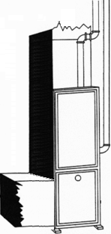
OEM ESP
Medium Speed Fan Tap
Supply SP = + 0.30
(+) 0.30
+ (-) 0.10
0.40 ESP
Return SP = - 0.10
____

Slide 42
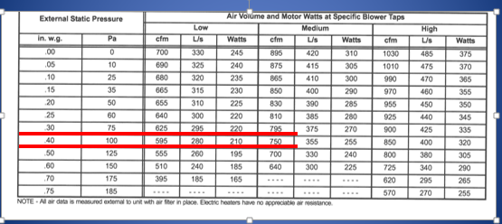
OEM ESP
Medium Speed Fan Tap
Supply SP = + 0.30
(+) 0.30
+ (-) 0.10
0.40 ESP
Return SP = - 0.10
____

Slide 43
Traversing Duct

Slide 44
Flow Grid Method

Slide 45
Pressure Matching

Slide 46
Temperature Rise (Heating Only)

Slide 47
Temperature Rise (Heating Only)

Slide 48
Airflow
1260

Slide 49
Assessment Table HVAC Temperature Difference

Slide 50
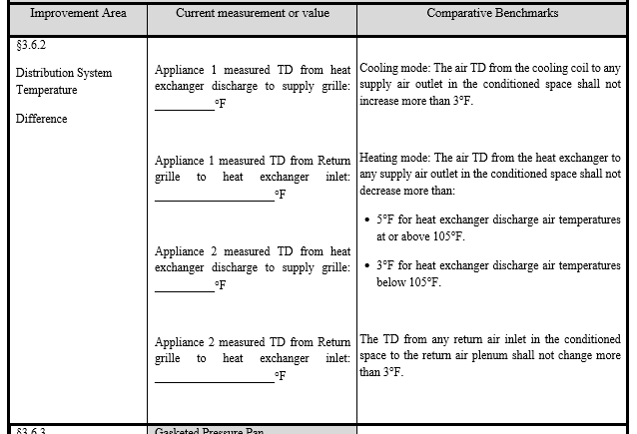
HVAC Temperature Difference

Slide 51
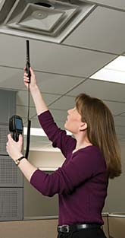
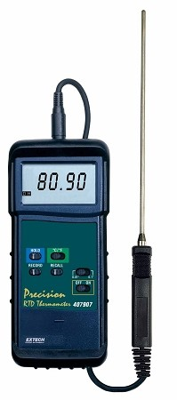
HVAC Temperature Difference

Slide 52
HVAC Temperature Difference

Slide 53
HVAC Temperature Difference

Slide 54
HVAC Temperature Difference

Slide 55
HVAC Temperature Difference

