Slide 1
Maria’s Restaurant Chapter 2 Section 9

Slide 2
Latent Capacity Question 1
Using Table 9C on Page 38 in Maria’s Restaurant Guide & Workbook, will the total latent capacity in Btuh for the XHP 10-86Z in operating in high speed with a return air wet bulb temperature of 67^{O}F and a fan CFM of 4,800 with a 85^{O}F outdoor dry bulb temperature be equal to or above a latent heat removal requirement of 12,000 Btuh?

Slide 3
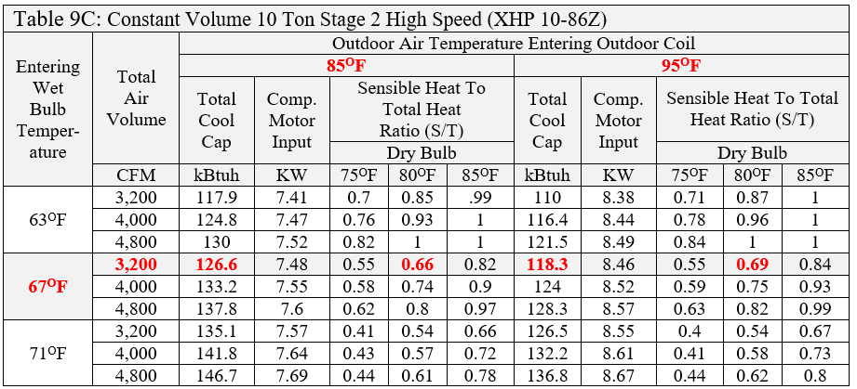
Table 9C Latent Capacity

Slide 4
Table 9C Latent Capacity 1
From the chart: at 4,800 CFM & Dry Bulb 85^{O}F the sensible over total heat ratio is 0.97 thus, with a total capacity of 137.8k Btuh our latent capacity would be 137,800 × (1- 0.97) = 4,134 Btuh of latent heat capability
Thus, the equipment would not meet the requirements at that fan speed.

Slide 5
Latent Capacity Question 2
What if the fan speed in the previous problem above was lowered to provide 4,000 CFM?
From the chart: at 4,000 CFM & 85^{O}F the sensible over total heat ratio is 0.90 thus, with a total capacity of 133,200 Btuh our latent capacity would be 133,200 × (1- 0.90) = 13,320 Btuh of latent heat capability
Thus, the equipment would meet 12,000 Btuh the requirements at that fan speed.

Slide 6
kW Question
Using Table 9C on Page 38 in Maria’s Restaurant Guide & Workbook, find the motor design load in kW and W for the XHP 10-86Z in operating with an outdoor air temperature at the condenser of 85^{O}F and a fan CFM of 4,000.

Slide 7
Table 9C Latent Capacity
7.55 kW and 7,550 W

Slide 8
Dehumidification Implications
When the building’s design SHR is high (0.85 or more), it will be relatively easy to select cooling equipment that will control indoor humidity in cooling mode.
If the building’s SHR is medium (0.80 to 0.85), then there is more humidity (latent load) to deal with, and it becomes more important to select cooling equipment that will control indoor humidity.
When the SHR is low (0.80 or less), there is an unusually large latent load and it may not be possible to find (standard) cooling equipment that will completely control the indoor humidity. Supplemental dehumidification may be necessary.

Slide 9
Dehumidification Implications
Since the sensible restaurant cooling (50,185 Btuh) load divided by the total restaurant (71,666 Btuh) cooling load is 0.70 SHR level and the selected equipment operating range is also below 0.69 SHR in the OEM’s tables.
Thus, there could be a problem with humidity control.
Thus, Maria decided to have room for dehumidification equipment left in the duct design for the dinning side of the restaurant in case high humidity becomes an issue during the restaurant’s 1st year of operation.

Slide 10
Dehumidification Implications
Finally, by selecting the lowest fan CFM, the designer assured airflow across the coil would be minimized and the humidity removal would be maximized. The coil surface area from the OEM tables is 12.8 ft². Thus, with 2,400 CFM of airflow, and a coil with a surface area of 12.8 ft² the velocity through the coil in feet per minute (FPM) can easily be calculated:
2,400ft³ ÷ 12.8 ft^{2.}= 187.5 FPM this is a very low value but it is within the acceptable operating range for the 7.5-ton rooftop package heat pump selected.
(Note: the old rule of thumb of 400 CFM per ton would put you at 3,000 CFM in the center of the chart.)

Slide 11
Comfort Question
Figure 16 on page 41 shows a Psychrometric chart with the human comfort zone shown in red stripes. If we measured a room at 70 ^{O}F with a relative humidity of 30% would most people feel comfortable sitting in that room.

Slide 12
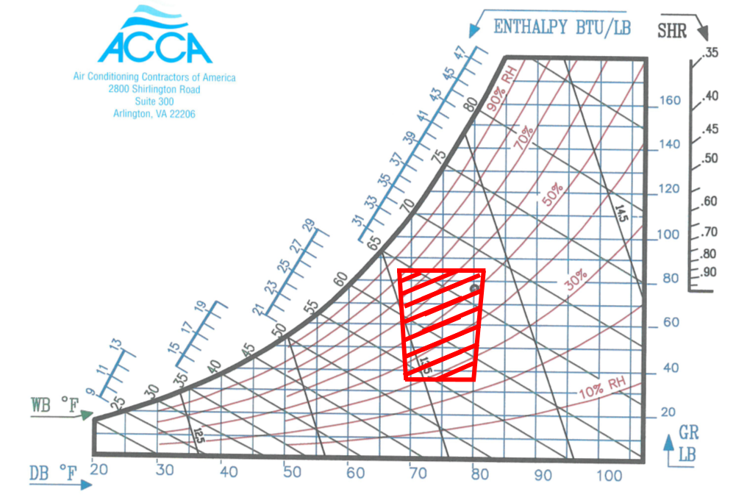
Comfort Question 1
No, due to the low humidity the room would feel cold to most people.

Slide 13
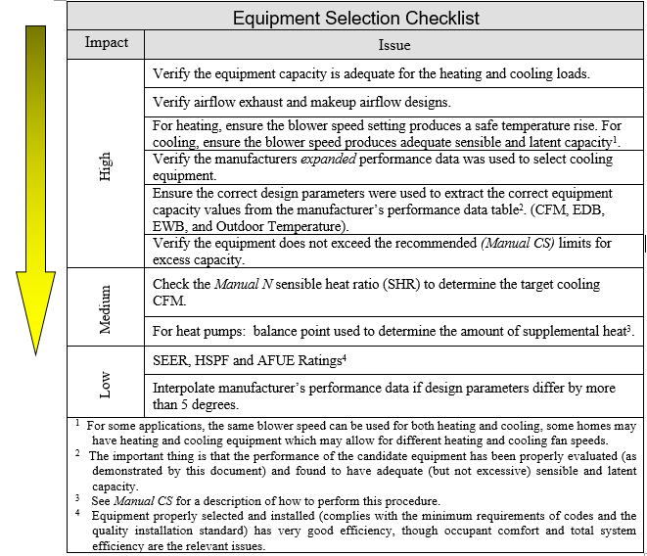
Equipment Selection Check List

Slide 14
Field Notes Page 1
A comfortable temperature is subjective and a few people in a room may never be comfortable even when the room temperature and humidity are dead center on the comfort chart. Some will say it is too hot, others will say it is too cold. Thus, Technician’s should know where they are on the comfort chart before changing the temperature based on one complaint or, they may be back with six more!

Slide 15
Field Notes Page 2
One blower motor variable frequency drive (VFD) setting related problem commonly encountered is: At lower speeds, the blower may not provide the required minimum replacement air volumes for the hoods. Thus, the restaurant will become in a low pressure with regards to the outside (making the inswing doors hard to close due to the air they are sucking in).

Slide 16
Field Notes Page 3
One Compressor motor variable frequency drive (VFD) related problem commonly encountered where a constant volume of airflow is required to make up for kitchen hood exhaust air is: due to the higher velocity of air with regards to the refrigerant in the coil the ability to remove moisture from the air being brought in is greatly decreased under most operating conditions (resulting in a much higher humidity inside the building than is outside and possibly a wet dog or mold smell in the building).

