Slide 1
Duct Design Basics: Lesson 5 Manual D Speedsheet Primer

Slide 2
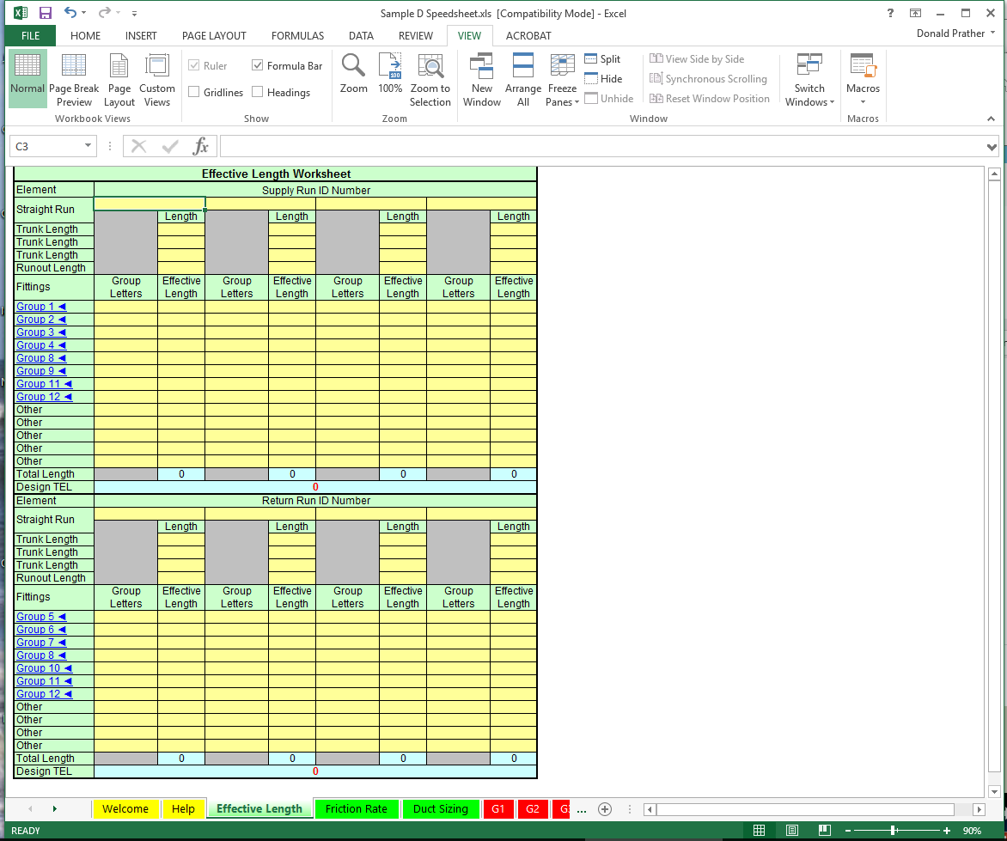

Slide 3
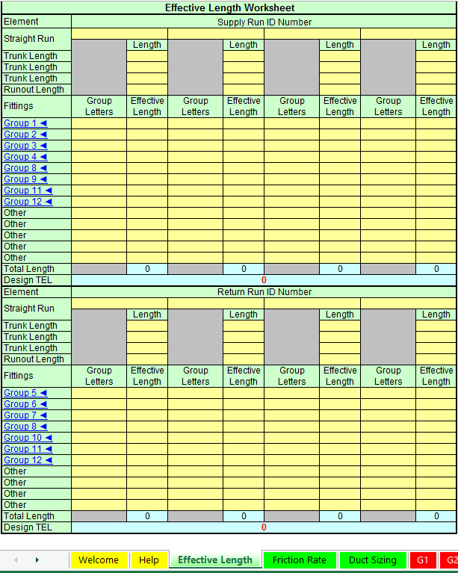
Manual D Speedsheet

Slide 4
Manual D Speedsheet

Slide 5
Manual D Speedsheet
Step 3:

Slide 6
Manual D Speedsheet

Slide 7
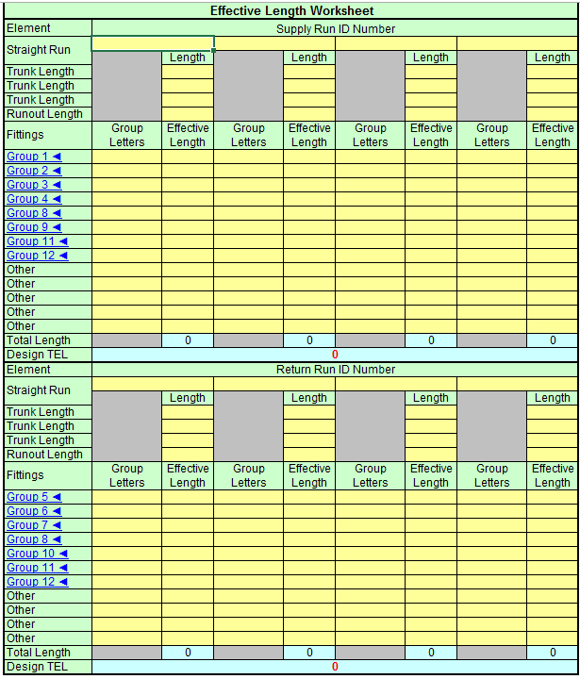
Manual D Speedsheet

Slide 8
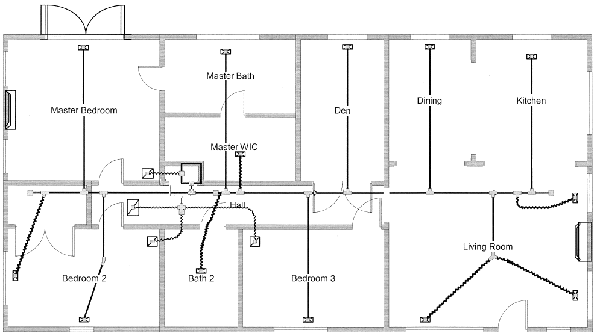
Duct Sketch/Drawing
1
2
13
12
11
3
1
2
10
3
4
6
4
9
5
7
8

Slide 9
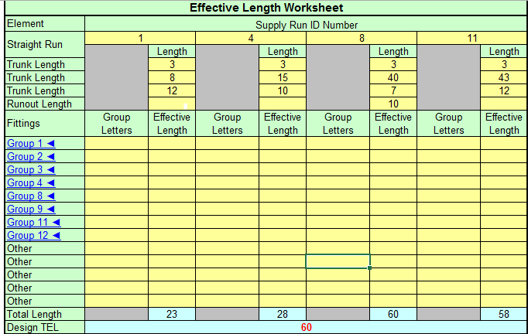
Manual D Speedsheet

Slide 10
2 Main Trunks
71 CFM
68 CFM
91 CFM
1
2
13
12
11
260 CFM
67 CFM
20 CFM
284 CFM
Trunk 1
3
1
92 CFM
2
Trunk 2
10
612 CFM
8
6
3
4
182 CFM
104 CFM
7
4
6
91 CFM each
9
45 CFM
100 CFM each
5
7
104 CFM
8

Slide 11
Manual D Speedsheet

Slide 12
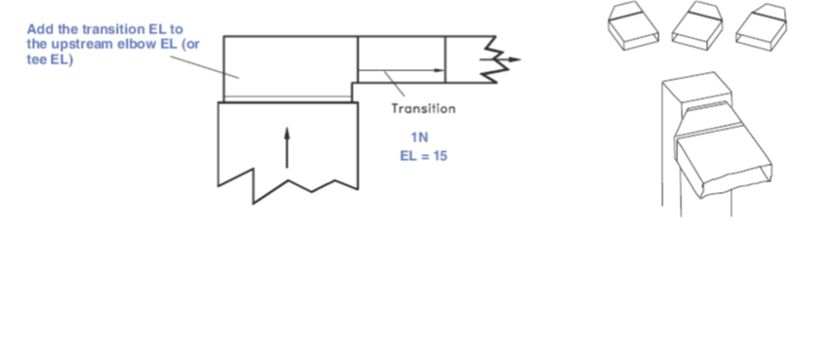
Manual D Speedsheet

Slide 13
Manual D Speedsheet

Slide 14
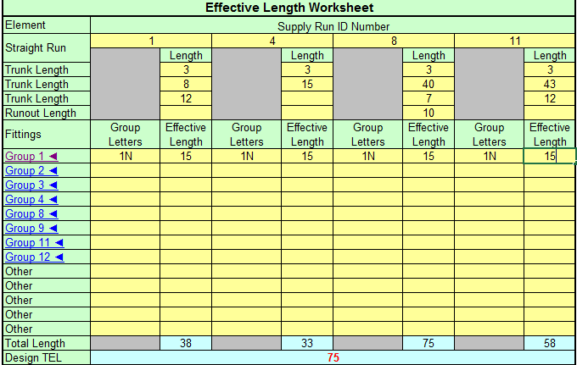
Manual D Speedsheet

Slide 15
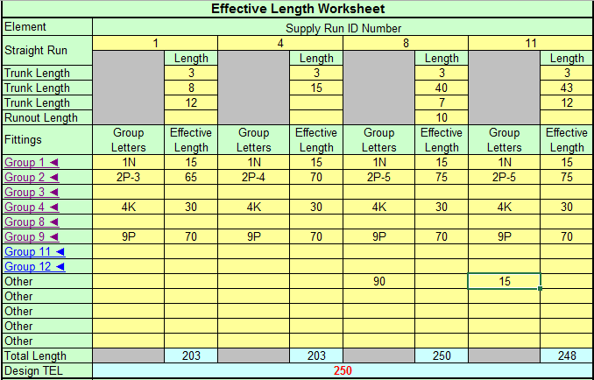
Manual D Speedsheet

Slide 16
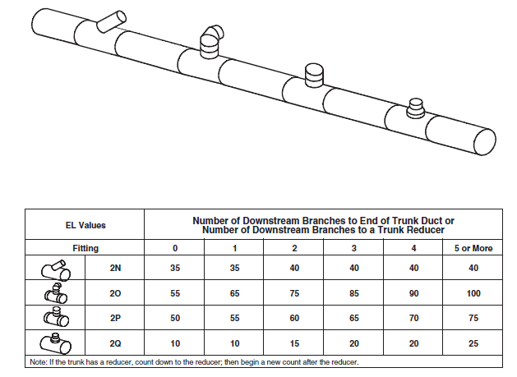
Manual D Speedsheet

Slide 17
Manual D Speedsheet
71 CFM
68 CFM
91 CFM
1
2
13
12
11
260 CFM
67 CFM
20 CFM
284 CFM
3
1
92 CFM
2
10
612 CFM
3
4
182 CFM
104 CFM
4
6
91 CFM each
9
45 CFM
100 CFM each
5
7
104 CFM
8

Slide 18
Manual D Speedsheet

Slide 19
Manual D Speedsheet

Slide 20
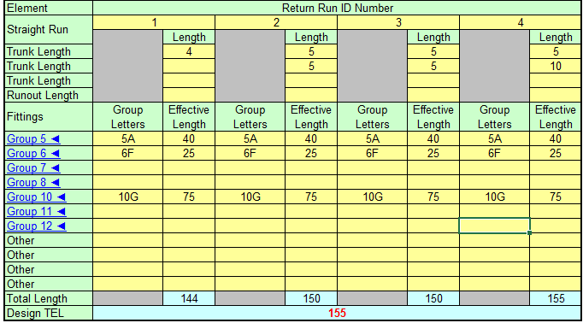
Manual D Speedsheet

Slide 21
Manual D Speedsheet

Slide 22
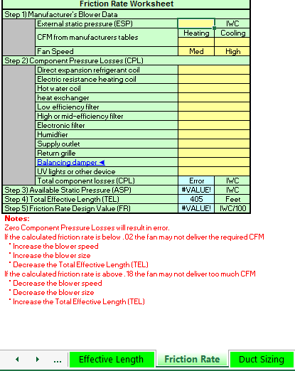
Manual D Speedsheet

Slide 23
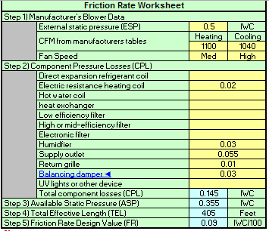
Manual D Speedsheet

Slide 24
Manual D Speedsheet
Step 3:

Slide 25
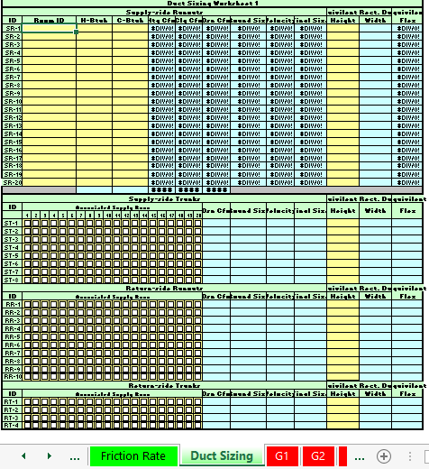
Manual D Speedsheet

Slide 26
Duct Sketch/Drawing
1
2
13
12
11
3
1
2
10
3
4
6
4
9
5
7
8

Slide 27
Manual D Speedsheet

Slide 28
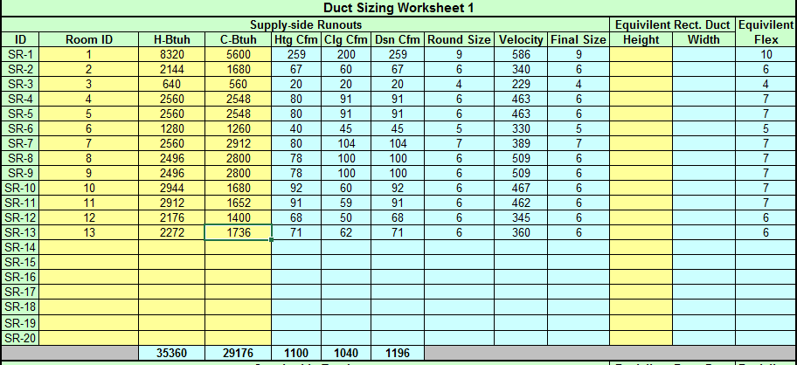
Manual D Speedsheet

Slide 29
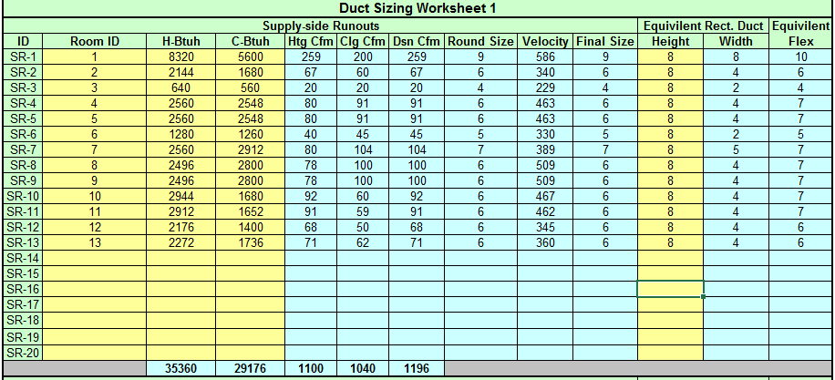
Manual D Speedsheet

Slide 30
Manual D Speedsheet
71 CFM
68 CFM
91 CFM
1
2
13
12
11
260 CFM
67 CFM
20 CFM
284 CFM
Trunk 1
3
1
92 CFM
2
Trunk 2
10
612 CFM
8
6
3
4
182 CFM
104 CFM
7
4
6
91 CFM each
9
45 CFM
100 CFM each
5
7
104 CFM
8

Slide 31
Manual D Speedsheet

Slide 32
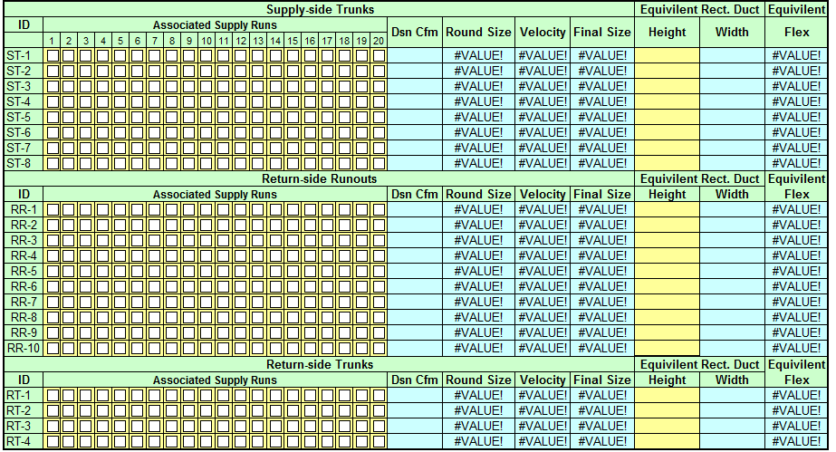
Manual D Speedsheet

Slide 33
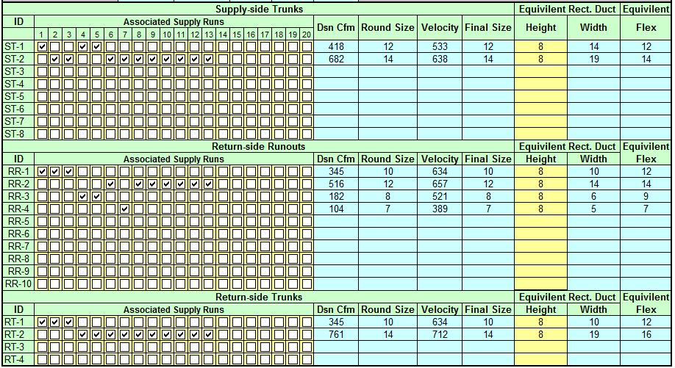
Manual D Speedsheet

Slide 34
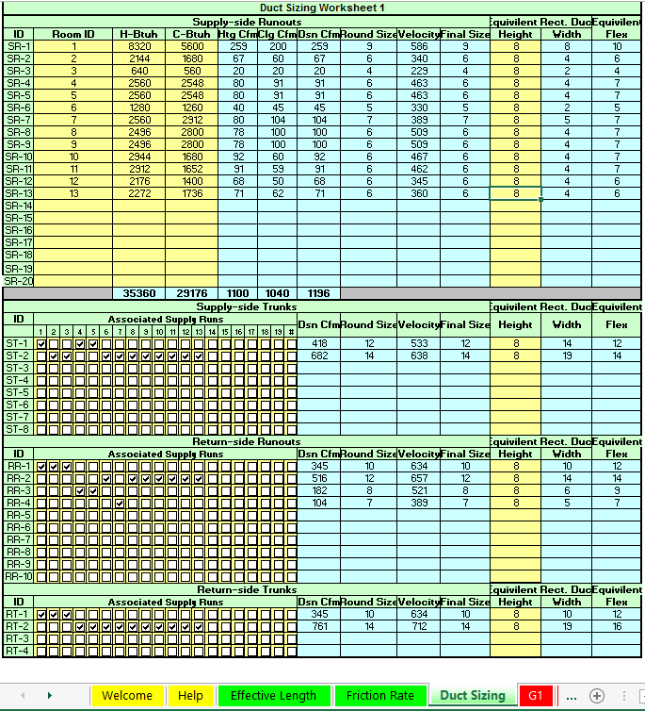
Manual D Speedsheet

Slide 35
Manual D Speedsheet
71 CFM
68 CFM
91 CFM
1
2
13
12
11
260 CFM
67 CFM
9
6
5
6
6
20 CFM
284 CFM
Trunk 1
3
4
1
92 CFM
2
12
14
Trunk 2
6
612 CFM
10
8
7
6
3
5
4
182 CFM
104 CFM
7
7
4
6
7
91 CFM each
9
45 CFM
100 CFM each
5
7
104 CFM
8

Slide 36
Manual D Speedsheet
71 CFM
68 CFM
91 CFM
1
2
13
12
11
260 CFM
67 CFM
12
20 CFM
284 CFM
3
1
92 CFM
16
14
2
10
612 CFM
7
3
9
4
182 CFM
104 CFM
4
6
91 CFM each
9
45 CFM
100 CFM each
5
7
104 CFM
8

