Slide 1
Maria’s Restaurant Chapter 1 Section 3

Slide 2
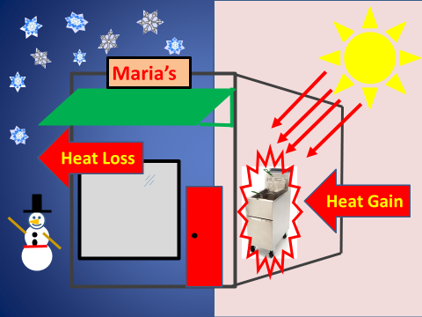
Heat Transfer Multiplier (HTM)

Slide 3
HTM
In a Manual N load calculation, the amount of heat that transfers depends on the Heat Transfer Multiplier (HTM) and the area of the building component (Load = HTM × area).
The HTM is determined by the building component’s heat transfer traits and the temperature difference on each side of the building component (windows, walls, ceilings, etc.).

Slide 4
HTM Sample Calculation
HTM can be used to simply multiply the size of the building component assembly to find the Btu required for the load. For example, an exterior wall assembly may be made up of; sheet rock, insulation, vapor retarder, metal framing material, and exterior siding materials may have a HTM of 1.9 for heating and 1.31 for cooling. For a wall of 200 ft² the related loads for the wall in Btu would be:
Heating 200 × 1.9 = 380 Btu
Cooling 200 × 1.31 = 262 Btu

Slide 5
Where Does The HTM Come From?
HTM is calculated for heating and cooling loads by multiplying the design temperature difference by the U-Factor (the inside design temperature and the outside design temperature see Table 1 in Manual N).

Slide 6
Deriving The HTM
Example: From Table 4 in Manual N let’s use a 13 CB-0fc Block, Framing w/R/13 cavity, drywall has a U-Value in a wall with a filed core and wood studs of 0.089.
The design heating TD for heating in the Long Beach location is 26^{O}F (70^{O} - 44^{O} = 26).
Thus, the heating HTM = 26 × 0.089 = 2.314
The cooling design TD is 13^{O}F (88^{O} - 75^{O}).
Thus the HTM would be 13 × 0.089 = 1.157

Slide 7
HTM Design Change Question (Worksheet 3)
Table 2 in Chapter 1 of Maria’s Restaurant shows the heat transfer multiplier for windows for heating as 17.94 and for cooling as 54.86. If the window size was changed to 200 square feet would the winter heat loss and the summer heat gain be changed enough to need a larger HVAC system?

Slide 8
HTM Heat Loss Calculations (Worksheet 3)
The winter window heat loss would become 200 × 17.94 = 3,588 Btuh.
Since the window size was increased by 40 square ft. the outside wall area was decreased from 200 to 160 ft². Again using the Table 2 values for the walls calculate new values for the winter heat loss and the summer heat gain.
The winter wall heat loss would be 160 × 1.90 = 304 Btuh.

Slide 9
HTM Heat Gain Calculations (Worksheet 3)
The summer window heat gain would become 200 × 54.86 = 10,972 Btuh.
Since the window size was increased by 40 square ft. the outside wall area was decreased from 200 to 160 ft². Again using the Table 2 values for the walls calculate new values for the winter heat loss and the summer heat gain.
The summer wall heat gain would be 160 × 1.31 = 209.6 Btuh.

Slide 10
Heating Load Comparison (Worksheet 3)
The total winter loss was 34,384 Btuh before the window size was changed what is it after the change?

Slide 11
Heating Load Comparison (Worksheet 3)
First, the total heat loss for the windows plus the wall for the original Table 2 values is 2,870 plus 380 or 2,870 + 380 = 3,250 Btuh.
Second, the total heat loss for the new values is 3,588 plus 304 Btuh; 3,588 + 304 = 3,892 Btuh.
Third, the change to the total of 34,384 would be 3,892 – 3,250 + 34,384 = 35,026 Btuh.
For the heating, increasing the load by 642 Btuh (less than 2%) will not generally result in needing to increase heating equipment sizing.

Slide 12
Cooling Load Comparison (Worksheet 3)
The total summer heat gain was 71,666 Btuh before the window size was changed what is it after the change?
First, the total heat gain for the windows plus the wall for the original Table 2 values is 8,777 plus 263 or 8,777 + 263 = 9,040 Btuh
Second, the heat gain for the new values is 10,972 plus 209.6 Btuh; 10,972 + 210 = 11,182 Btuh.
Third, the change to the total of 71,666 would be 11,182 – 9040 + 71,666 = 73,808 Btuh
For Cooling, increasing the load by 2,142 Btuh by 3% moves the total from 5.97 tons to 6.15 tons and most likely not change the equipment sizing requirement.

Slide 13
Infiltration (Worksheet 3)
For a building, the total summer heat gain due to infiltration is listed as 1,108 Btuh, and there is a total cooling load of 115,534 Btuh. The total winter heating load is listed as 111,764 Btuh with an infiltration load of 3,632 Btuh. Calculate what percentage of those values is due to the infiltration.

Slide 14
Infiltration (Worksheet 3)
First, for summer heat gains infiltration is 1,108 Btuh; 1,108 ÷ 115,534 ×100 = 0.959%
Second, for winter heat gains infiltration is 3,632 Btuh; 3,632 ÷ 111,764 ×100 = 3.25%

Slide 15
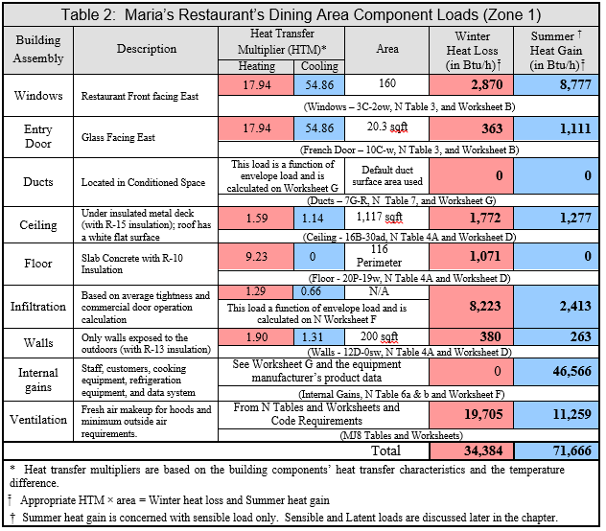
Cooling Load In Zone 1 (Worksheet 3)

Slide 16
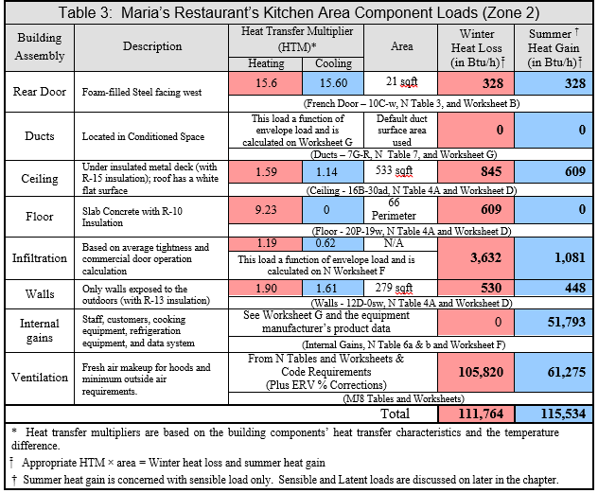
Cooling Load In Zone 2 (Worksheet 3)
Based on the summer heat gains estimate the cooling equipment’s size in tons needed to cool the restaurant area, the kitchen area, and the total tonnage for the restaurant.

Slide 17
Total Cooling Load In Tons (Worksheet 3)
First, for summer heat gains in the seating area from Table 2: 71,666 ÷ 12,000 = 5.972 Tons
Second, for summer heat gains in the cooking area from Table 3: 115,534 ÷ 12,000 = 9.628 Tons
Third, for the total tonnage 9.628 + 5.972 = 15.6 Tons

Slide 18
Sensible and Latent Heat (Worksheet 3)
A cooling load calculation on Manual N states that the sensible heat is 75,000 Btuh and the latent heat is listed as 25,000 Btuh. What is the total cooling load?

Slide 19
Total Cooling Load Calculation (Worksheet 3)
Sensible Heat + Latent Heat = Total Cooling Load
25,000 + 75,000 = 100,000 Btuh

Slide 20
Field Notes
One would be surprised by how often a builder changes a wall or roofing material, without giving a thought to the HVAC design implications.
Technicians who understand building materials and how they are put together as assemblies can often spot problems with changes made to the original design plans. Thus, those who only focus on the mechanical and electrical sections may miss a big design change during construction that wrecks their load calculations.

