Slide 1
Part 7 Technician’s Guide & Workbook for Duct Diagnostics and Repair

Slide 2
Section 3.1: Updating Duct Designs

Slide 3
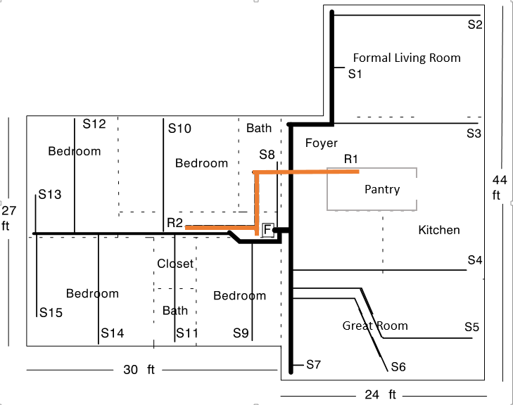
Typical Tract Built Layout & Construction

Slide 4
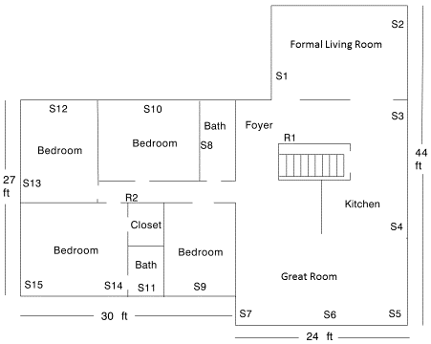
Typical Tract Built Layout & Construction
HVAC equipment and the duct
is located in the crawl space.
Formal Living Room
Bath
Foyer
Bedroom
Bedroom
Pantry
Supply Diffuser
Locations
Kitchen
Closet
Bedroom
Bedroom
Bath
Great Room

Slide 5
Typical Tract Built Layout & Construction
HVAC equipment and the duct
is located in the crawl space.
Formal Living Room
Bath
Foyer
Bedroom
Bedroom
Pantry
Return Diffuser
Locations
Kitchen
Closet
Bedroom
Bedroom
Bath
Great Room

Slide 6
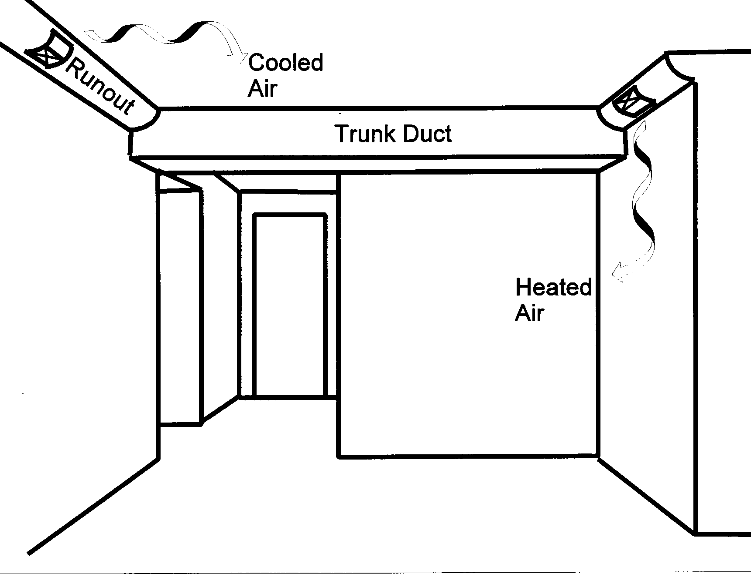

Slide 7
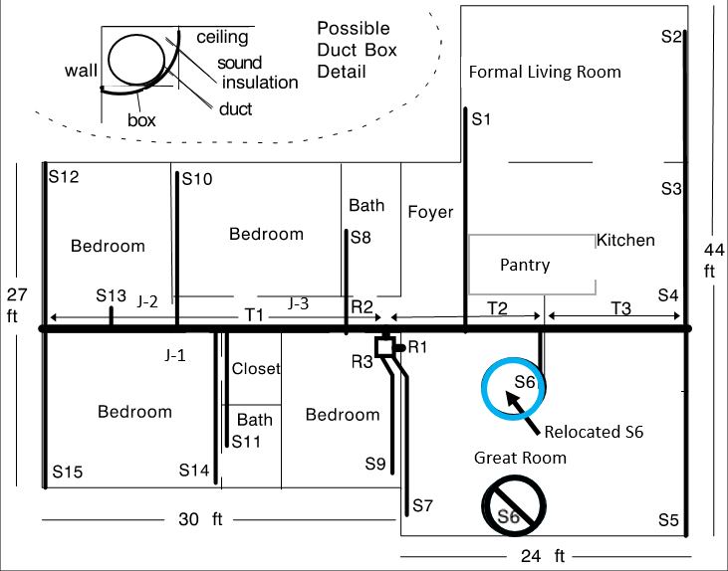

Slide 10
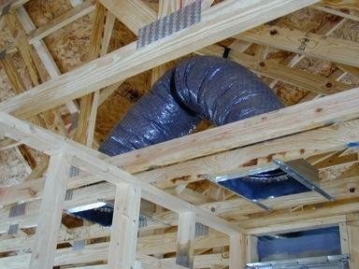
Jump Duct

Slide 11
Good Practices For Duct System Design
The following checklist reviews the important elements of good practice.:
Calculate the loads. Don’t guess. Use ACCA Manual J (Residential) or Manual N (Commercial);
Size equipment properly. Use ACCA Manual S (Residential) or Manual CS (Commercial);
Keep ducts in the conditioned space as much as possible;
Use the ACCA Manual D (Residential) or Manual Q (Commercial) duct sizing procedure;

Slide 12
Good Practices For Duct System Design
Route ducts directly, especially if they have to be placed in unconditioned spaces;
Use low-loss duct fittings; this permits smaller duct cross sections to be used. Duct fitting choices are covered extensively in ACCA Manual D or Manual Q;
Locate supply registers near inside walls where feasible;
Locate return grilles near outside walls or over heat sources where feasible;

Slide 13
Good Practices For Duct System Design
Seal ducts using a method that will ensure long life, i.e., U.L. Listed mastic;
Insulate ducts in unconditioned spaces (R-8 to R-11 preferred); and
Specify maximum 2% supply and return leakage to unconditioned spaces; and;
Require (DO) a test to confirm the 2% leakage duct performance was achieved.

Slide 14
Lessons Learned
You should now be able to explain what a good duct design looks like.
You should now be able to develop an installation plan based on good duct design practices.
You should now be able to explain why you may want to recommend adding jump ducting.
You should be able to explain why recommending a duct leakage test is a good practice.

