Slide 1
Maria’s Restaurant Chapter 1 Section 5

Slide 2
Maria’s Restaurant Location
What If Maria’s Restaurant was picked up and dropped in Detroit MI, San Antonio TX, or Denver CO?

Slide 3
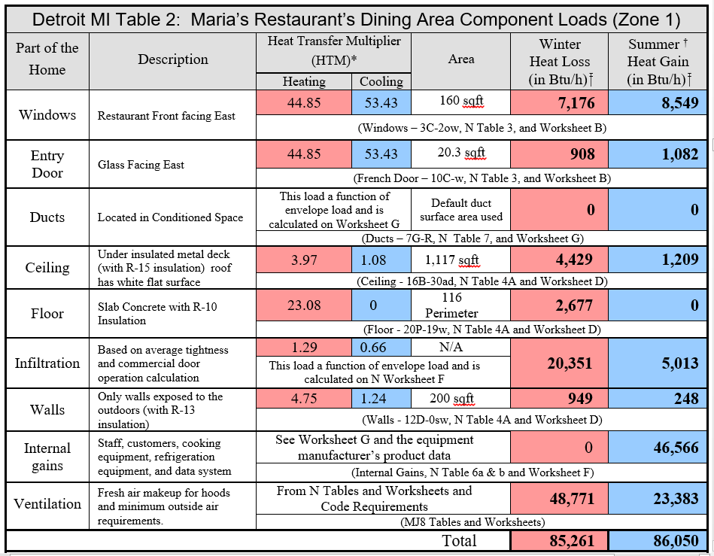
Zone 1 In Detroit MI

Slide 4
Zone 1 In Detroit MI
The heating load requirement has more than doubled from 34,384 Btuh to 85,261 Btuh for Zone 1, and the cooling load requirement has actually gone up slightly from 71,666 Btuh to 86,050 Btuh.

Slide 5
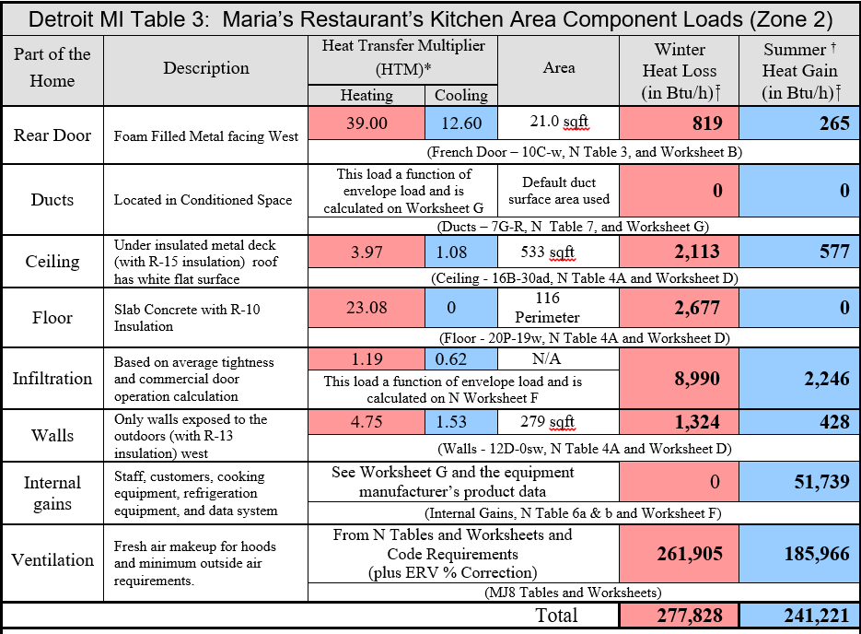
Zone 2 In Detroit MI

Slide 6
Zone 2 In Detroit MI
Detroit MI is very different from the load in Long Beach CA, the heating load requirement has more than doubled from 111,764 Btuh to 277,828 Btuh for Zone 2, and the cooling load requirement has actually more than doubled too, going from 115,534 Btuh to 241,221 Btuh.

Slide 7
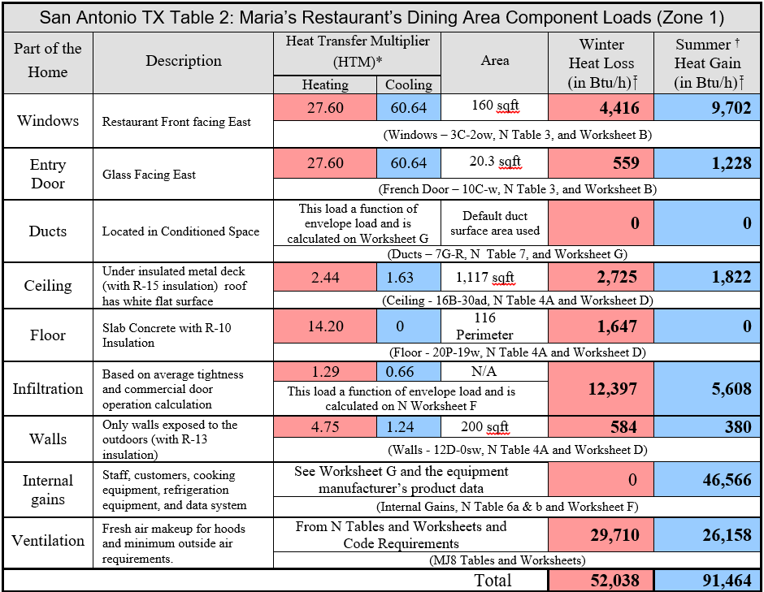
Zone 1 In San Antonio TX

Slide 8
Zone 1 In San Antonio TX
The load for San Antonio TX is again very different from the load in Long Beach CA. Our heating load requirement went up from our 34,384 Btuh to 52,038 Btuh for Zone 1, and our cooling load requirement went up from 71,666 Btuh to 91,464 Btuh.

Slide 9
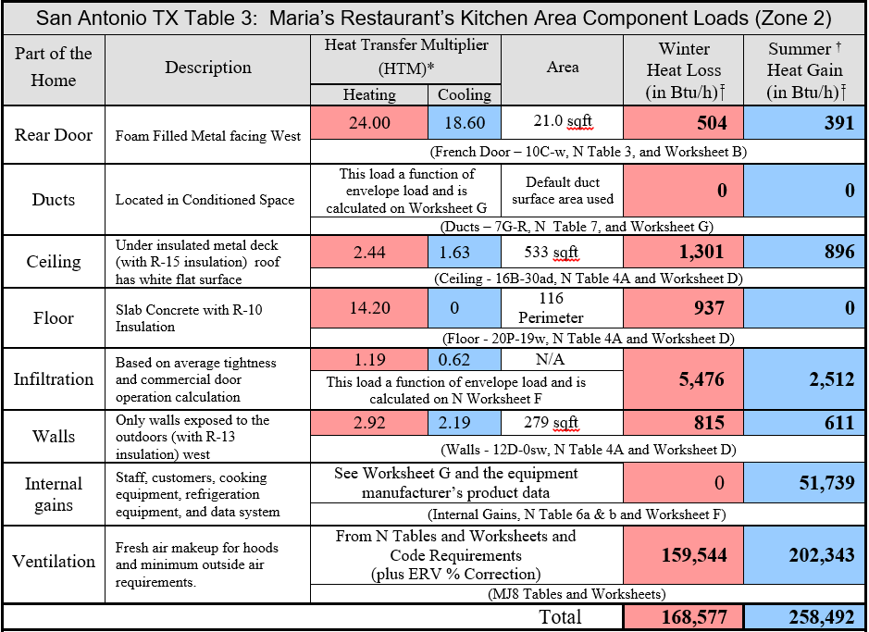
Zone 2 In San Antonio TX

Slide 10
Zone 2 In San Antonio TX
Load totals for San Antonio TX are very different from the load totals in Long Beach CA, the heating load requirement rose from 111,764 Btuh to 168,577 Btuh for Zone 2, and the cooling load requirement has actually more than doubled too, going from 115,534 Btuh to 258,492 Btuh.

Slide 11
Zone 1 In Denver CO

Slide 12
Zone 1 In Denver CO
The load for Denver CO is again very different from the load in Long Beach CA, the heating load requirement more than doubled again, going from our 34,384 Btuh to 83,208 Btuh for Zone 1, and the cooling load requirement went down slightly from 71,666 Btuh to 69,376 Btuh.

Slide 13
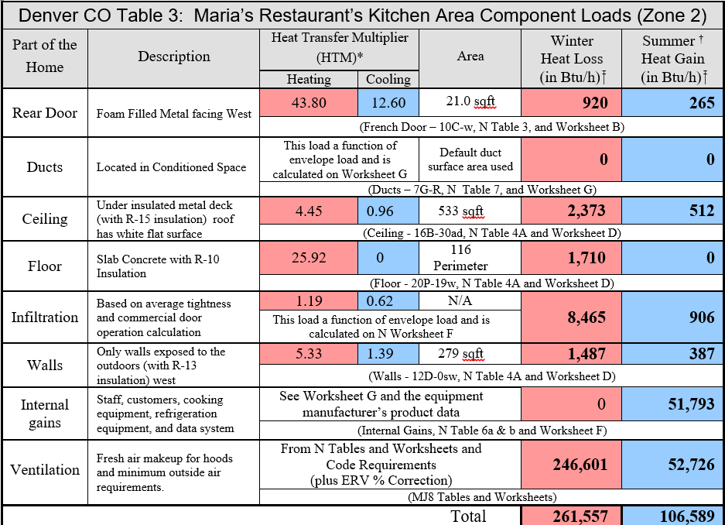
Zone 2 In Denver CO

Slide 14
Zone 2 In Denver CO
Denver CO has a very different load than the one we had in Long Beach CA, the heating load requirement more than doubled from 111,764 Btuh to 261,557 Btuh for Zone 2, and the cooling load requirement has decreased, going from 115,534 Btuh to 106,589 Btuh.

Slide 15
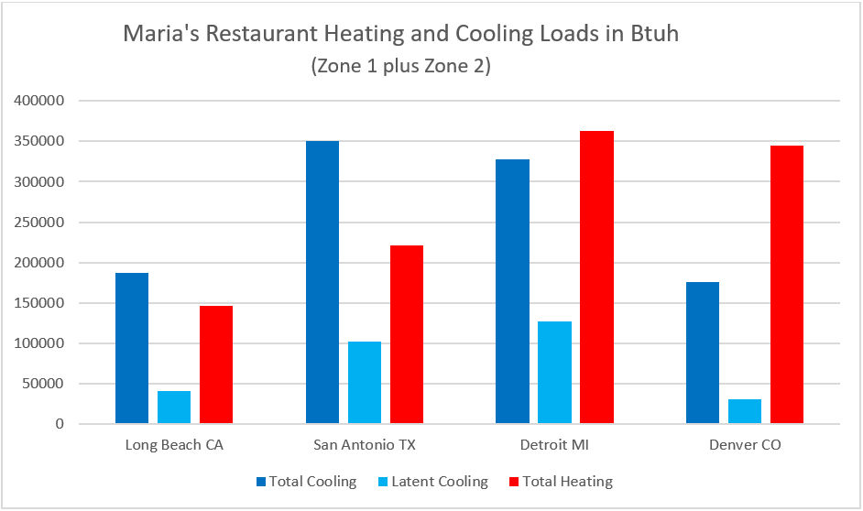
Comparison Graph

Slide 16
Comparison Graph Calculations
Based on an estimate using the graph, what would the total heating in Btuh be for the location that requires the most heat?

Slide 17
Comparison Graph Calculations
Detroit MI beat out Denver with approximately 360,000 Btuh shown on the graph.
Note: We know the exact total is Zone 1 + Zone 2 from our table values, or
277,828 + 85,261 = 363,089 Btuh

Slide 18
Graph Calculations
Based on an estimate using the graph, what would the Sensible Cooling load be for Long Beach CA?

Slide 19
Graph Calculations Sensible Cooling
Based on an estimate using the graph, Long Beach CA has a Total Cooling Load of 190,000 Btuh and a Latent Cooling Load of about 40,000 Btuh.
Total Cooling = Sensible Cooling + Latent Cooling
Thus:
190,000 Btuh = Sensible Cooling + 40,000 Btuh
Sensible Cooling =150,000 Btuh

Slide 20
Super Heat Ratio
A comparison number for evaluating how much humidity removal is required for cooling called Super Heat Ratio (SHR) is used in the equipment selection process.
SHR = Sensible Cooling ÷ Total Cooling Load
Using the table values find the SHR for San Antonio TX.

Slide 21
Graph Calculations
Based on an estimate using the graph, what would the Super Heat Ration be for San Antonio TX?

Slide 22
SHR
First find the Sensible Cooling Total
350,000 Btuh = Total Cooling
100,000 Btuh = Latent Cooling
Thus,
350,000 – 100,000 = Sensible Cooling = 250,000

Slide 23
SHR
Second find the SHR
SHR = Sensible Cooling ÷ Total Cooling Load
350,000 Btuh = Total Cooling
100,000 Btuh = Latent Cooling
250,000 Btuh = Sensible Cooling
Thus,
SHR = 250,000 ÷ 350,000 = 0.714
(Note: More on SHR in Chapter 2)

Slide 24
Field Notes
Numerous attempts to tune an HVAC system were made for a building in North Carolina with a new maintenance contract. The HVAC contractor wanted to know what the solution was for this building. A top diagnostic technician was sent to a location where the building was not cooling properly. While there, the technician found a Manual N load calculation was done for the equipment sizing. After studying the Load calculation the problem was clear: Undersized equipment, the wrong weather data was used. The load calculation had Dayton Ohio selected as the building’s location!

