Slide 1
Maria’s Restaurant Chapter 2 Section 6

Slide 2
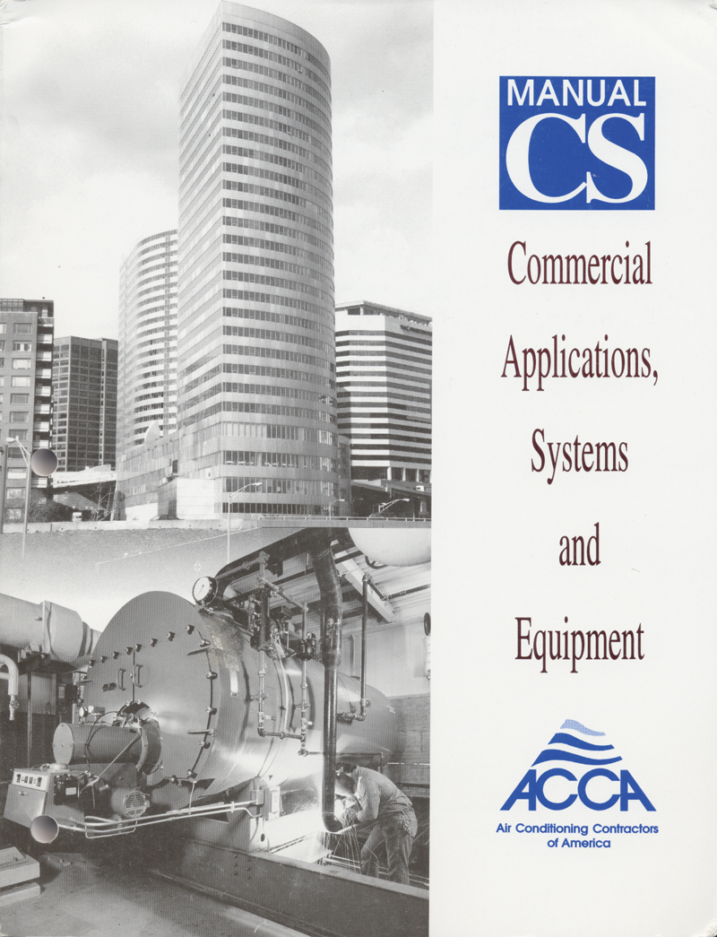
Manual CS Commercial Applications, Systems and Equipment

Slide 3
Heating Equipment Selection
Forced Air
Fossil fuel furnaces (gas or oil)
Stoves burning wood or fuel pellets
Air source heat pump
Electric furnace or resistance heat
Geothermal or water source heat pump
Variable refrigerant flow
Hydronic Heat
Boiler (hot water or steam heat)
Geothermal or water source heat pump
Electric water heater
Fossil fuel water heater

Slide 4
Cooling Equipment Selection
Forced Air
Electric Air Conditioner
Air source heat pump
Evaporative Cooler (Swamp cooler)
Geothermal or water source heat pump
Chilled water
Variable Refrigerant Flow
Hydronic Cooling
Radiant
Chilled Beam

Slide 5
Designer Needs To Know
Cooling/heating airflow – Generally expressed in these blower speed intervals:
Low - High,
Low – Medium – High,
Low – Medium Low - Medium High - High.
Variable
(Continued next page)

Slide 6
Designer Needs To Know
Outdoor air temperature – This is the temperature of the air around the outdoor condensing coil*, sometimes called the condenser air temperature. (Keep in mind this temperature may not exactly match what is listed on the manufacturer’s data, so we may have to interpolate.)
Condition of air entering the indoor coil – OEMs use either a dry bulb temperature, a wet bulb temperature, or may ask for some dry bulb – wet bulb combination.
*Note: The temperature of the air at the outdoor coil may be warmer than the outdoor temperature if the equipment is on a flat, black roof or near masonry walls, etc.

Slide 7
Cooling Design Information

Slide 8
Heating Design Information

Slide 9
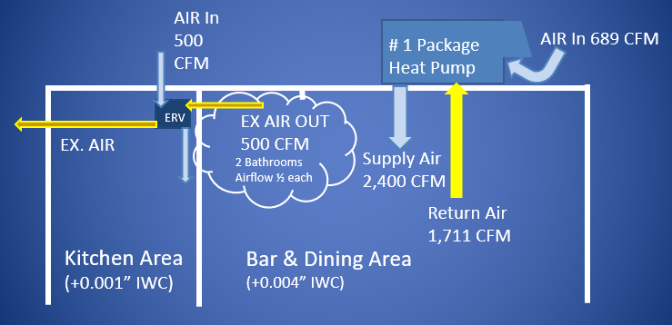
Zone 1 Dining Area Sketch

Slide 10
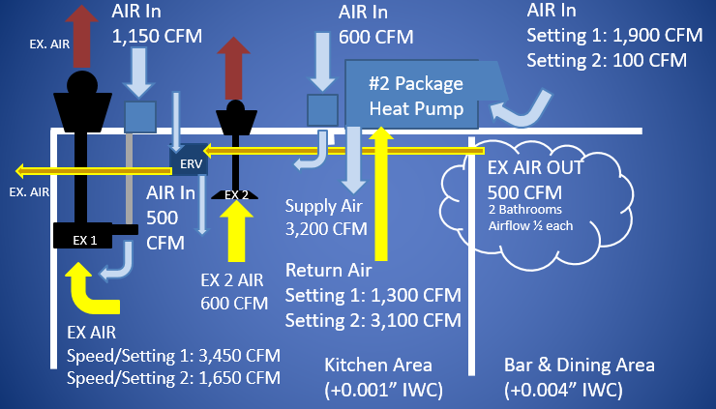
Zone 2 Kitchen Area Sketch

Slide 11
Sizing for Cooling
Indoor Design = 75^{O}F and 50% RH; Outdoor Design = 88^{O}F and 70^{O}F WB; Entering Dry Bulb = 77^{O}F; Entering Wet Bulb = 64 ^{O}F
Zone 1: Zone 2:
Sensible Load = 50,185 Btuh Sensible Load = 96,495 Btuh
Latent Load = 21,481 Btuh Latent Load = 19,039 Btuh
HVAC System CFM = 2,400 HVAC System CFM = 3,200
Fresh air makeup = 689 CFM Make Up Air CFM = 3,550

Slide 12
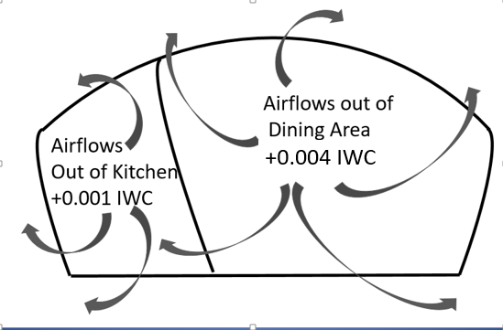
Positive Building Pressure
More Mechanical Air Coming Air Than Air Being Exhausted = Positive Pressure

Slide 13
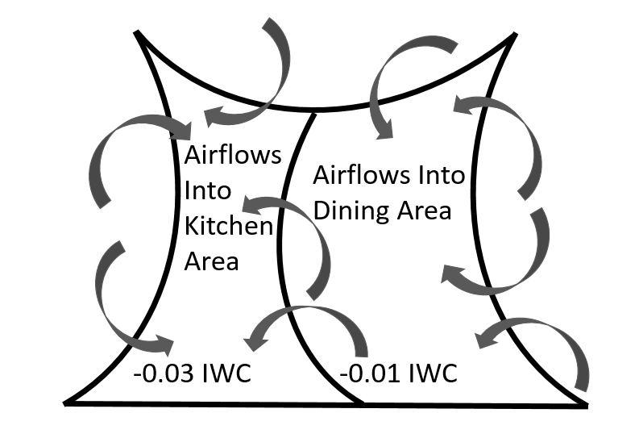
Building Pressure
Less Mechanical Air Coming Air Than Air Being Exhausted = Negative Pressure

Slide 14
Pressurization Question (worksheet 4)
A restaurant has an exhaust fan that is designed to pull 2,300 CFM of air of the kitchen. It has a dedicated outdoor makeup air system that brings in 2,300 CFM. If you wanted to make the kitchen positively pressurized what would need to happen?

Slide 15
Total Area Pressurization Question (worksheet 4)
The kitchen exhaust hood could be slowed down so it pulled out less air. However, it may not meet the code airflow requirements.
The dedicated outside air system could be adjusted so it will bring in more outside air if the unit sizing will allow for the increase and still properly heat and cool the entering air.
Air could be brought in from the dining area if it is operating at a higher pressure than the kitchen. Again Codes must be followed. For example, in the location where Maria’s restaurant was located the air transferred would need to be filtered.

Slide 16
What Pressure Is Best
A slightly positive building pressure is preferable to keep contaminants in the air from leaking in.

Slide 17
Odor From Kitchen In Dining Area (worksheet 4)
Kitchen odors are coming into the dining area when the waiters open the doors to the kitchen. The owner states this never used to happen. What could be the cause for this change in pressure?

Slide 18
Odor From Kitchen In Dining Area (worksheet 4)
The number one cause to check would be the dining area HVAC system outside air minimum position. If it was closed off or stuck closed, the dining area would lose its positive pressurization.
The number two thing to check would be the makeup air fan or pathway for the kitchen hood. It could be as simple as dirty filters.
(Continued Next Page)

Slide 19
Odor From Kitchen In Dining Area (worksheet 4)
It could be something else, like a prevailing wind into the back kitchen loading area door that is being left open.
It could be a combination of all of the above. When checking a system check all of the components!

Slide 20
Field Notes
Generally, the engineering additional CFM designs to provide pressure differences will work. However, positive and negative air pressures between zones with designs based on extra CFM in those zones always needs to be checked in the field. The pressures are very small and can be influenced by wind outside of the building and the tightness of the buildings outside walls and the walls separating the Zones. The easiest and quickest check is with a chemical smoke stick that can verify the airflow direction at doors and between sections.

