Slide 1
Duct Design Basics Lesson 4 The Manual D Primer

Slide 2
Fitting Equivalent Length 4.5

Slide 3
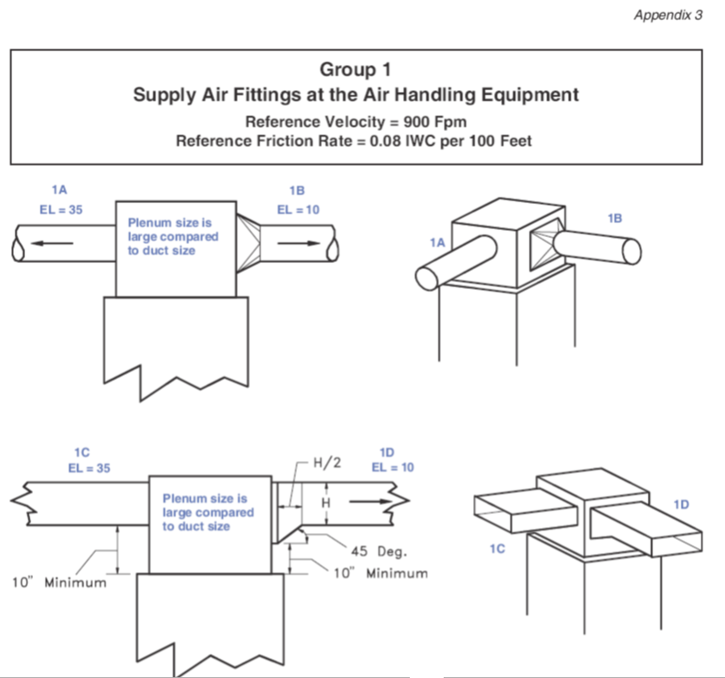

Slide 5
What happens when we have a different reference velocity?
For example what would the EL be for the 1C fitting
If we were designing a system to operate at 600 FPM?

Slide 6
Formula:
EL_{For Fitting} = EL_{Table Value} x [V_{For Fitting} ÷ V_{Table Value}]²

Slide 8
Formula:
EL_{For Fitting} = EL_{Table Value} x [V_{For Fitting} ÷ V_{Table Value}]²
EL_{For Fitting} = 35 x [600 ÷ 900]² = 15.56

Slide 9
Formula:
EL_{For Fitting} = EL_{Table Value} x [V_{For Fitting} ÷ V_{Table Value}]²
EL_{For Fitting} = 35 x [600 ÷ 900]² = 15.56
0.444444….

Slide 10
What happens when we have a different reference friction rate?
For example what would the EL be for the 1C fitting
If we were designing a system to operate at a FR of 0.06?

Slide 11
Formula:
EL_{For Fitting} = EL_{Table Value} x [FR_{Table Value}÷ FR_{For Fitting}]
EL_{For Fitting} = 35 x [0.08 ÷ 0.06] = 46.67

Slide 12
Formula:
EL_{For Fitting} = EL_{Table Value} x [FR_{Table Value}÷ FR_{For Fitting}]
EL_{For Fitting} = 35 x [0.08 ÷ 0.06] = 46.67
1.3333….

Slide 13
What happens when we have a different reference friction rate and a different Velocity?

Slide 14
What happens when we have a different reference friction rate and a different Velocity?
For example what would the EL be for the 1C fitting
If we were designing a system to operate at a FR of 0.06 and a velocity of 600 FPM?

Slide 15
Formula:
EL_{For Fitting} = EL_{Table Value} x [FR_{Table Value}÷ FR_{For Fitting}] x [V_{For Fitting} ÷ V_{Table Value}]²

Slide 16
Formula:
EL_{For Fitting} = EL_{Table Value} x [FR_{Table Value}÷ FR_{For Fitting}] x [V_{For Fitting} ÷ V_{Table Value}]²
EL_{For Fitting} = 35 x [0.08 ÷ 0.06] x [600 ÷ 900]² = 20.74

Slide 17
Formula:
EL_{For Fitting} = EL_{Table Value} x [FR_{Table Value}÷ FR_{For Fitting}] x [V_{For Fitting} ÷ V_{Table Value}]²
EL_{For Fitting} = 35 x [0.08 ÷ 0.06] x [600 ÷ 900]² = 20.74
0.59

Slide 18
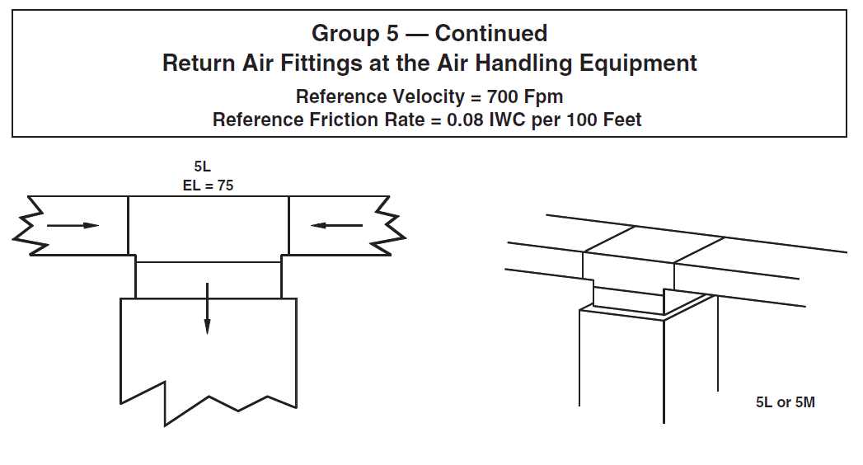

Slide 19
What would the EL be if we have a design for 500 FPM at 0.08 IWC?

Slide 20
Formula:
EL_{For Fitting} = EL_{Table Value} x [FR_{Table Value}÷ FR_{For Fitting}] x [V_{For Fitting} ÷ V_{Table Value}]²
EL_{For Fitting} = 75 x [0.08 ÷ 0.08] x [600 ÷ 700]² = 55.1

Slide 21
What would the EL be if we have a design for 700 FPM at 0.06 IWC?

Slide 22
Formula:
EL_{For Fitting} = EL_{Table Value} x [FR_{Table Value}÷ FR_{For Fitting}] x [V_{For Fitting} ÷ V_{Table Value}]²
EL_{For Fitting} = 75 x [0.08 ÷ 0.06] x [700 ÷ 700]² = 100

Slide 23
What would the EL be if we have a design for 500 FPM at 0.07 IWC?

Slide 24
Formula:
EL_{For Fitting} = EL_{Table Value} x [FR_{Table Value}÷ FR_{For Fitting}] x [V_{For Fitting} ÷ V_{Table Value}]²

Slide 25
Formula:
EL_{For Fitting} = EL_{Table Value} x [FR_{Table Value}÷ FR_{For Fitting}] x [V_{For Fitting} ÷ V_{Table Value}]²
EL_{For Fitting} = 75 x [0.08 ÷ 0.06] x [600 ÷ 700]² = 74

Slide 26
Formula:
EL_{For Fitting} = EL_{Table Value} x [FR_{Table Value}÷ FR_{For Fitting}] x [V_{For Fitting} ÷ V_{Table Value}]²
EL_{For Fitting} = 75 x [0.08 ÷ 0.06] = 100
EL_{For Fitting} = 75 x [0.08 ÷ 0.10] = 60

Slide 27
Formula:
EL_{For Fitting} = EL_{Table Value} x [FR_{Table Value}÷ FR_{For Fitting}] x [V_{For Fitting} ÷ V_{Table Value}]²
EL_{For Fitting} = 75 x [0.08 ÷ 0.06] = 100
EL_{For Fitting} = 75 x [0.08 ÷ 0.10] = 60
EL_{For Fitting} = EL_{Table Value} x [FR_{Table Value}÷ FR_{For Fitting}] x [V_{For Fitting} ÷ V_{Table Value}]²
EL_{For Fitting} = 75 x [600 ÷ 700] = 64.29
EL_{For Fitting} = 75 x [900 ÷ 700] = 96.42

Slide 28
Formula:
EL_{For Fitting} = EL_{Table Value} x [FR_{Table Value}÷ FR_{For Fitting}] x [V_{For Fitting} ÷ V_{Table Value}]²
EL_{For Fitting} = 75 x [0.08 ÷ 0.06] x [600 ÷ 700]² = 74

Slide 29
For Math Lovers:
A formula based on equal friction rates for the conversion from rectangular ducts to a circular equivalent.
Round Duct Diameter (In) = 1.3 x [(a x b)^{0.625}) ÷ (a + b)^{0.25}]
Where a = length of side one in inches and b = length of side 2 in inches
a
Side 1
Side 2
b

Slide 30
See Appendix 2 in Manual D for Conversion Charts
and Formulas or use the ACCA Duct Slide Rule!
For Math Lovers:
A formula based on equal friction rates for the conversion from rectangular ducts to a circular equivalent.
Round Duct Diameter (In) = 1.3 x [(a x b)^{0.625}) ÷ (a + b)^{0.25}]
Where a = length of side one in inches and b = length of side 2 in inches
a
Side 1
Side 2
b

Slide 31
See Appendix 2 in Manual D for Conversion Charts
and Formulas or use the ACCA Duct Slide Rule!
For Math Lovers:
A formula based on equal friction rates for the conversion from rectangular ducts to a circular equivalent.
Round Duct Diameter (In) = 1.3 x [(a x b)^{0.625}) ÷ (a + b)^{0.25}]
Where a = length of side one in inches and b = length of side 2 in inches
a
Side 1
Side 2
b

