Slide 1
14.0 Math Review 14.1 Using a Calculator

Slide 2
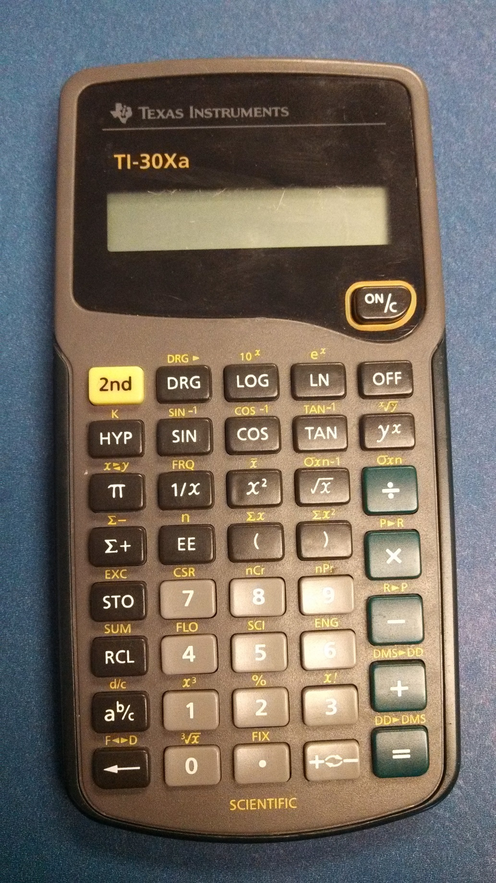
Calculator
3.141592654

Slide 3
Calculator

Slide 4
Calculator

Slide 5
Calculator

Slide 6
Calculator
256
2⁸
2 x 2 x 2 x 2 x 2 x 2 x 2 x 2 = 256
2^{.67} or 2^{1.5} ?

Slide 7
Calculator
1.591072968
2^{.67}?

Slide 8
Calculator
2.828427125
2^{1.5}?

Slide 9
14.0 Math Review 14.3 Squaring & Square & Cube Roots

Slide 10
Squaring & Square Roots

Slide 11
Square
2² = 2 x 2 = 4
4² = 4 x 4 = 16
1.75² = 1.75 x 1.75 = 3.0625
0.12² = 0.12 x 0.12 = 0.0144
Any Number ² = Any Number x Any Number

Slide 12
Square Root
4 ^{1/2} = 4 = 2
4 ^{1/2} = 2 x 2 = 2
1.75 ^{1/2} = ? X ? = ?
1.1 x 1.1 = 1.21
1.4 x 1.4 = 1.96
1.3 x 1.3 = 1.69

Slide 13
Square Root
1.75 ^{1/2} = ? X ? = ? ……. 1.3 x 1.3 = 1.69
1.33 x 1.33 = 1.7689
1.325 x 1.325 = 1.755
1.324 x 1.324 = 1.752976
1.3235 x 1.3235 = 1.751
1.322875656

Slide 14
Square Root
1.75 ^{1/2} = ? X ? = ? ……. 1.3 x 1.3 = 1.69
1.322875656
1.322875656 x 1.322875656 = 1.75

Slide 15
Cubing & Cube Roots

Slide 16
Cubed
2³ = 2 x 2 x 2 = 8
4³ = 4 x 4 x 4 = 64
1.75³ = 1.75 x 1.75 x 1.75 = 5.359375
0.12³ = 0.12 x 0.12 x 0.12 = 0.001728

Slide 17
Cubed
2³ = 2 x 2 x 2 = 8
4³ = 4 x 4 x 4 = 64
1.75³ = 1.75 x 1.75 x 1.75 = 5.359375
0.12³ = 0.12 x 0.12 x 0.12 = 0.001728

Slide 18
Cubed
Any Number ³ = Any Number x Any Number x Any Number

Slide 19
Checking Cubes
0.12³ = 0.12 x 0.12 x 0.12 = 0.001728
0.001728 ÷ 0.12 = 0.0144
0.0144 ÷ 0.12 = 0.12

Slide 20
Cube Root
3
8 ^{1/3} = 8 = 8^{0.33333}
3
8 ^{1/3} = 2 x 2 x 2 = 2
3
1.75 ^{1/3} = ? X ? = ?
1.1 x 1.1 x 1.1 = 1.331
1.2 x 1.2 x 1.2 = 1.728
1.21 x 1.21 x 1.21 = 1.771561
OR

Slide 21
Cube Root
3
1.75 ^{1/3} = 1.75 = 1.75^{0.33333}
1.75
.333333333
1.205071132

Slide 22
Cube Root
3
1.75 ^{1/3} = 1.75 = 1.75^{0.33333}
1.205071132 x 1.205071132 x 1.205071132
=
1.452196433 x 1.205071132 = 1.749999999

